Slide 1
A Preliminary Base-case model in SS3.30 for the 2023 North Pacific Swordfish Assessment
Michelle L Sculley, Yi-Jay Chang, Hirotaka Ijima

Slide 2
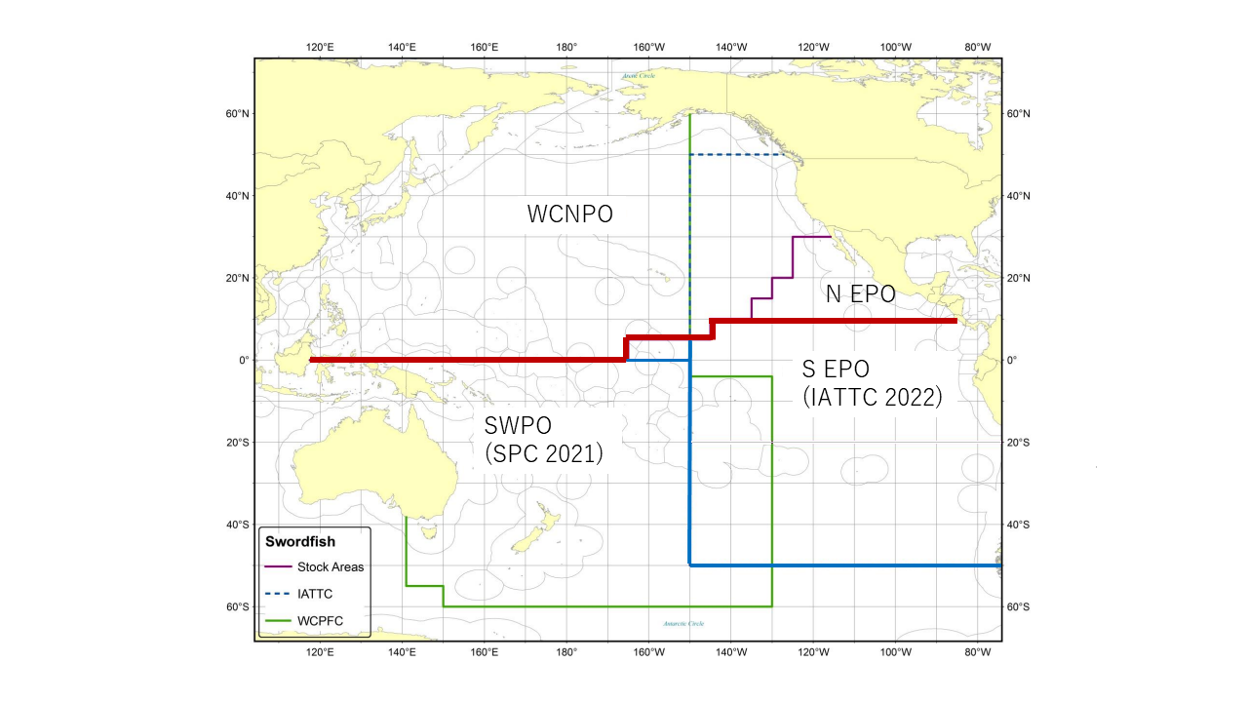
Figure 1: Western and Central North Pacific Ocean and North Eastern Pacific Ocean swordfish stock boundaries for the 2023 North Pacific swordfish assessment. Spatial structure is treated implicitly using fleets as areas.

Slide 3
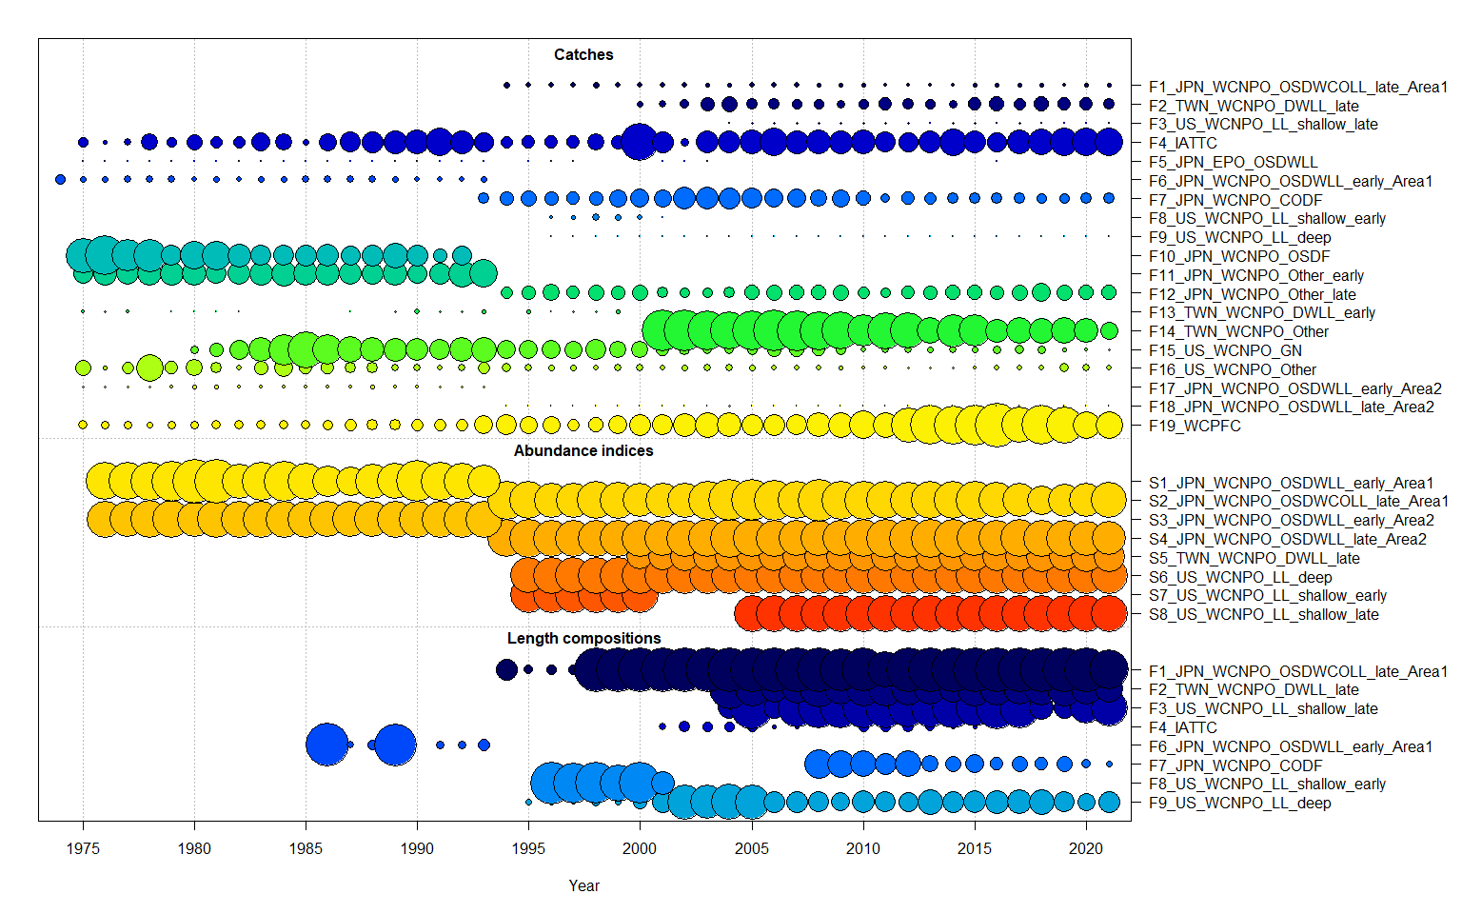
Figure 2: Catch, CPUE index, and size composition data included in the 2023 NP swordfish stock assessment. The size of the bubble indicates the relative number of observations available.

Slide 4
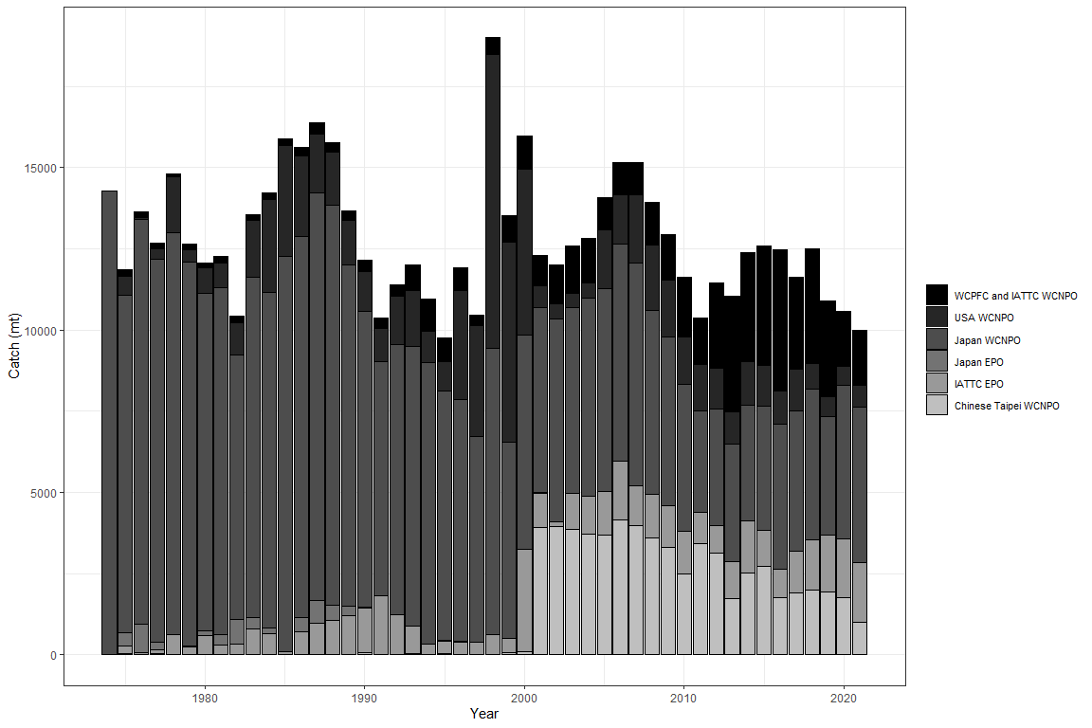
Figure 3: Annual catch of NP swordfish by country or commission and area.

Slide 5
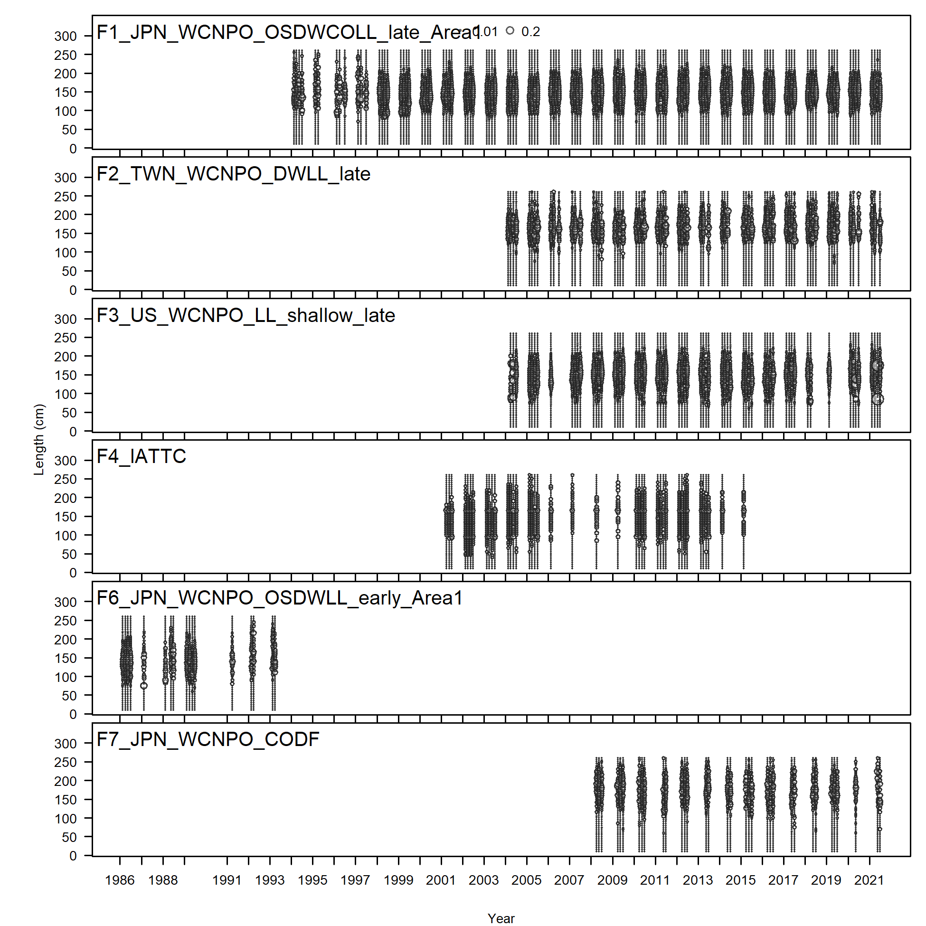
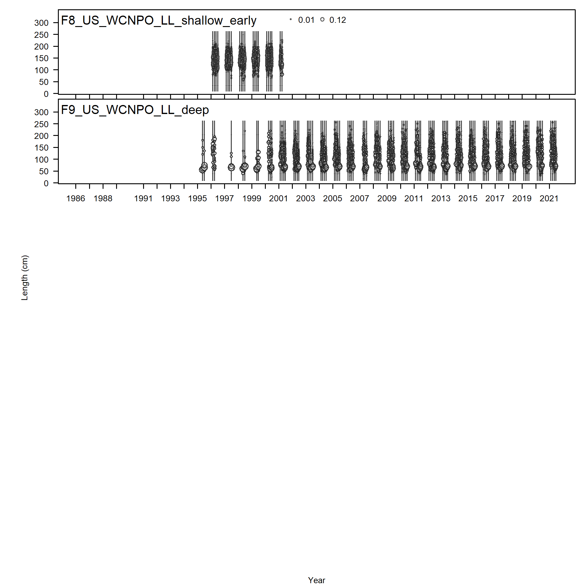

Slide 6
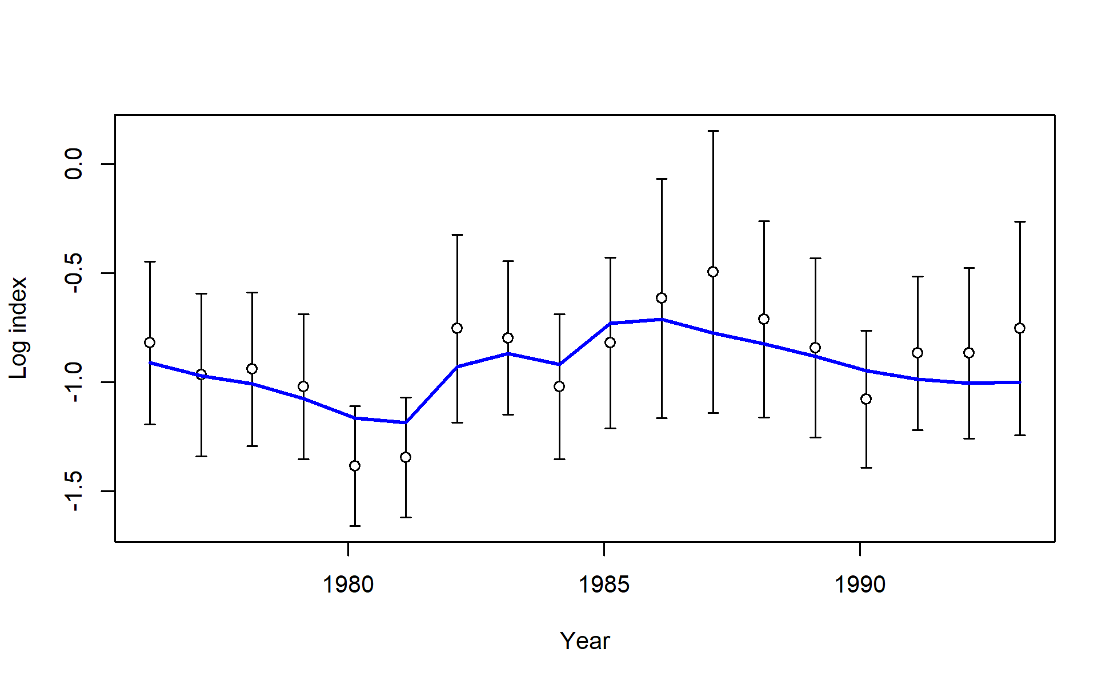
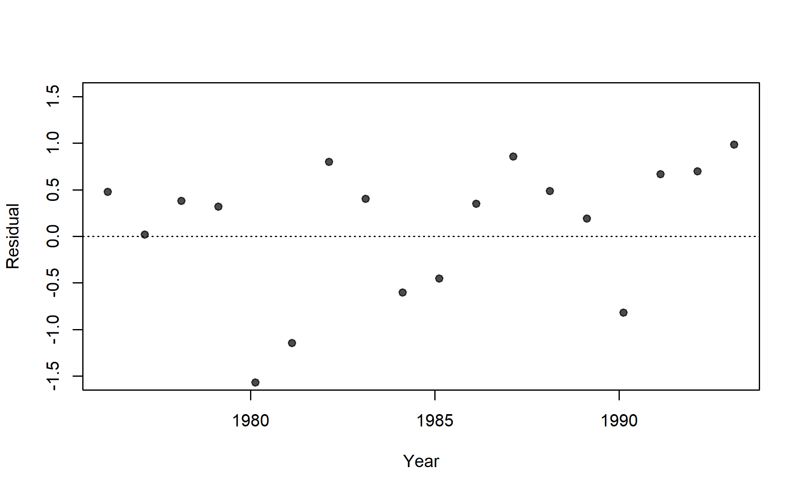
S01_JPN_WCNPO_LL_early_area1

Slide 7
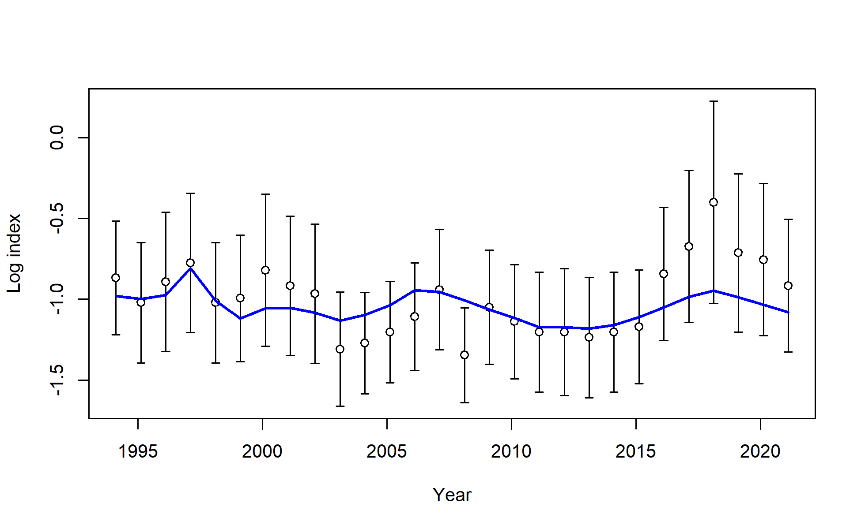
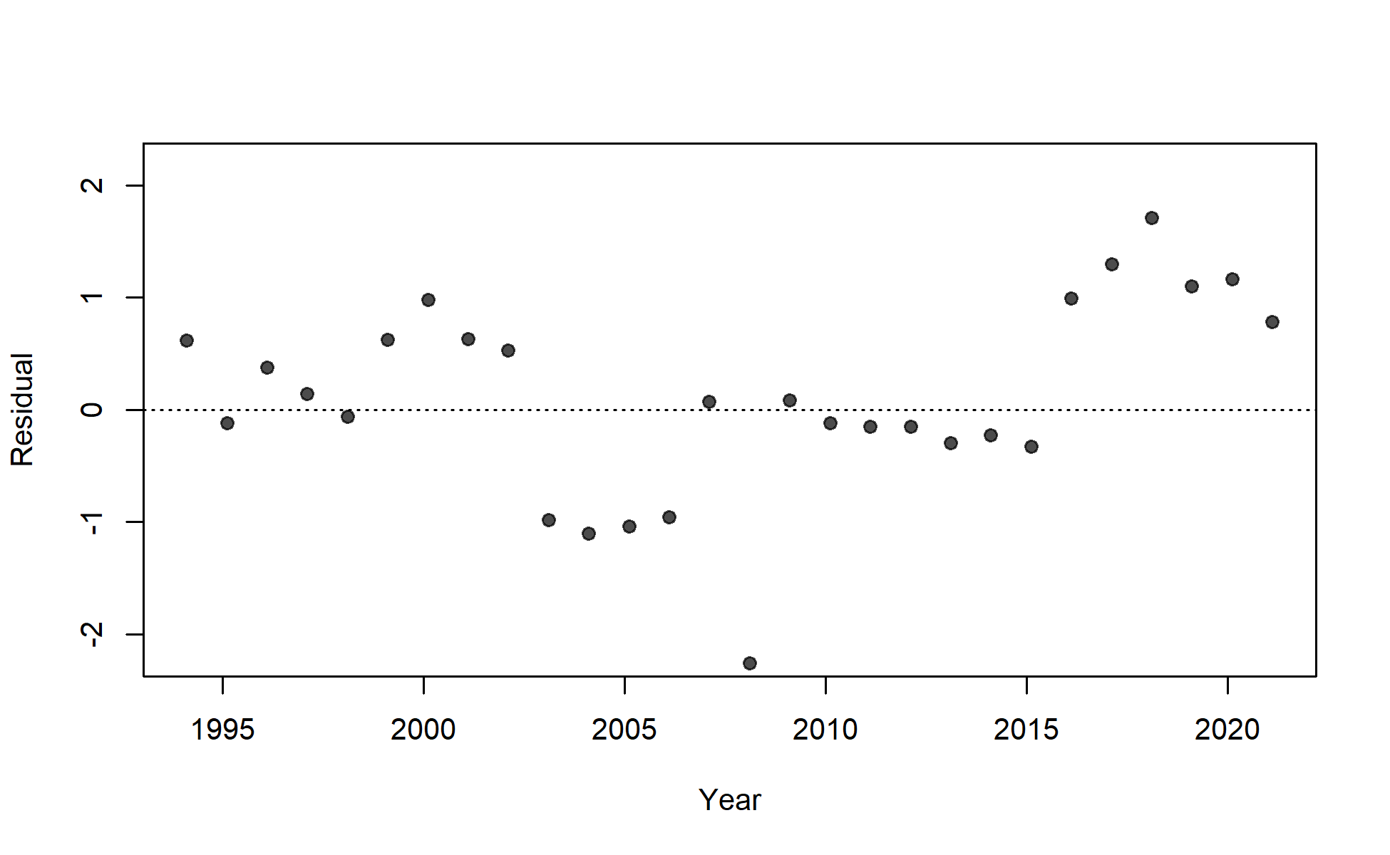
S02_JPN_WCNPO_LL_late_area1

Slide 8
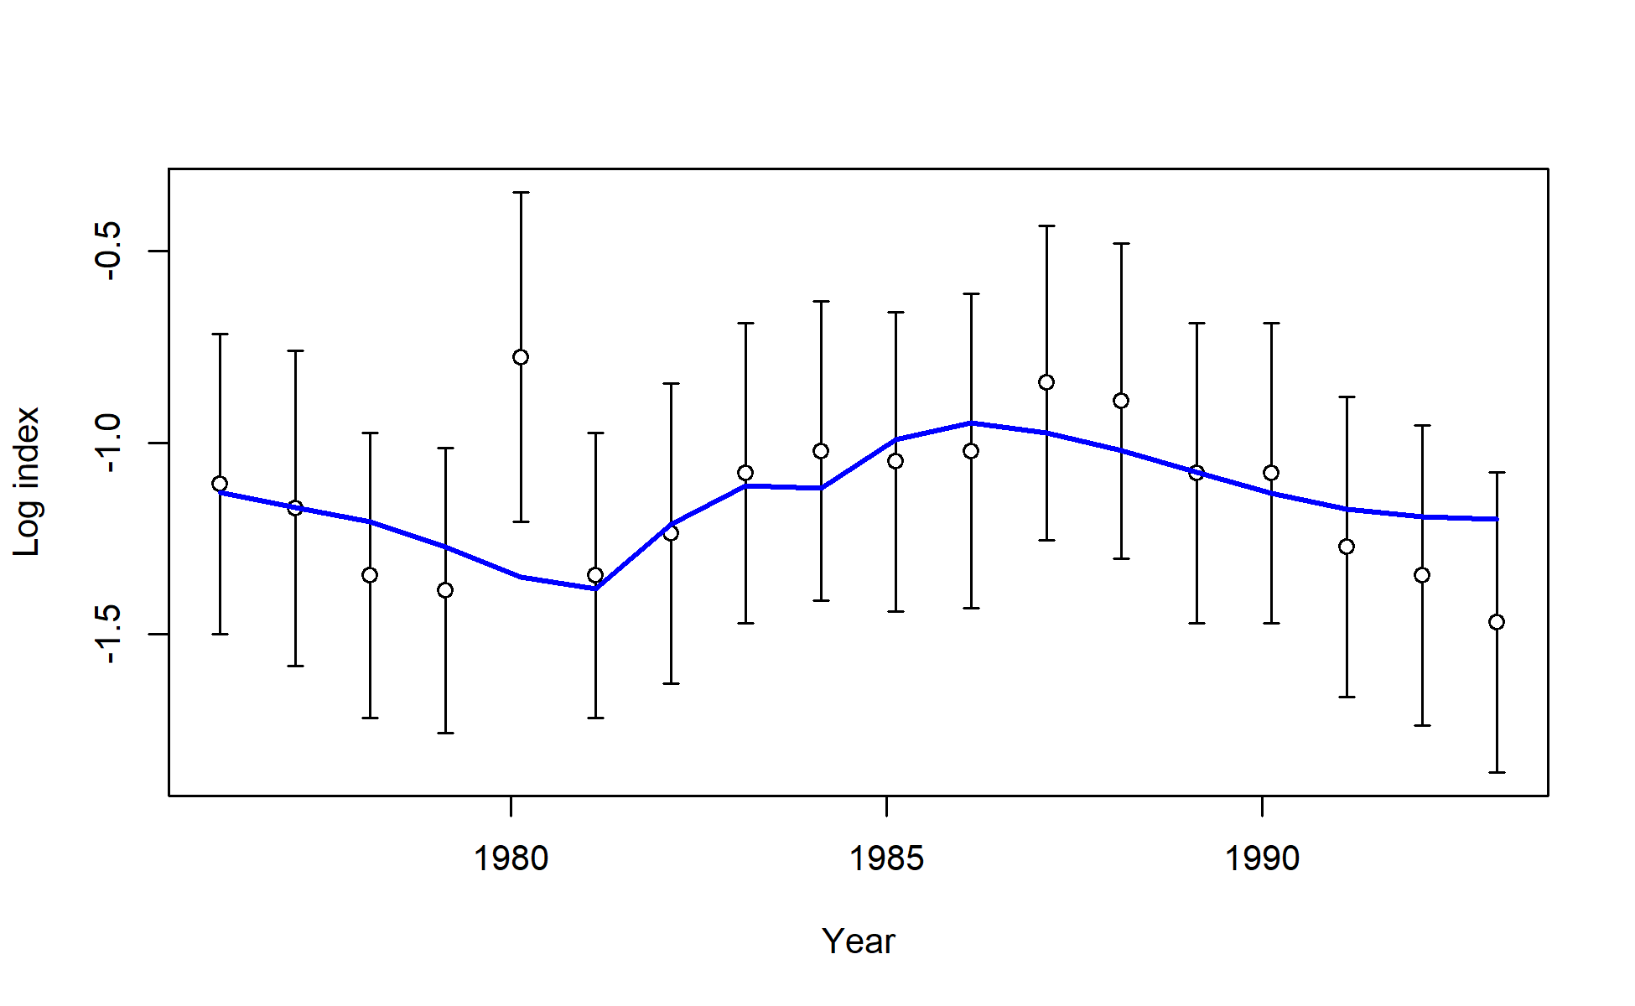
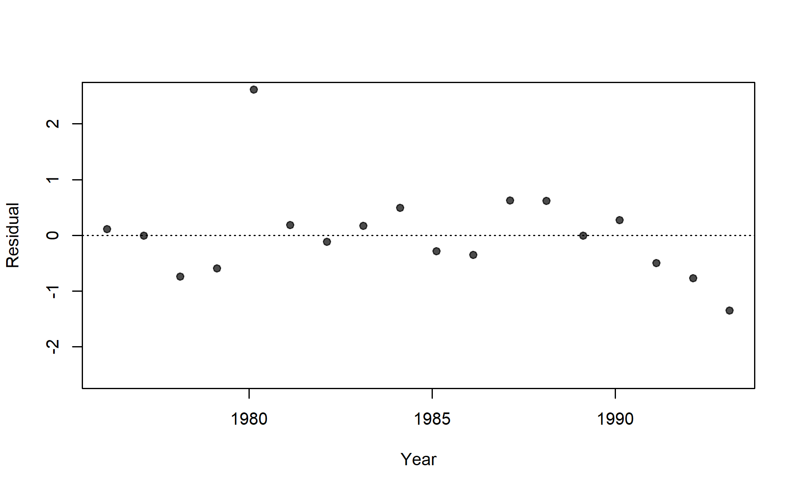
S03_JPN_WCNPO_LL_early_area2

Slide 9
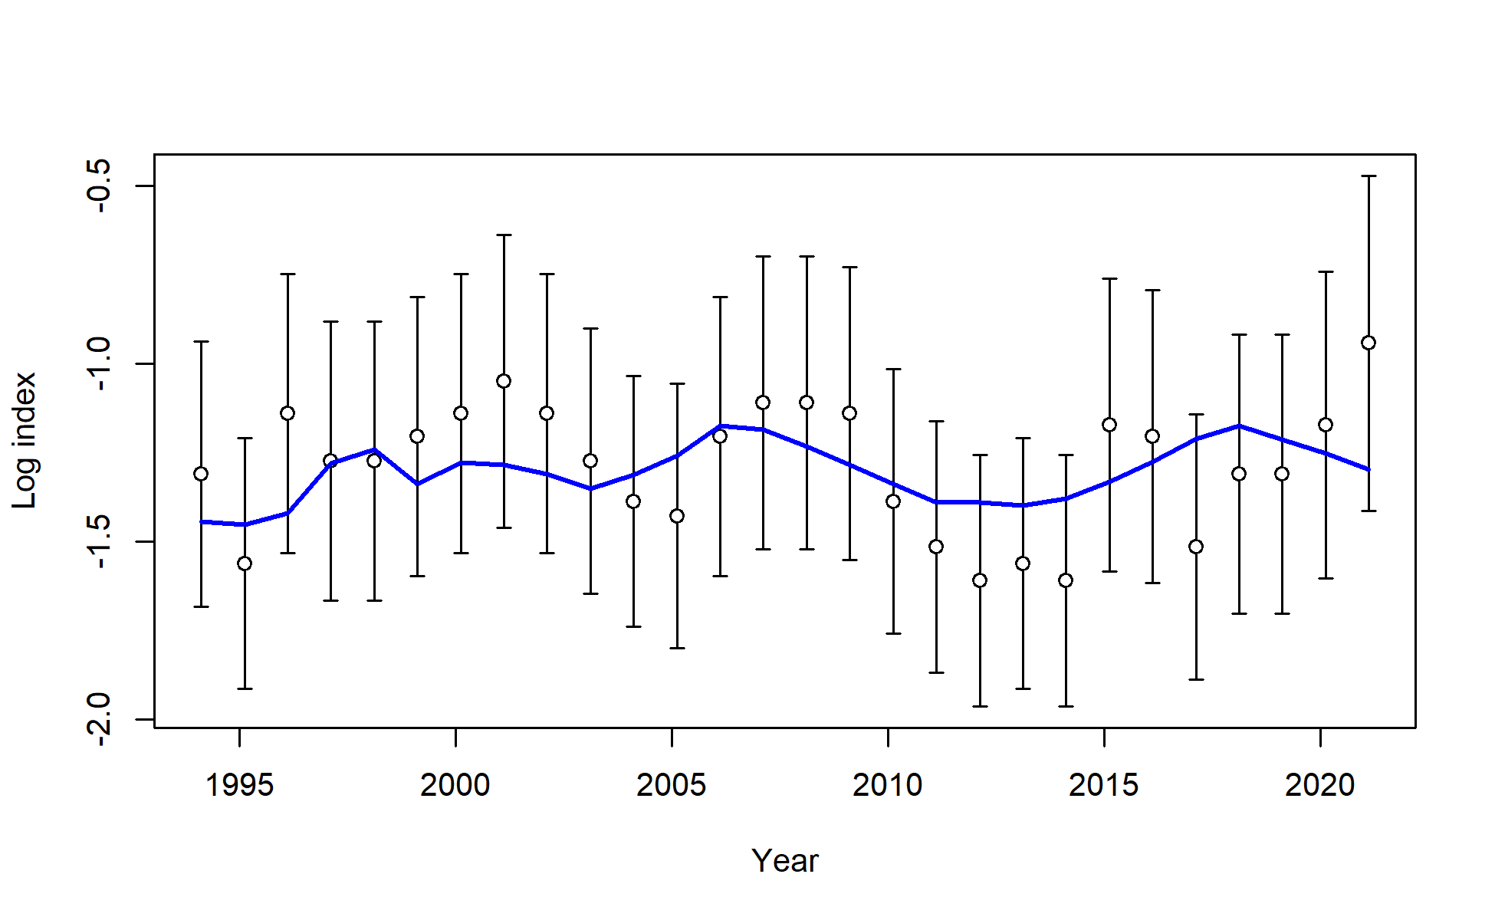
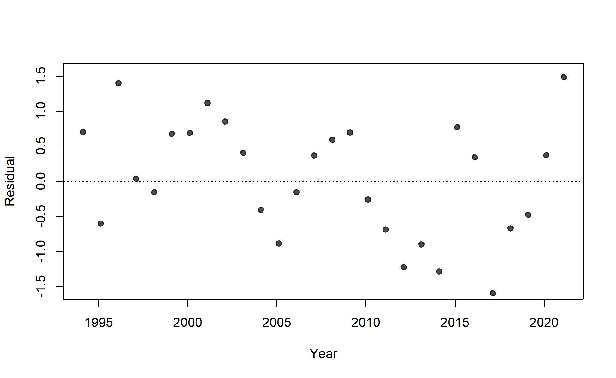
S04_JPN_WCNPO_LL_late_area2

Slide 10
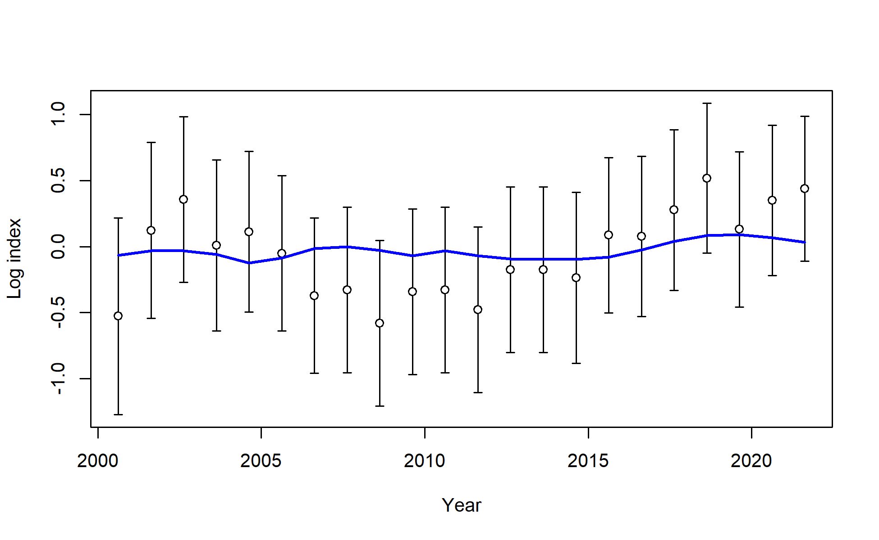
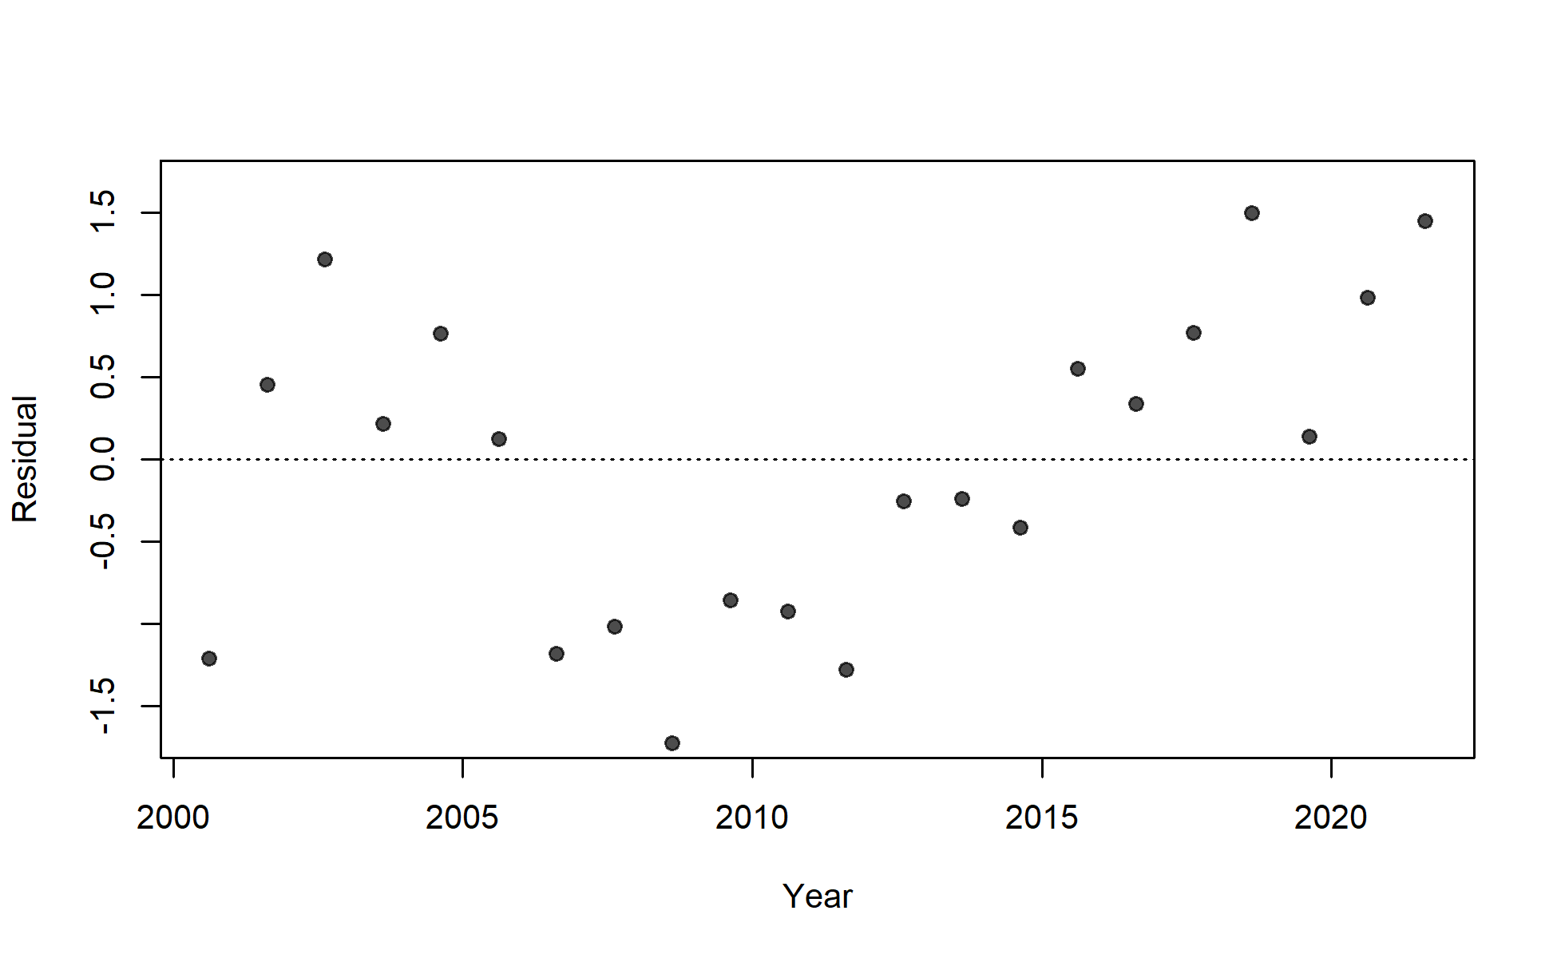
S05_TWN_WCNPO_DWLL

Slide 11
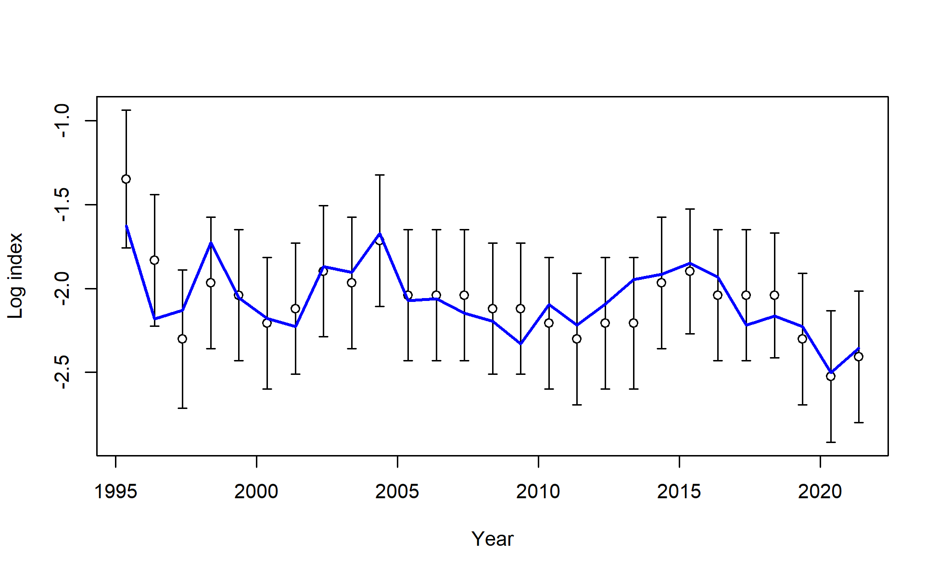
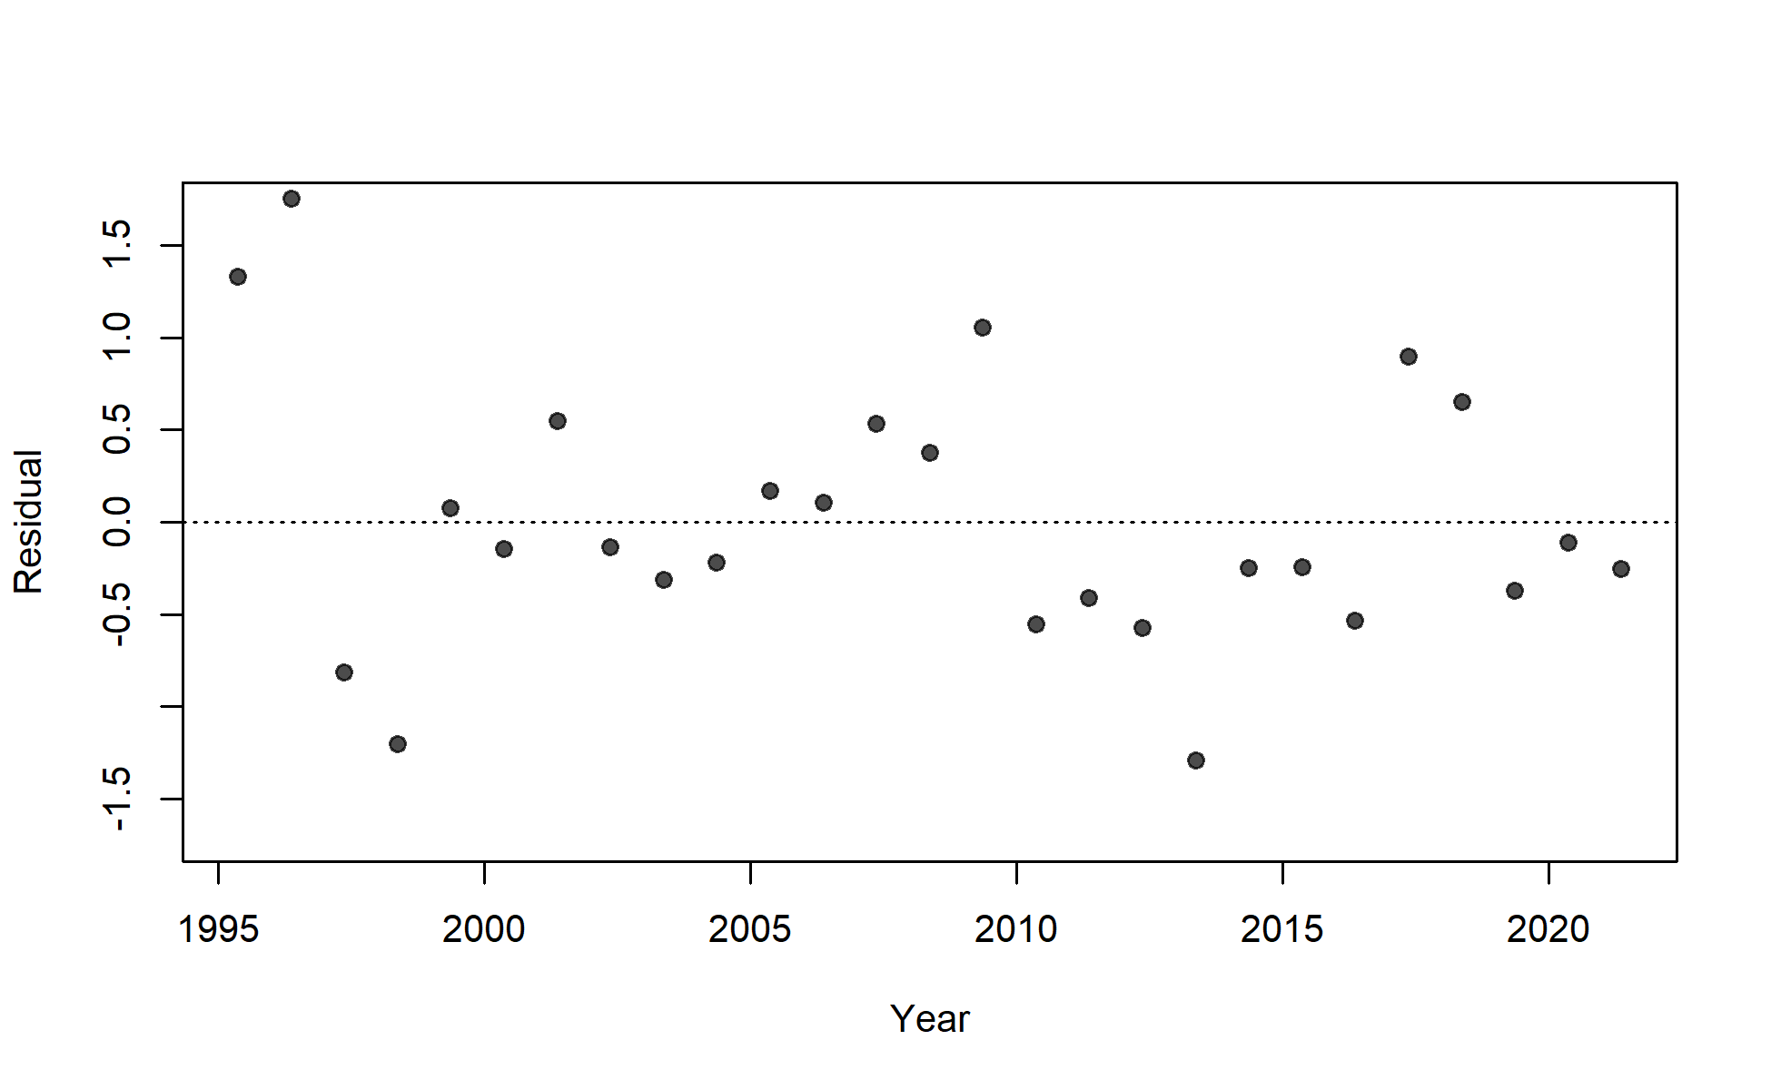
S06_US_WCNPO_LL_deep

Slide 12
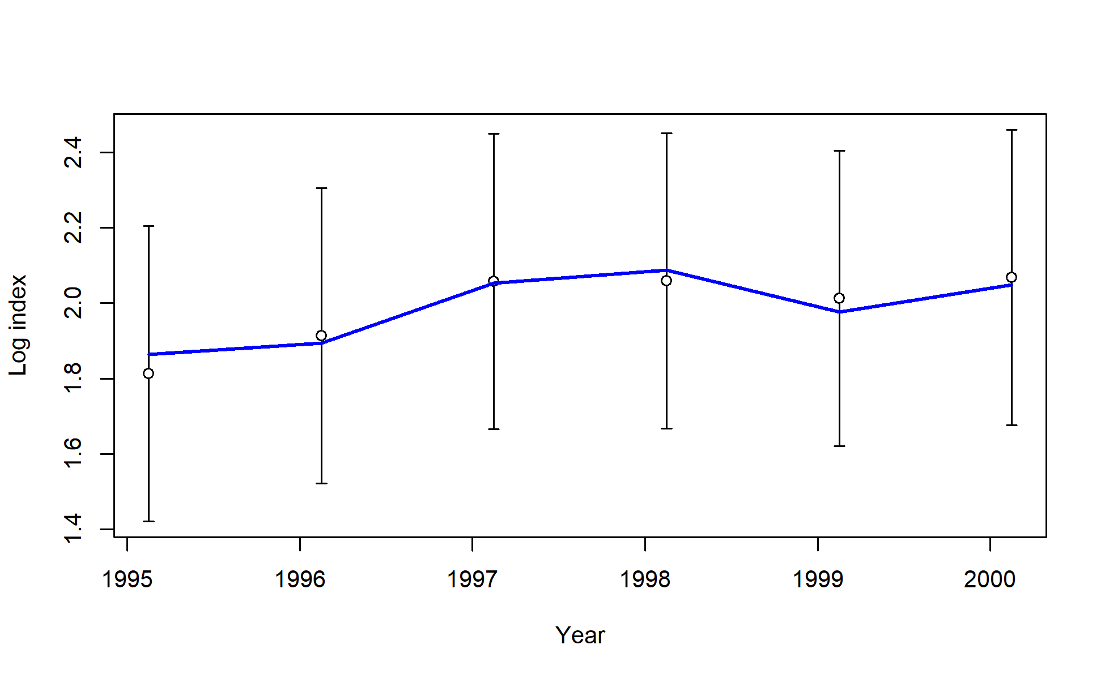
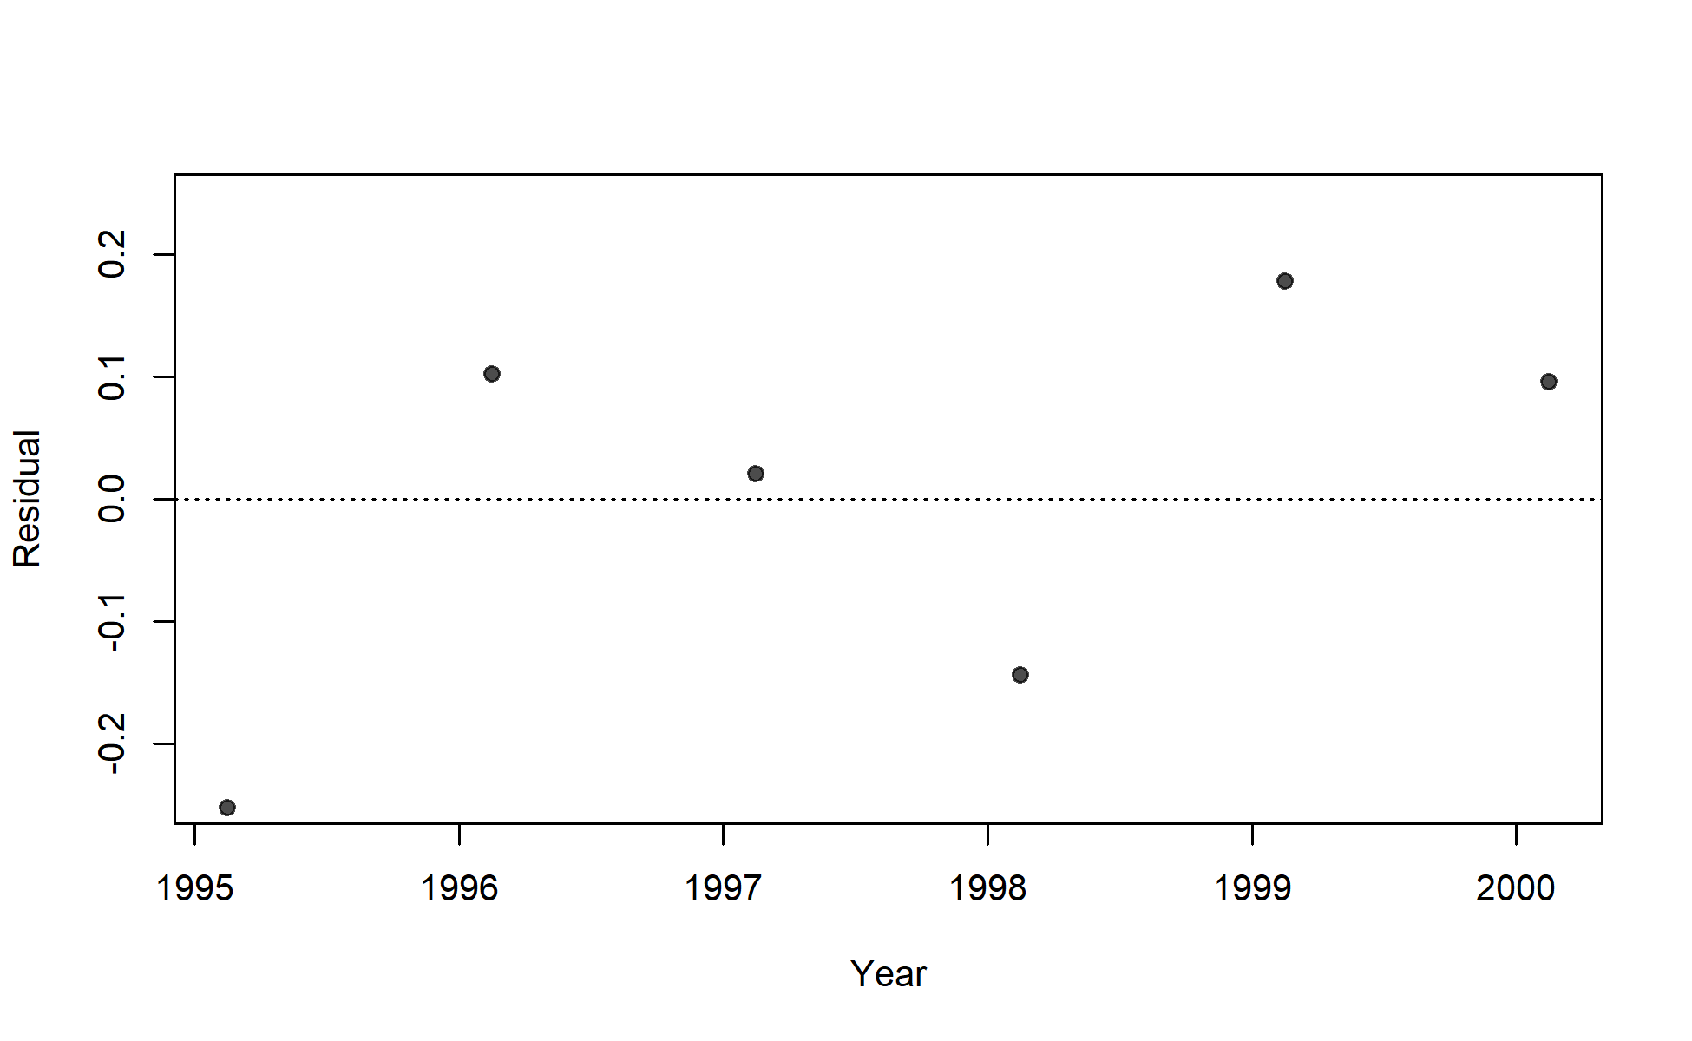
S07_US_WCNPO_LL_shallow_early

Slide 13
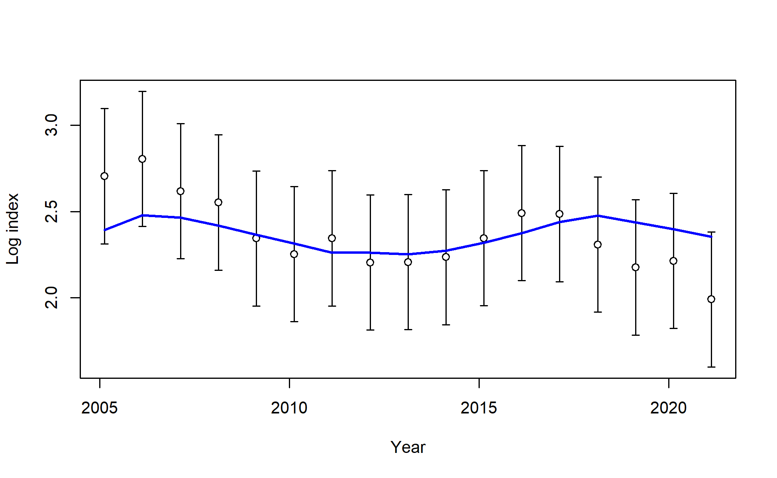
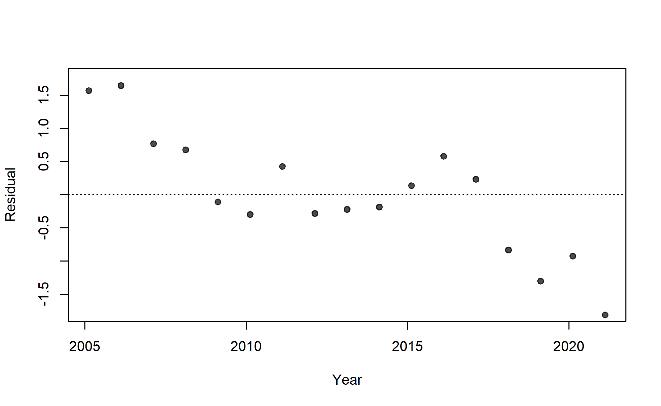
S08_US_WCNPO_LL_shallow_late

Slide 14
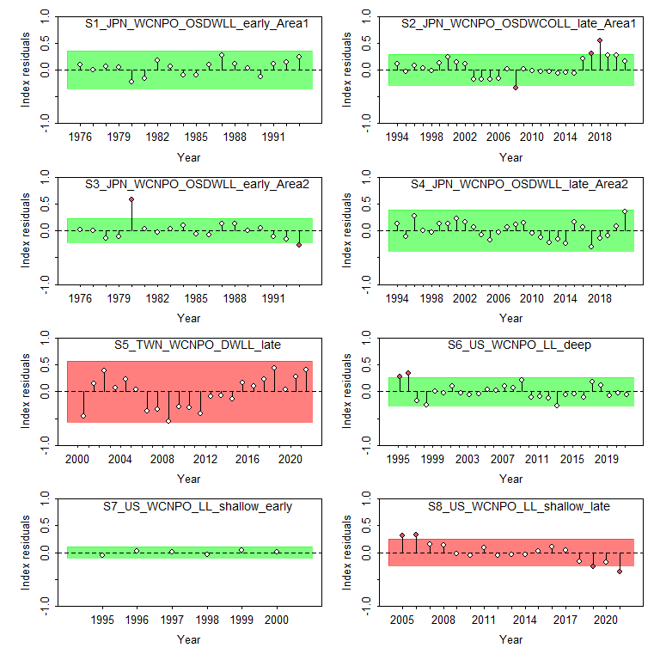
Figure 13: Results from a runs test for each CPUE index. Red indicates the index failed the test (residuals are not random), green indicates the index passed the test.

Slide 15
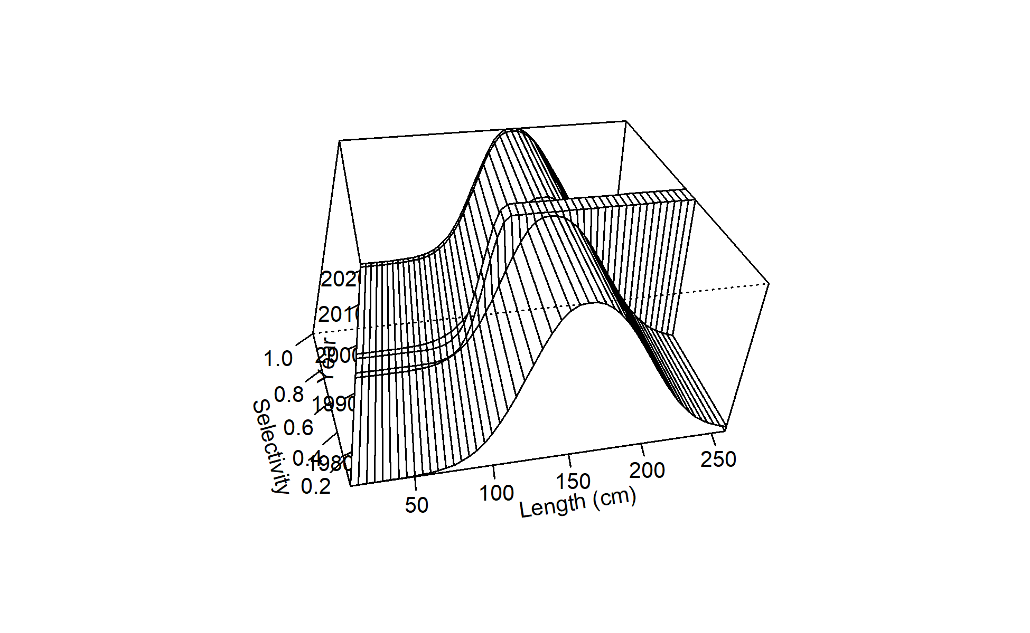
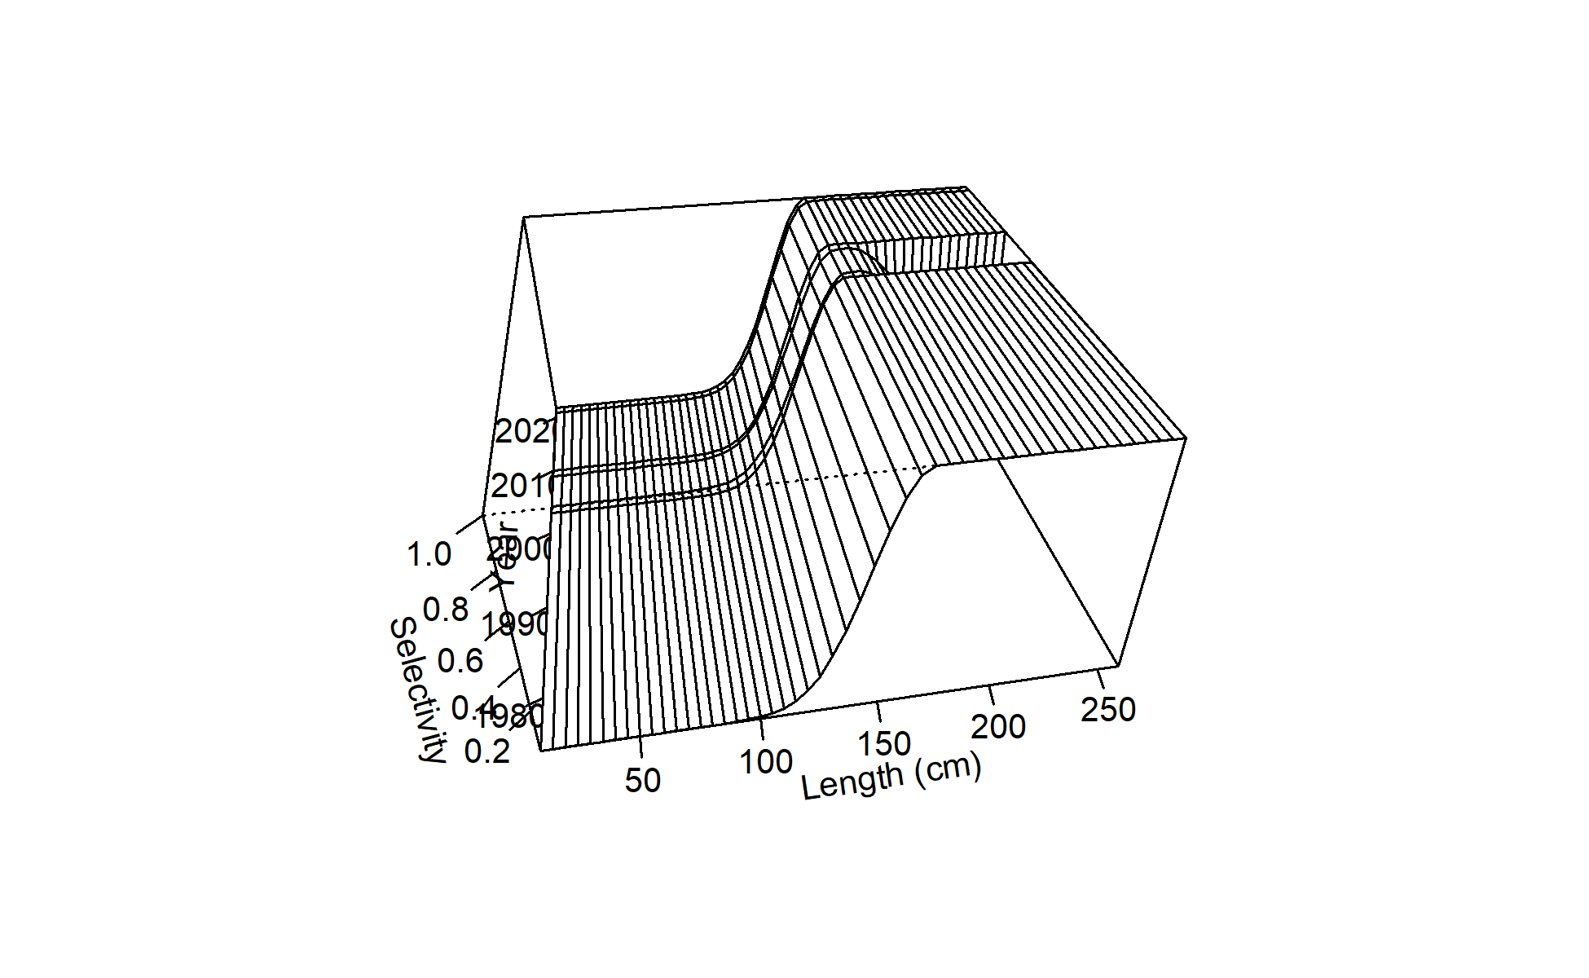
Figure 15: Time-varying selectivity estimated for F02 Chinese Taipei LL late.
Figure 14: Time-varying selectivity estimated for F01 Japan LL area 1 late.

Slide 16
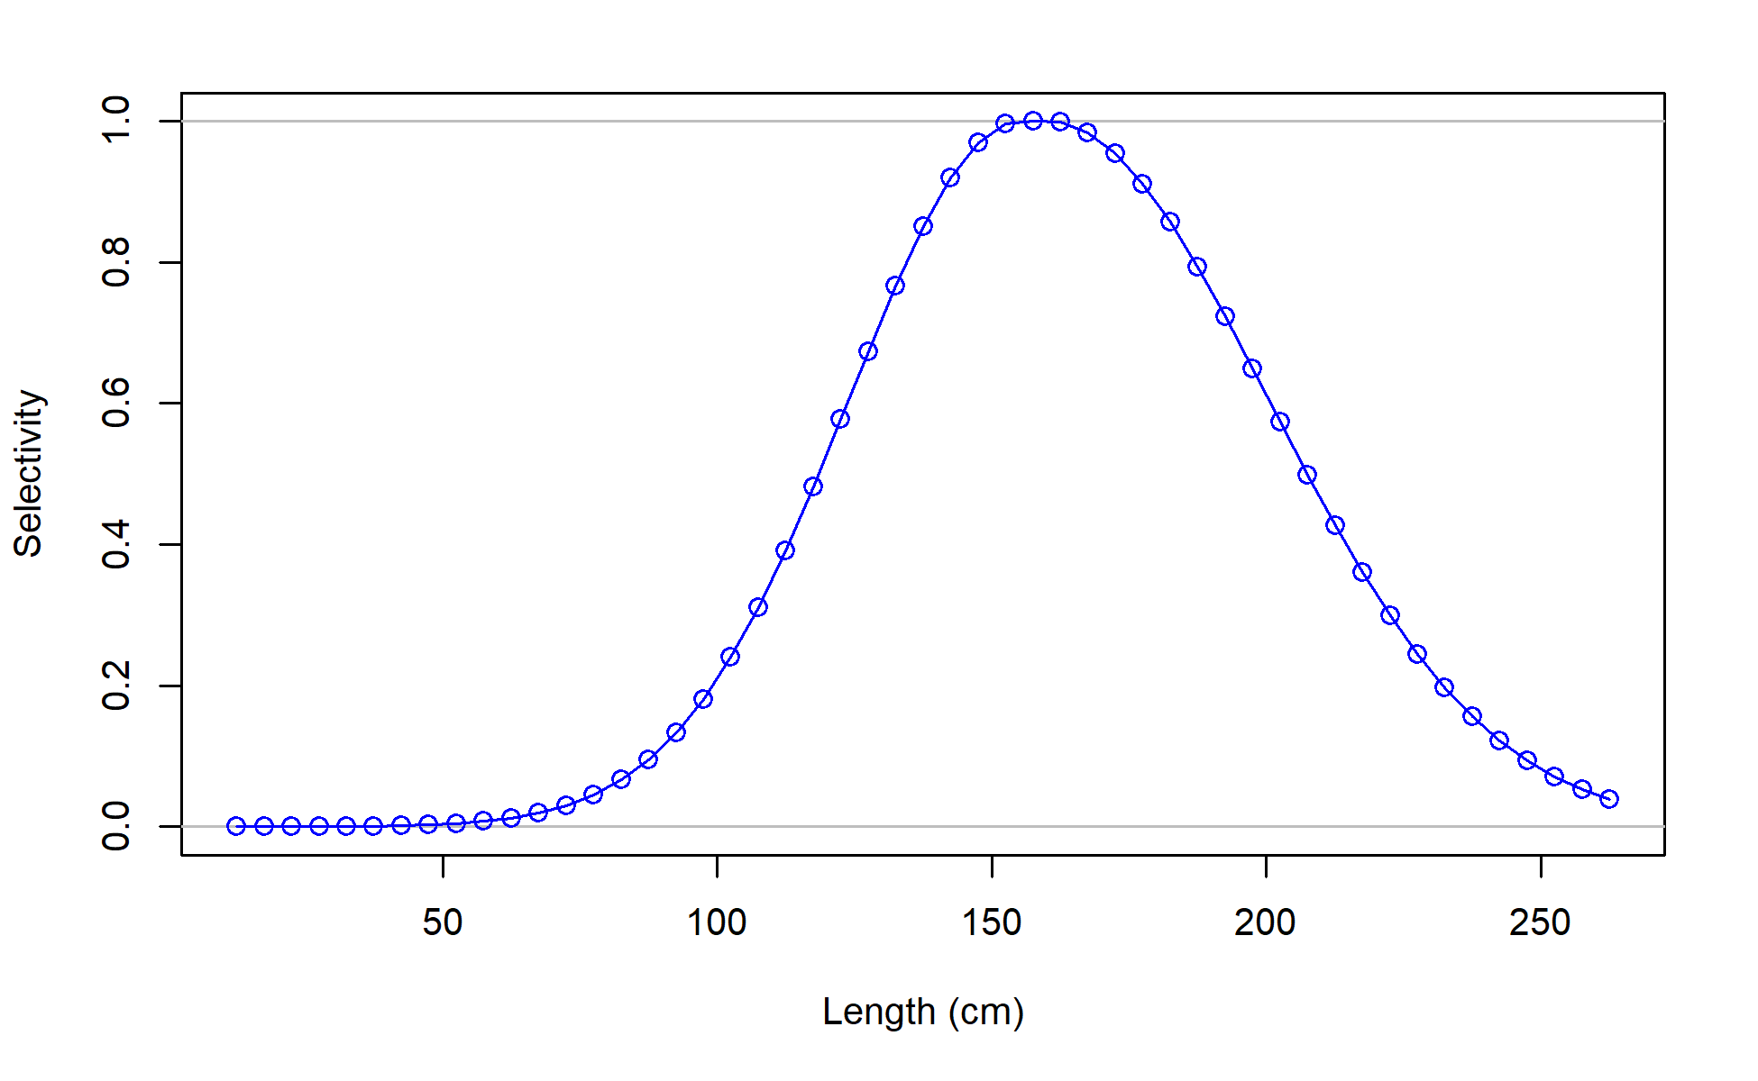
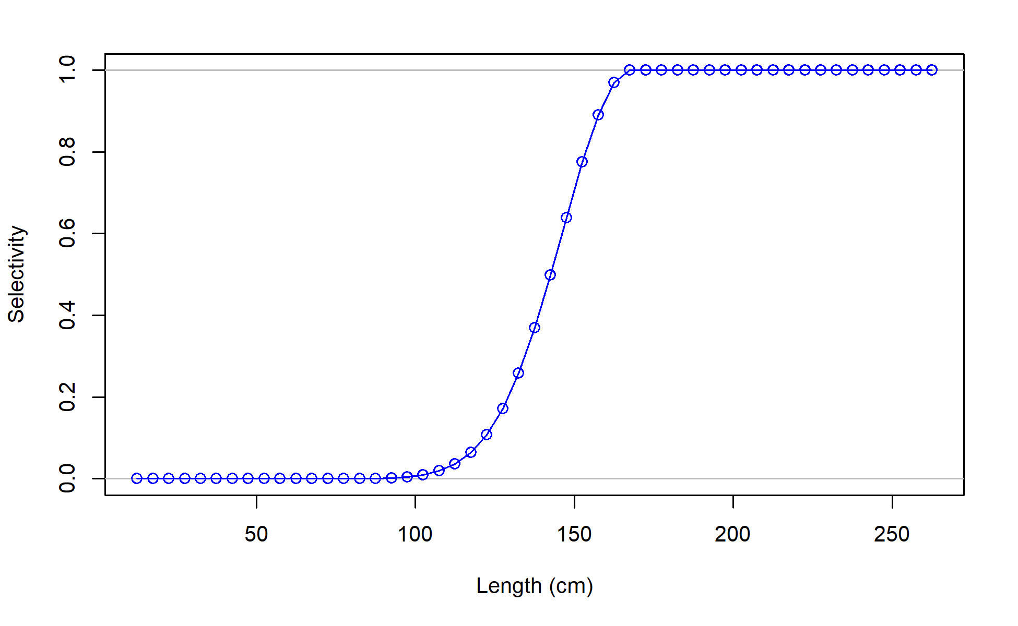
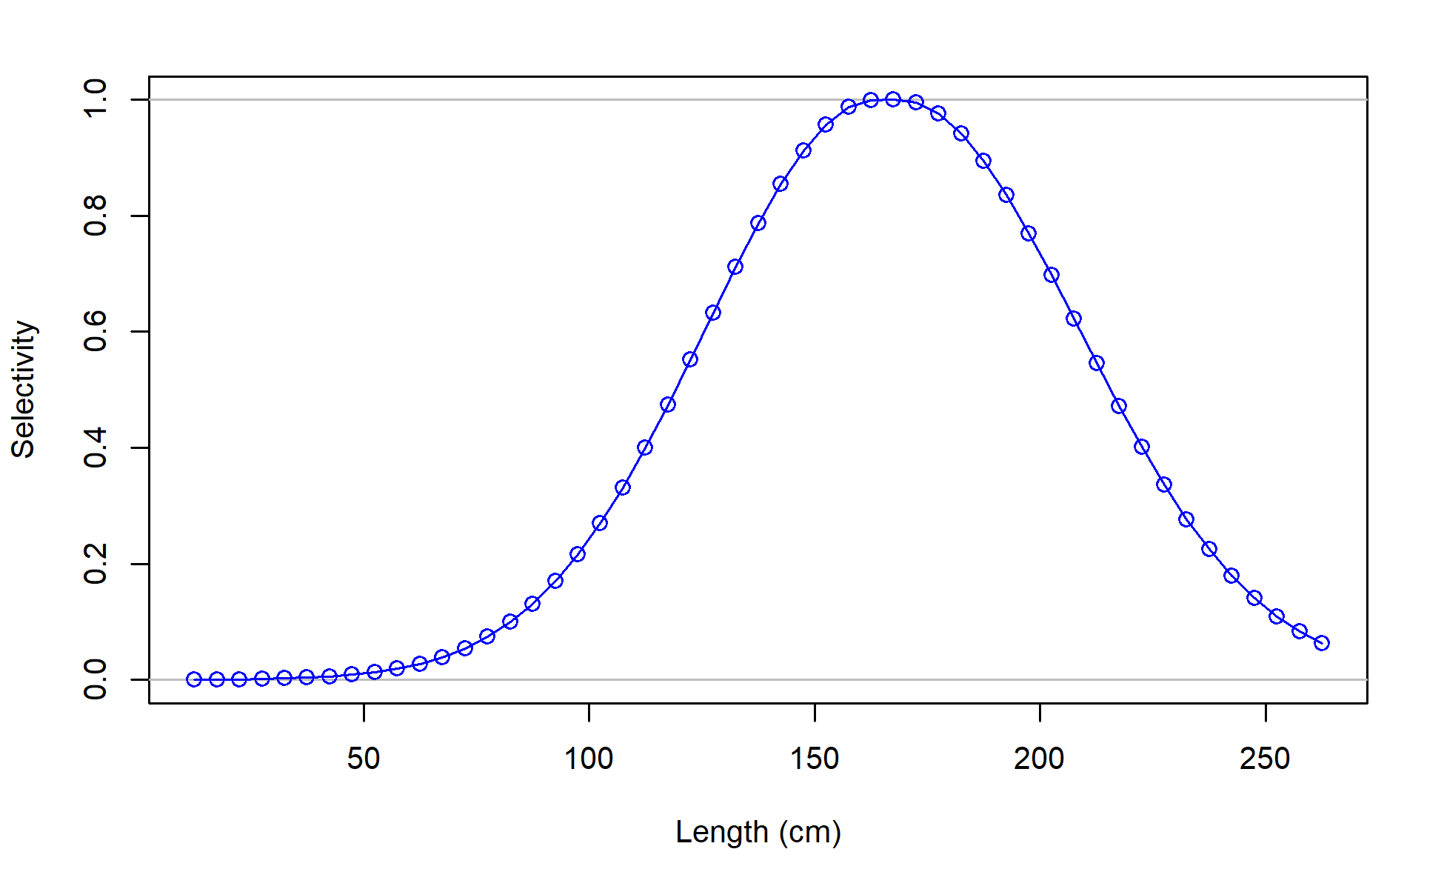
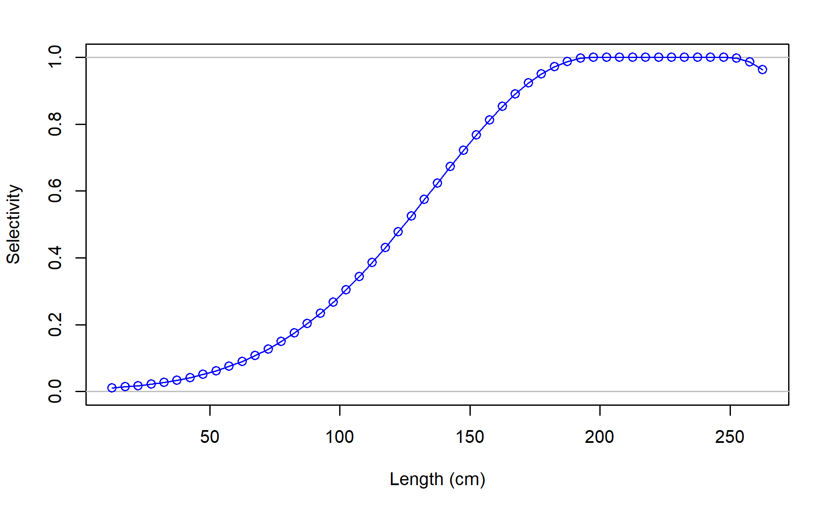
F01_JPN_WCNPO_OSDWLL_late_area1
F02_TWN_WCNPO_DWLL
F03_US_WCNPO_LL_shallow_late
F04_IATTC

Slide 17
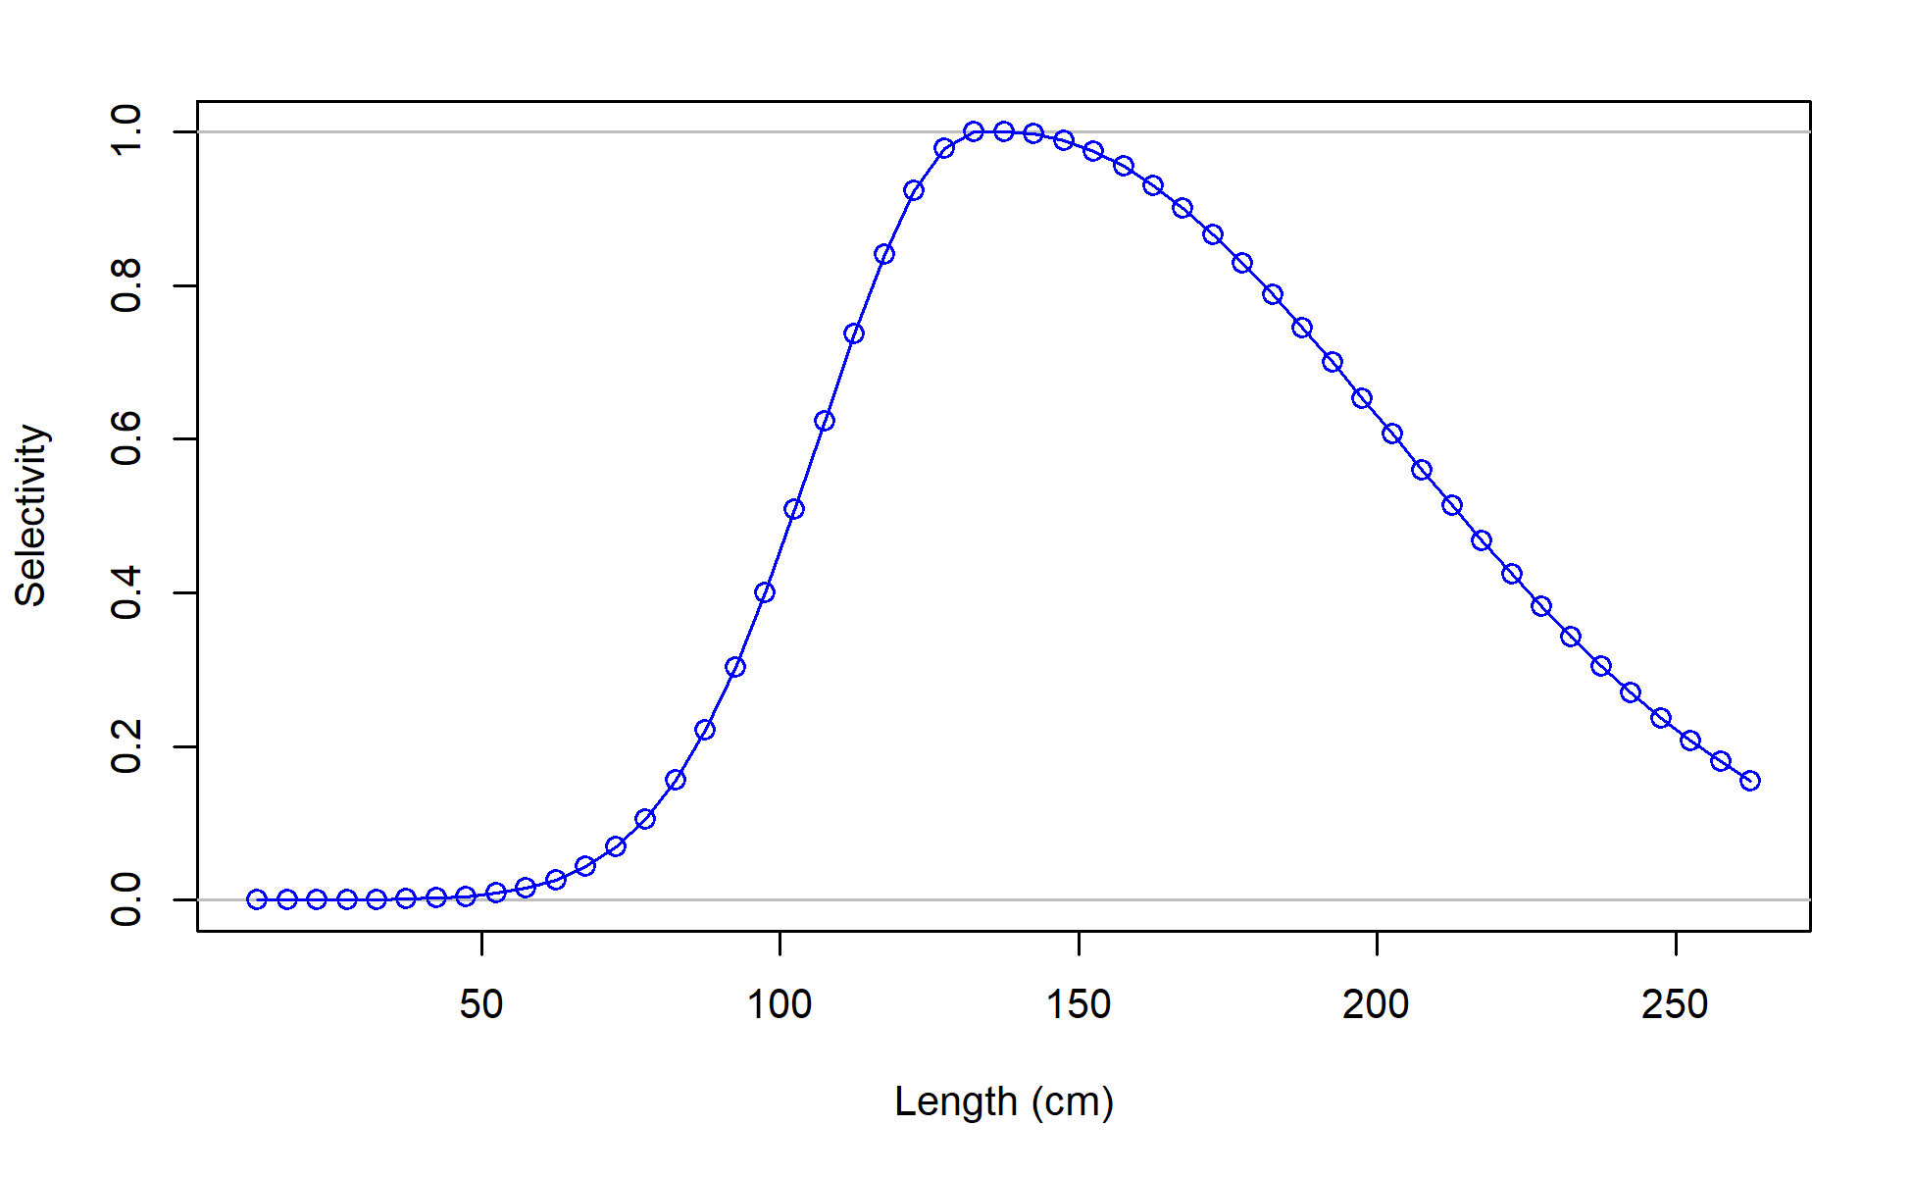
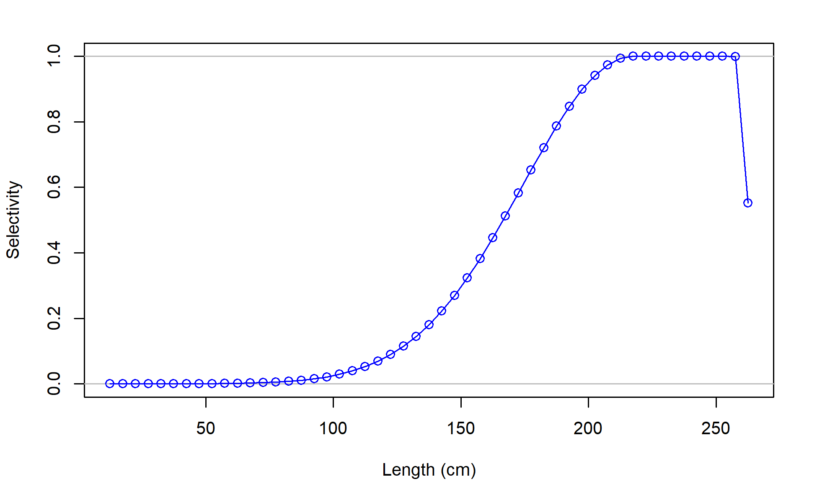
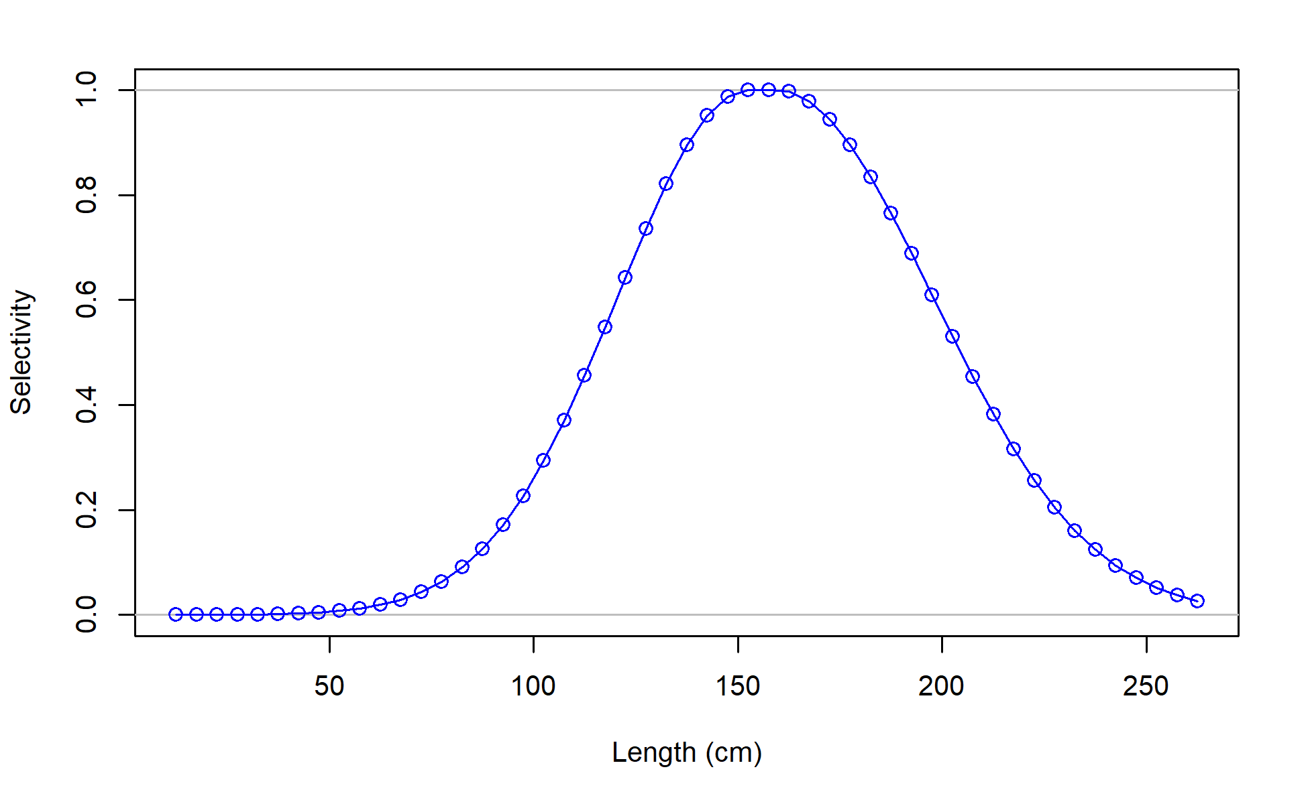
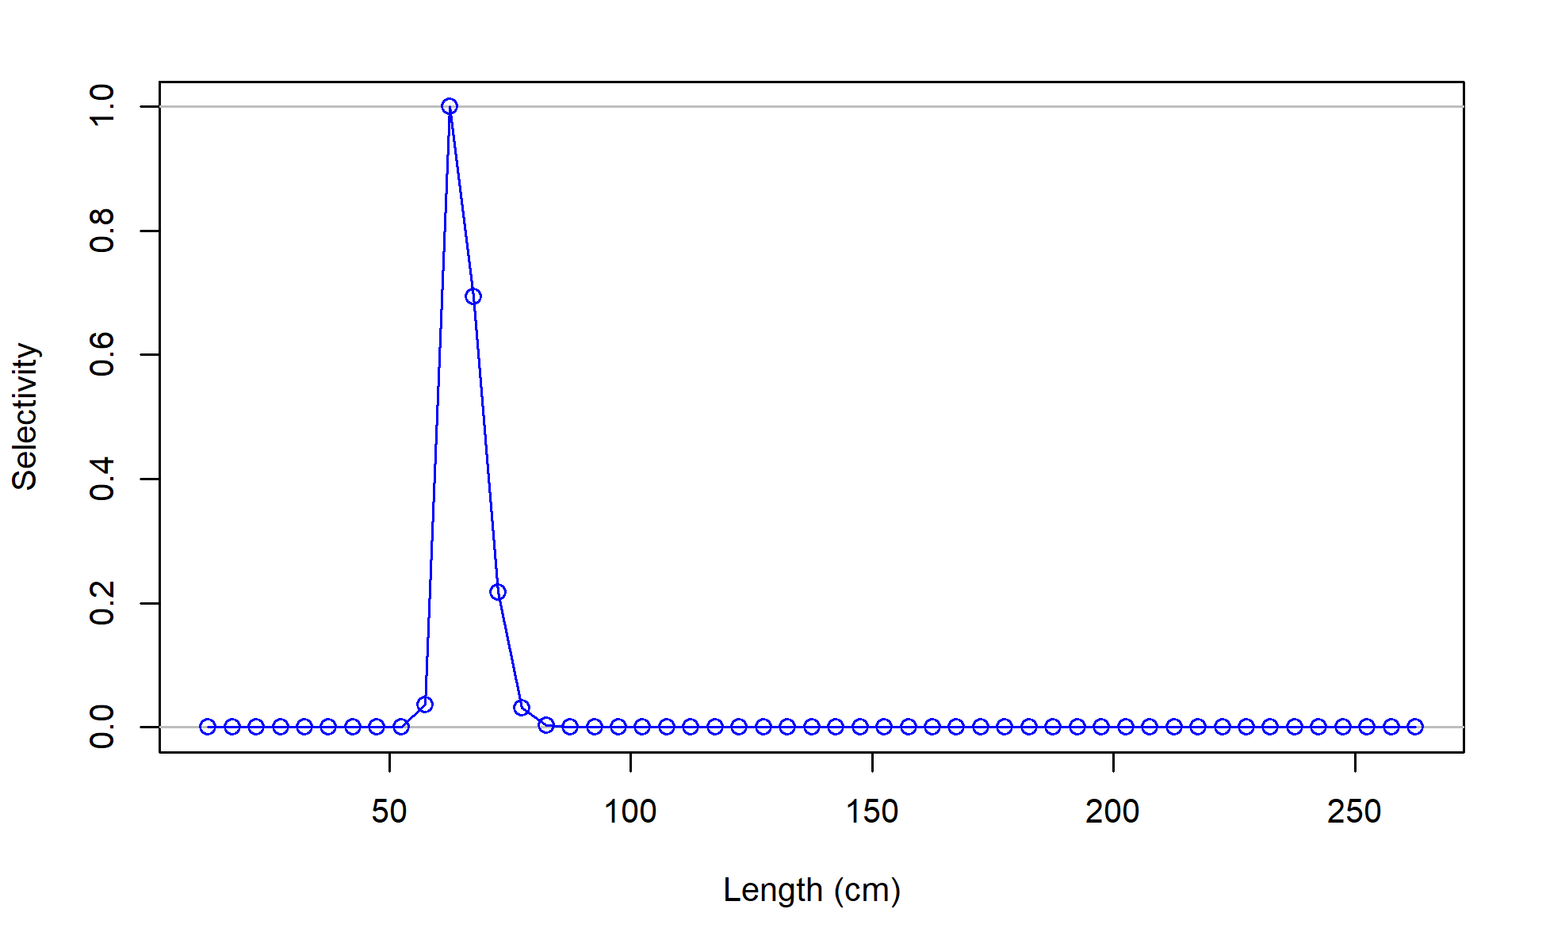
F06_JPN_WCNPO_OSDWLL_early_area2
F07_JPN_WCNPO_CODF
F08_US_WCNPO_LL_shallow_early
F09_US_WCNPO_LL_deep

Slide 18
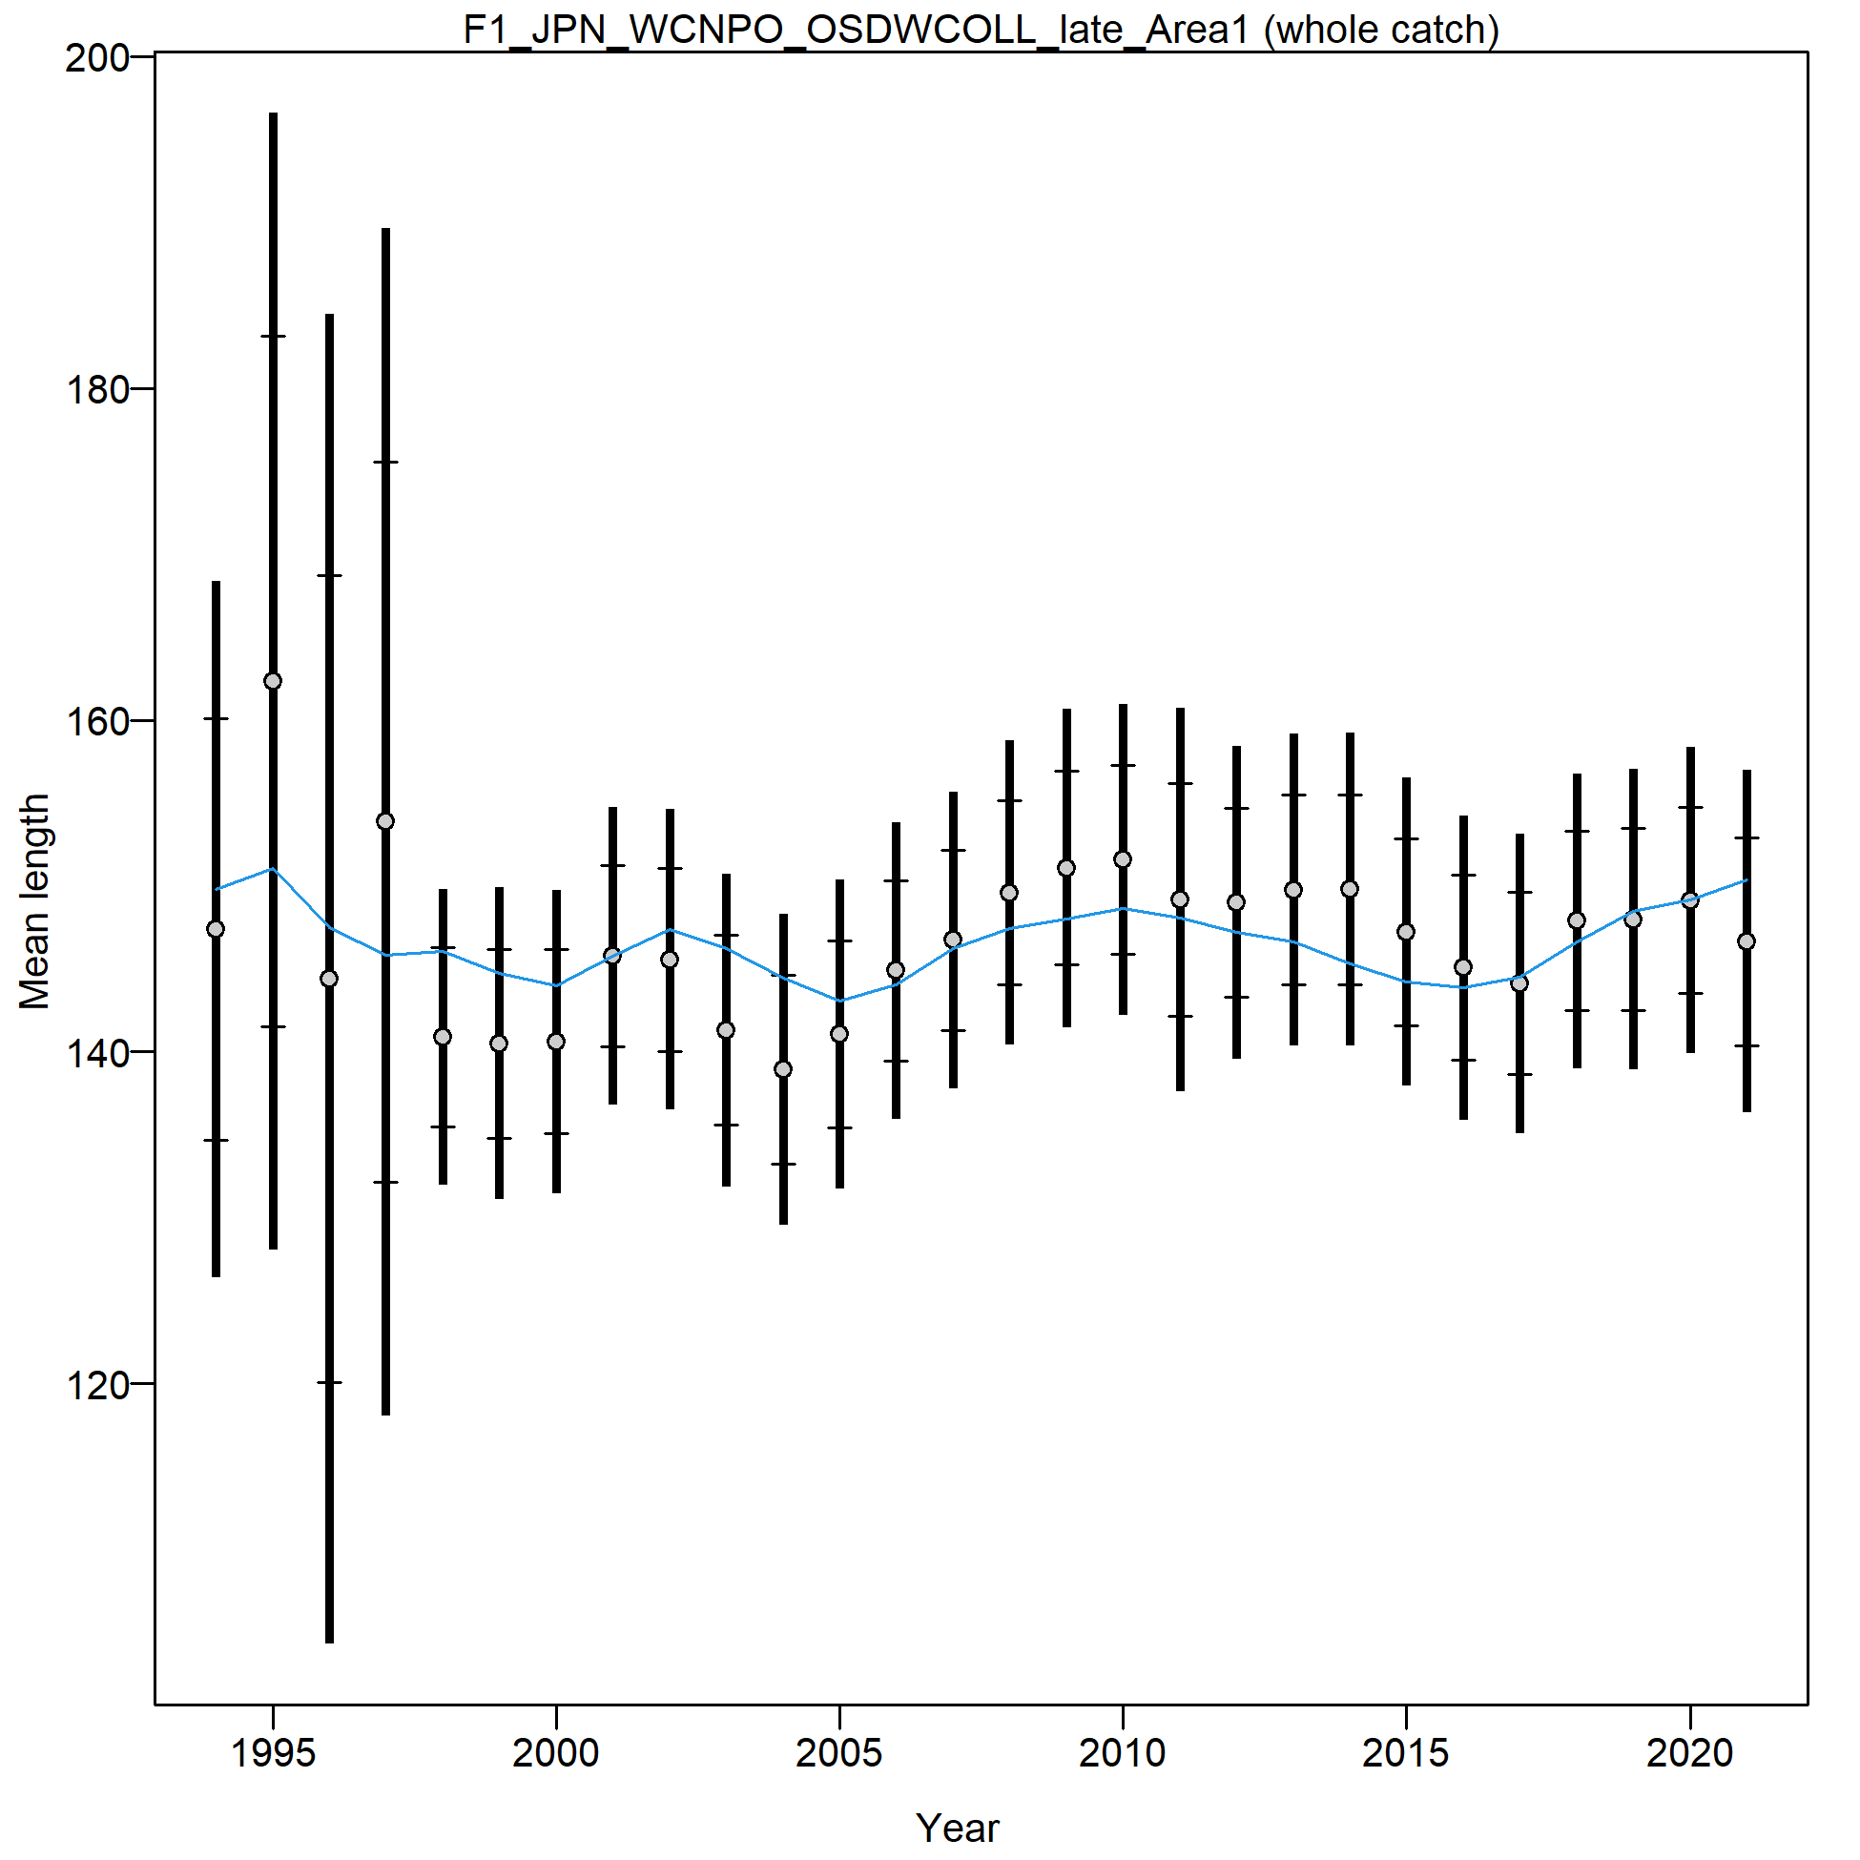
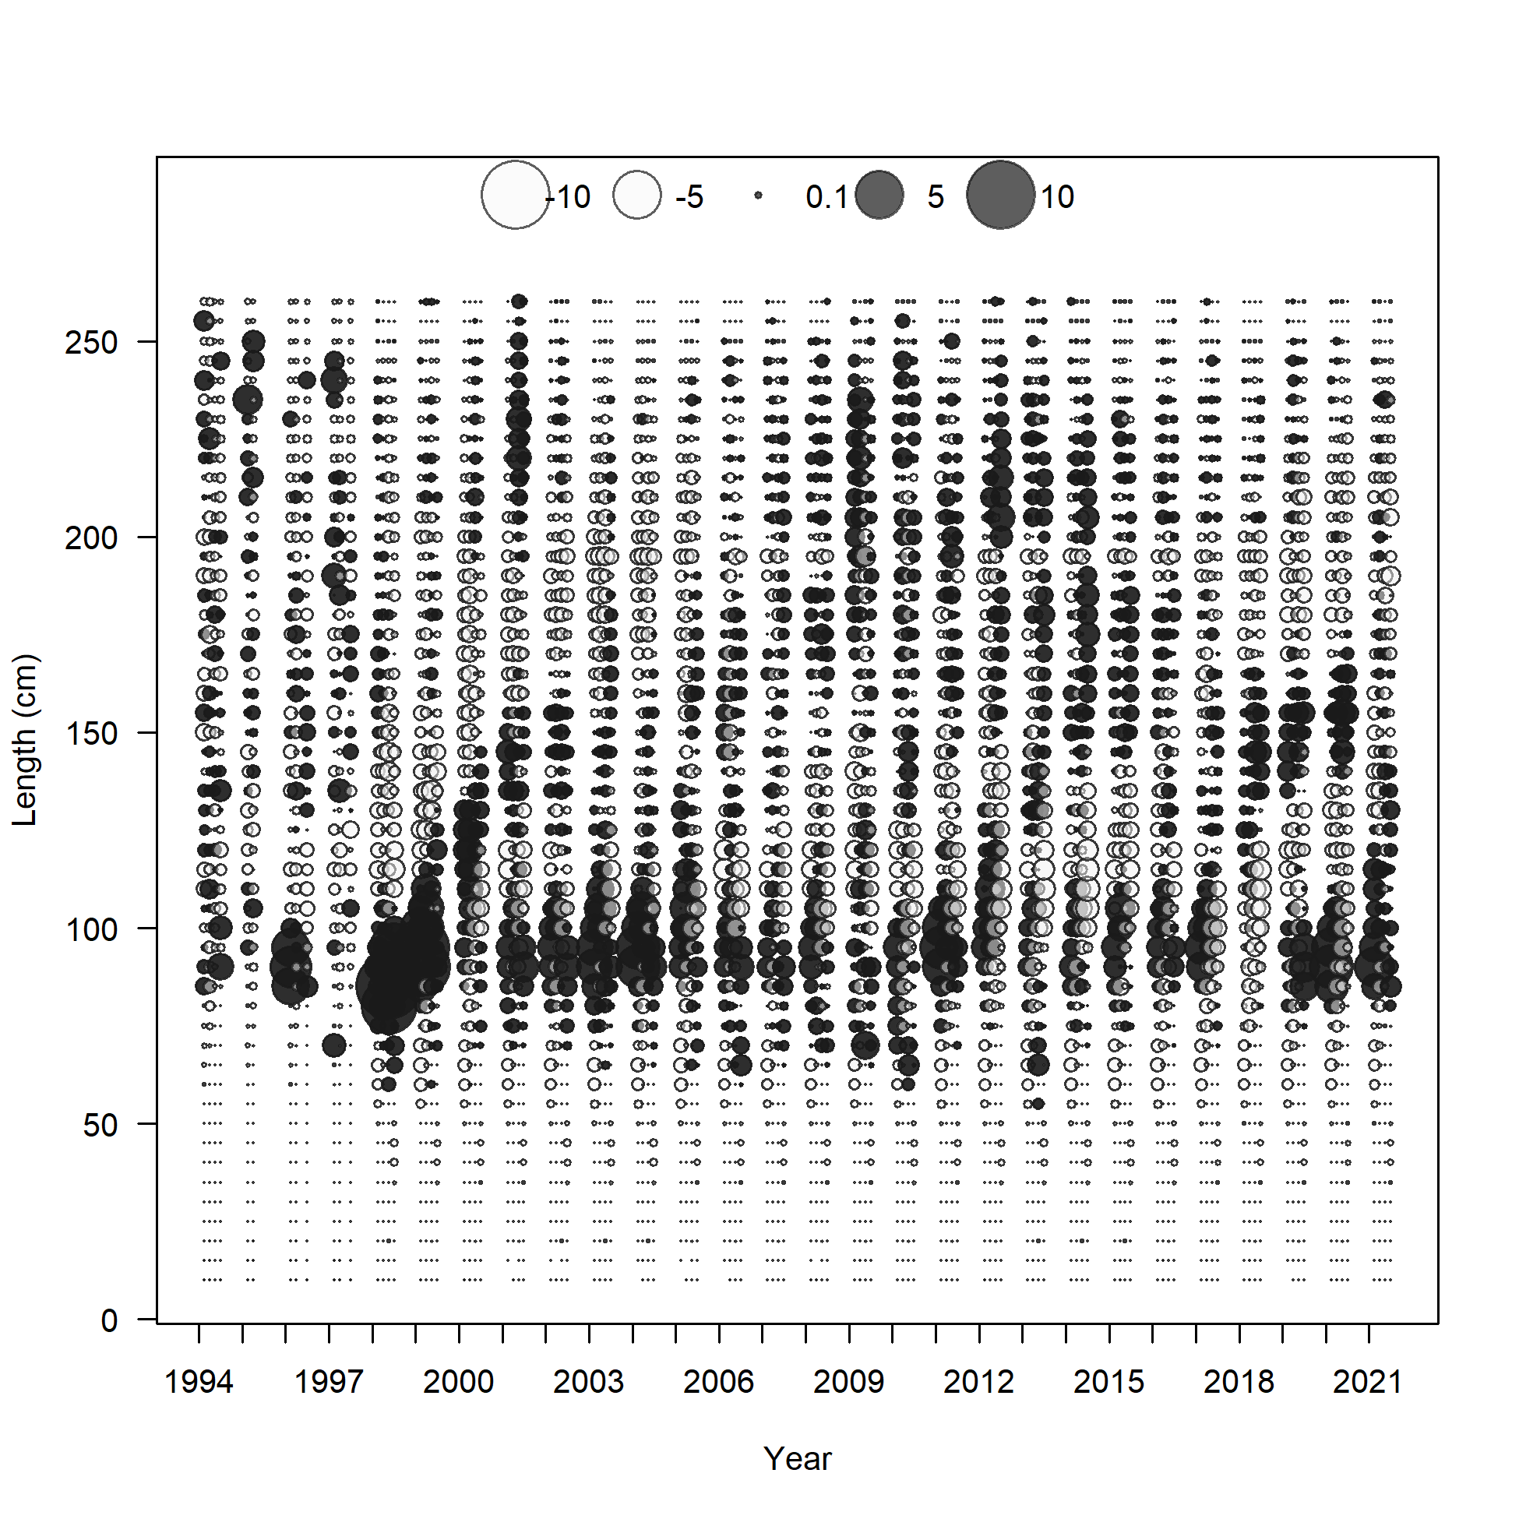

Slide 19
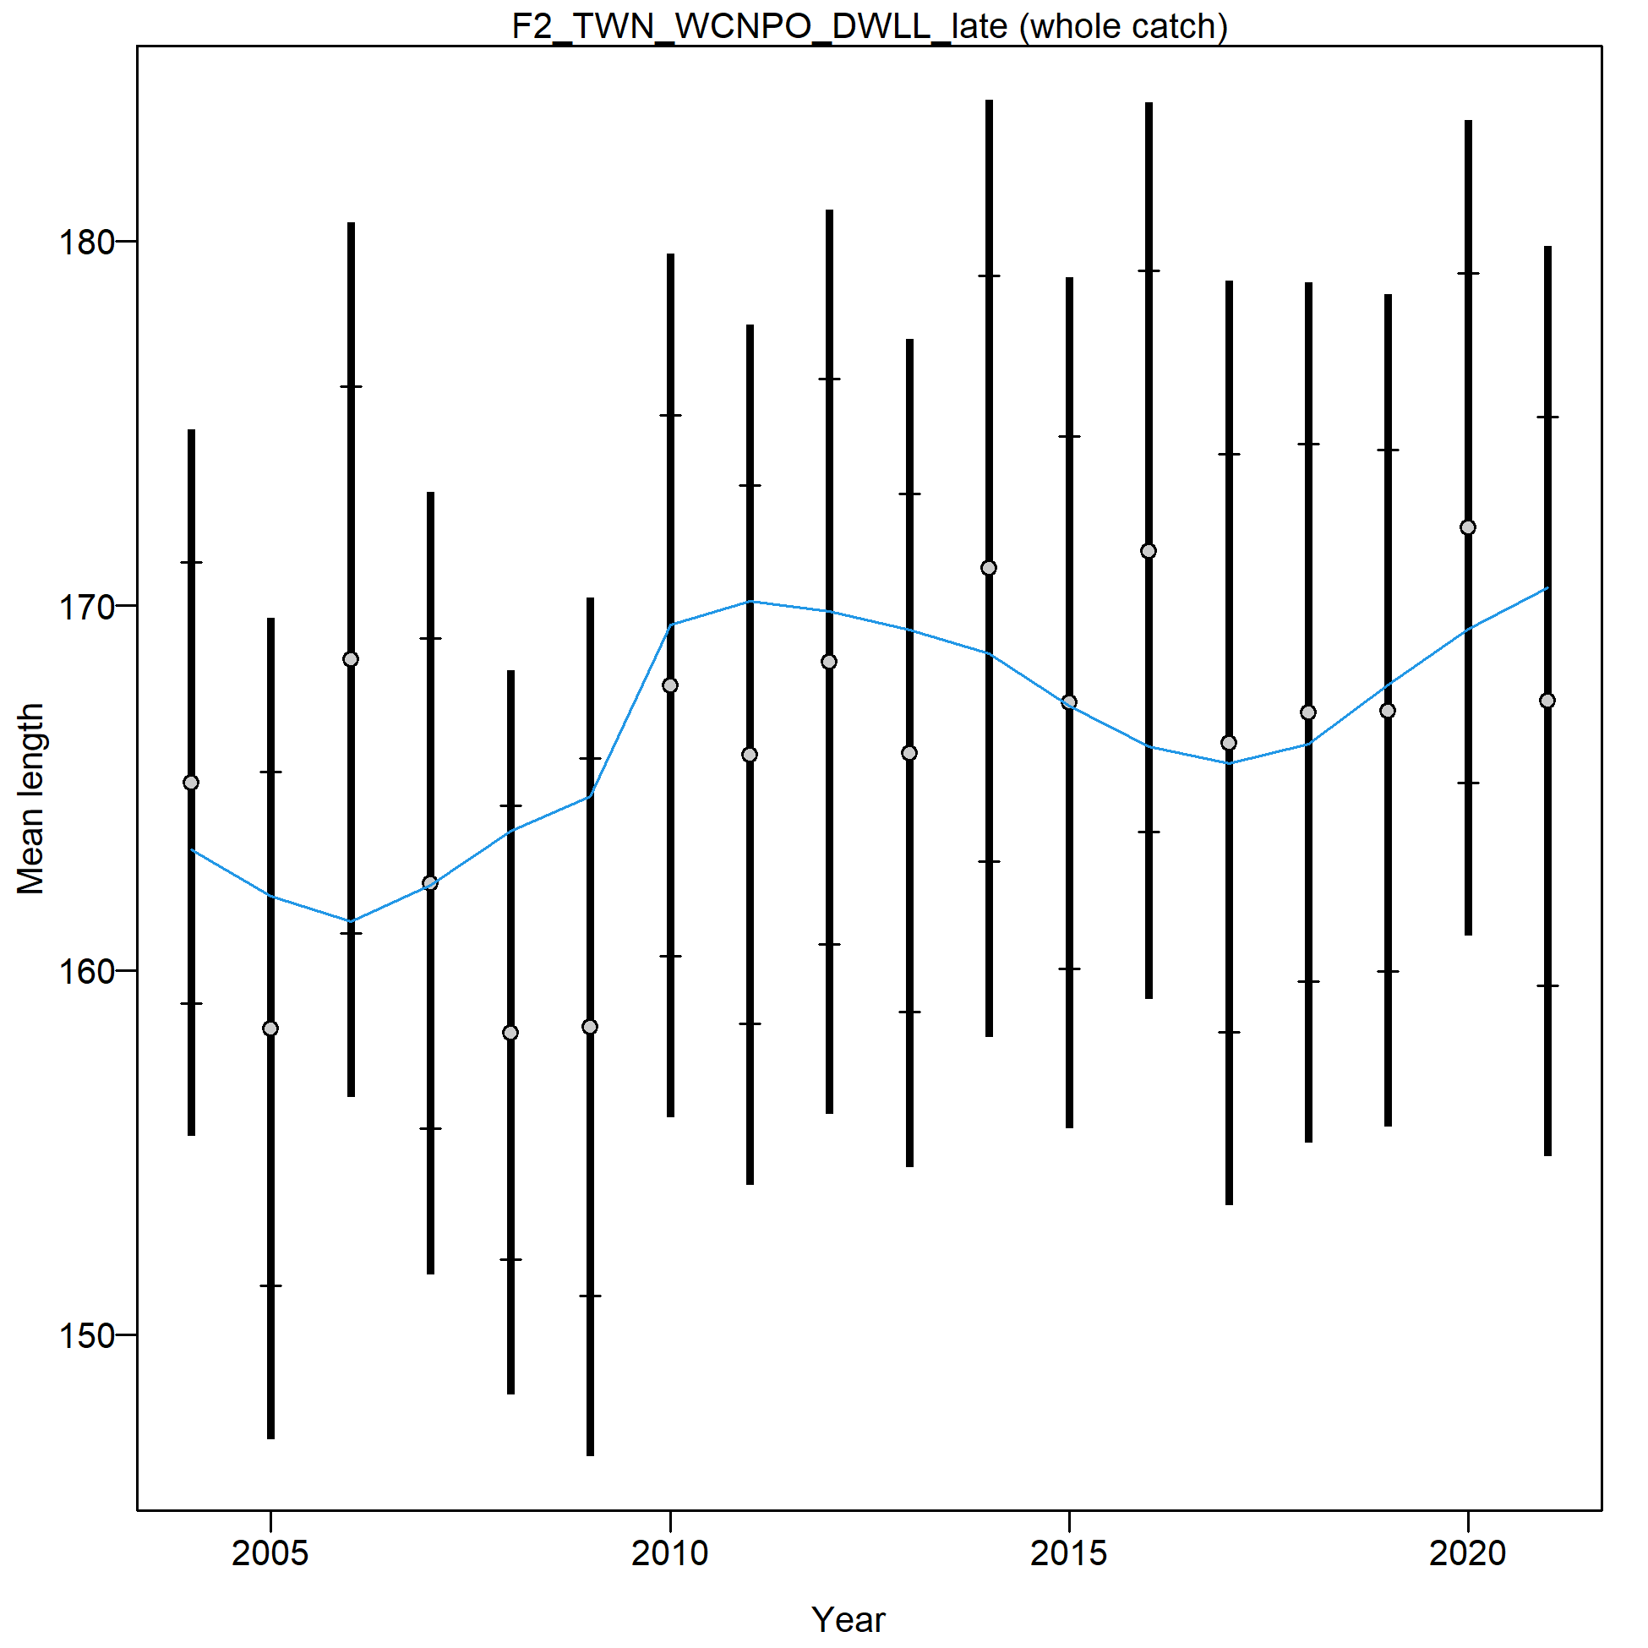
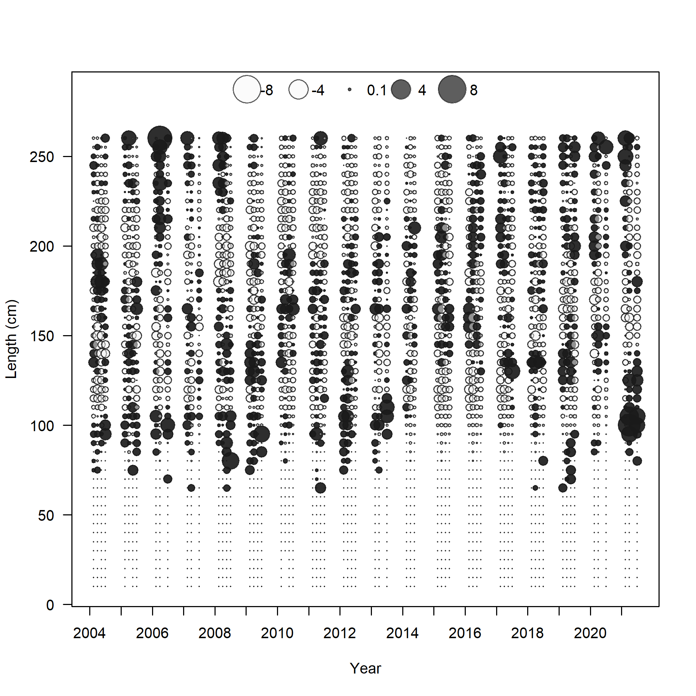

Slide 20
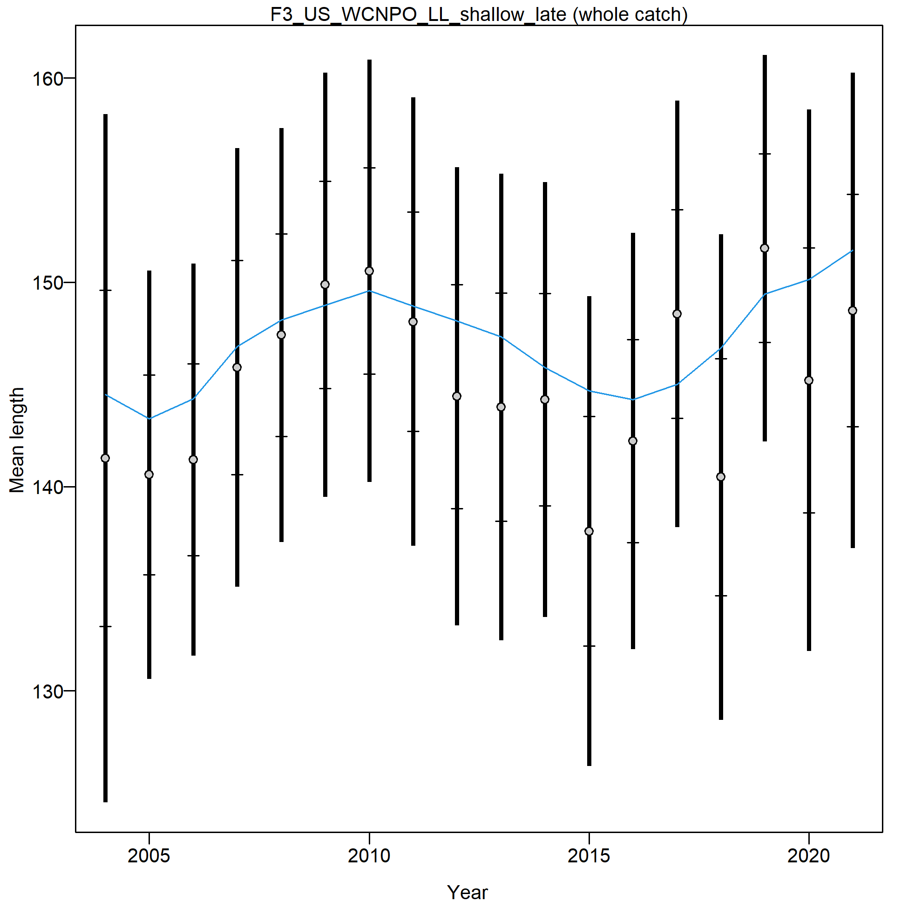
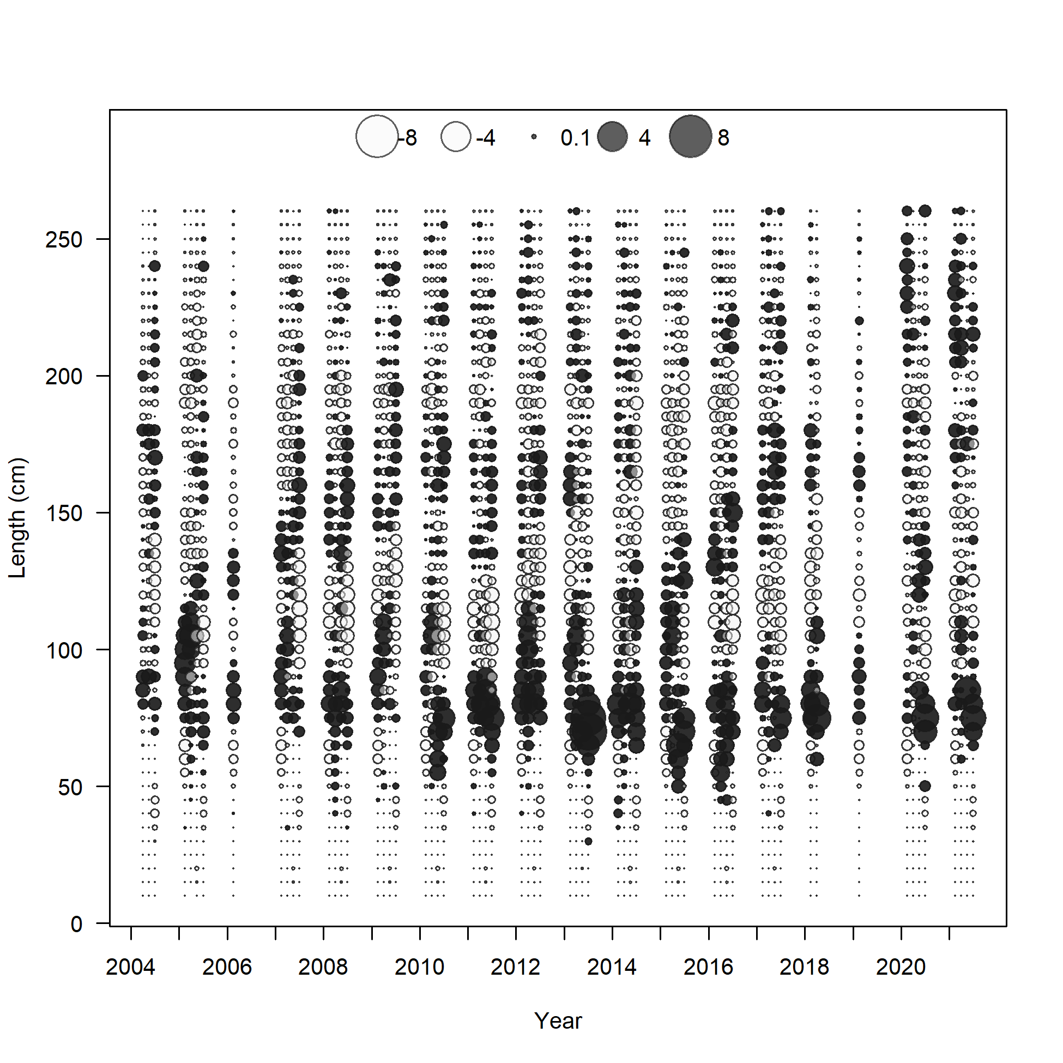

Slide 21
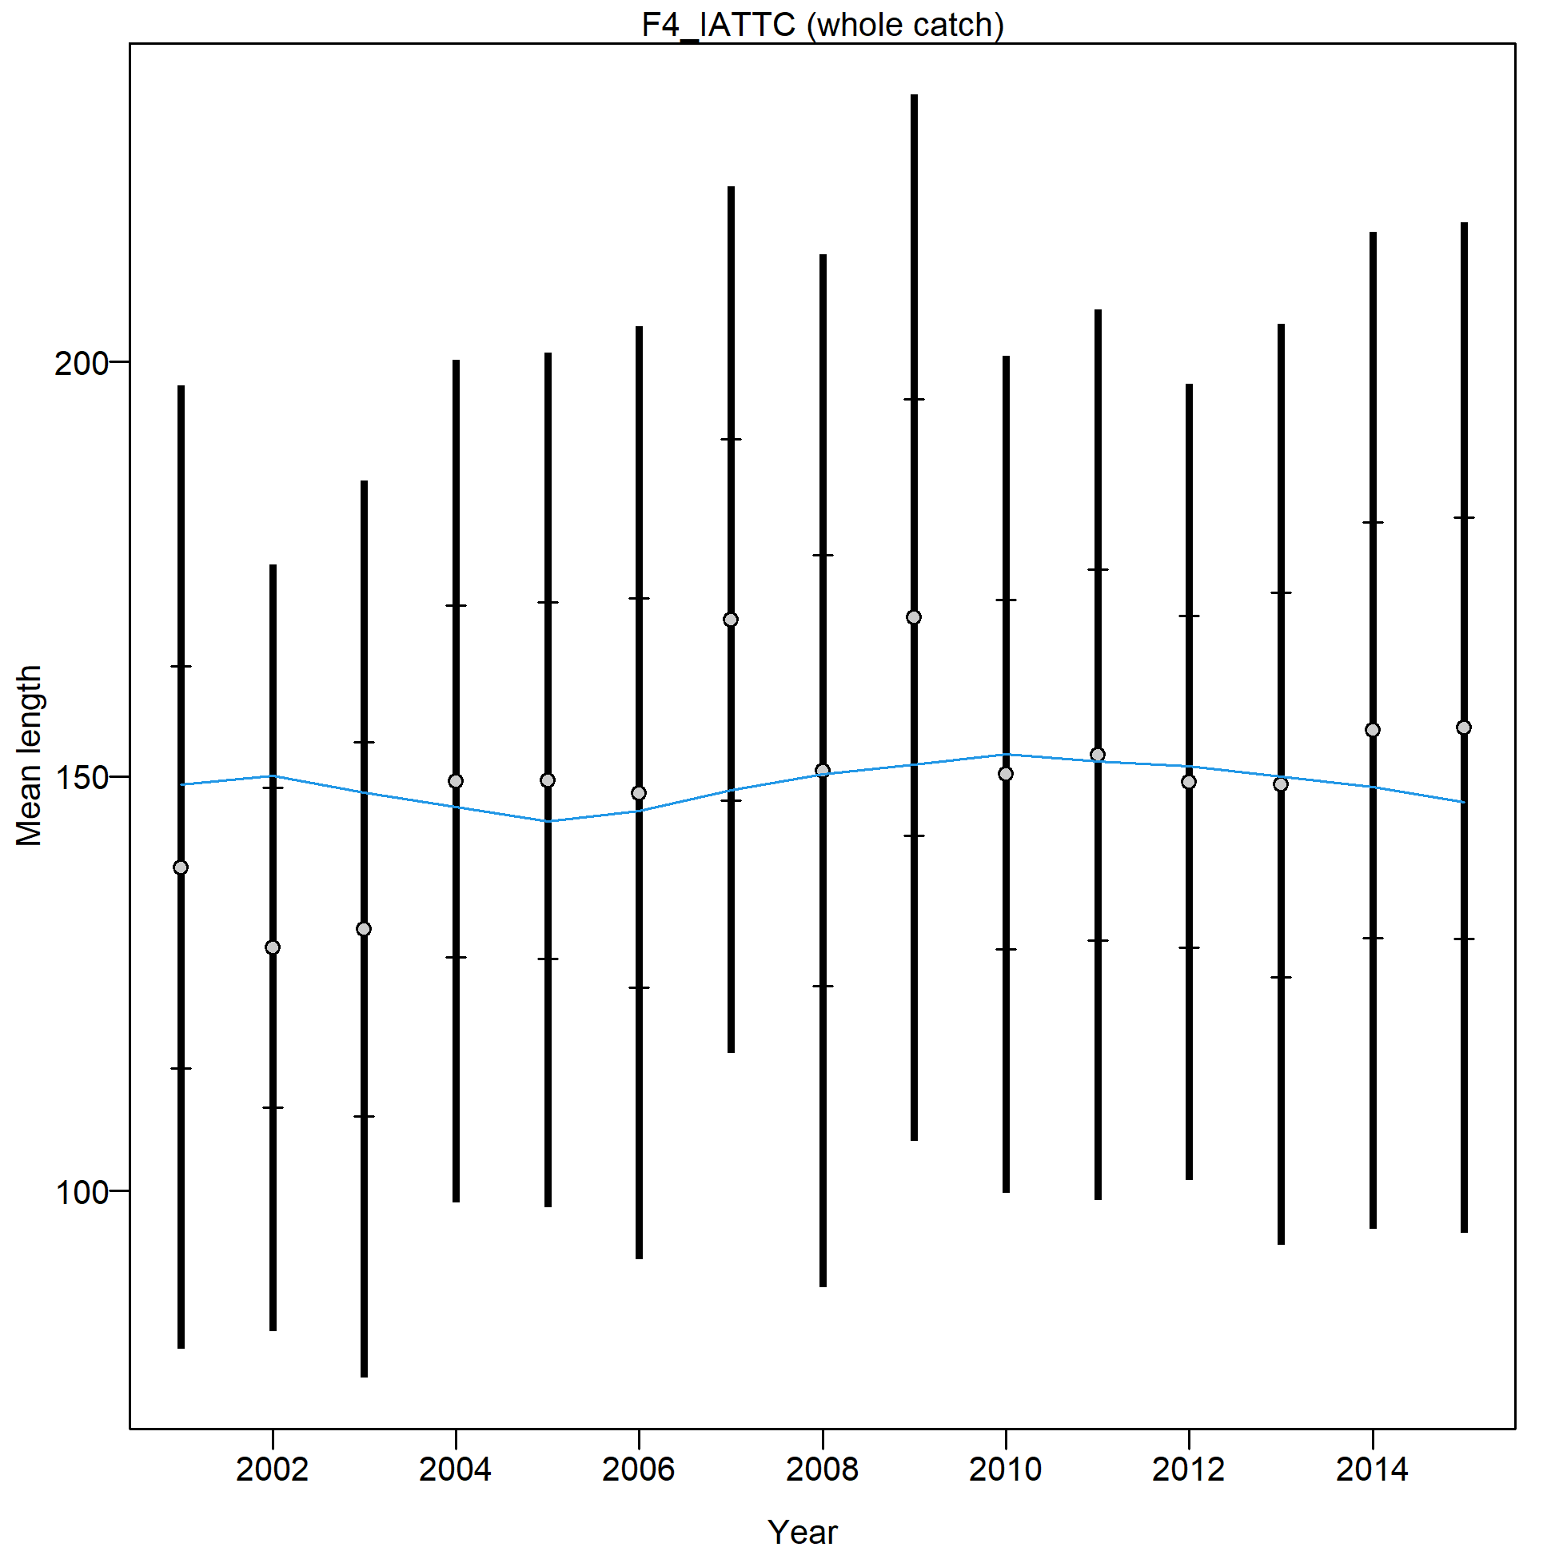
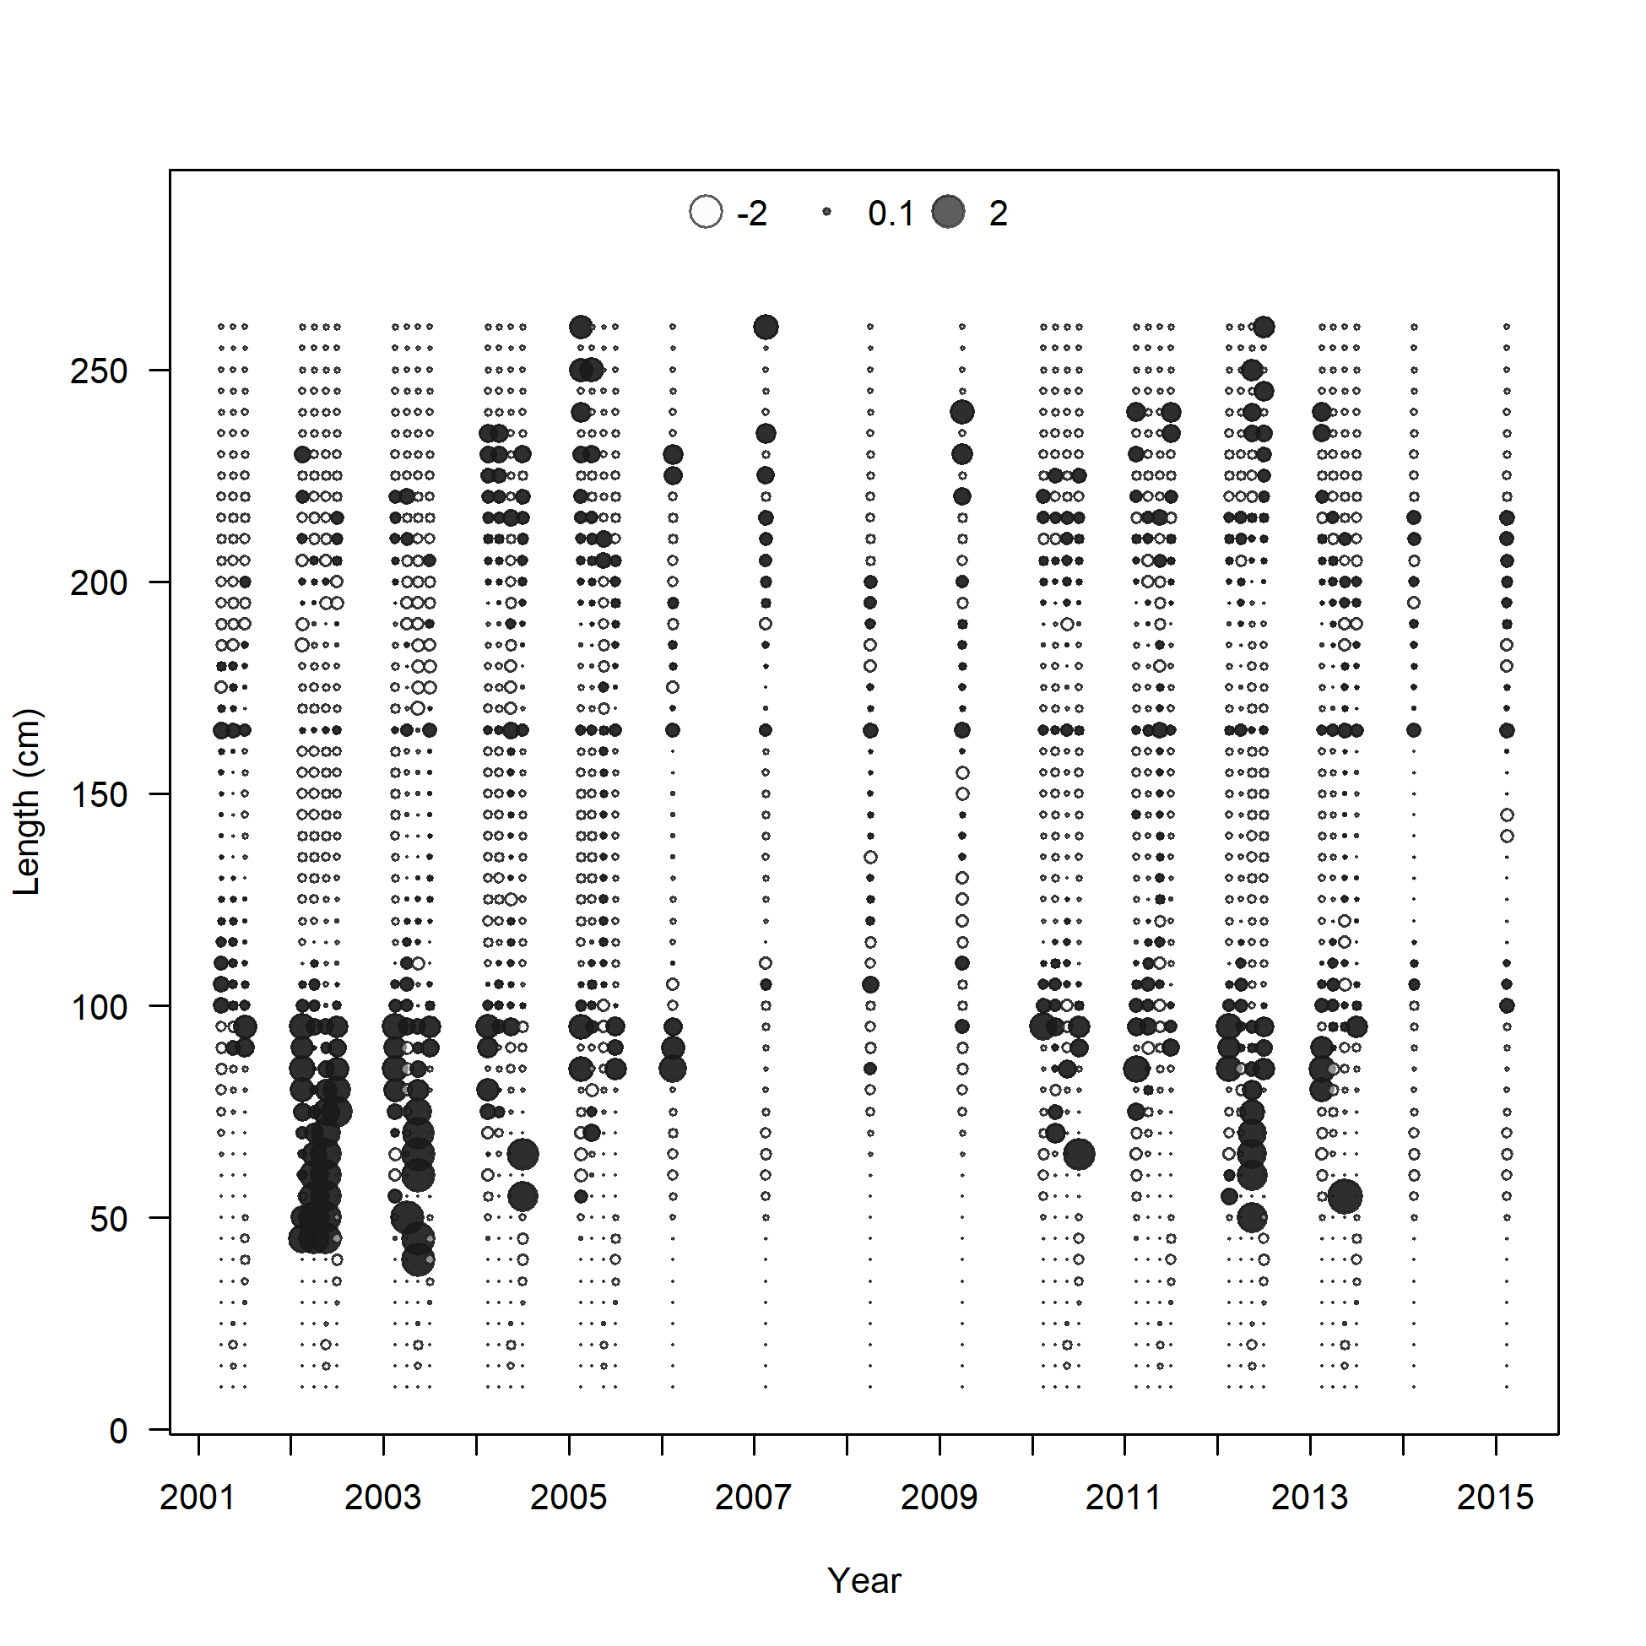

Slide 22
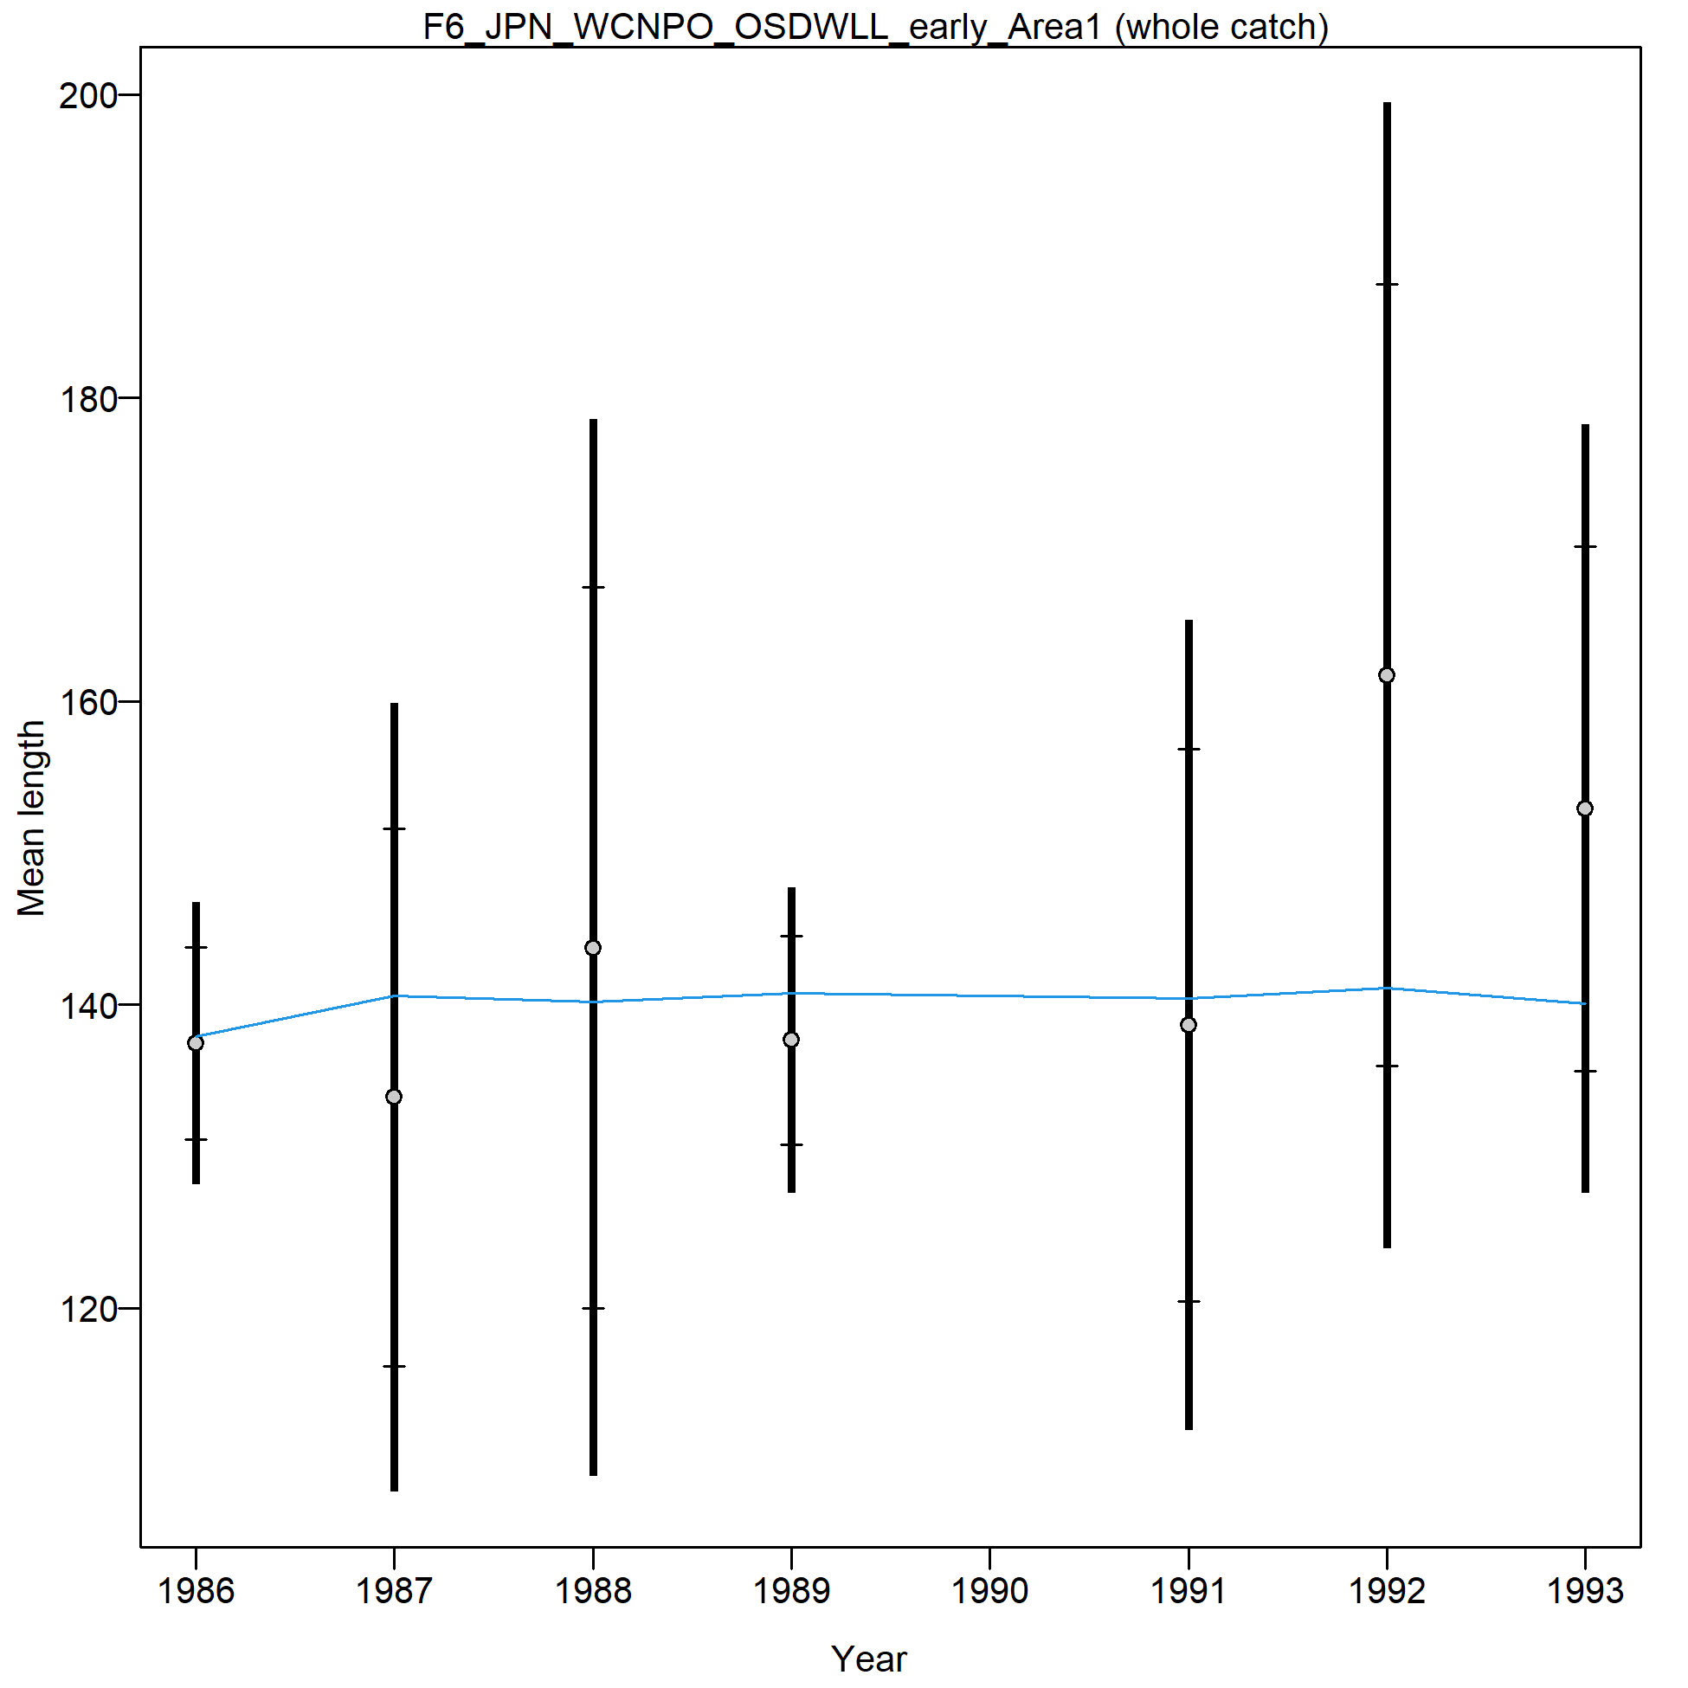
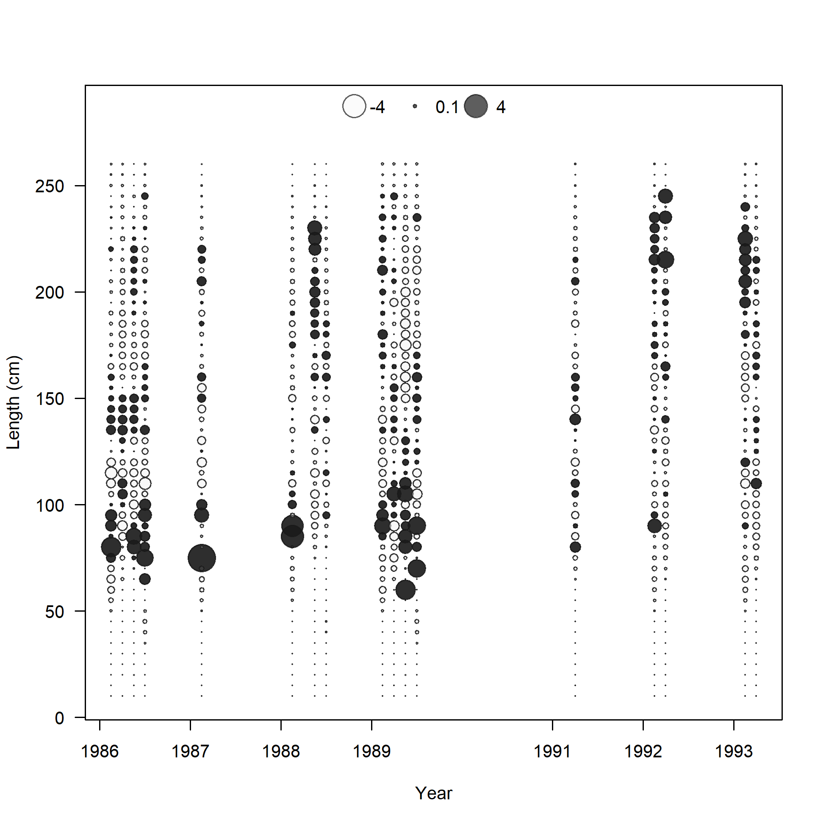

Slide 23
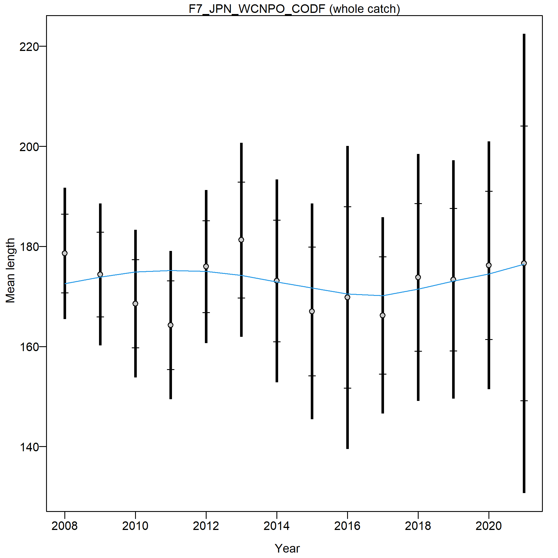
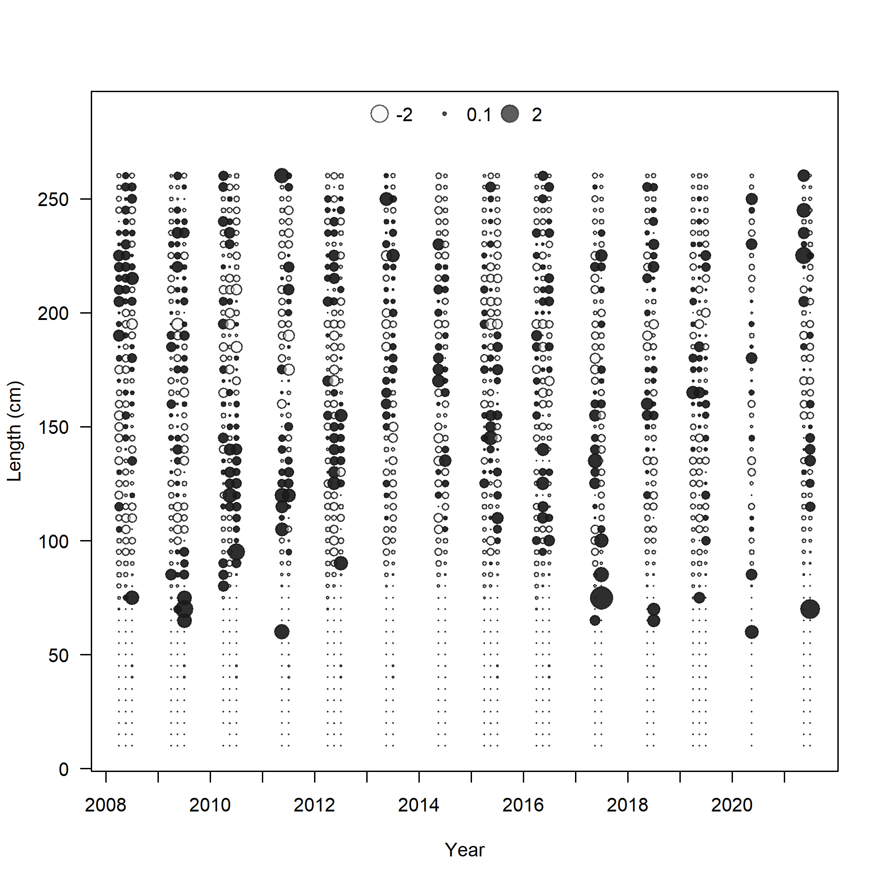

Slide 24
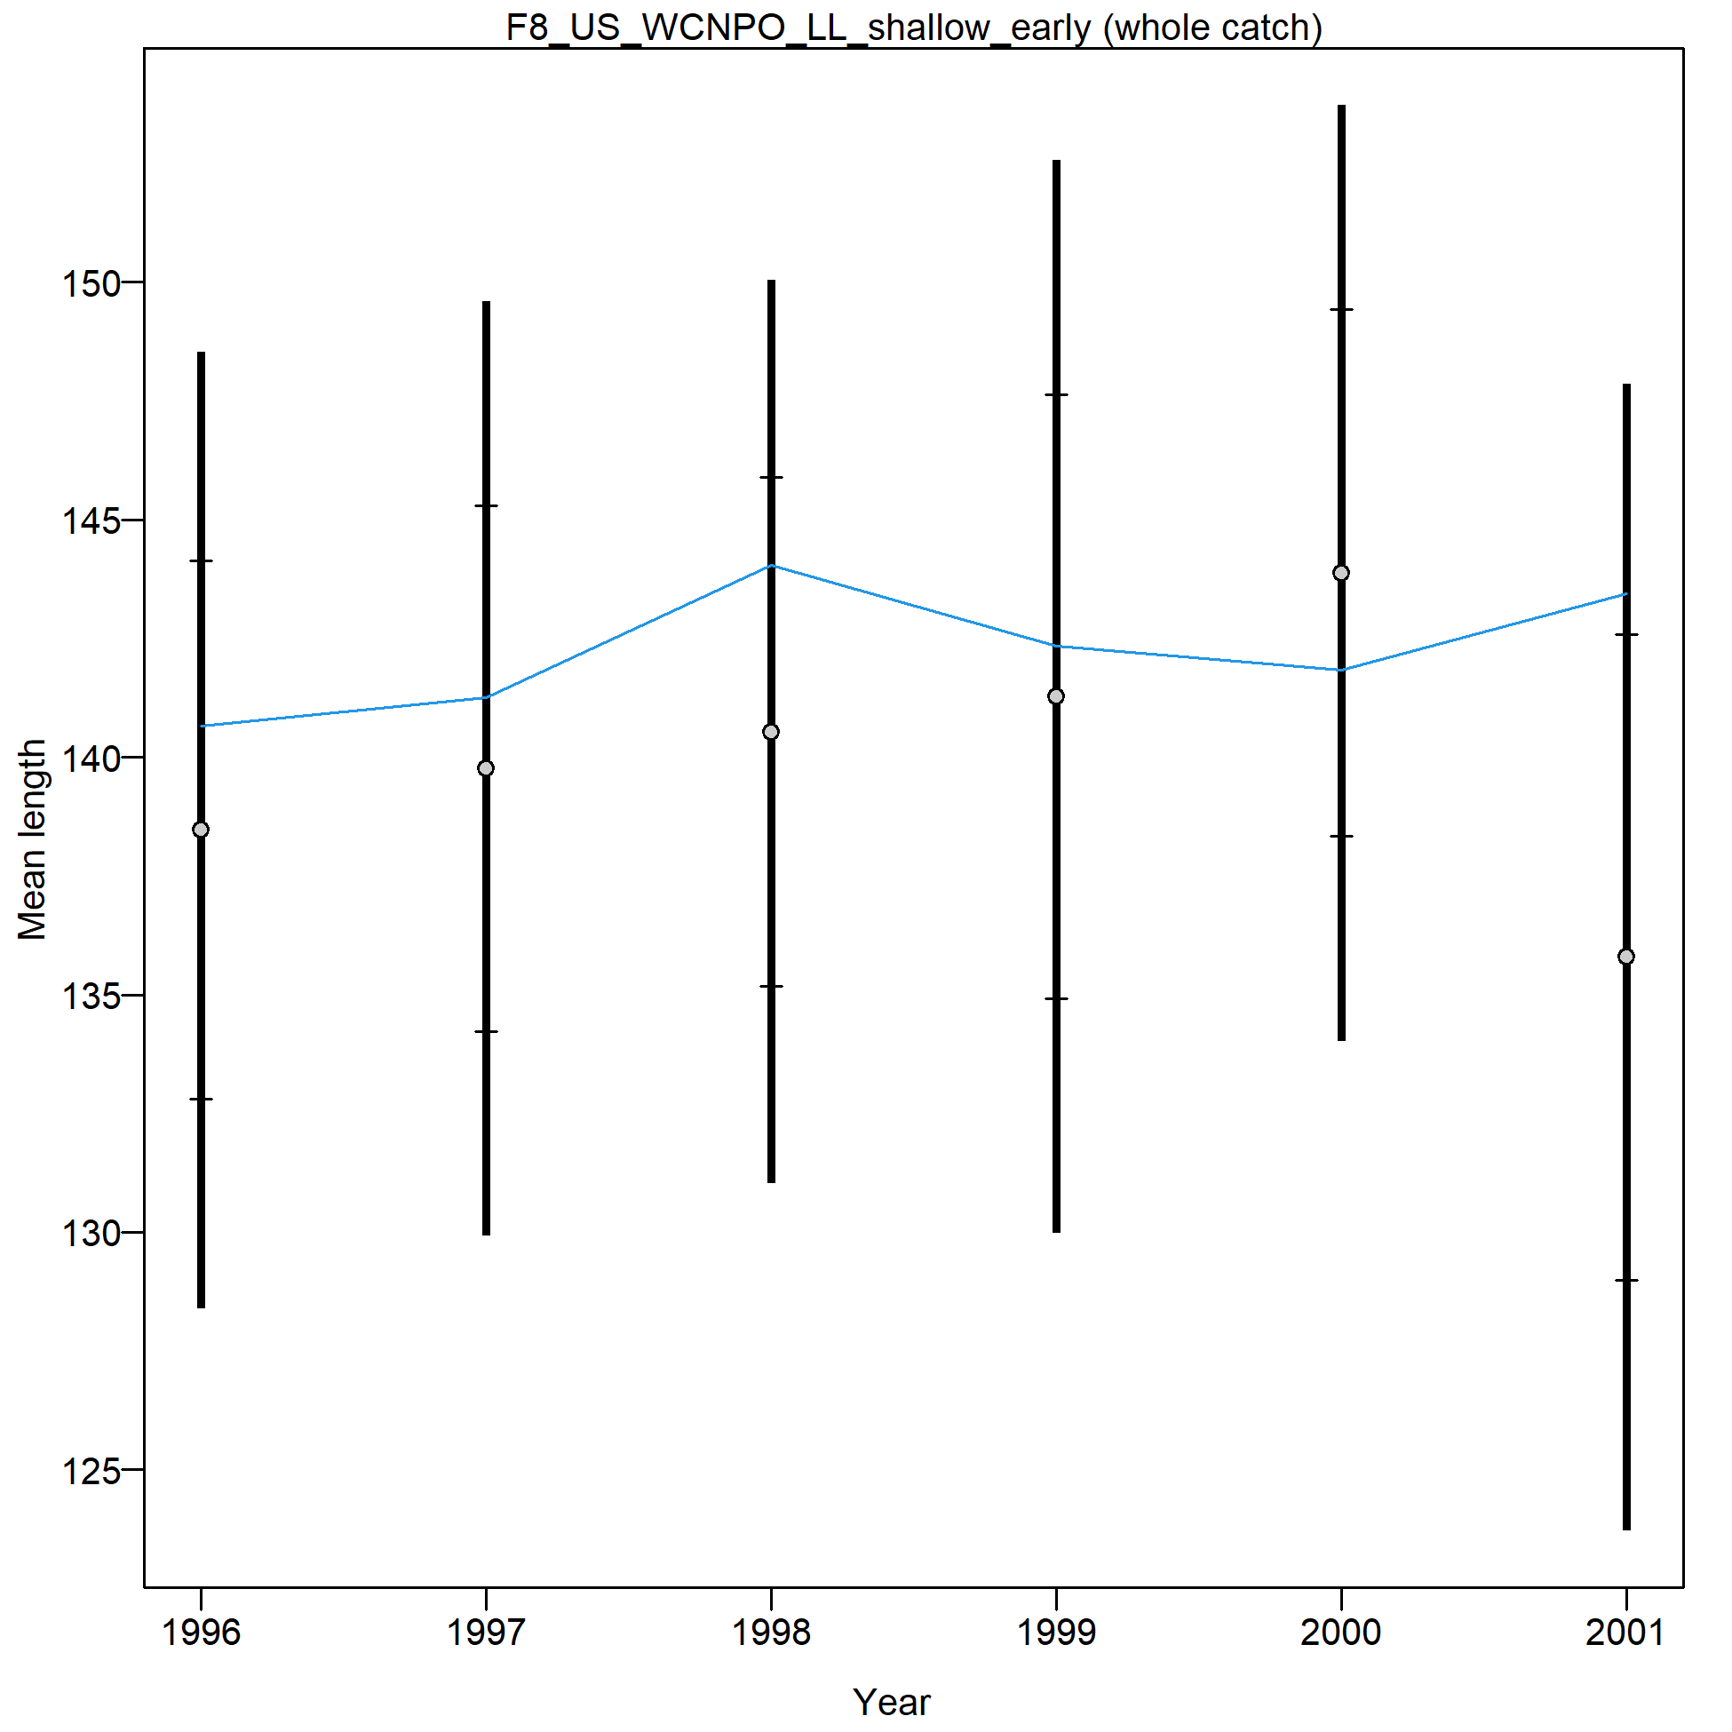
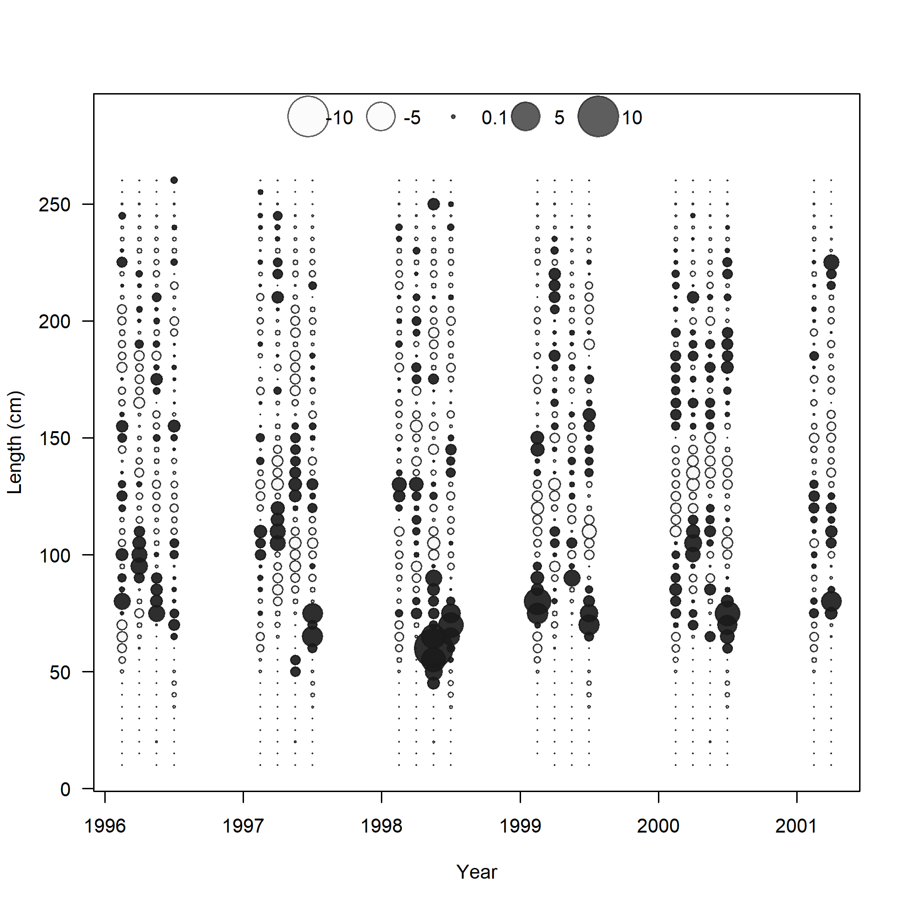

Slide 25
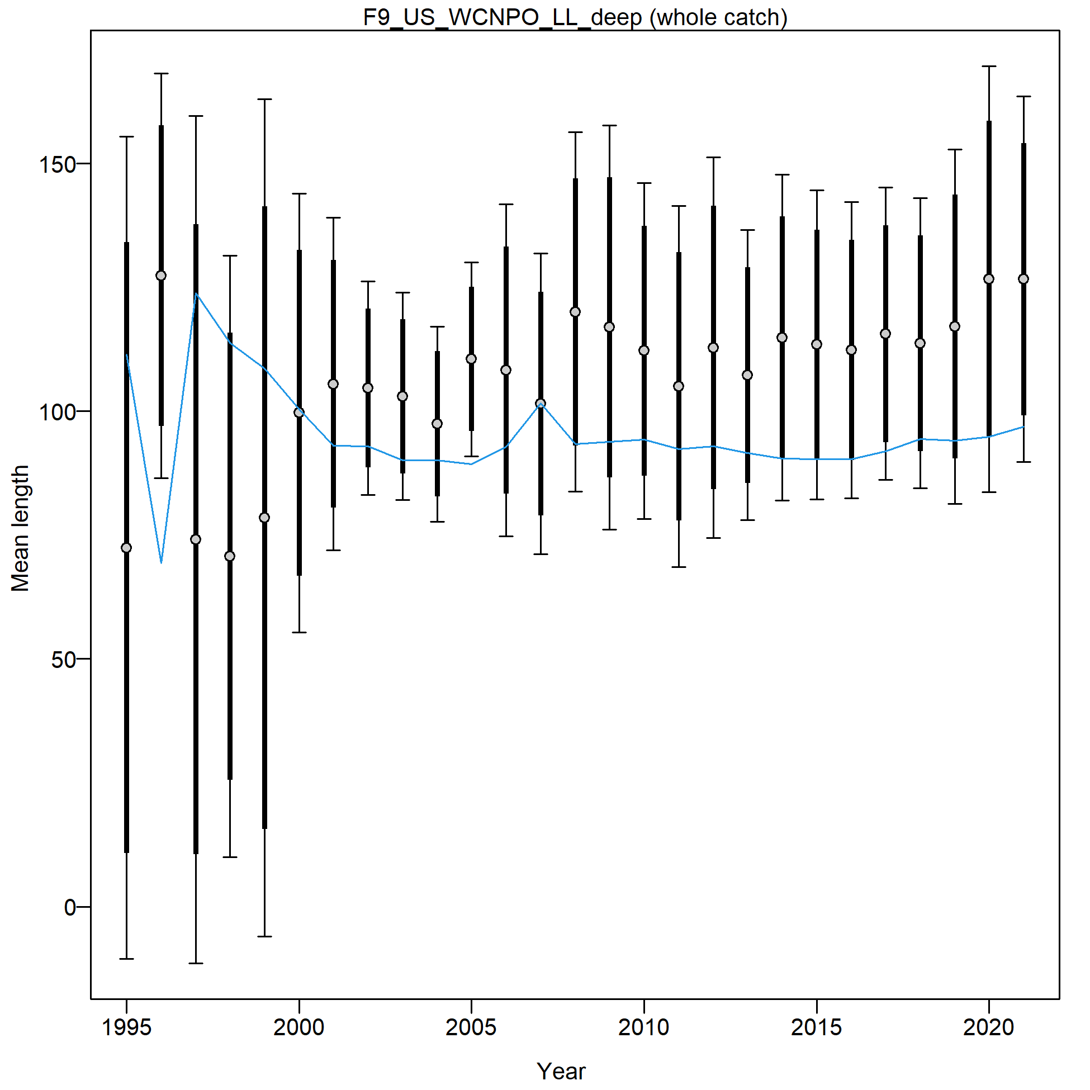
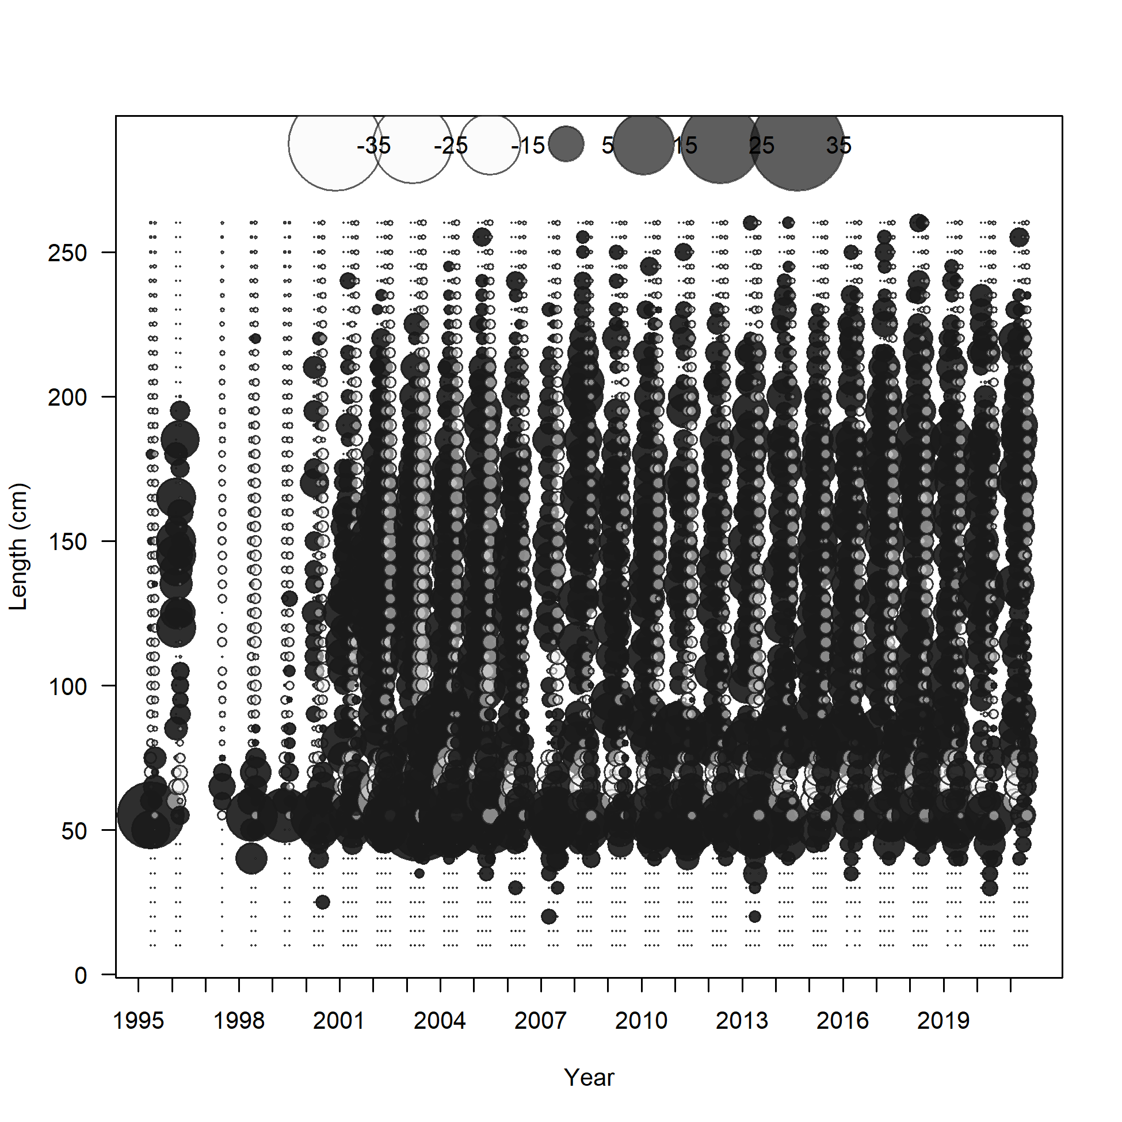
@ the last Modeling Team meeting, we decided to focus on improving the fit to this fleet. A model dividing this fleet into 4 is in progress, but while fits to the data improve, the model does not converge.

Slide 26
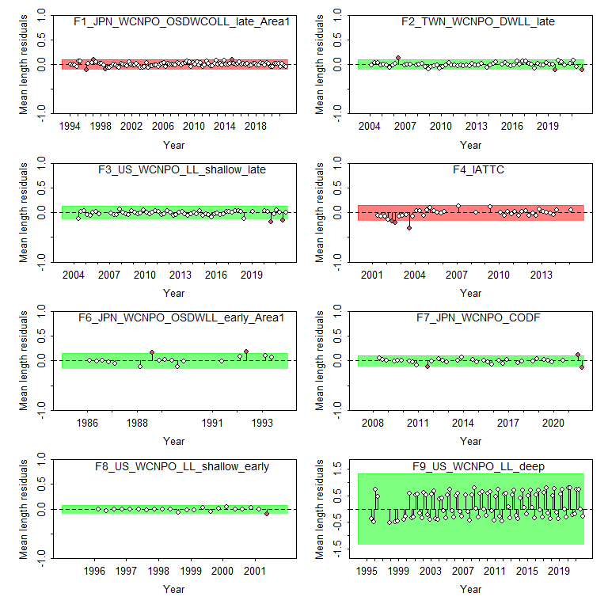

Slide 27
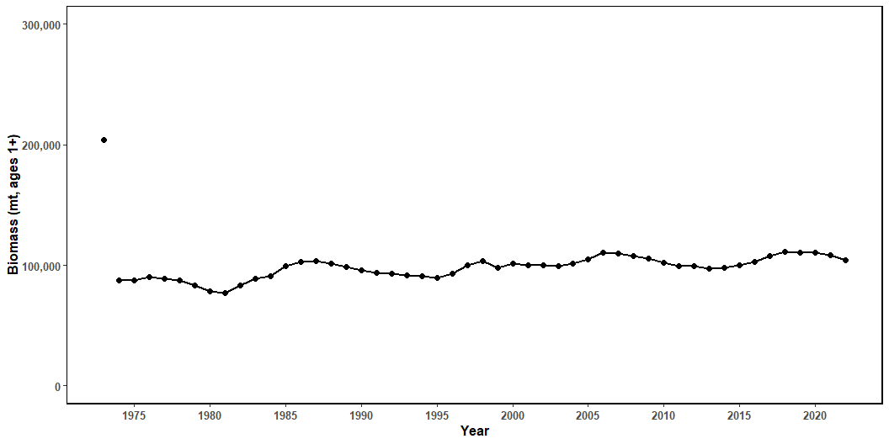
Figure 22: Estimated biomass (mt) of NP swordfish 1+ from the base-case model.

Slide 28

Figure 23: Estimated NP swordfish Spawning Stock Biomass (SSB) from the with 95% confidence intervals. SSB_{MSY} is indicated by the dashed green line.

Slide 29

Figure 24: Estimated annual fishing mortality (average ages 1-10) the with 95% confidence intervals. F_{MSY} is indicated by the dashed green line.

Slide 30

Figure 25: Estimated annual recruitment (thouseands of age-0 fish) with 95% confidence intervals.

Slide 31


Slide 32

Figure 27: Likelihood profile over R0 by CPUE index for the base-case model.

Slide 33

Figure 28: Likelihood profile over R0 for each length composition time series for the base-case model.

Slide 34

Figure 29: Spawning stock biomass trend for the ASPM model run (dashed line, triangles) and the base-case model (solid line, circles). Grey shading indicates 95% confidence intervals for each model.

Slide 35

Figure 30: Hind casting cross-validation (HCxval) results showing observed (large points with dashed line), fitted (solid lines), and one-year-ahead forecast values (small terminal points)

Slide 36

Figure 31: Hind casting cross-validation (HCxval) results for size composition mean lengths, showing observed (large points with dashed line), fitted (solid lines), and one-year-ahead forecast values (small terminal points.

Slide 37
April 13, 2023 Model 3_combine 1 and 2
Dropped S4 and S8 (lambda = 0)
Included corresponding time block to TWN CPUE as used in TWN size comp
Separated US deep size data into 2 fleets:
Fleet 9 is only quarters 1 and 2
Fleet 20 is only quarters 3 and 4
All fish 85 cm and larger are in quarter 4
All fish 80 cm and smaller are in quarter 3
All quarter 4 inputs are given negative years – the model won’t include their fits in the likelihood but will still fit the data
Normal Prior on R0 – mean of 7, standard deviation of 0.2

Slide 38
What’s happening
The likelihood profile for the model with a single US deep size comp fleet has a very flat likelihood above the MLE estimate of R0
Of the information available to inform the upper bound of R0 – most of it comes from the US deep size data, it is the largest contributor to the likelihood.
The change in likelihood overall is 2.87, of this 2.39 is from the F9 size data

Slide 39
Why does this matter?
In attempting to improve the fit to this size comp because the strong seasonality in selectivity produces very large residuals, we are reducing the contribution of this fleet to the likelihood, therefore removing the information informing the upper bound of R0
Because of this, and because the stock is in good condition, catch is declines, CPUE is increasing (mostly), the model is able to fit the input data well at almost any value above the minimum (~7.2), and therefore unless constrained, will always hit the upper bound
We have two (three?) basic choices to address this issue

Slide 40
How do we fix this?
Accept the poor fit to the US deep size data in the original model with the combined fleet
We can explain why this poor fit exists
We can attempt to downweight this fleet slightly, but acknowledge that it is a bycatch fleet and contributes a small amount of catch and it contains important information on recruitment
OR we could move forward with the split US deep size comps, and put a reasonably strong prior on R0
One option is to use the R0 from the combined size data model
But this makes a very strong assumption about R0 and should not be undertaken lightly.
The current model has a prior on R0, but still has very high result – decreasing the CV to 0.01 gives results fairly consistent with the combined model, but is a very strong prior
Or we could drop this size data all together and see what happens (we did this in the 2018 assessment).

Slide 41
April 13 - afternoon
3_both 1 and 2 – starting point
Note that for all the following models, the index for US deepset LL S6 is changed from 31 (recruitment devs) to 33 (age-0 fish).
4_drop S4 and S8, split F9, change Amin to 0.5 (80cm) and lognormal selectivity on TWN and IATTC
Size comp fit improve, converges, very large R0
5_change settlement month
Doesn’t converge (no hessian) R0 very large, improves fit to quarter 3 F9 data, not q1-2 F9 data
6_increase CV Lmin
R0 very large, improves size comp fit
7_lognormal selectivity, F9 one fleet, drop S4 and S8 – like model 2
poor F9 fit
8_lognormal selectivity, F9 one fleet, change Amin to 0.5
R0 rather large, some mis-fit in F9 but not bad
9_drop S4 and S8, split F9, lognormal selectivity
Improves fit to size comp data, very large R0
10_Split F9, Drop S4 and S8, change Amin to 0.5, increase Lmin CV, lognormal selectivity
In progress
11_split F9, drop Q3/4 size, change Amin to 0.5, drop S4 and S8, lognormal selectivity
In progress

Slide 42
Next runs
Model 12
Mirror F9 catch to US shallow early
Decrease Amin to 0.5
Change IATTC selectivity
Drop S4 and S8
Model 13
Mirror F9 catch to US shallow early
Keep Amin @1yr
Change IATTC and TWN selectivity
Drop S4 and S8
(Increase weight of CPUE indices)
Model 14
Mirror F9 catch to US shallow early
Keep Amin @1yr
Change IATTC selectivity
Drop S4 and S8
Fix initial equilibrium catch at 2018 b-c levels
Remember to run ASPM for each as well

Slide 43


Slide 44


Slide 45


Slide 46


Slide 47
April 14 next steps
Models 12 and 13 and 7
Runs Tests
Run R0 profile
Run ASPM
Model 7 – lognormal selectivity on TWN and IATTC
Estimate equ catch
Amin = 1 yr
Include F9 size comp as one fleet
Include S4 and S8
To plot ASPM and runs test diagnostics:
Go to Rscripts folder on github
Open 001_LoadModel.R
Change directories for base.dir and current.dir to your directories
Run 001_LoadModel.R
Run 002_SummaryFigs.R
Summary figs are saved to a variable to be printed whenever needed
Run 005_DiagnosticPlots.R
Plots will be saved to your plot.dir set in 001_LoadModel.R

Slide 48


Model 7 likelihood

Slide 49


Model 7 likelihood and ASPM

Slide 50


Model 7 Runs test

Slide 51
Comparisons Summary
TWN size comp selectivity
Asymptotic logistic (Model 7) – fails runs test (p-value = 0.01) BUT more curve in likelihood profile >MLE
Double normal (Models 12 and 13) – passes runs test (p-values = but flat likelihood profile >MLE
Amin/Lmin setting
Amin = 0.5 yr – IATTC size comp data passes runs test (p-value = 0.135), but larger overall likelihood (342)
Amin = 1.0 yr – IATTC size comp data fails runs test (p-value =0.043) but smaller overall likelihood (289)
Have agreed upon:
Dropping F9 size data
Dropping S4 and S8
IATTC size comp asymptotic logistic selectivity
Estimate equ catch
Amin = 0.5 yr
Asymptotic logistic (model 15) TWN selectivity if R0 profile improves, otherwise Double normal (model 12)

Slide 52


Base-case (Model 15)

Slide 53

Base-case

Slide 54




Growth Sensitivity
6 | base_case_large_Amax
7 | base_case_Sun_Growth

Slide 55


Maturity Sensitivity
8 | base_case_high_L50
9 | base_case_low_L50
10 | base_case_Wang2003

Slide 56


Natural Mortality Sensitivity
1 | base_case_highM
2 | base_case_lowM

Slide 57




Steepness Selectivity
3 | base_case_h070
4 | base_case_h081
5 | base_case_h099

Slide 58


CPUE Sensitivities
18a |  | Fit to S1 and S2
18b |  | Fit to S3 and S4
18c |  | Fit to S5
18d |  | Fit to S7
18e |  | Fit to S8
18f |  | Fit to S7 and S8
19 |  | Fit to all CPUE

