Slide 1
Power Grid Temporal Evolution Model
Random Infrastructure Networks (of Networks)
Paul Schultz
PIK Research Domain IV, Transdisciplinary Concepts & Methods
Nov 9, 2016

Slide 2
Facts

Slide 3
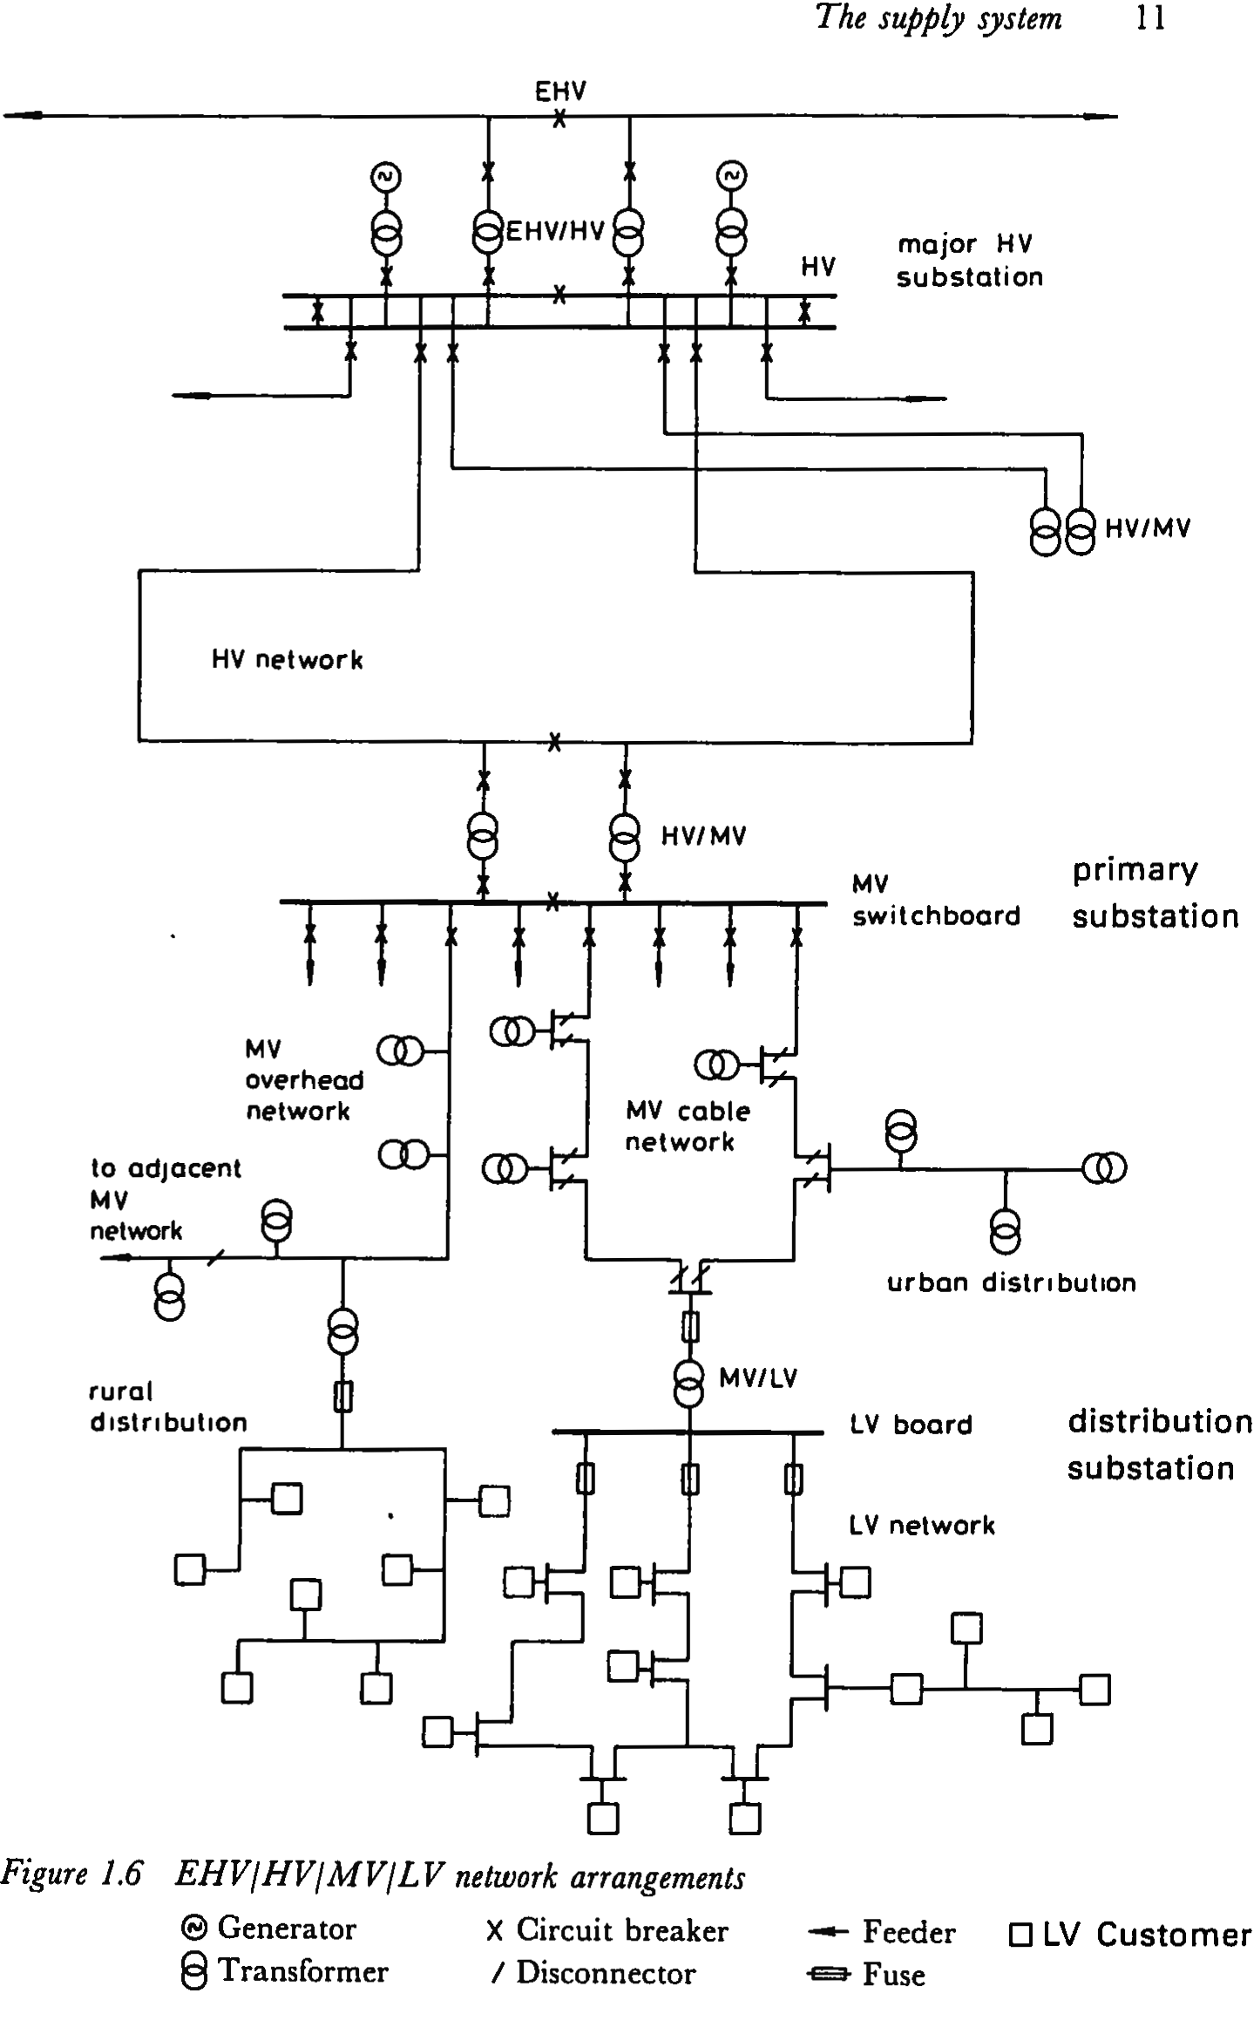
Power Grid Structure
(E)HV
  typically built as meshed grid [3, p.15]
MV
  operated as radial network (open loops) [3, p.17]
  mesh another option but more complex to handle [3, p.176]
  in urban areas, grid follows the road network [3, p.181]
LV
  operated/built as radial network (open loops) [3, p.192], i.e. single in-feed from MV
  length of LV line usually limited to 500m or less [3, p.12]
  main difference urban/rural [3, p.194ff.], e.g. urban grids are inter-connected (proximity)
Interconnections
  short AC/DC/AC lines and in general at EHV [3, p.6]
Notes:
Diverse hierarchical structure
Integration of renewables induces topologz changes and at the same time destabilises the szstem due to fluctuations
AIM:
How is the dynamical stability of a complex system related to the underlying network structure.

Slide 4
Schematic Process
init many small-scale local networks on LV/MV [1, 2]
update a) if network’s capacity becomes a limiting factor, MV lines are extended
update b) HV overlay added, connecting also different local network on lower voltage [3, p.3]
constraint HV/EHV usually fulfill N-1 criterium [3, p.7]
remark 1 Historically, EHV superseded HV in this role, but they still coexist. [3, p.148]
remark 2 LV network growth driven by amount of load
location HV/MV substations close to load centres [3, p.152]
Notes:
Diverse hierarchical structure
Integration of renewables induces topologz changes and at the same time destabilises the szstem due to fluctuations
AIM:
How is the dynamical stability of a complex system related to the underlying network structure.

Slide 5
Modelling Assumptions
Grid Levels:
low LV, i.e. connecting all households in a building block to the next higher level
middle MV+HV, the actual distribution backbone in an area
high EHV, connecting different areas over long distances
Choice of line type?
expected power flow, distance to next substation, type of existing adjacent lines, topography, … ?
Dynamics:
i.e. creation of new nodes driven by load increase?
Local reaction?
Notes:
Diverse hierarchical structure
Integration of renewables induces topologz changes and at the same time destabilises the szstem due to fluctuations
AIM:
How is the dynamical stability of a complex system related to the underlying network structure.

Slide 6
Model

Slide 7
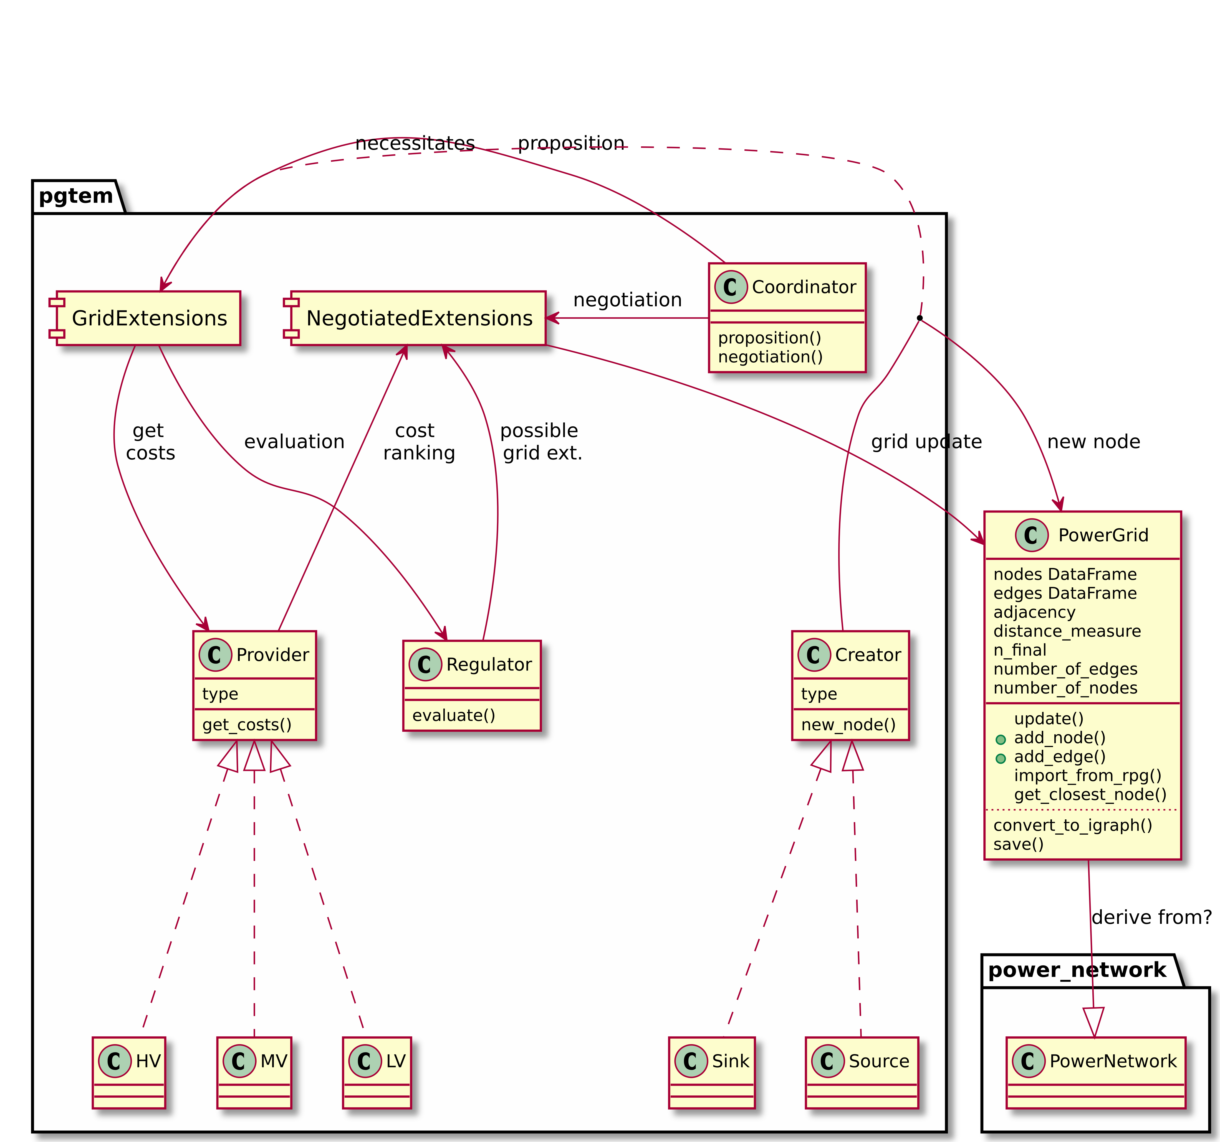
Notes:
Diverse hierarchical structure
Integration of renewables induces topologz changes and at the same time destabilises the szstem due to fluctuations
AIM:
How is the dynamical stability of a complex system related to the underlying network structure.

Slide 8
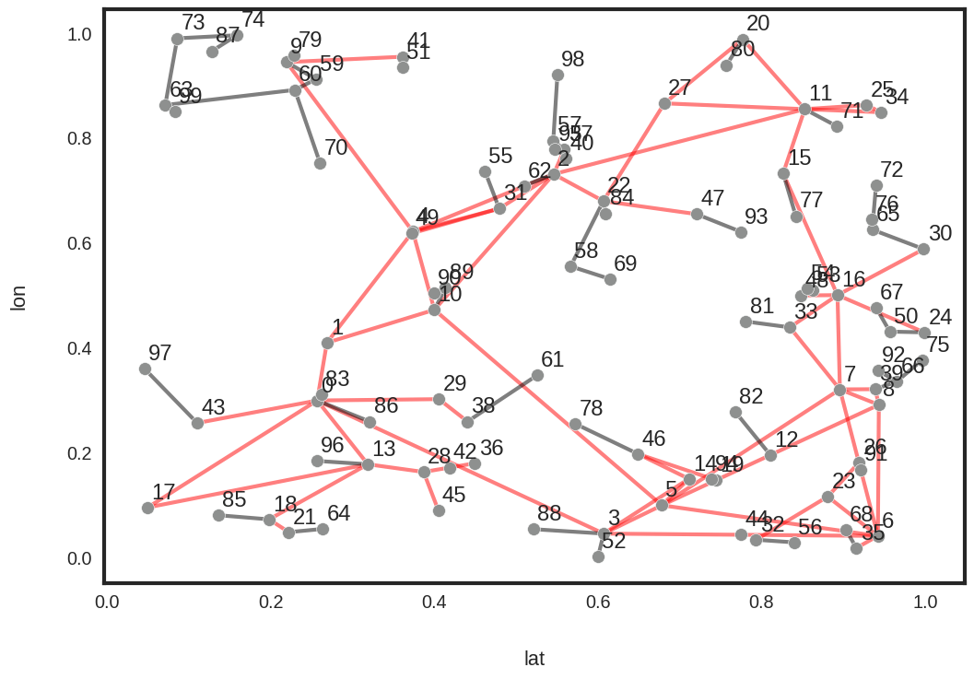
2D Projection
Notes:
Diverse hierarchical structure
Integration of renewables induces topologz changes and at the same time destabilises the szstem due to fluctuations
AIM:
How is the dynamical stability of a complex system related to the underlying network structure.

Slide 9
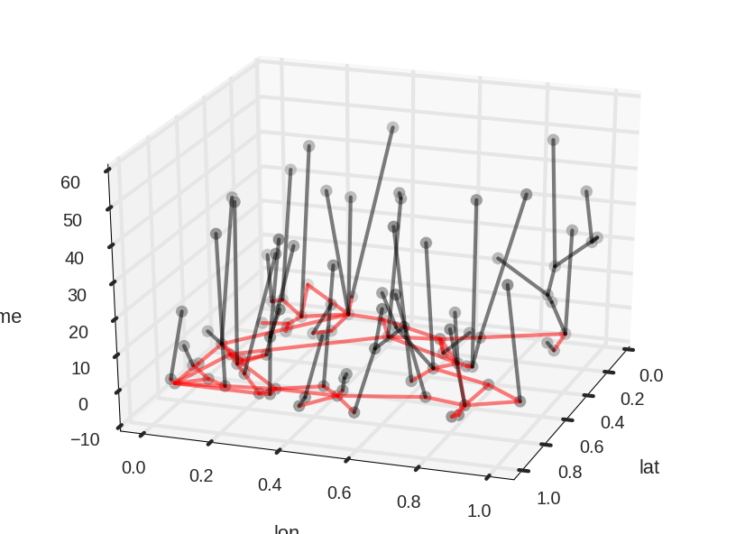
3D Growth in Time
Notes:
Diverse hierarchical structure
Integration of renewables induces topologz changes and at the same time destabilises the szstem due to fluctuations
AIM:
How is the dynamical stability of a complex system related to the underlying network structure.

Slide 10
References
[1] 50Hertz. Beginn der elektrifizierung in deutschland. URL http://www.50hertz.com/de/50Hertz/Historischer-Hintergrund.
[2] BURN. The electricity grid: A history. Online. URL http://burnanenergyjournal.com/the-electricity-grid-a-history/.
[3] Erkki Lakervi and Edward J Holmes. Electricity distribution network design. Number 21 in IEEE Power Series. IET, 2nd edition, 1995.
[4] Rui Liu, Wei-Ping Hu, Hong-liang Wang, and Chi Wu. The Road Network Evolution Analysis of Guangzhou-Foshan Metropolitan Area Based on Kernel Density Estimation. Computational and Information Sciences, International Conference on, 0:316–319, 2010.
[5] Hans F Ravn, Jens M Rygaard, and Berno Wibbels. Power network design. Control and Cybernetics, 25(1), 1996.
[6] Mart ́ı Rosas-Casals. Topological complexity of the electricity transmission network. Implications in the sustainability paradigm. PhD thesis, Universitat Polit`ecnica de Catalunya, 2009.
[7] Mart ́ı Rosas-Casals, Sergi Valverde, and Ricard V. Sol ́e. Topological vulnerability of the European power grid under errors and attacks. International Journal of Bifurcation and Chaos, 17(07):2465–2475, July 2007.
[8] Emanuele Strano, Vincenzo Nicosia, Vito Latora, Sergio Porta, and Marc Barth ́elemy. Elementary processes governing the evolution of road networks. Scientific Reports, 2:1–8, March 2012.
[9] Hai Yang and Michael G. H. Bell. Models and algorithms for road network design: a review and some new developments. Transport Reviews, 18(3):257–278, July 1998.
Notes:
Diverse hierarchical structure
Integration of renewables induces topologz changes and at the same time destabilises the szstem due to fluctuations
AIM:
How is the dynamical stability of a complex system related to the underlying network structure.

