Slide 1
LPJmLmdi
Model-data integration for LPJmL
Overview of the LPJmLmdi R package
Matthias Forkel
Jena, 2015-09-23

Slide 2
Purpose of LPJmL-MDI
Estimation of LPJmL parameters by integrating observations
  Estimating best parameter sets
  Assessing parameter uncertainties, sensitivities and correlations
  Testing different cost functions
Comparison of model results with observations
LPJmL-MDI provides an interface between LPJmL and the GENOUD genetic optimization algorithm

Slide 3
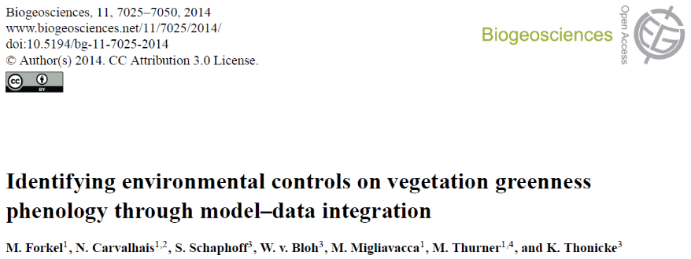
First application of LPJmL-MDI
LPJmL DGVM
Model-data
integration
Opt Data
Temp, Precip, Radiation, CO2
FAPAR
(GIMMS3g)
Parameter
FAPAR
(Geoland2)
Reco
Photo-
synth.
Snow
Genetic Optimization
GPP
(MTE)
Phenology
Albedo
(MODIS)
Cost
Land cover
(FPC)
Fire
Albedo
FAPAR

Slide 4
GENOUD: Genetic optimization using derivatives
Genetic algorithm combined with gradient search
Operators: Cloning, Uniform Mutation, Boundary Mutation, Non-Uniform Crossover, Polytope Crossover, Simple Crossover, Whole Non-Uniform Mutation, Heuristic Crossover, Local-Minimum Crossover: BFGS
important parameters:
  Population size
  Maximum number of generations
  Wait generations
  BFGS burnin
Mebane, W. and J.S. Sekhon (2011): Genetic Optimization Using Derivatives: The rgenoud package for R. - Journal of Statistical Software, 42(11): 1-26.

Slide 5
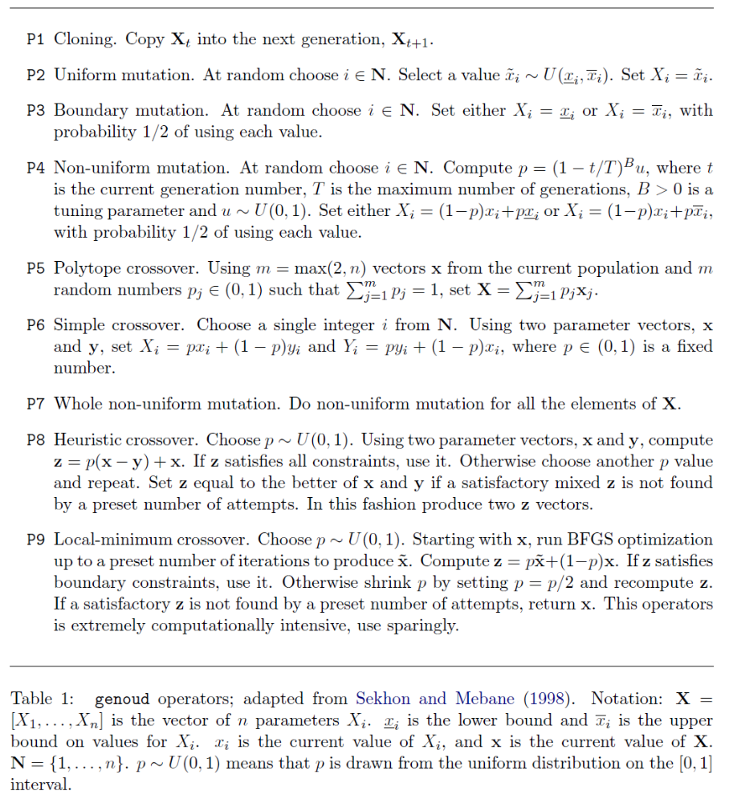
GENOUD: Genetic optimization using derivatives
Operators in GENOUD

Slide 6
How to use LPJmL-MDI?
Install the R package:
  setwd("Z:/R_packages/") # change to your directory
  system("R CMD INSTALL --html LPJmLmdi --resave-data")
  Alternative: source the *.R functions:
  setwd("Z:/R_packages/LPJmLmdi/R/") # change to your directory
  files <- list.files(pattern=".R")
  for (i in 1:length(files)) source(files[i])
See example script: LPJmLmdi/inst/LPJmL-MDI_example.R

Slide 7
Function dependence in LPJmL-MDI
LPJmL input and
configuration files
Integration datasets
*.clm
*.conf
*.par
Define file names
in LPJfiles
*.nc
LPJfiles()
LPJpar()
IntegrationData()
Model-data
comparison plots:
matrix of
grid cells
LPJfiles
LPJpar
plot()
IntegrationData
OptimizeLPJgenoud(…)
RunLPJ
CostMDS
*.bin
ReadLPJ2IntegrationData
Several output files
*.pdf for plots
*.RData for settings
and results
LPJmL outputs
R internal object
R function
File
Input/output
Function dependence

Slide 8
Processing steps in OptimizeLPJgenoud
OptimizeLPJgenoud(…)
(some steps are optional):
(load settings from restart files?)
initial setups: file names, create temporary directories, create LPJ configuration files
spinup model run and prior model run
plot results of prior model run
(setup cluster for parallel computing)
perform genetic optimization: GENOUD
automatically restart GENOUD in case of a crash
(stop cluster)
plot cost vs. iterations
(compute Jacobian and Hessian)
compute parameter uncertainties
plot parameter distributions
posterior model run
plot results of posterior model run
remove temporary directories
plot cost surfaces
compute and plot parameter correlation
plot prior/posterior cost and change in cost
return result as list
_optsetup.RData
_prior.pdf
_prior.RData
_opt.genetic.RData
_jacobian.RData
_hessian.RData
_posterior-best.pdf
_posterior-best.RData
_results.RData

Slide 9
Optimize LPJmL using GENOUD
General steps → example script “LPJmL-MDI_example.R”
Set directories, load packages and functions: library(LPJmL-MDI)
Prepare LPJmL input data
  Select the grid cells or sites for which you want to optimize LPJmL
  Subset input data for these grid cells with ReadLPJinput() and WriteLPJinput()
Define LPJmL directories and templates for parameter files and input files
  Create template files based on the following LPJ files: lpjml.conf, param.conf, par/pft.par, par/param.par, input.conf
  Define the template files in LPJfiles()
Define and read integration data: IntegrationDataset() and IntegrationData()
Define LPJmL prior parameter values and ranges: LPJpar()
Perform optimization: OptimizeLPJgenoud()

Slide 10
Optimize LPJmL using GENOUD
1. Set directories and load packages
Define these basic directories:
path.lpj <- “/mforkel/LPJmL/” LPJmL installation
path.tmp <- “/scratch/tmp/mforkel/” temporary LPJmL results
path.out <- “/mforkel/LPJmL-MDI/” optimization results
Install and load the following R packages:
library(LPJmLmdi)
You need to install the following packages:
library(raster)
library(plyr)
library(rgenoud)

Slide 11
Optimize LPJmL using GENOUD
2. Prepare LPJmL input data
Select the grid cells or sites for which you want to optimize LPJmL
  Optimizing for all grid cells is stupid → redundant/similar information in adjacent grid cells, long computing time
  Select grid cells that are representative for the process of interest
  Define grid cells as matrix of longitude/latitude coordinates:
  grid <- cbind(lon=c(-100.75, 120.25, 130.75), lat=c(40.25, 50.75, 56.25))
Use selected grid cells to subset the LPJmL input/forcing data
  Use LPJmL input data in CLM(2) and RAW (binary) formats – more efficient for many optimization runs, other formats not supported by LPJmL-MDI
  Use whatever you want to subset input data, or use (but can be slow):
  lpjinput <- ReadLPJinput(files.clm, grid)
  WriteLPJinput(lpjinput, files=files.clm.new)
  See slide “Read and write LPJmL input data from CLM and BIN files”

Slide 12
Optimize LPJmL using GENOUD
3. Define LPJmL directories and templates
Create template files based on the LPJ configuration files, i.e. define the following FLAGS in each file (see template files in LPJmL-MDI/inst):
  lpjml_template.conf – LPJ configuration file needs:
    #define OUTPATH CELL_OUTPATH
    #include "CELL_PARCONF_FILE"
    #include "CELL_INPUT_FILE"
    CELL_START
    CELL_END
  param_template.conf – parameter configuration file needs:
    #include "PAR_FILE_CELL"
    #include "PAR_PFT_FILE_CELL"
  input_template.conf – input configuration file needs:
    SOILCODE_FILE, GRID_FILE, DRAINCLASS_FILE, TMP_FILE, PRE_FILE, LWNET_FILE, SWDOWN_FILE, WINDSPEED_FILE, DTR_FILE, BURNTAREA_FILE, WET_FILE …
  par/pft_template.par – PFT parameter file, set flags for all parameters that you want to include in optimization experiments, e.g.:
    ALPHAA_TrBE, LIGHTEXTCOEFF_TrBE, ALPHAA_TrH, …
  par/param_template.par – global parameter file, e.g.:
    ALPHAC3, ALPHAC4

Slide 13
Optimize LPJmL using GENOUD
3. Define LPJmL directories and templates
  Define all LPJmL configuration template files and input with LPJfiles():
  files.clm <- c(
  GRID_FILE = “cells.grid”,
  TMP_FILE = "cru_ts_3.20.1901.2011.tmp.clm",
  PRE_FILE = "cru_ts3.20.1901.2011.pre.dat.clm",
  SWDOWN_FILE = "swdown_erainterim_1901-2011.clm",
  LWNET_FILE = "lwnet_erainterim_1901-2011.clm“,
  WINDSPEED_FILE = "mwindspeed_1860-2100_67420.clm”,
  DTR_FILE = “cru_ts3.20.1901.2011.dtr.dat.clm",
  BURNTAREA_FILE = “GFED_CNFDB_ALFDB_Extrap2.BA.360.720.1901.2012.30days.clm",
  DRAINCLASS_FILE = "drainclass.bin",
  SOILCODE_FILE = "soil_new_67420.bin“,
  WET_FILE = “cru_ts3.20.1901.2011.wet.dat.clm“)
  input.df <- data.frame(name=names(files.clm), file=files.clm)
  lpjfiles <- LPJfiles(path.lpj = path.lpj, path.tmp = path.tmp,
  path.out = path.out, sim.start.year = 1901,
  lpj.conf = paste0(path.lpj, "lpjml_template.conf"),
  param.conf = paste0(path.lpj, "param_template.conf"),
  pft.par = paste0(path.lpj, "par/pft_template.par"),
  param.par = paste0(path.lpj, "par/param_template.par"),
  input.conf = paste0(path.lpj, "input_template.conf"), input=input.df)

Slide 14
Optimize LPJmL using GENOUD
4. Define and read integration data
  Define the properties of a single data set and read the data with IntegrationDataset():
  fapar.gimms <- IntegrationDataset(name="FAPAR", unit="",
  data.val.file = "GIMMS3g.FPAR.720.360.1982.2011.30days.nc",
  data.unc.file = 0.18,
  data.time = seq(as.Date("1982-01-01"), as.Date("2011-12-31"), by="month"),
  model.val.file = "mfapar.bin",
  xy = grid,
  AggFun = NULL,
  data.factor = NULL,
  cost=TRUE,
  CostFunction = SSE,
  weight = 1)
  gpp.mte <- IntegrationDataset(name="GPP", unit="gC m-2 yr-1", data.val.file = "GPP.MA.MSC.1982.2011.GPP_MSC.nc", data.unc.file = “GPP.MA.MSC.1982.2011.GPP_MSC_unc.nc", data.time = seq(as.Date("1982-01-01"), as.Date("2011-12-31"), by="month"), model.val.file = "mgpp.bin", xy = grid, AggFun = AggMSC, data.factor = ndaymonth, cost=TRUE, CostFunction=SSE, weight=1)
NetCDF file with data
Uncertainty: value or NetCDF file
Corresponding model output
Time period
Grid cells for which the optimization is done
Function for temporal aggregation of model results
Factor to be applied to data (e.g. unit conversion)
Use data set in cost function (TRUE) or only for evaluation?
Cost function for this data set, default: SSE
Weight to be applied to data set in computation of total cost

Slide 15
Optimize LPJmL using GENOUD
4. Define and read integration data
  Combine all IntegrationDatasets with IntegrationData()
  integrationdata <- IntegrationData(fapar.gimms, gpp.mte)

Slide 16
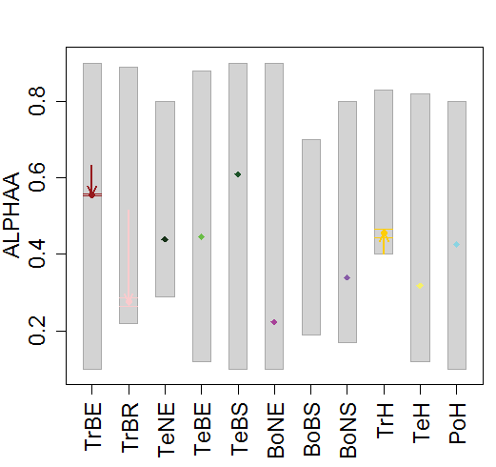
Optimize LPJmL using GENOUD
5. Define LPJmL prior parameter values and ranges
  It is helpful to save all parameter names, prior values and prior ranges in a Excel table or *.csv file, read this file with read.table and then create LPJpar
  Create a LPJpar object:
  lpjpar <- LPJpar(
    par.prior = c(0.5, 0.12, …),
    par.lower = c(0.1, 0.1, …),
    par.upper = c(0.9, 0.18, …),
    par.pftspecif = c(TRUE, TRUE, …),
    par.names = c(“ALPHAA_TrBE”, “ALBEDO_LEAF_TrBE”, …))
  Plot parameters with plot():
  plot(lpjpar, "ALPHAA")
  Write parameters to parameter files or as table:
  WriteLPJpar(lpjpar, “MyParams”)
Prior/initial values
Lower boundaries
Upper boundaries
PFT-specific parameter?
Use the same parameter names as the defined FLAGS in the LPJmL parameter files

Slide 17
Optimize LPJmL using GENOUD
6. Perform optimization: OptimizeLPJgenoud
OptimizeLPJgenoud(xy = grid,
name = “MyOptimization",
lpjpar = lpjpar,
lpjfiles = lpjfiles,
integrationdata = integrationdata,
par.optim = c(“ALPHAA_BoNS” …),
pop.size = 1000,
max.generations = 20,
wait.generations = 15,
BFGSburnin = 3,
restart = 0,
path.rescue = NULL)
matrix of grid cell coordinates (lon, lat) for the optimization
name of the experiment (basic file name for all outputs)
‘LPJpar’ object: prior values and ranges of all parameters
‘LPJfiles’ object: directories, templates for configuration and parameter files, files with input/forcing data
‘IntegrationData’ object: observation data that should be used in optimization, definition of temporal aggregation and cost functions
Which parameters in ‘lpjpar’ should be optimized?
Population size: individual model runs per generation
Maximum number of generations
How many generations should genoud wait before returning an optimum?
The number of generations before BFGS is first used
Restart the optimization? 0 = start at the beginning, 1 = continue with existing genoud optimization, 2 = start after genoud and post-process results.
Directory with ‘rescue’ files to restart the optimization

Slide 18
Read and write LPJmL input data from CLM and BIN files
(some functions require installed LPJmL modules like txt2grid, cru2clm, printclm)
LPJinput
*.clm
ReadLPJinput(files.clm, grid, …)
*.clm
*.clm
*.bin
WriteLPJinput(lpjinput, files.clm, …)
SpatialPixelsDataFrame
ReadCLM(file.clm, …)
ReadBIN(file.bin, …)
WriteCLM(data.sp, file.clm, start, nbands, …)
WriteBIN(data.sp, file.bin, size)
If a matrix of grid cells is provided to ReadLPJinput,
LPJ input data is cropped to the new grid
*.clm
*.bin
InfoCLM(file.clm, …)
ReadGrid(file.grid, …)
*.grid
WriteGrid(grid, file.grid)
matrix
R internal object
R function
File
Input/output
Function dependence

Slide 19
R interfaces to read LPJ output data from BIN files
Single LPJ binary output file:
All binary files of a LPJ run:
*.bin
*.clm
*.clm
*.bin
InfoLPJ(file.bin)
ReadLPJ(file.bin)
ReadLPJ2ts(file.bin, …)
ReadLPJsim(…)
SpatialPointsDataFrame
ts
LPJsim
plot.LPJsim(x)
R internal object
R function
File
Input/output
Function dependence

Slide 20
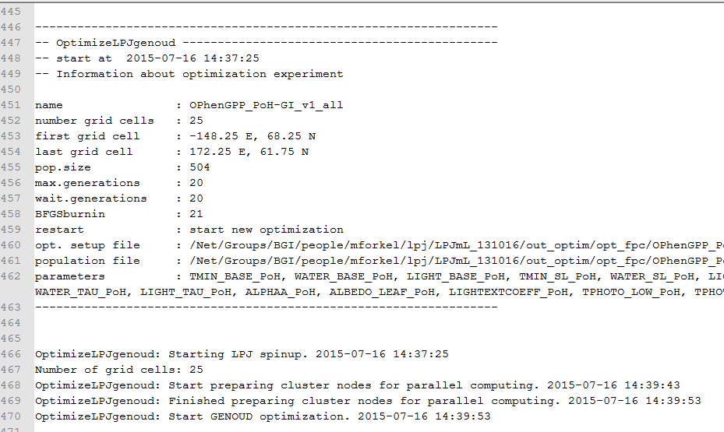
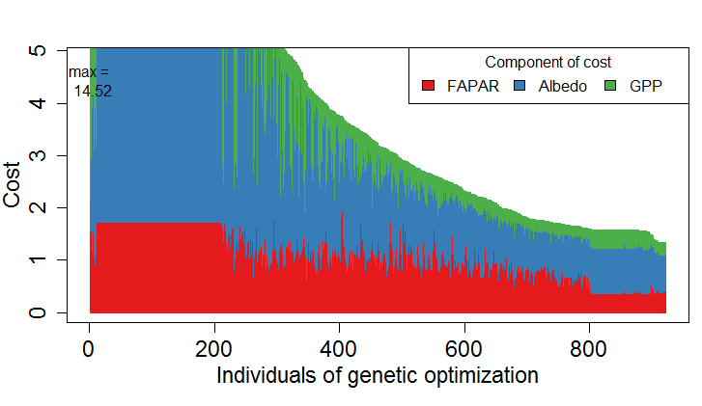
What is the optimization doing?
Make sure you are writing all messages to a log file (depends on you cluster; check llsubmit, bsub, …)
Check the development of the cost
during optimization based on the “rescue” files:
setwd("Z:/lpj/LPJmL/opt_fpc/OPhenGPP_PoH-GI_v1_all_0_24_rescue")
files <- list.files(pattern=".RData")
rescue <- CombineRescueFiles(files, remove=FALSE)
plot(rescue)

Slide 21
Overview of functions in LPJmLmdi (1)
Model-Data Integration
OptimizeLPJgenoud | Perform the genetic optimization
IntegrationData | Define a list of all datasets that should be used in optimization or evaluation
IntegrationDataset | Define a list with the properties of a single dataset
plot.IntegrationData | Plot model-data comparisons
AggFun | Several functions for temporal aggregation of model results to link them with observations
LPJmL Parameters
LPJpar | Define LPJmL parameters (priors, ranges) and includes after optimization also posterior parameter sets and ranges
CheckLPJpar | Check the validity of parameters
plot.LPJpar | Plot prior and posterior parameters and parameter ranges
WriteLPJpar | Write LPJpar to LPJmL parameter files (*.par) and to tables (*.txt)
Cost functions
CostMDS.KGE | Cost function for multiple data sets based on Kling-Gupta efficiency
CostMDS.KGEw | Cost function for multiple data sets based on Kling-Gupta efficiency and weighted with uncertainty of observations
CostMDS.SSE | Cost function based on sum of squared error
SSE | sum of squared error
ObjectiveFunctions | Various model performance metrics
StandardError | Compute standard error of model parameters based on variance-covariance matrix
VarCovMatrix | Compute variance-covariance matrix from Hessian
Setup and run LPJmL
RunLPJ | Make a LPJmL run and return simulation results or cost
LPJfiles | Define a list of all LPJmL configuration files and working directories
ChangeParamFile | Write parameter values into a LPJmL parameter file
ChangeSoilCodeFile | Change the soilcode in a LPJmL soilcode file
GridProperties | Get properties of the used grid cells
FileExistsWait | Check if files are existing and waits if the file does not yet exist

Slide 22
Overview of functions in LPJmL-MDI (2)
Read LPJmL results
ReadLPJsim | Read all LPJmL simulation results into an object of class “LPJsim”
plot.LPJsim | Plot “LPJsim”
ReadLPJ | Read a LPJ binary output file
ReadLPJ2IntegrationData | Read LPJ outputs into “IntegrationData” to do model-data comparisons or to compute costs
Restart of optimization runs - Parameter and cost values are saved in a rescue file after each iteration of the optimization
CombineRescueFiles | Combine several rescue files in a single file
CreateRestartFromRescue | Create restart files from rescue files of previous optimization
plot.rescue | Plot a “rescue” object: Cost per data set against iterations of genetic optimization
PrepareRestartFiles | Create setup files to restart optimization
ReadPRO | Read a *.pro file that contains all iterations of the optimization
Write LPJmL input files
WriteLPJinput | Write all LPJmL input files from a object of class “LPJinput” at once
WriteCLM | Write *.clm input files (version 1)
WriteBIN | Write *.bin input files
WriteGrid | Write *.grid files
Read LPJmL input files
ReadLPJinput | Read all LPJmL input files to an object of class “LPJinput”
InfoCLM | Get header information of *.clm files
ReadCLM | Read *.clm files
ReadBIN | Read *.bin files
ReadGrid | Read *.grid files
More …
DefaultParL | Standard par() settings for nice plots
EstOptimUse | Estimate optimal number of jobs (i.e. individuals) given a number of cluster nodes
PlotWorld110 | Plot a world map
Texture2Soilcode | Convert soil texture to LPJmL soilcode

