Slide 1
B.Tech CS (AI/ML) · V Semester
eBPF-Shield AI
eBPF
AI
Kernel-Level Cloud-Native Runtime Threat
and Container Escape Engine
Project Presentation
Arpit Sharma · Aryan Gupta · Ananya Mishra
Mentor: Sanjana Shaw
GLA University
Notes:
Presenter: Arpit Sharma
Good morning ma’am. We are presenting eBPF-Shield AI, a runtime security project for Docker containers and Kubernetes. I will first explain the problem, our solution and how the complete system works. After that, each team member will explain their own responsibility and implementation plan.

Slide 2
The problem and our project
ARPIT · INTRODUCTION
Traditional agents run inside pods
Our idea
They use CPU and memory from the application environment.
They may miss fast container escapes or privilege changes.
Application logs do not show every kernel-level action.
Watch container activity
at the Linux kernel
eBPF collects important events.
Rules and ML find suspicious behavior.
The dashboard explains each alert.
In simple words
A security camera for containers that also understands unusual behavior.
02
Notes:
Presenter: Arpit Sharma
The main problem is that normal security tools either use too many resources or do not have enough visibility inside the Linux kernel. Our project watches important process, file and network activity using eBPF. It then checks that activity with security rules and machine learning. The user sees a clear alert on the dashboard.

Slide 3
How the system works
ARPIT · WORKFLOW
1
Observe
eBPF records process, file and network events
2
Add context
The collector identifies the pod and container
3
Detect
Rules and ML calculate a threat score
4
Explain
The dashboard shows the event and evidence
5
Respond
An authorized user can isolate the pod
03
Notes:
Presenter: Arpit Sharma
The system follows five steps. First, eBPF observes an event. Second, the collector adds Kubernetes details. Third, our rules and ML models check whether the event is suspicious. Fourth, the dashboard shows the reason. Finally, an authorized user can approve a response. We do not allow uncontrolled destructive actions.

Slide 4
System architecture
ARPIT · DESIGN
Dashboard
Next.js · live alerts · investigation
↓
Backend
FastAPI · WebSockets · response API
↓
Detection
Security rules · Isolation Forest · Autoencoder
↓
Data
PostgreSQL · events · alerts · audit log
↓
Runtime
eBPF sensors · Linux nodes · Kubernetes
04
Notes:
Presenter: Arpit Sharma
The sensor layer runs on Linux nodes and collects events. PostgreSQL stores the required information. The detection layer checks events using rules and ML models. FastAPI provides the backend services and WebSockets send live updates. The Next.js dashboard is the part the user interacts with.

Slide 5
Arpit Sharma
TEAM LEAD · ML & SECURITY
My responsibility
Implementation
Finalize project scope and system design.
Prepare features for normal and suspicious behavior.
Build the Isolation Forest model first.
Add an Autoencoder if the baseline works well.
Combine rule and model scores into one threat score.
Review security, integration and final results.
Training
Normal container events
Features
Process rarity, parent-child pattern,
network destination, sensitive file access
Output
Threat score and detection reason
Testing
Precision, recall and false alerts
05
Notes:
Presenter: Arpit Sharma
My main work is project leadership, machine learning and security design. I will prepare the features, train the Isolation Forest model and compare it with an Autoencoder. I will also combine ML results with security rules, calculate the final threat score and evaluate accuracy, false alerts and detection time.

Slide 6
Aryan Gupta
eBPF & BACKEND
My responsibility
Implementation path
Write eBPF programs for selected kernel events.
Collect process execution, file access and network connections.
Connect events with the correct pod and container.
Create FastAPI endpoints for events and alerts.
Store data in PostgreSQL.
Send live alerts through WebSockets.
1.
Linux kernel event
2.
eBPF ring buffer
3.
Node collector
4.
FastAPI service
5.
PostgreSQL and WebSocket
06
Notes:
Presenter: Aryan Gupta
My work starts at the Linux kernel. I will write eBPF programs to collect selected events and send them through a ring buffer to the node collector. The collector will add pod and container details. I will create the FastAPI endpoints, store the events in PostgreSQL and send live alerts to the frontend using WebSockets.

Slide 7
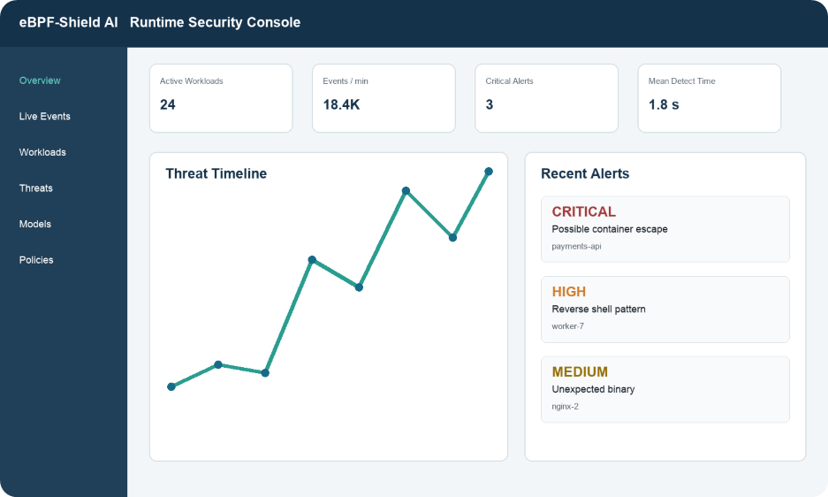
Ananya Mishra
FRONTEND · TESTING · DOCUMENTATION
Build the Next.js dashboard.
Show live events and alert severity.
Create alert details with process chain and evidence.
Add workload filters and response confirmation.
Test the main user flow and accessibility.
Prepare documentation and final demo steps.
Dashboard output
Live workload status, threat timeline and recent alerts
07
Notes:
Presenter: Ananya Mishra
My responsibility is the frontend, testing and documentation. I will build the Next.js dashboard and connect it with the backend WebSocket stream. The alert page will show severity, affected workload, process chain and evidence. I will test the complete user flow and prepare the documentation needed for the final demonstration.

Slide 8
Implementation and demonstration
TEAM
Eight-week plan
1–2
Research, architecture and lab setup
Demo scenario
Nginx unexpectedly starts /bin/sh
3–4
eBPF collection, backend and database
The shell opens an external connection.
eBPF captures both events.
The models assign a high threat score.
The dashboard shows the process chain.
The user approves pod isolation.
5–6
ML detection, dashboard and integration
7–8
Testing, security review and final demo
08
Notes:
Presenter: Arpit, Aryan and Ananya
We will complete the project in four phases. In the demo, we will run a safe test where a web-server container starts a shell and opens an unusual connection. The system will capture the event, identify the pod, calculate the threat score, show the evidence and ask the user before isolation.

Slide 9
Why we chose this project
TEAM
Why this topic matters
What success looks like
Companies increasingly run applications in containers.
Container attacks can affect the host and other workloads.
eBPF gives deep visibility with low overhead.
The topic combines security, cloud computing and AI.
The project has a clear practical demonstration.
Selected attacks produce clear alerts.
Important events appear within about three seconds.
Each alert shows useful evidence.
The sensor uses limited CPU and memory.
The team can reproduce the demo reliably.
This project lets each member apply a different skill while building one connected system.
09
Notes:
Presenter: Team
We chose this project because container security is a practical problem and eBPF is a modern Linux technology. The project also matches our AI and ML course because anomaly detection has a clear role. It gives all three members meaningful work in security, backend, machine learning, frontend and testing.

Slide 10
eBPF-Shield AI
Kernel visibility. Clear detection. Controlled response.
Arpit Sharma
Aryan Gupta
Ananya Mishra
Project lead · ML · security
eBPF · backend · database
Frontend · testing · documentation
Thank you
Questions?
Notes:
Presenter: Arpit Sharma
To summarize, eBPF-Shield AI monitors container activity at the kernel level, detects suspicious behavior using rules and machine learning, and presents understandable evidence on a web dashboard. Thank you. We are ready for your questions.

