Slide 1


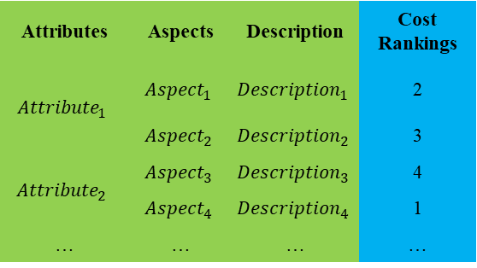
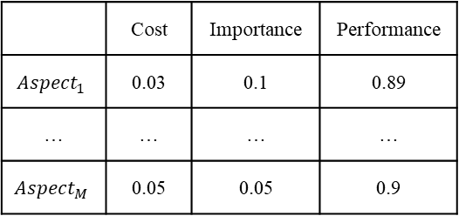
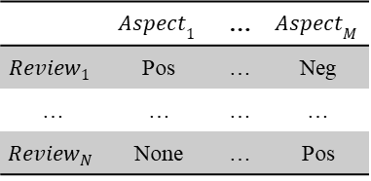
LLMs
Preproce-ssing
ABSA
 | $${Aspect}_{1}$$ | … | $${Aspect}_{M}$$
$${Review}_{1}$$ | Pos | … | Neg
… | … | … | …
$${Review}_{N}$$ | None | … | Pos
Calculation performance and importance
Online reviews
 | Cost | Importance | Performance
$${Aspect}_{1}$$ | 0.03 | 0.1 | 0.89
… | … | … | …
$${Aspect}_{M}$$ | 0.05 | 0.05 | 0.9
Attributes | Aspects | Description | Cost Rankings
$${Attribute}_{1}$$ | $${Aspect}_{1}$$ | $${Description}_{1}$$ | 2
 | $${Aspect}_{2}$$ | $${Description}_{2}$$ | 3
$${Attribute}_{2}$$ | $${Aspect}_{3}$$ | $${Description}_{3}$$ | 4
 | $${Aspect}_{4}$$ | $${Description}_{4}$$ | 1
… | … | … | …
Calculation cost
Prompt for Preprocessing
Prompt for ABSA
Prompt engineering
Discussion

Slide 2
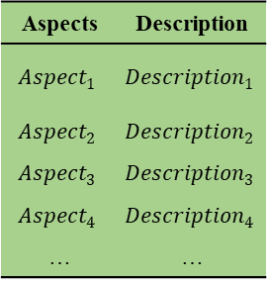
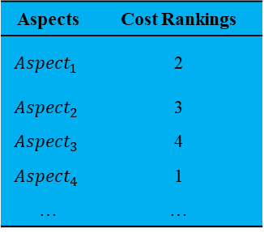
Prompt engineering
Discussion
Aspects | Description
$${Aspect}_{1}$$ | $${Description}_{1}$$
$${Aspect}_{2}$$ | $${Description}_{2}$$
$${Aspect}_{3}$$ | $${Description}_{3}$$
$${Aspect}_{4}$$ | $${Description}_{4}$$
… | …
Aspects | Cost Rankings
$${Aspect}_{1}$$ | 2
$${Aspect}_{2}$$ | 3
$${Aspect}_{3}$$ | 4
$${Aspect}_{4}$$ | 1
… | …
Prompt for Preprocessing
Prompt for ABSA

Slide 3
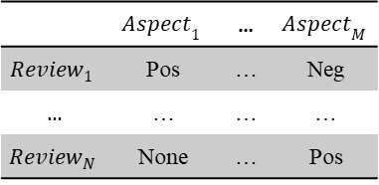
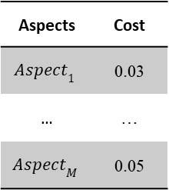
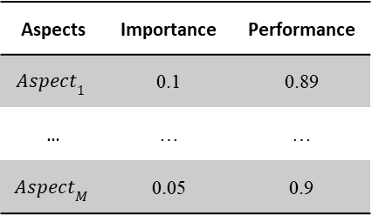
Online reviews
Aspect cost rankings
LLMs
Importance
Importance
 | $${Aspect}_{1}$$ | … | $${Aspect}_{M}$$
$${Review}_{1}$$ | Pos | … | Neg
… | … | … | …
$${Review}_{N}$$ | None | … | Pos
Performance
Performance
Aspects | Importance | Performance
$${Aspect}_{1}$$ | 0.1 | 0.89
… | … | …
$${Aspect}_{M}$$ | 0.05 | 0.9
Aspects | Cost
$${Aspect}_{1}$$ | 0.03
… | …
$${Aspect}_{M}$$ | 0.05
Aspects and their descriptions
Prompt for Preprocessing
Prompt for ABSA

Slide 4
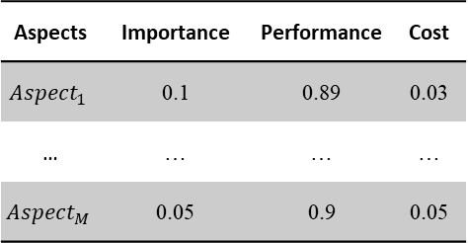
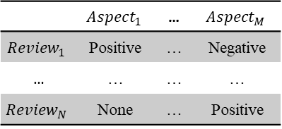
Online reviews
LLMs
Prompt engineering
Aspects and their descriptions
Ⅱ
Ⅰ
 | $${Aspect}_{1}$$ | … | $${Aspect}_{M}$$
$${Review}_{1}$$ | Positive | … | Negative
… | … | … | …
$${Review}_{N}$$ | None | … | Positive
Importance
Importance
Ⅵ
Ⅴ
Ⅲ
Ⅳ
Discussion
Ⅶ
Ⅷ
Performance
Performance
(a) High cost
(b) Low cost
Aspects | Importance | Performance | Cost
$${Aspect}_{1}$$ | 0.1 | 0.89 | 0.03
… | … | … | …
$${Aspect}_{M}$$ | 0.05 | 0.9 | 0.05
Aspect cost rankings

Slide 5
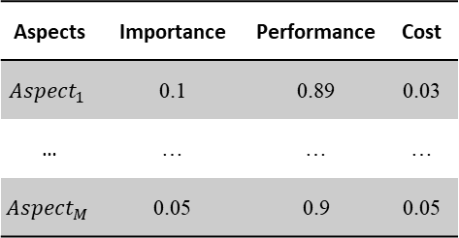
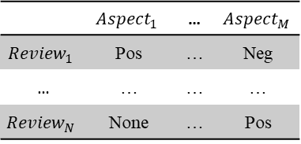
Online reviews
LLMs
Prompt engineering
 | $${Aspect}_{1}$$ | … | $${Aspect}_{M}$$
$${Review}_{1}$$ | Pos | … | Neg
… | … | … | …
$${Review}_{N}$$ | None | … | Pos
Discussion
Importance
Importance
Aspects | Importance | Performance | Cost
$${Aspect}_{1}$$ | 0.1 | 0.89 | 0.03
… | … | … | …
$${Aspect}_{M}$$ | 0.05 | 0.9 | 0.05
Performance
Performance
(a) High cost
(b) Low cost

Slide 6
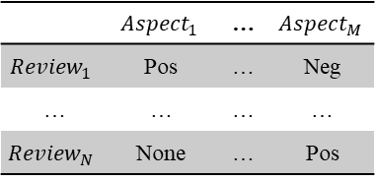
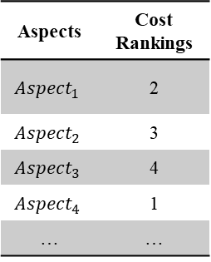
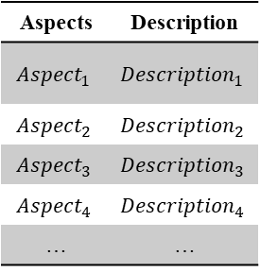
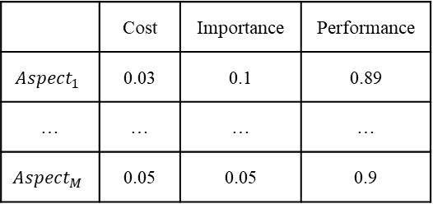
Aspects | Cost Rankings
$${Aspect}_{1}$$ | 2
$${Aspect}_{2}$$ | 3
$${Aspect}_{3}$$ | 4
$${Aspect}_{4}$$ | 1
… | …
Calculation cost
Calculation performance and importance
Discussion
Aspects | Description
$${Aspect}_{1}$$ | $${Description}_{1}$$
$${Aspect}_{2}$$ | $${Description}_{2}$$
$${Aspect}_{3}$$ | $${Description}_{3}$$
$${Aspect}_{4}$$ | $${Description}_{4}$$
… | …
LLMs
 | Cost | Importance | Performance
$${Aspect}_{1}$$ | 0.03 | 0.1 | 0.89
… | … | … | …
$${Aspect}_{M}$$ | 0.05 | 0.05 | 0.9
 | $${Aspect}_{1}$$ | … | $${Aspect}_{M}$$
$${Review}_{1}$$ | Pos | … | Neg
… | … | … | …
$${Review}_{N}$$ | None | … | Pos
Online reviews
Prompt for Preprocessing
Prompt for ABSA
Prompt engineering

Slide 7





$$i∈[1,N]$$
$$j∈[1,M]$$
Template
$${Review}_{i}$$
0, if not involved
LLM
1, if positive
$${Aspect}_{j}$$
Prompt
-1, if negative
$${Description}_{j}$$

Slide 8
LLM
Initial prompt
Manual evaluation
Best prompt
Alternative prompt

