Slide 1
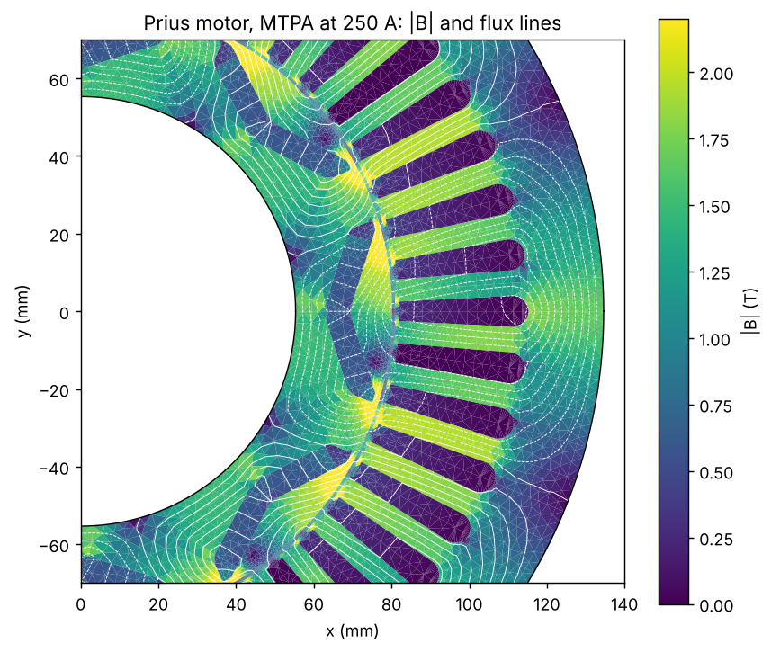
2004 Toyota Prius traction motor
Verified FEA to drive, thermal, robustness and design
Interior-PM, 48 slots, 8 poles, V magnets
Open-source chain in PINNeAPPle
Every number from the committed results of examples 10 to 17

Slide 2
Executive summary
Done: 2-D nonlinear FEA of the Prius motor, checked against closed forms, a second FEA code (GetDP) and a published torque curve; drive, end effects, thermal, demagnetisation, skew, tolerances, design.
Torque at 250 A (R1, MTPA): 345.6 N m. Peak of the angle sweep 345.6 vs published 353 N m (-2.1 %); second code within 1.1 N m.
WLTC 3b, illustrative car: 102.1 Wh/km battery-side (motor losses only).
End effects: torque -2.6 % (magnet end leakage), high-speed envelope -11 % at 3000 rpm (end windings).
Two-step skew: ripple 22.9 -> 8.8 % for -2.0 % torque. FEA + GP + NSGA-II: 91-93 % fewer FEA calls at equal quality.
Not verified: no measurement of this motor; cogging uncertain to ~25 % (two codes); thermal data illustrative; magnet grade unknown.
Test-bench data that would close the gaps: torque vs current angle and back-EMF; cogging; winding and magnet temperatures over a cycle; standstill inductances; loss map.
Limits: a model study from public data (pyleecan geometry, M400-50A steel).

Slide 3
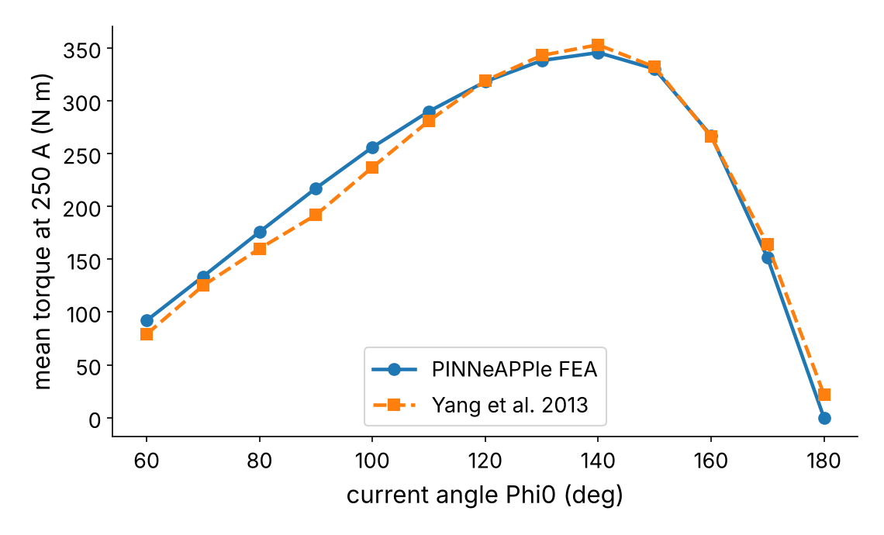
2-D FEA, verified
Torque vs current angle at 250 A against Yang et al. 2013: rms difference 13.3 N m.
Closed-form verification cases: 6 of 6 pass.
Reference values (R)
Mesh: 960 gap nodes, 29936 elements; magnets 20 degC
R1 torque at 250 A, MTPA (50.3 deg), 12 rotor angles: 345.6 N m
R2 cogging pk-pk, 24 angles per slot pitch: 1.38 N m
R3 back-EMF fundamental, 1000 rpm: 87.6 V peak, THD 9.3 %
R4 L_d / L_q at R1: 1.386 / 2.435 mH
Other slides give their mesh or definition where it differs.
Limits: 2-D; P1 elements; the published model and the pyleecan geometry differ (centre post, steel data).

Slide 4
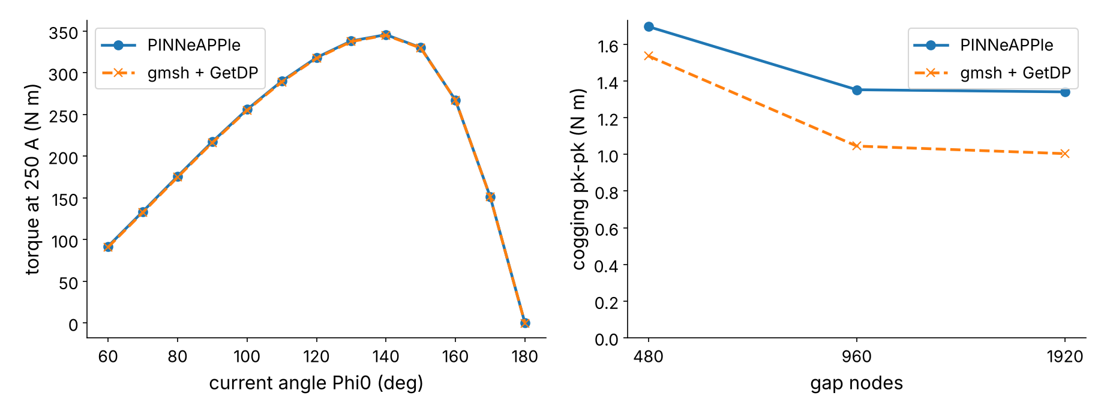
Second code: gmsh + GetDP
Torque vs angle: within 1.09 N m (960 nodes, as R1); EMF 87.60 vs 87.64 V (R3).
Cogging, 12 angles per slot pitch: 1.34 vs 1.00 N m at 1920 nodes; linear iron agrees (1.22 vs 1.21): the gap is in the saturated bridges.
Limits: cogging uncertain by ~25 % between the codes; FEMM, pyleecan, Elmer not run.

Slide 5
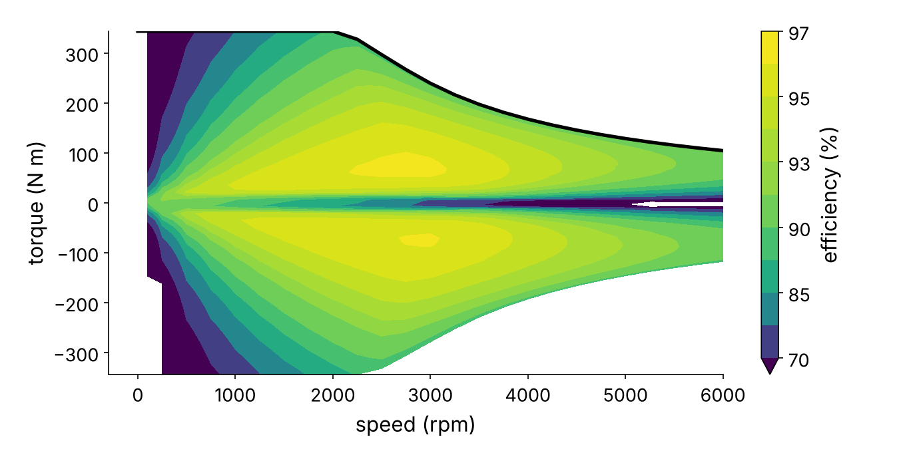
Drive: MTPA, flux weakening, efficiency
250 A, 500 V DC (SVPWM), FEA flux map (480 gap nodes, interpolated): 343.6 N m at low speed, 77.7 kW peak.
Peak efficiency 96.2 % at 2750 rpm; WLTC 3b 102.1 Wh/km (illustrative car).
Limits: steady state; no inverter, mechanical or battery losses; the car is not a Prius.

Slide 6
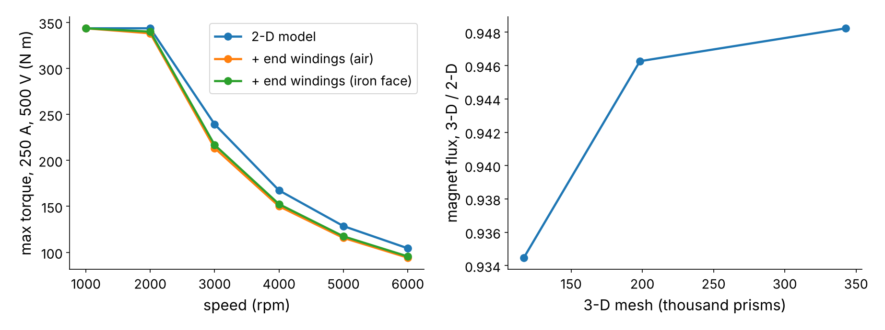
End effects
End windings: L_end 135 uH (air) / 115 uH (iron face); envelope at 3000 rpm 239.3 -> 213.3 N m.
Magnet end leakage (3-D GetDP, 3 meshes): flux x0.948; R1 345.7 -> 336.7 N m, R3 87.6 -> 82.9 V.
Limits: corrections, not a coupled 3-D solution at load; no measured end-winding inductance.

Slide 7
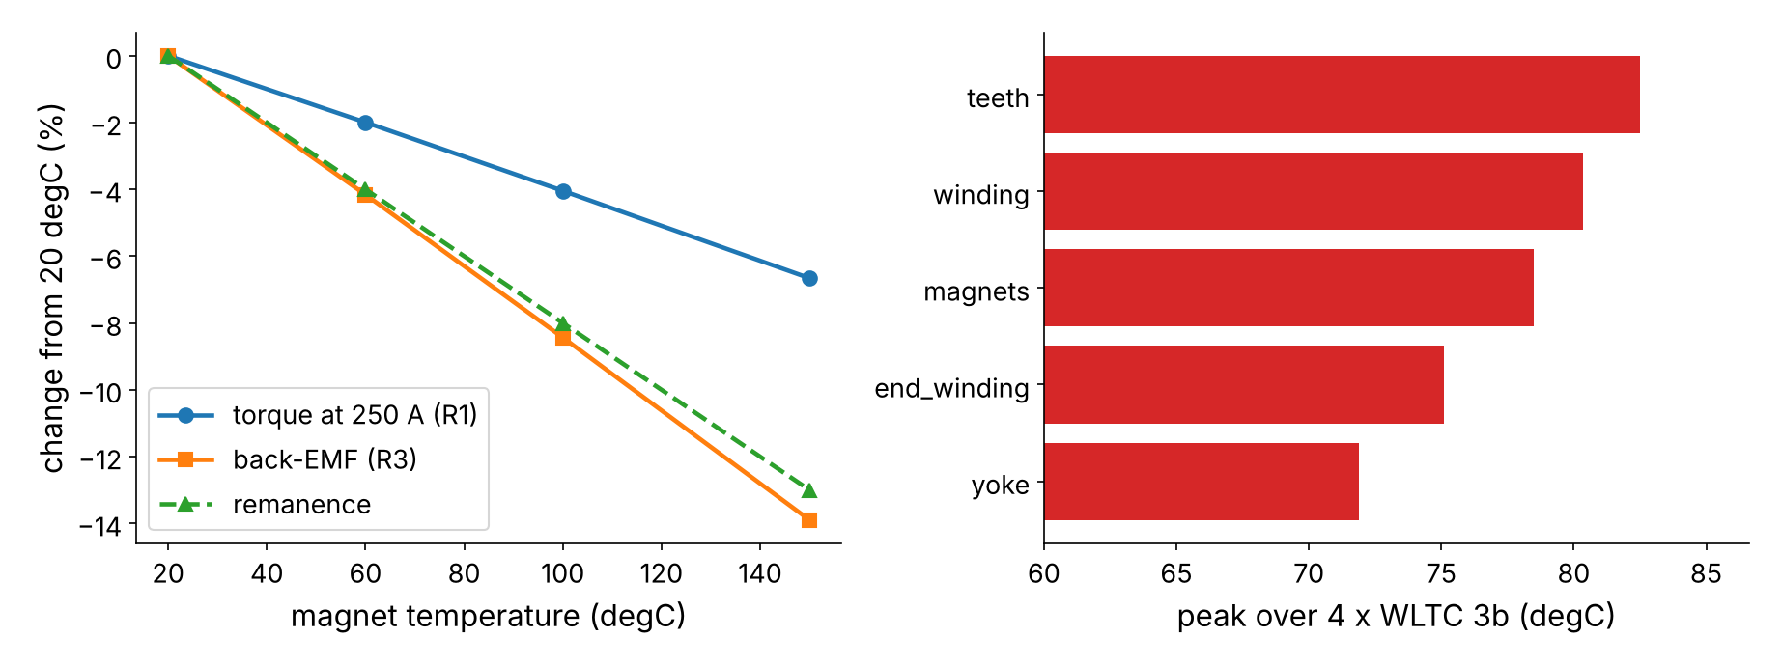
Magnet temperature and thermal network
Magnets 20 -> 150 degC: R1 345.6 -> 322.6 N m, R3 87.6 -> 75.4 V.
Peak load (343 N m, 1500 rpm) after 4 cycles: winding at 180 degC in 237 s; magnets settle at 127 degC.
Limits: seven-node network, illustrative thermal data (not fitted to a Prius).

Slide 8
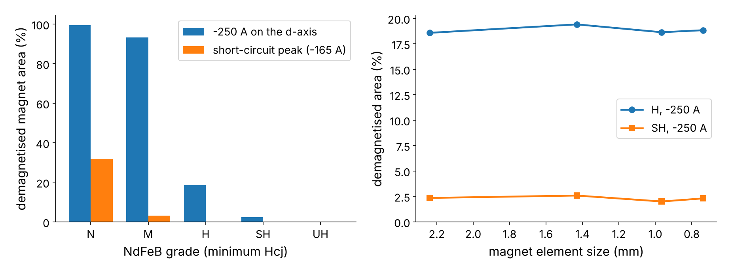
Demagnetisation at the hottest magnet temperature
Magnets at 127 degC, reverse field per element against Hcj(T) of each grade letter.
Grade H loses 19 % of the magnet area at -250 A, SH 2.4 %; area fractions are mesh-converged.
Limits: Hcj coefficient assumed (-0.55 %/K); static knee test; the Prius grade was not found in public sources: the bars compare candidate grades.

Slide 9
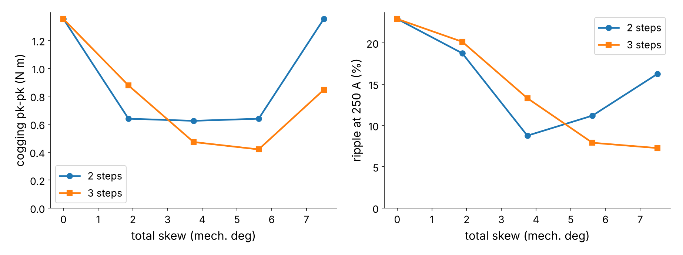
Step skew
Two steps over 3.75 deg: cogging 1.35 -> 0.62 N m (12 angles per slot pitch; R2 uses 24), ripple 22.9 -> 8.8 %, R1 345.6 -> 338.8 N m.
Back-EMF fundamental x0.9659 = closed-form skew factor 0.9659.
Limits: multi-slice: no inter-segment axial flux, no end effects.

Slide 10
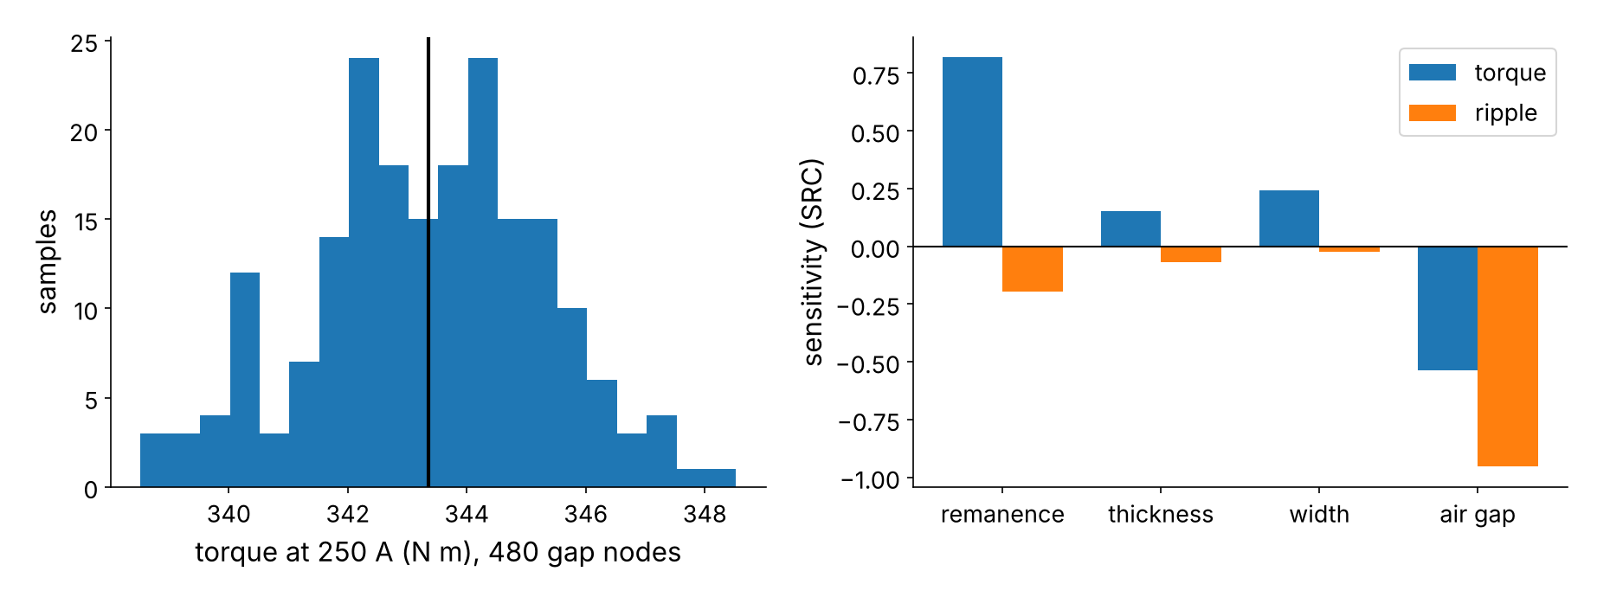
Manufacturing tolerances
200 Monte-Carlo FEA samples (480 gap nodes; nominal 343.4 N m on that mesh, R1 at 960 nodes): torque sigma 1.96 N m (0.57 %).
Remanence drives the torque spread, the air gap the ripple spread.
Limits: the tolerance sigmas are assumptions, not measured spreads.

Slide 11
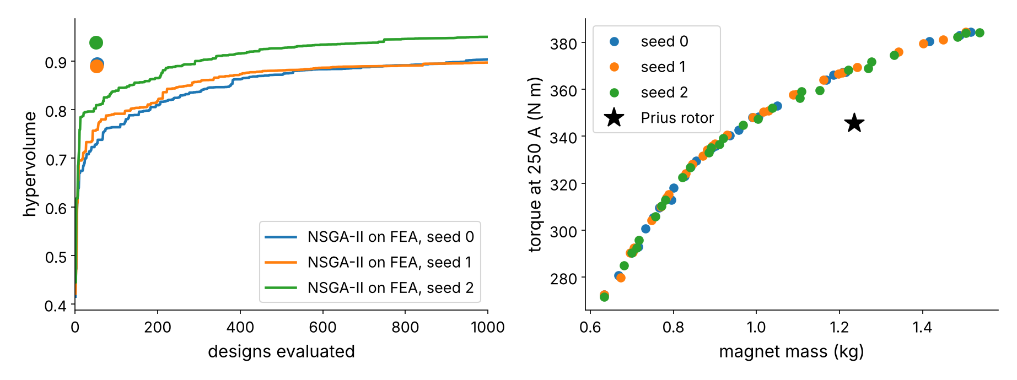
Rotor design: FEA + Gaussian process + NSGA-II
Equal quality: 51-53 FEA calls (hybrid, dots) vs 601-711 (NSGA-II on the FEA): 91-93 % fewer.
Front designs beating the Prius rotor sit at the 1.0 mm bridge bound (Prius 1.5 mm); 288 gap nodes.
Limits: no bridge stress, demagnetisation or speed constraints: the method and its saving, not a better rotor.

Slide 12
What is verified, what is not, what would close it
Verified: closed forms (FEM, filament inductance, thermal network, skew factor, drive optimiser); a second FEA code (torque, EMF, inductances); a published torque curve.
Not verified: any measurement of this motor; cogging to better than ~25 %; thermal parameters; magnet grade; FEMM, pyleecan and Elmer runs (input files are written).
Test bench: locked-rotor torque vs current angle; no-load back-EMF and cogging; thermocouples in winding and end winding over a WLTC; standstill L_d, L_q; loss map.
Exchange: pyleecan in/out, FEMM Lua, Elmer, gmsh/GetDP, MATLAB, DXF, VTK, CSV/Parquet/HDF5 contracts.
Limits: see the Limits section of docs/guides/electromagnetics.md.

