Slide 1


SafeGuard: Congestion and Memory-aware Failure Recovery in SD-WAN
Meysam Shojaee*, Miguel Neves‡ and Israat Haque*
*Dalhousie University
‡ UFRGS University
1

Slide 2
Outline
SD-WANs and network failure
1
Failure recovery challenges
2
SafeGuard’s model and architecture
3
Results analysis
4
Conclusion
5
2

Slide 3
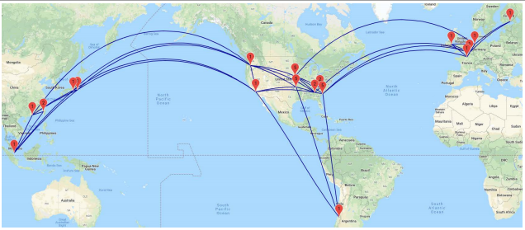

SDN deployment examples
B4: Google’s private SD-WAN [2]
Large service providers such as Amazon, Facebook, Google, and Microsoft are deploying SDN in their WAN [1]. University, Halifax, Canada
Institute of Informatics, UFRGS, Brazil
Network failures are common in wide area networks [3].
80% of the network component failures last from 10 to 100 minutes which leads to intensive packet loss [4].
3
Notes:
B4 connects 33 Google’s data centers across the globe as of January 2018
Network failures severely degrades application performance

Slide 4





Why failure recovery is challenging is SD-WAN?
This route is prone to congestion
$$S_{1}$$
Providing short backup routes
conflicts with
making a balanced link utilization
x
$$S_{3}$$
$$S_{4}$$
$$S_{5}$$
Shortest route failed
Bandwidth capacity of links are limited
The memory of the switches are limited
The route and traffic rate need to be configured in small Traffic Engineering (TE) cycles
TCAMs are well-known to be power-hungry and to have limited capacity [5]
4
Notes:
The forwarding rules in a SDN switch are commonly stored in Ternary Content Addressable Memory(TCAM), a specialized type of high-speed memory

Slide 5

Problem formulation
We formulated the failure recovery problem as a multi-objective MILP optimization problem
Objectives
Minimizing the maximum link utilization
Minimizing the backup route length
Objective function:
1
2
Term 1: The length of the backup route
Term 2: The load on each link
5

Slide 6



Constraints of the designed model
We have considered a number of constrains in our model:
1. Link bandwidth capacity
2. Switch memory capacity
3. Flow satisfaction
It takes more than one hour to solve the model in CPLEX
The model is an MILP problem which is known to be NP-hard
We developed a heuristic to solve it in a reasonable time
6
Notes:
For a topology like Cogent [7], it takes us more than an hour to solve this model on CPLEX

Slide 7


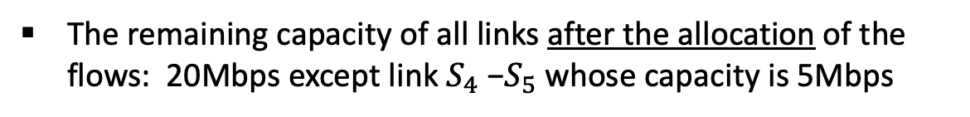





Operation of the heuristic
Key ideas of the heuristic:
Assigns the larger flows to the shorter routes first
When get to the memory usage threshold: best-fit strategy is applied
Both flows are affected by the failure
$f_{1}$ from switch $S_{1}$ to $S_{5}$ has a demand of 25Mbps
15 Mbps
$$S_{1}$$
$$S_{3}$$
X
$$S_{5}$$
$f_{2}$ from switch $S_{2}$ to $S_{5}$ requires 20Mbps
10Mbps
10Mbps
The remaining capacity of all links after the allocation of the flows: 20Mbps except link $S_{4}$ −$S_{5}$ whose capacity is 5Mbps
$$S_{2}$$
$$S_{4}$$
$$S_{6}$$
10Mbps
7
Notes:
we start looking for a “best-fit” demand for it, i.e., demands that can be fully satisfied to ensure that smaller flows have access to shorter routes too

Slide 8




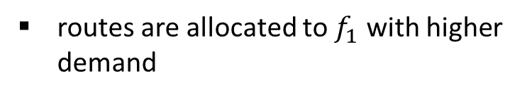









Operation of the heuristic
10Mbps
$$S_{1}$$
$$S_{3}$$
X
$$S_{5}$$
routes are allocated to $f_{1}$ with higher demand
15 Mbps
$$S_{2}$$
$$S_{4}$$
$$S_{6}$$
$$S_{1}$$
$$S_{3}$$
X
$$S_{5}$$
10Mbps
routes are allocated to $f_{2}$ after $f_{1}$
$$S_{2}$$
$$S_{4}$$
$$S_{6}$$
10Mbps
8
Notes:
For a topology like Cogent [7], it takes us more than an hour to solve this model on CPLEX

Slide 9
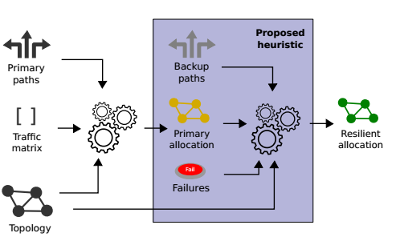
SafeGuard’s architecture
Input: a traffic matrix, the network topology, and a set of forwarding routes (primary routes)
Produces a primary allocation that will be used for forwarding traffic under normal conditions
SafeGuard then applies the heuristic to augment the primary allocation with backup routes for all flows for each possible single link failure.
9
Notes:
For a topology like Cogent [7], it takes us more than an hour to solve this model on CPLEX
SafeGuard uses the OpenFlow protocol to configure switches for the primary and backup routes and traffic rates.

Slide 10
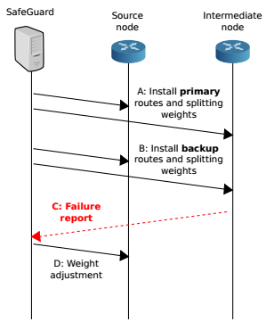
SafeGuard’s work-flow
Step A: SafeGuard computes and installs all primary tunnels and splitting weights for every flow
Step B: proactively installs backup routes and computes the weights for allocated flows
Step C: When a failure happens:
the failing switch activates the corresponding backup tunnels
sends a message reporting the failure to the network controller
Step D: the network controller adjusts splitting weights for all affected flows at their respective ingress switches.
10
Notes:
For a topology like Cogent [7], it takes us more than an hour to solve this model on CPLEX

Slide 11

Evaluation setup
Implementation:
We implemented a prototype of SafeGuard using the Ryu SDN controller
Each node is implemented as a CpqD switch instance
Link capacities are set to 1 Gbps
https://github.com/Meysam-Sh/SafeGuard
Network topologies:
We considered two networks: B4 with 12 nodes and ATT with 25 nodes
Data generation:
We used Iperf tool to generate UDP traffic
We randomly failed a link in the network
11
Notes:
We benchmark SafeGuard against Sentinel, state-of-the-art failure recovery scheme for SD-WANs Averages of 30 simulation results with 95% confidence interval.

Slide 12
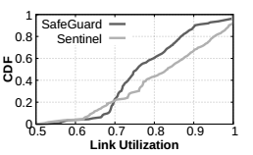
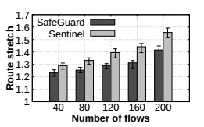
Results
48%
SafeGuard: 48% of the links are under 80%+ load
57%
Sentinel: 57% of links are under 80% + load
SafeGuard results in backup routes around 10% shorter than Sentinel
12
Notes:
Link utilization: the bandwidth usage percentage over the links / The number of flows is fixed at 60 for B4 and 200 for ATT
(around 40%)

Slide 13
Conclusion
SDN is widespread in the production networks. The link failures are a common occurrence in SD-WANs.
We formulated the failure recovery problem as a multi-objective MILP optimization problem.
We designed and developed a heuristic as the problem was NP-hard.
We implemented a prototype of SafeGuard using the Ryu SDN controller and evaluated it in Mininet.
Our results show that SafeGuard can reduce the number of congested links by up to 50% compared to the state-of-the-art failure recovery scheme.
13
Notes:
SafeGuard requires fewer flow rules:

Slide 14

Any Question?
14
Notes:
SafeGuard requires fewer flow rules:

Slide 15
References:
[1] “Software-defined networking: The new norm for networks,” Open Netw. Found., Palo Alto, CA, USA, ONF White Paper, 2012.
[2] Feamster, N., Rexford, J., & Zegura, E. (2014). The road to SDN: an intellectual history of programmable networks. ACM SIGCOMM Computer Communication Review, 44(2), 87-98.
[3] A. Markopoulou, G. Iannaccone, S. Bhattacharyya, C.-N. Chuah, and C. Diot, “Characterization of failures in an IP backbone,” in IEEE International Conference on Computer Communications (INFOCOM). IEEE, 2004
[4] R. Govindan, I. Minei, M. Kallahalla, B. Koley, and A. Vahdat, “Evolve or Die: High-availability design principles drawn from googles network infrastructure,” in Proceedings of the 2016 ACM SIGCOMM Conference, ser. SIGCOMM ’16, 2016, pp. 58–72
[5] Mohan, P. M., Truong-Huu, T., & Gurusamy, M. (2015, December). TCAM-aware local rerouting for fast and efficient failure recovery in software defined networks. In 2015 IEEE Global Communications Conference (GLOBECOM) (pp. 1-6). IEEE.
[6] Li, J., Hyun, J., Yoo, J. H., Baik, S., & Hong, J. W. K. (2014, May). Scalable failover method for data center networks using OpenFlow. In 2014 IEEE Network Operations and Management Symposium (NOMS) (pp. 1-6). IEEE.
[7] https://cogentco.com/en/network/network-map
20
Notes:
SafeGuard requires fewer flow rules:

