Slide 1











Characterizing network performance of
single-node large-scale container deployments
Conrado Boeira, Miguel Neves, Tiago Ferreto, Israat Haque
‹#›

Slide 2
Outline
Motivation
Related Work
Methodology
Results
Final Considerations
‹#›

Slide 3
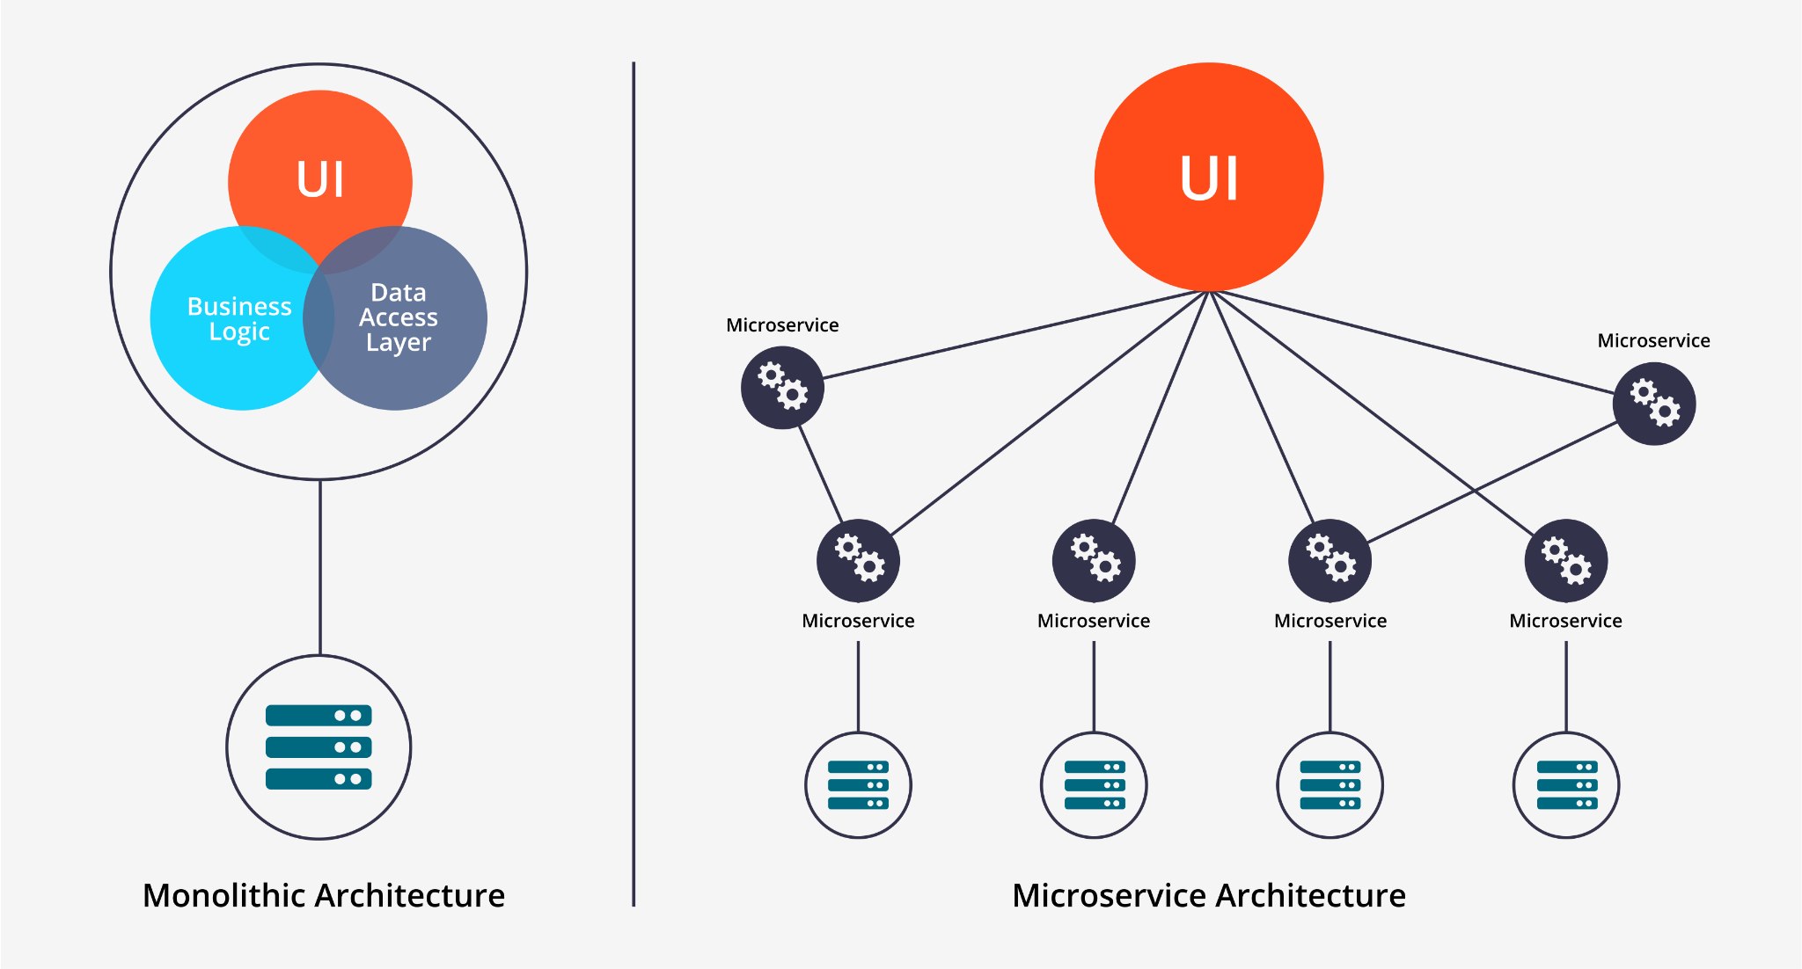
Motivation
Cloud services are shifting from monolithic architectures to microservices
Containers widely used in microservice deployment
Large number of containers running on a single server¹
Need for minimal performance degradation on intra-host communication
¹ Gan, Yu, et al. "Seer: Leveraging big data to navigate the complexity of performance debugging in cloud microservices." Proceedings of the twenty-fourth international conference on architectural support for programming languages and operating systems. 2019.
‹#›
Notes:
X TODO: Update this with text from the latest text version
X Shorter topics
Images

Slide 4
Related Work
Zhao et al. (HotConNet 2018)
Multiple allocation scenarios (e.g., on the same VM, same host or different hosts )
Single pair of containers
Suo et al. (INFOCOM 2018)
Evaluate the influence of packet size, network and CPU interference on container performance
Up to 8 container pairs
Mentz et al. (CloudNet 2020)
Multiple allocation, workloads and congestion scenarios
Two pairs of containers
Our work
Single-node allocation, multiple workloads and congestion scenarios
Up to 50 container pairs
‹#›
Notes:
Tabela menor OU topicos

Slide 5
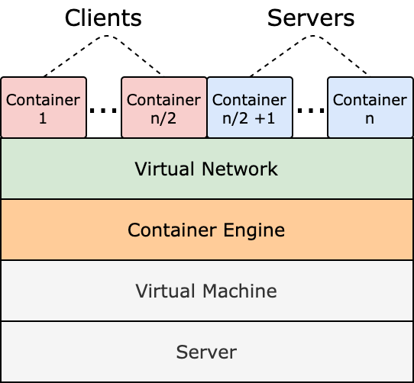
Methodology
Testbed
Single server running an Ubuntu VM
Docker as the container engine
Workload
Throughput stress tests (Iperf, sockperf)
Fixed-size (5 MB) file transmissions (Netcat)
Metrics
Throughput
Flow-Completion Time (FCT)
Network drivers
Linux Bridge
Macvlan
Open vSwitch (OVS)
‹#›

Slide 6
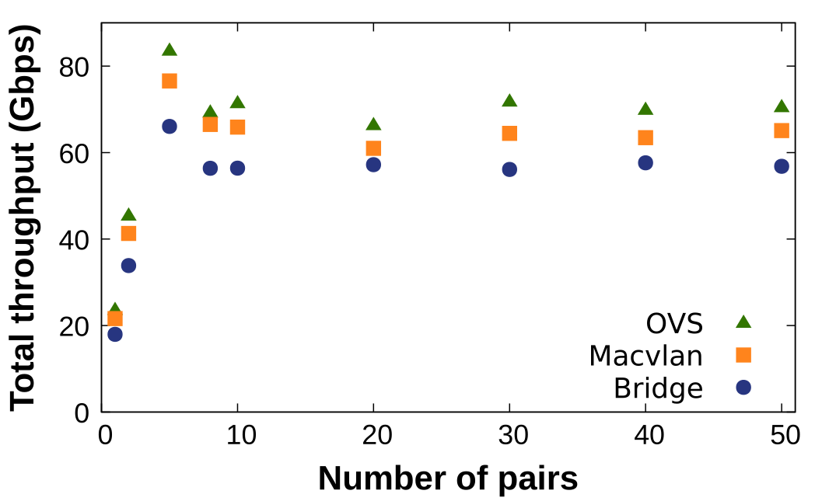
Overall Performance
OVS presents the best performance due to the fast-path mechanism
Throughput increases up to 5 pairs, then stabilizes
Performance restricted by the CPU capacity
‹#›
Notes:
X Diminuir grafico (metade image, metade texto)
X Apontar pontos nos graficos
X Deixar mais claro a explicação do comportamento (exemplo: colocar a parte de CPU capacity num novo topico para chamar mais atencao)

Slide 7
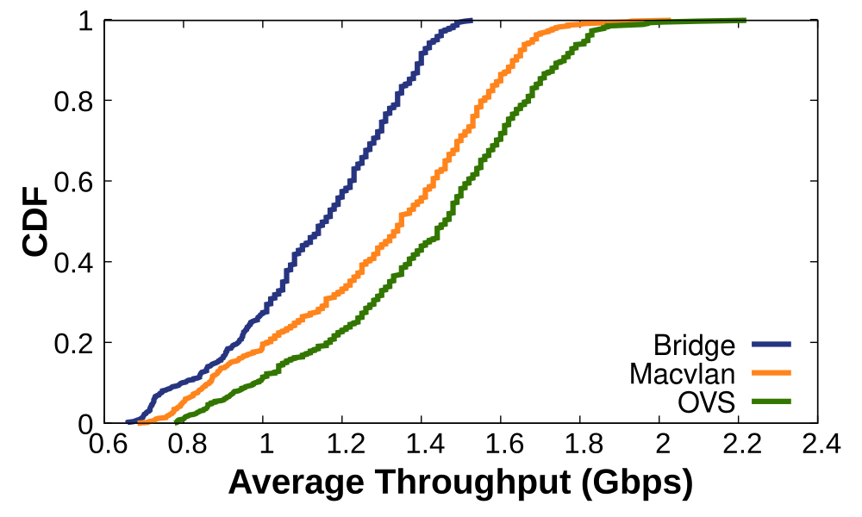
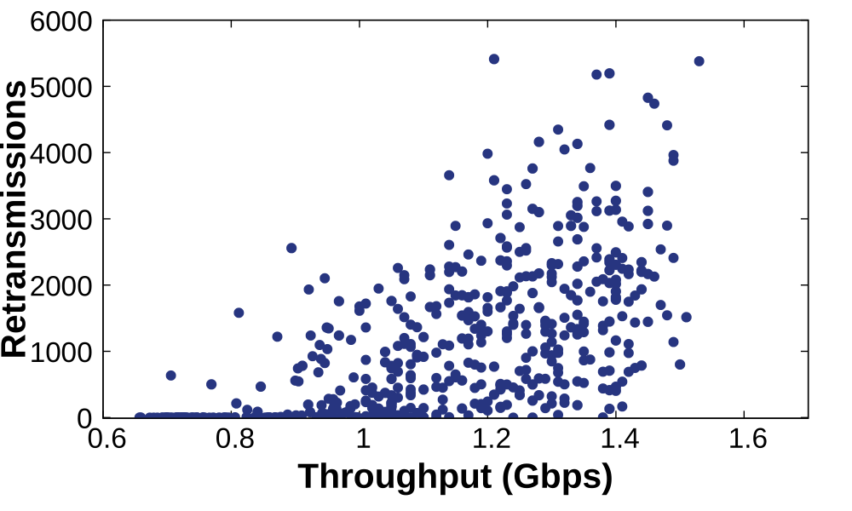
Network Interference among containers
Throughput can vary up to 3x for all drivers
Unfair resource sharing
Clients with more retransmissions achieve higher throughput values
Scarce CPU resources lead to unequal opportunities to transmit packets
‹#›
Notes:
X Animar: primeiro só grafico 1, dps grafico 2

Slide 8
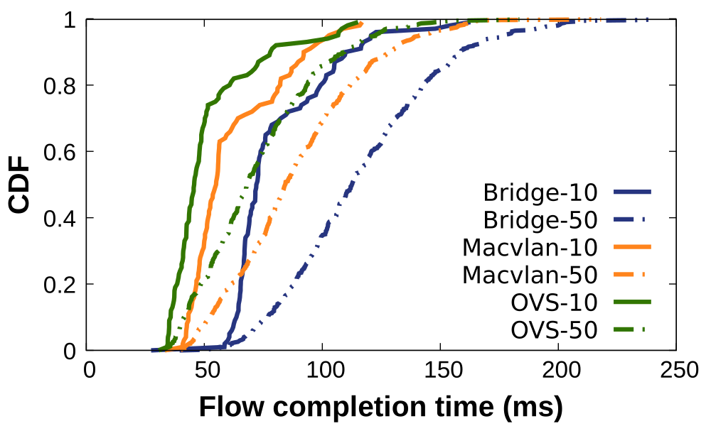
Network Interference among containers
Large difference in performance for concurrent flows
up to 5x depending on the networking driver
Result of intense CPU contention
High increase in the FCT as the number of pairs increase
>30% for OVS (99th-percentile)
‹#›
Notes:
Primeiro grafico
X tail
X Diferenca numero de pares
X Cortar -> Segundo grafico

Slide 9
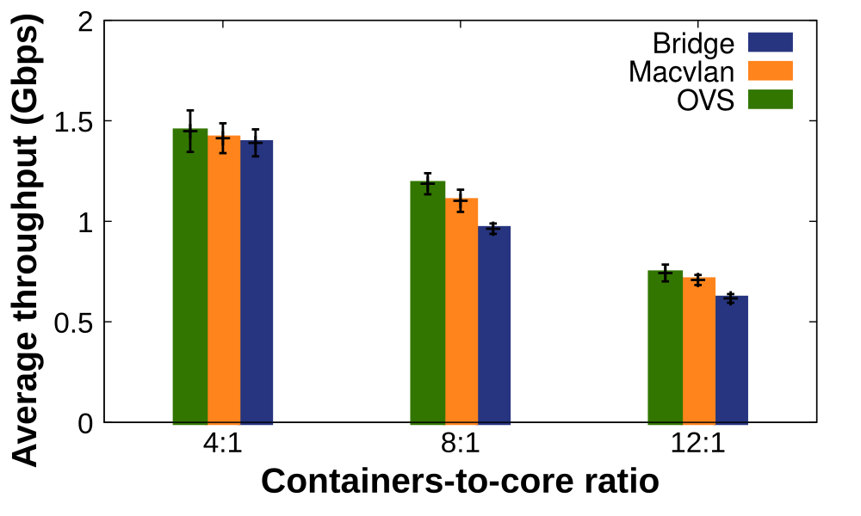
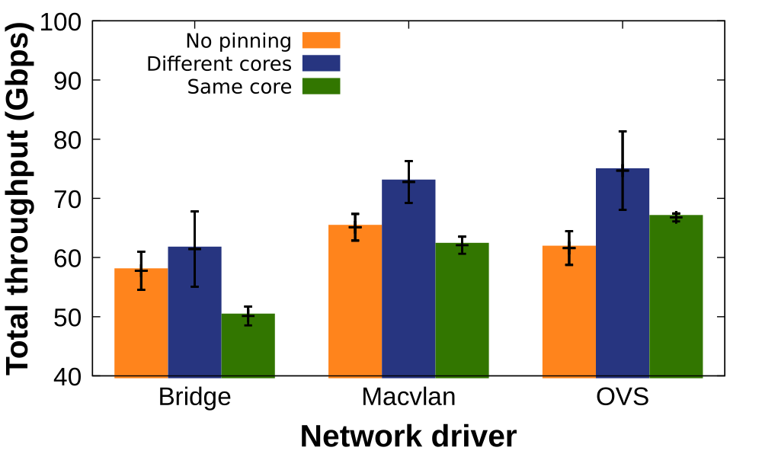
CPU Contention
Throughput greatly decreases with higher container-to-core ratios
Smaller CPU slices per container
More interrupts and context switches
Pining containers to cores can help
Reduce context switches
Pining client and server in the same core was detrimental
Limits concurrency
Notes:
X Quebrar dois slides OU animação deixando clara a diferença entra um e outro
X Trocar grafico 1 por throughput

Slide 10
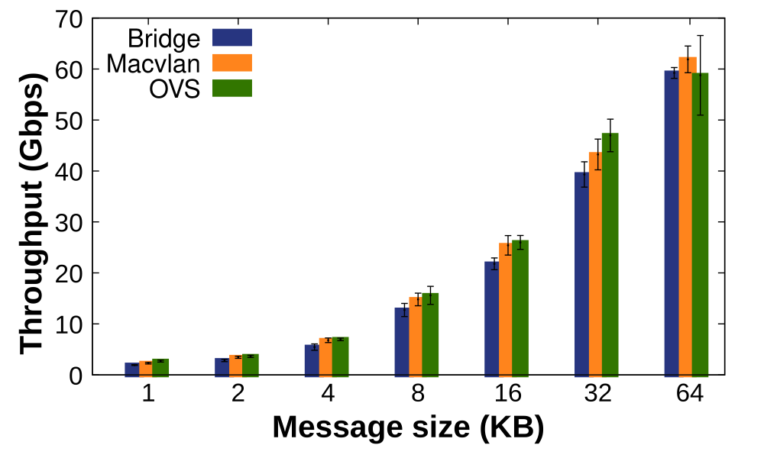
Packet Size
Larger message sizes result in higher throughput
Less packets to send
Less forwarding overhead
Significant performance degradation despite the intra-VM communication
Notes:
Checar tempo de apresentação para ver se esse slide precisa
tamanho da imagem
Apresentar conclusoes encontradas

Slide 11

Key Takeaways
Drivers’ Performance:
OVS consistently presents the best results
Importance of CPU Resources:
Number of CPU cores and/or usage of binding techniques can greatly influence performance
Resource Sharing Fairness:
Some containers can achieve much higher throughput than others due to the unfair sharing of the CPU
Notes:
X Figura (canto inferior direito)
X Quebrar um pouco mais em subtopicos

Slide 12

Research Directions
Different allocation scenarios
Services spread throughout multiple VMs
Services in different physical hosts (virtualized or not)
Different transport protocols
UDP
QUIC
Flow prioritization
Priority based mechanisms to enforce fair CPU sharing
Notes:
X Reduzir pra 3
X Imagem

Slide 13
Thank you!
Contact: Conrado.Boeira@dal.ca
‹#›
Notes:
X Trocar para obrigado

