Slide 1
PROJECT TITLE Chatbot based helpdesk for govt employees and departments
PIP104 University Project-II
Review-3
Roll Number | Student Name
20211CIT0110 | S P BRAHMA CHAITANYA
20211CIT0156 | BHUVANESHWAR Y
20211CIT0147 | SHREYANKA B L
20211CIT0069 | DHANUSH M
Under the Supervision of,
Dr. Nihar Ranjan Nayak
Associate Professor
School of Computer Science and Engineering
Presidency University
Batch Number:CIT-G14

Slide 2
Introduction
This project aims to create a chatbot-based helpdesk system that helps government employees and departments easily access information and get support. The chatbot uses artificial intelligence (AI) to answer questions, guide users through processes, and help with tasks like submitting forms or checking the status of requests.
The goal is to make it easier for government workers to find the information they need quickly and to reduce the time spent on repetitive tasks. The chatbot will be available 24/7, providing instant support and improving efficiency within government departments. By automating common tasks and inquiries, it will also reduce the workload on human support staff and make the entire process faster and more efficient.

Slide 3
Literature Review
Chatbots are increasingly being used in various sectors, including government, to improve services and reduce manual work. Below are key insights from studies on how chatbots are benefiting government employees and public services:
Improving Public Services: Chatbots help public sector agencies by answering common questions and providing information quickly. Studies show that chatbots reduce waiting times and help citizens and employees get the information they need faster, improving service delivery.
AI and Natural Language Processing (NLP) in Government: Chatbots use AI and Natural Language Processing (NLP) to understand and respond to questions more naturally. This technology allows chatbots to interpret complex language and provide relevant answers, making them useful in government settings where the language can be technical.

Slide 4
Literature Review
Assisting Employees and Automating Tasks: Chatbots are also being used to help government employees by automating routine tasks, such as checking the status of requests or submitting forms. This reduces the workload for employees and saves time for more important tasks.
Improving Efficiency and Reducing Costs: Using chatbots in government departments can lower costs and make operations more efficient. By handling common questions and requests, chatbots reduce the need for human staff, allowing them to focus on more complex issues.
Security and Privacy Concerns: Since chatbots in government often deal with sensitive information, ensuring data security is a major concern. Studies highlight the importance of strong security measures to protect the personal data and privacy of citizens and employees interacting with these systems.

Slide 5
Objectives
Automate Routine Tasks: Streamline administrative tasks such as form submissions, status checks, and policy inquiries.
Improve Efficiency: Reduce manual workload for government employees and enhance overall productivity.
24/7 Availability: Offer round-the-clock support to employees for quick, real-time responses to queries and requests.
Enhance User Experience: Provide easy access to information and guidance for employees, making tasks simpler and faster.
Ensure Security & Privacy: Safeguard sensitive government data with strong encryption and compliance with privacy regulations.
Continuous Improvement: Enable the chatbot to learn and adapt over time for more accurate and efficient assistance.

Slide 6
Research Gaps Identified
Language Support: Chatbots lack support for regional Indian languages.
Data Security: Sensitive user data may not be fully protected.
Context Handling: Bots struggle to understand follow-up or related questions.
System Integration: Difficult to connect with old government software systems.
Knowledge Base: Chatbots rely on incomplete or outdated information.
Learning Ability: Most bots don’t improve from new data or feedback.
User-Friendliness: Interfaces are not easy for non-technical staff.
Performance Metrics: No standard way to measure chatbot success.
Human Support: Poor system for transferring unresolved queries to real

Slide 7
Proposed Methodology
Requirement Analysis:
Identify common queries, tasks, and services needed by government employees.
Design & Development:
Develop AI and NLP models to power the chatbot for understanding and processing queries.
Integration with Government Systems:
Integrate the chatbot with internal databases and platforms for real-time information retrieval.
Security & Privacy:
Implement encryption and data protection measures to ensure sensitive information is secure.
Testing & Optimization:
Conduct user testing to identify issues and improve chatbot accuracy.
Deployment & Continuous Learning:
Deploy the chatbot across government departments.

Slide 8
Algorithm
1. User Initialization
Input: User starts chat session.
Process:Identify the user (Employee/Department/Guest).
Authenticate if needed (e.g., Employee ID and OTP/email).
Output: Authenticated user or access level set.
2. Intent Detection (NLP Processing)
Input: User query (e.g., “How to apply for leave?”).
Process:Use NLP to extract:
Intent (e.g., "Leave Application")
Entities (e.g., "Annual Leave", "HR Policy")
Match query with predefined intents using Dialogflow/Rasa.

Slide 9
Algorithm
3. Response Decision Tree
Input: Detected Intent & Entities.
Process:Route based on category:
HR → Leave, Salary, Transfers
IT → Password Reset, Email Access
Admin → Circulars, Orders
Check if FAQ/database answer exists.
If yes: Retrieve from knowledge base.
If no: Escalate to human agent or ticketing system.
4. Knowledge Base Query
Input: Intent and context.
Process:Query structured or semi-structured database:
FAQs table, Document Index, Policy PDFs, etc.
Output: Matched answer or document link.

Slide 10
Algorithm
5. Ticketing System Integration (If No Answer Found)
Input: Unanswered query.
Process:Auto-generate ticket with:
User details
Query log
Department routing
Notify the user with ticket ID and estimated resolution time.
6. Response Generation
Input: Answer or ticket info.
Process:Format natural language response.
Attach any necessary files or links (PDFs, forms).
Output: Response sent to user.

Slide 11
Algorithm
7. Feedback & Logging
Input: User's satisfaction (Yes/No, Ratings).
Process:Log feedback for improvement.
Update query logs, unresolved cases.
Output: Improved accuracy and ticket analytics.
8. Learning & Updates (Optional)
Input: New queries or feedback.
Process:Admin reviews new or failed queries.
Update chatbot training data & knowledge base regularly.
Output: Improved chatbot intelligence.

Slide 12
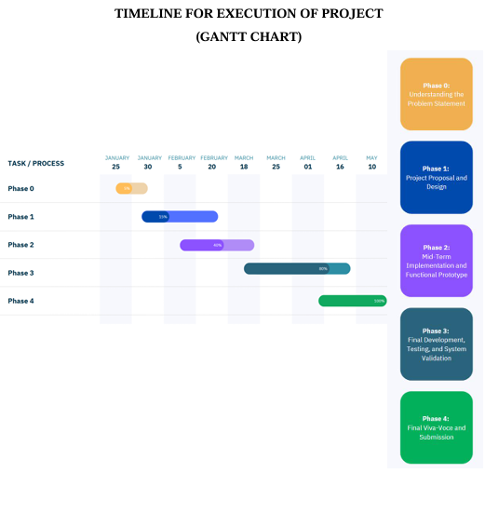
Project Timeline (Gantt Chart)

Slide 13
Expected Outcome
Improved Efficiency: Employees can quickly access information, complete tasks, and resolve issues, reducing manual intervention and waiting times.
Cost Savings: By automating routine tasks, the chatbot reduces the workload on human staff, leading to savings in time and operational costs.
24/7 Support: The chatbot will be available around the clock, ensuring employees can get help anytime, improving accessibility and responsiveness.
Enhanced User Experience: A user-friendly interface with accurate, personalized responses will improve satisfaction among government employees.
Increased Productivity: Employees spend less time on administrative tasks and more time on critical work, boosting overall productivity.
Continuous Improvement: The chatbot will evolve over time by learning from user interactions, resulting in increasingly accurate and efficient support.

Slide 14
Conclusion
Enhanced Service Delivery: The chatbot will streamline communication and task management, providing faster, more accurate assistance to government employees.
Efficiency & Cost Reduction: Automating routine tasks will reduce workload on staff, leading to cost savings and improved efficiency across government departments.
24/7 Accessibility: The chatbot ensures round-the-clock support, improving responsiveness and accessibility for employees.
Data Security & Privacy: Strong security protocols will safeguard sensitive information, ensuring compliance with government regulations.
Scalable & Continuous Improvement: The chatbot will evolve based on user feedback and interactions, continuously improving its performance and adaptability.

Slide 15
References (IEEE Paper)
Almeida, M., et al. (2020). Chatbots in Public Services: Improving Government-Citizen Interaction. Journal of Public Administration.
Vermesan, O., & Friess, P. (2014). AI Technologies in Government: Enhancing Public Services. Springer International Publishing.
Bhatnagar, R., & Rani, P. (2021). Role of AI Chatbots in Automating Administrative Tasks in Government Sectors. Government Technology Review.
Chaudhary, V., et al. (2019). Cost Reduction through Automation in Government Services: A Case Study. International Journal of Public Sector Management.
Müller, M., et al. (2018). Security and Privacy in AI-based Public Sector Applications. Security & Privacy Journal.

Slide 16


