Slide 1
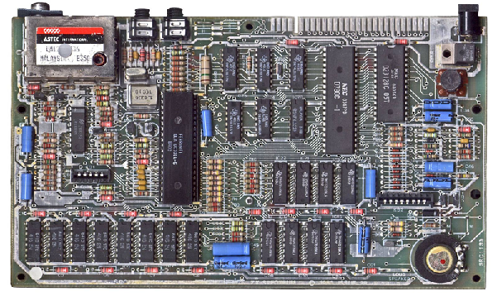

ENGR 151
An (accelerated) introduction to computers and programming
Lecture 3 - MATLAB: Data Structures, Logical Operations and Indexing

Slide 2
Recap
Creating arrays: [] and : operators
Matrix/vector operations vs. array element-wise operations (use . )
Vectorization (operators and functions): speed!
Script and function files
Variable scope
Notes:
[] creates array where data can be entered
: creates array of arithmetic sequence

Slide 3
Contents
Array indexing
Logical operations and indexing
Datatypes and typecasting
Notes:
Last lecture: vectorization - array/matrix operation as a whole; want information of a specific element
Logical operations: indexing: want a certain set of elements

Slide 4
Indexing
Indexing is the way of accessing a subset of individual elements of an array
We can either extract certain values
or modify certain values in an array
Note: indexing starts at 1 in MATLAB (starting at 0 in C++)
value =
10
1.41
3423
345
0.013
index =
1
2
3
4
5
Notes:
c language (precursor of c):
Index n of an array refers to a memory location n-elements away from the starting element, so the first element of the array is exactly contained in the memory location (0 elements away).

Slide 5

Indexing
We can extract a single value from an array by using the indices for the row #, col #, etc.:
my_var(i,j…)
We can also use a single index (linear indexing)
Matlab uses column-major order
a11
1
a21
2
a11
a12
a13
is stored in memory as
a12
3
a21
a22
a23
a22
4
a13
5
my_var(n)
a23
6
Notes:
Demo: initialize 2x3 array
access using x,y indices
access using a single index

Slide 6
Getting and setting values
This syntax is the same for extracting values:
A = my_var(i,j…)
and setting values:
my_var(i,j…) = A

Slide 7
Indexing - multiple elements
We can perform indexing of a subset of multiple values
use : or [] operators
Recall: The : and [ ] operators are used to construct an array of values
We create an array of indices that define the subset of values we will extract / modify
ii = [1 2]
A = my_var(1:2) or A = my_var(ii)
value =
value =
10
10
1.41
1.41
3423
3423
345
345
0.013
0.013
index =
index =
1
1
2
2
3
3
4
4
5
5
Notes:
Demo: indexing multiple elements with two ways
Also show using ii when index is not continous

Slide 8
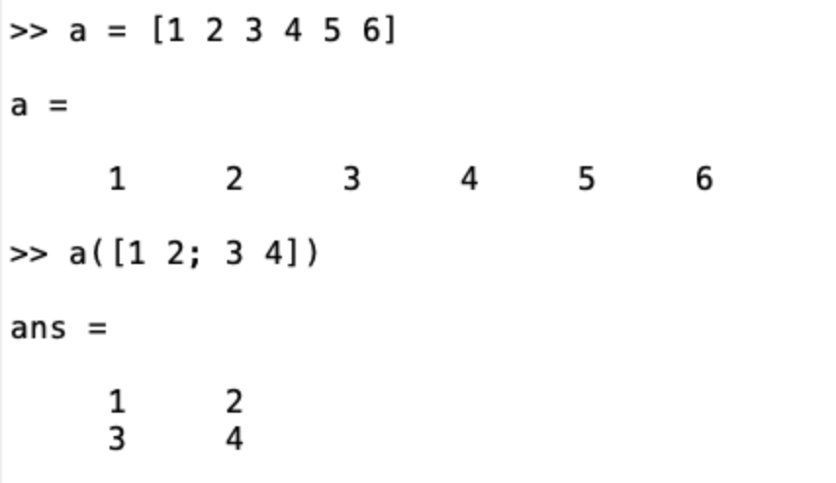
Indexing with [ ]
From a linear array of values, the array extracted by indexing using [ ] will be the size of the indexing array:

Slide 9
More colon operator syntax
Just the colon : , returns all elements along a dimension
A = my_var(:,1:3)
A = my_var(:,:)
end, denotes the last element in the series
A = my_var(1:end,2:end-1)
end - 1 is second last element in the array
Notes:
Demo
: and end

Slide 10
Challenge: Indexing
Write a single line of code to reverses the columns in an MxN matrix.
Write a single line of code to cyclically shift all columns one to the left (i.e. $2→1$, $3→2$,$1→N$,… ).
Notes:
b = a(:, end:-1:1) first:step:last (arithmetic sequence - difference between the consecutive terms is constant, use ‘:’ operation)
b = a(:, [2:end,1])
Better around 12:30

Slide 11
Contents
Indexing
Logical operations and indexing
Datatypes and typecasting
Notes:
12:35

Slide 12
Computers are built on Boolean logic
Symbol
input A | input B | AND | NAND | OR | NOR | XOR | XNOR
0 | 0 | 0 | 1 | 0 | 1 | 0 | 1
0 | 1 | 0 | 1 | 1 | 0 | 1 | 0
1 | 0 | 0 | 1 | 1 | 0 | 1 | 0
1 | 1 | 1 | 0 | 1 | 0 | 0 | 1
Also not - which is a unary operator with 0=not(1) and 1=not(0)
The logical datatype in MATLAB has two values ‘true’ and ‘false’ (or 1 and 0)
Notes:
Explain all the logic symbols
XOR: exclusive or (different is true); XNOR: complement of XOR (same is true).

Slide 13
Vectorized logic operators in MATLAB
Logical | a, b type logical
and | a & b
or | a | b
not | ~a
Relational | x, y type numeric
is greater than | x > y
is greater than or equal | x >= y
is less than | x < y
is less than or equal | x <= y
is not equal to | x ~= y
is equal to | x == y
The result of these operators is an array of true (1) or false (0) values
Notes:
Demo:
set up a = [true,false] or a = [1,0] show class (double)
set up a and b to logical arrays and try logical operators
set up a and b to numeric arrays and try relational operators

Slide 14
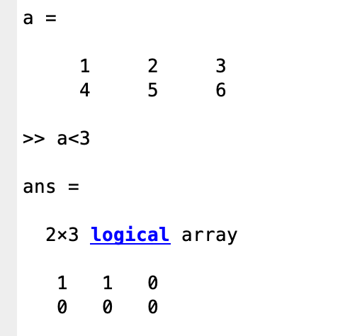
The result of logical operations on arrays will be logical arrays

Slide 15
Operator precedence
Operation Type | Operators
Parentheses | ()
Transpose / Power | .' | ' | .^ | ^
Unary | + | - | ~
Multiplicative | .* | * | ./ | /
Additive | + | -
Range Construction | :
Relational | < | <= | > | >= | == | ~=
Logical AND | &
Logical OR | |
Assignment | =
Higher
(happens first)
Lower
(happens last)
ENGR 101 1/28/19

Slide 16
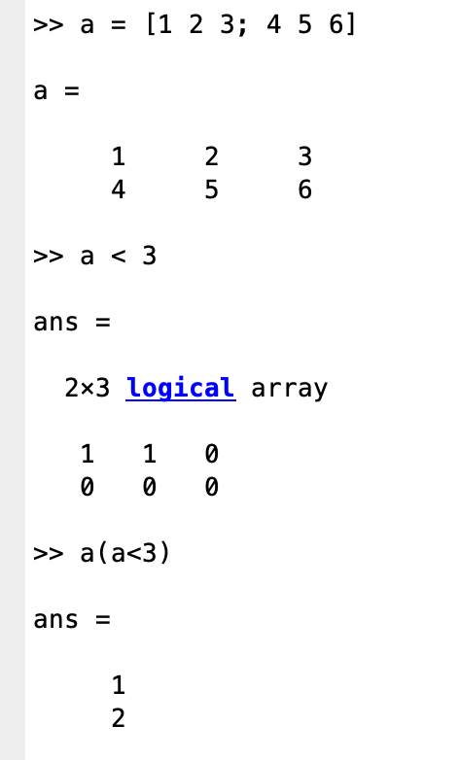
Logical Indexing
We can also use a logical array to index elements in a matrix
In this case, we extract / modify all the elements from the source matrix that correspond to positions with a ‘true’ value in the logical matrix
The result will be an unwrapped vector of values
Notes:
Other examples: x(x == 2) Note == and =

Slide 17
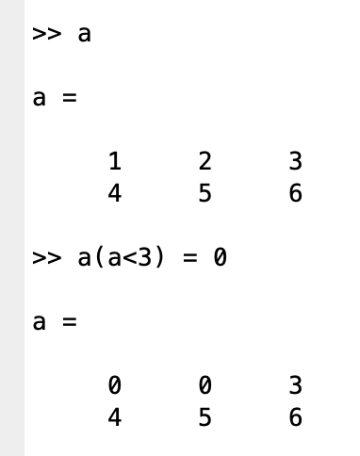
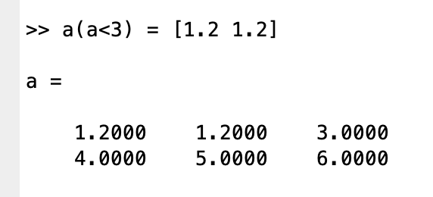
Writing Into a Logically Indexed Matrix
A logical indexing expression can be used to modify elements
The RHS must either be a scalar or have the same number of elements as there are 1s in the logical index matrix.
Notes:
Demo
"set elements less than 3 to zero"
which = x < 3
X(which) = 0
"set all elements except values 2 and 4 to 0"
x(x ~= 2 & x ~= 4) = 0
"subtract one from all elements, but don't go below zero"
x(x > 0) = x(x > 0) -1

Slide 18
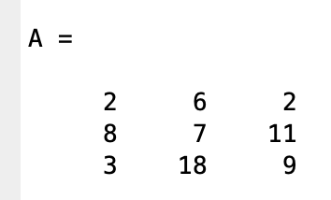
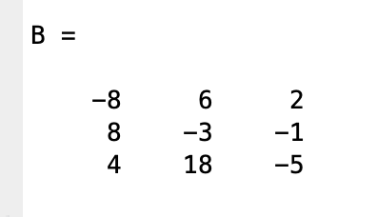
Challenge: Logical Indexing
Write code for each of the following:
Find the number of elements that match between A and B.
sum(sum(A == B))
Double all elements in A that are between 5 and 10 (inclusive).
A(5 <= A & A <= 10) = 2 .* A(5 <= A & A <= 10)
ENGR 101 1/28/19
Notes:
A == B (hold off on sum and do it later)
which = A>=5 & A<=10
A(which) = 2*A(which)

Slide 19
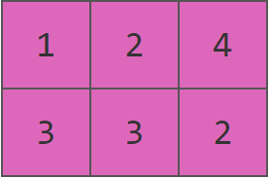
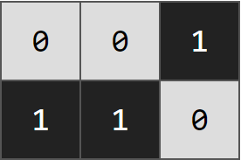
Example: Counting the number of elements greater than 2 in an array
You can use the sum function, combined with a logical operation, to count the number of elements that match certain criteria.
Example: How many elements are greater than 2?
3
a
a > 2
sum(a > 2,’all’)
Note: The logical 0s and 1s are implicitly converted to numeric 0s and 1s
Notes:
Do sum here

Slide 20
Challenge: Exam grades
In MATLAB - use “load examgrades” to load in built-in example data* - exam scores out of 100. Array has 5 columns - each are results from a different year
Write code to:
Find the percentage of people getting at least a B grade (82 score)
Each year
For all years combined
* or if that doesn’t work, download examgrades.mat from canvas/Files/Matlab_files into the directory you are working from and try again
Notes:
sum(grades(:,1) >= 82)
sum(grades >= 82, ‘all’)

Slide 21
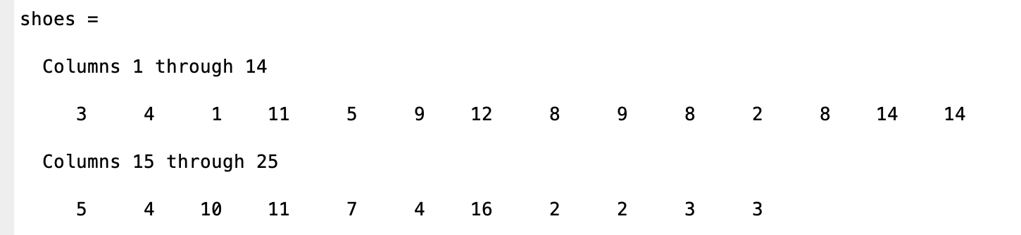
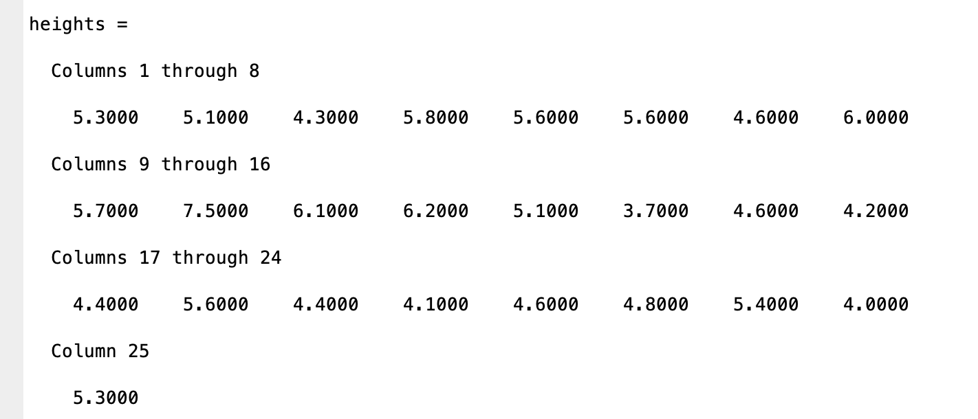
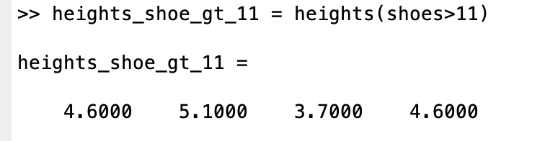
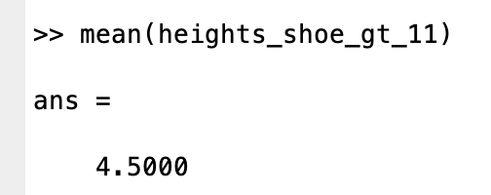
Example - average heights of people with shoe size greater than 11

Slide 22
Contents
Indexing
Logical operations and indexing
Datatypes and typecasting

Slide 23
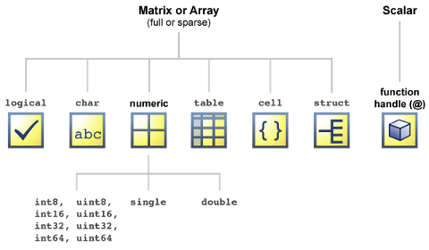
Datatypes in MATLAB

Slide 24
Data Type vs Memory
Integer: 8, 16, 32, 64 bits
Single: 4 bytes (or 32 bits)
Double: 8 bytes (or 64 bits)
Char: 2 bytes (UTF-16)
Logical: 1 byte
Notes:
UTF: unicode transformation format (encoding unicode character data)
Logical: no 1 bit data type due to speed

Slide 25
Datatypes in MATLAB
Numeric Types: Integer and floating-point data
Characters and Strings: Text in character arrays and string arrays
Dates and Time: Arrays of date and time values that can be displayed in different formats
Categorical Arrays: Arrays of qualitative data with values from a finite set of discrete, nonnumeric data
Tables: Arrays in tabular form whose named columns can have different types
Timetables: Time-stamped data in tabular form
Structures: Arrays with named fields that can contain data of varying types and sizes
Cell Arrays: Arrays that can contain data of varying types and sizes
Function Handles: Variables that allow you to invoke a function indirectly
Map Containers: Objects with keys that index to values, where keys need not be integers
Time Series: Data vectors sampled over time

Slide 26
Typecasting: What is the difference between logical 1 and integer 1?
The values 1 (type logical), 1 (type number), 1 (type integer) are stored in different format; using different number of bits / representation
But we can typecast between different datatypes to convert e.g. logical 1 to integer 1
Syntax is either Y = cast(X, type)
or generally <type>(X) e.g. logical(1), int64(1), double(1)

Slide 27
In MATLAB typecasting is often implicit - this is known as coercion
e.g. the result of an arithmetic operation is a numerical type, the result of a logic operation is a logical type
1 + logical(1)
1 & logical(1)
What is the result of:
?
logical(2)
1.5 + int32(3)
…may need to explicitly typecast sometimes:
Notes:
demo the four operations
Matlab demotes on interaction between integer and double
Matlab round when convert to integer
demo
cos(double(2<1))

Slide 28
The whos function
The whos function shows us the type of a variable, as well as its dimensions and how much memory it takes to store.
>> x = 1; >> whos x
Name Size Bytes Class Attributes
x 1x1 8 double
>> y = [1,2; 3,4];
>> whos y
Name Size Bytes Class Attributes
y 2x2 32 double
>> word = ['h', 'e', 'l', 'l', 'o'];
>> whos word
Name Size Bytes Class Attributes
word 1x5 10 char

Slide 29
Next lecture
MATLAB: Data Visualization and Analysis and Project 1 Overview

