Slide 1
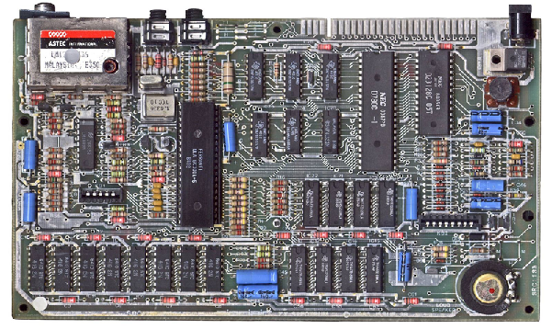

ENGR 151
An (accelerated) introduction to computers and programming
Lecture 6 - MATLAB: Program Design and Flow Control

Slide 2
Exams
Midterm 1: Sept 27 - class time
Quick review next Thursday (22th)
Midterm 2: Nov 1 - class time
Final: Dec 19 - 8am-10am
All exams are paper-based. Laptop/phone or any reference materials are not allowed, but we will provide a reference sheet
Notes:
Have conflict: send me an email

Slide 3
Recap
Basic statistics
Mean and variance
Data smoothing and curve fitting
no function vs explicit function
parameter tuning vs coefficient optimization

Slide 4
Contents
Program Design
Flow control: selection
Flow control: loops
Notes:
Briefly talk about program design and focus on flow control
Two types of flow control

Slide 5




Engineering Computing: Solving real world problems
Problem
Testing
Ideas
Algorithm
Code development
Debug
Program
Solution
Notes:
The code development is not a linear process
your program has bugs
unit tests and regression tests
refine the algorithm

Slide 6





Program Design
Recall that an algorithm is a well-ordered set of steps to solve a problem.
Program design is the process by which we turn an algorithm into a computer program (well-tested and ‘bug free’).
The more complex the problem is, the more complex the algorithm will be.
Problem
Testing
Ideas
Algorithm
Code development
Debug
Program
Solution
Notes:
Just repeat program design

Slide 7
Program Design Concepts
Structural programming
Iteration (loops)
Branching (selection)
Procedural Abstraction (using functions)
Object Oriented Programming
Notes:
Loop: repeat the same thing for a sequence of data
Branching: do action A or B determined by some condition
Using functions:
Write code that can cope with a variety of different situations (parameters of the function);
Easy to test
OOP: abstraction and reuse of codes

Slide 8
Program Design Concepts
Sequence specifies the order of execution
Selection is the execution of a branch of instructions based on a condition
A condition is a statement with the result TRUE or FALSE - i.e. logical operations, relational operations etc.
Selection allows for branching of the program flow $→$ flow control

Slide 9

Flow control
We may imagine our program as driving on an expressway network
At runtime there is only one path through due to a given set of selections - this is known as the thread of the execution
From Google Map
Notes:
Our program will run as we driving on an express way network
We select the direction at each exit
At the beginning of development, it would be helpful to draw a flowchart for all the situations (paths) that the program will potentially cover

Slide 10
Flowchart for program design
Start
It can be useful to start by drawing a flowchart to help design a code
This can help with understanding the overall structure and determine what modules need to be written
Work
N
Am I hungry?
Y
Eat
A hungry workaholic’s day
Notes:
rectangular: action
diamond: selection under a condition

Slide 11
Example: Babylonian algorithm
Calculate $x=\sqrt{y}$
input
y
Start with a sensible guess $x_{0}$
initialize $x_{0}$
Find a better approximation through $x_{n+1}=\frac{1}{2}\left(x_{n}+\frac{y}{x_{n}}\right)$
$$x_{n+1}=\frac{1}{2}\left(x_{n}+\frac{y}{x_{n}}\right)$$
Repeat step 2 until the answer is “close enough”
false
$$\left|y-x_{n+1}^{2}\right|<ε$$
true
test condition
$$\left|y-x_{n+1}^{2}\right|<ε$$
output $x_{n+1}$

Slide 12
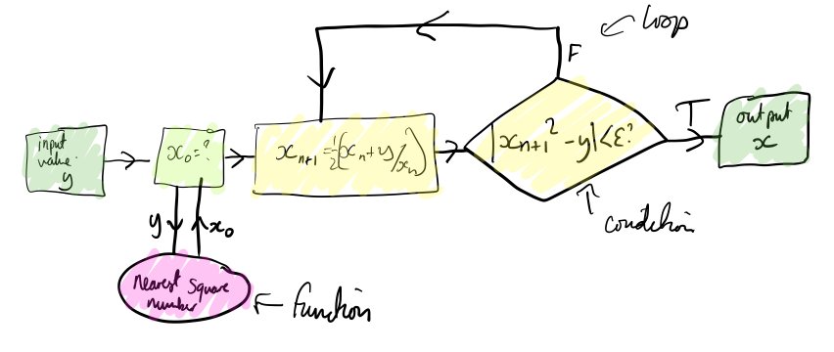
Flowchart for program design

Slide 13
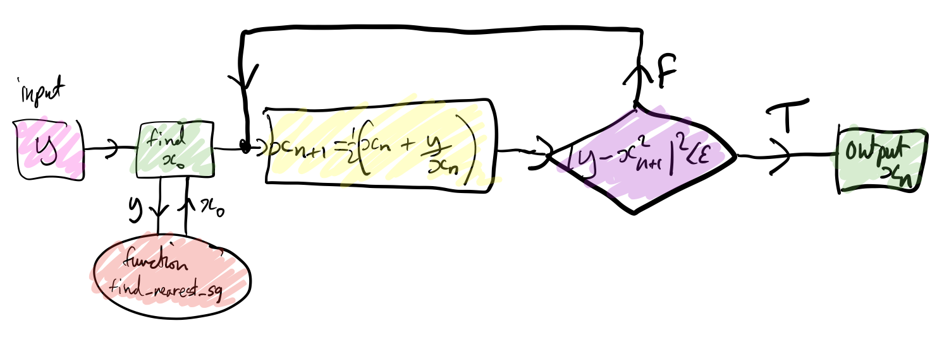
Flowchart for Babylonian algorithm

Slide 14
Unit testing
Write code into modules!
Unit testing is making sure you test each module / subroutine works individually before putting them together
Don’t just code the whole code and expect it to work - think about what outputs you should expect for given inputs and verify each function (section) of your code
Notes:
Project 1:
constant water array
just show water above the terrain
just show water behind the Dam line
12:20

Slide 15
Contents
Program Design
Flow control: selection
Flow control: loops

Slide 16
Selection
Allows the selective execution of a portion of your code depending on true/false value or comparison with constants
Two main types of selection statement in MATLAB:
if-(else)-end
switch-case
condition
true
do something
false
condition
do something else
switch
case 1
do A
case 2
do B
case 3
do C
…
Notes:
at intersection of roads turn left/right or straight
nested if else: test another condition to keep branching it out

Slide 17
if-else-end
if logical_expression
statements
elseif logical expression
statements
else
statements
end
Notes:
test first condition
test second condition

Slide 18
if example
x = input('Enter value x: ’);
minVal = 2;
maxVal = 6;
if (x >= minVal) & (x <= maxVal)
disp('Value within specified range.’)
elseif (x > maxVal)
disp('Value exceeds maximum value.’)
else
disp('Value is below minimum value.')
end
Ask user to input value for x
Notes:
first line: interactive command

Slide 19
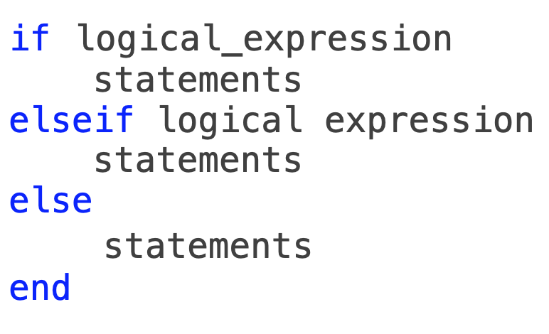
Challenge: Selection
Write a code that sets C to the following values for the comparisons given for A and B
A > B; C = 1
A < B; C = 2
A = B (mathematically!); C = 3
Starter code:
A = input(‘A = ‘);
B = input(‘B = ‘);

Slide 20
switch-case-otherwise
switch switch_expression
case case_expression1
statements
case case_expression2
statements
...
otherwise
statements
end

Slide 21
switch example
n = input('Enter a number: ');
switch n
case -1
disp('negative one')
case 0
disp('zero')
case 1
disp('positive one')
otherwise
disp('other value')
end

Slide 22
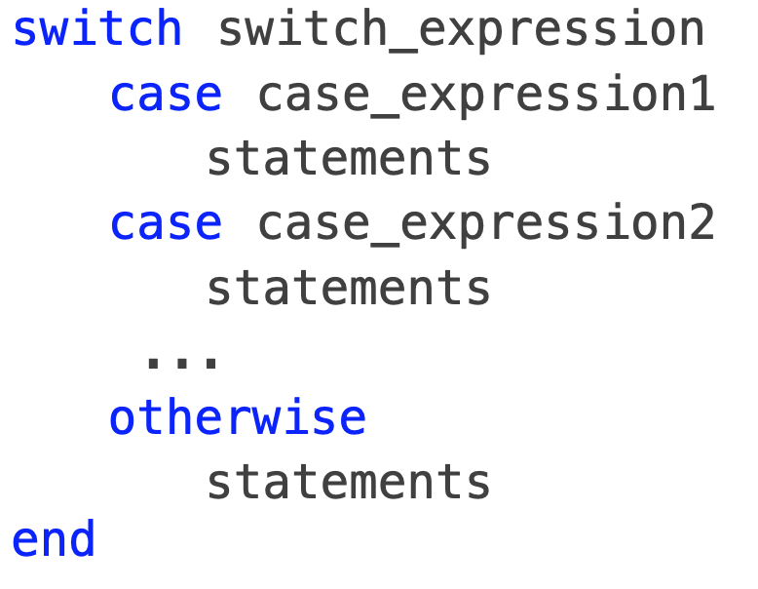
Challenge: Selection 2
Write a code that for a given numerical value of $x∈[0,3]$ outputs the English language equivalent (e.g. 1 : ‘one’)
If anything other than 0:3 is entered, code should disp(‘error’)
Starter code:
x = input(‘x = ‘);
disp(‘one’)
Notes:
12:45

Slide 23
Contents
Program Design
Flow control: selection
Flow control: loops

Slide 24
Iteration (Loops)
Most programming languages provide mechanism to repeat several lines of code over and over: loops
The process of repetition in programs is called iteration - loops will repeat a set of statements until an exit condition (true/false) is met
Two main types of iteration in MATLAB:
while
for
initial i
i = i+1
do sth
condition
true
do sth
i < n
true
false
false

Slide 25
while
while logical_expression
statements
end
do sth
condition
true
false

Slide 26
while example
n = 10;
f = 1;
while n > 1
f = f*n;
n = n-1;
end
disp(['n! = ' num2str(f)])

Slide 27
for
for index = values
statements
end
initial i
i = i+1
do sth
i < n
true
false

Slide 28
for example
n = 10;
f = zeros(n,n);
for i = 1:n
for j = 1:n
f(i,j) = 1/(i^2+j^2/2);
end
end
Nested for loop
Notes:
How many times are the statement executed if n=10?

Slide 29
vectorized form of previous code….
n = 10;
f = zeros(n);
for i = 1:n
for j = 1:n
f(i,j) = 1/(i^2+j^2/2);
end
end
Loops will generally be inefficient in MATLAB compared to vectorized methods
i = 1:n;
[I,J] = meshgrid(i,i);
f = 1./(I.^2+J.^2/2);
Notes:
I and J will be a matrix of (10 by 10)

Slide 30
More loop efficiency
We can place loops within loops
Or loops within loops within loops...
But be aware that the number of operations will scale as N to the power of the number of loops
Look for ways to avoid this (for efficiency)
Notes:
Interpreted languages must both interpret and evaluate code each time a loop executes
In compiled languages, the loop bodies are transformed into machine code only once at compiling time

Slide 31
Challenge: Loops
Write a short code that calculates the value of a geometric series up to N terms using a for loop: $a+ax+ax^{2}+ax^{3}+...+ax^{N-1}$ $≡a\overset{N-1}{\underset{i=0}{∑}}x^{i}$
Can test against $sum=a\left(\frac{1-x^{N}}{1-x}\right)$
Notes:
a = 2;
x = 2;
n = 10;
for i=0:n-1

Slide 32
Challenge: Loops 2
Using a for loop, write a short code that approximates the sum $\overset{N}{\underset{i=1}{∑}}\left(\sum_{j=1}^{i-1}{Δ}\right)Δ$
With ∆ = 0.001 and N = 10000

Slide 33
More flow control
To control flow in loops (and functions) there are several statements:
continue - will exit the current iteration
break - will exit a loop
return - will exit the current function and return to the caller
Less severe
More severe
Notes:
minesweeper
demo:
for i = 1:10
if i == 6
continue;
end
disp(i);
end

Slide 34
Infinite loops
If the exit condition and/or any break statement are not met/executed, the loop will continue forever…
Ctrl-C will terminate the program as a last resort
Notes:
Debugging!!!

Slide 35
Challenge: Loops 2
Write a while loop to make the following game:
Generate a random number between 1 and 10: my_number = randi(10);
Ask the user to guess the number: your_number = input('Guess what number I am thinking of:');
Repeat asking for a number until the correct guess is made
For every incorrect guess, display either disp('No, your number is too big.’); or disp('No, your number is too small.’);

Slide 36
Loop invariants
A loop invariant is a logical expression that is true at the initialization of the loop and at the end of every iteration but does not have to be true during the rest of the loop body
This can help with designing an algorithm if a loop invariant can be identified (especially as loops get more complex)
e.g. for the factorial algorithm $f=k!andk≤N$
$$k!=k×(k-1)!$$

Slide 37
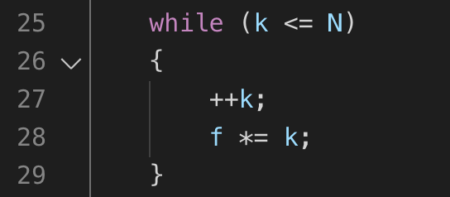
Loop invariants
e.g. for the factorial loop algorithm $f=k!andk≤N$
We need both of these to be true at the end of each loop
Initially k = 0 and f = 1 - invariant is true
increment k - f=k! is temporarily not true
f = k! again - invariant is true at end of loop
On last iteration, at end of loop k = N+1 - invariant is false
- loop should have k < N as condition

Slide 38
Next lecture
MATLAB: Strings, cells and file I/O

