Slide 1
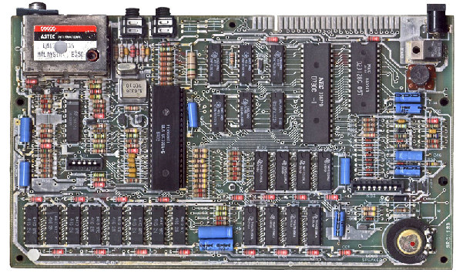

ENGR 151
An (accelerated) introduction to computers and programming
Lecture 7 - MATLAB: Strings, cells
and structures

Slide 2
Recap
Algorithm -> Program: iterative process
Two types of flow control
  Selection (if-else, switch-case)
  Loop (while, for)
    Terminate the current iteration, the whole loop or the function/script

Slide 3
Contents
Strings
Working with Data and File I/O
Cells and structs
Notes:
Start by creating data (array and indexing), and visualization of data.
Then we learned flow control.
Other data types (numerical and logical)

Slide 4
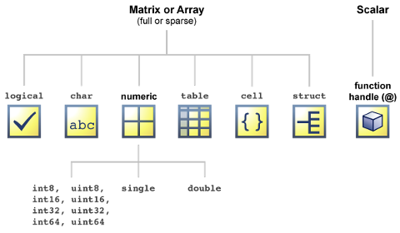
Datatypes in MATLAB

Slide 5
Some data types
  double – A (floating point, double precision) number.
  uint8 – An integer between 0 and 255, inclusive
  logical – A true or false value, written as 0 or 1
  char – A character (e.g. ‘a') - [char is actually an integer but is interpreted as an ASCII character]
Notes:
ASCII: American standard code for information change

Slide 6
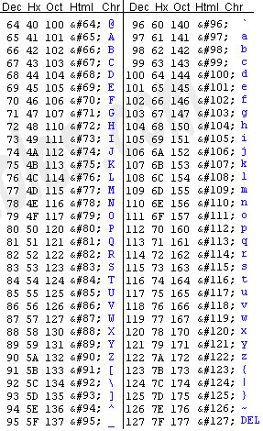
Some ASCII characters
Notes:
everything you can type in a keyboard
decimal: base 10
hexadecimal: a numbering system with base 16
oct: base 8

Slide 7
Strings as character arrays
A string is a sequence of characters. [Note: spaces are a char]
In MATLAB, a string is simply an array of chars
>> word1 = ['h','e','l','l','o']
word1 =
hello
>> word2 = 'world'
word2 =
world
>> [word1 ' ' word2]
ans =
hello world
Instead of each character individually, we can also use a string literal.
Joining strings together is often called ‘concatenation’.
ENGR 101 2/12/19

Slide 8
Storing a list of strings
Let's say we wanted to store several strings, for example, the names of countries
One option is to use a matrix of characters.
  Because the matrix must be rectangular, we have to pad with spaces.
  One problem: If one string is a lot longer than the others, we have a lot of wasted space!
5x14 char
'A' | 'f' | 'g' | 'h' | 'a' | 'n' | 'i' | 's' | 't' | 'a' | 'n' | ' ' | ' ' | ' '
'A' | 'l' | 'b' | 'a' | 'n' | 'i' | 'a' | ' ' | ' ' | ' ' | ' ' | ' ' | ' ' | ' '
'A' | 'l' | 'g' | 'e' | 'r' | 'i' | 'a' | ' ' | ' ' | ' ' | ' ' | ' ' | ' ' | ' '
'A' | 'm' | 'e' | 'r' | 'i' | 'c' | 'a' | 'n' | ' ' | 'S' | 'a' | 'm' | 'o' | 'a'
'A' | 'n' | 'd' | 'o' | 'r' | 'r' | 'a' | ' ' | ' ' | ' ' | ' ' | ' ' | ' ' | ' '
Notes:
Each row is a country, the longest country name determines the number of columns

Slide 9
Storing a list of strings
We need to remove the spaces before working with the string.
For example:
5x14 char
'A' | 'f' | 'g' | 'h' | 'a' | 'n' | 'i' | 's' | 't' | 'a' | 'n' | ' ' | ' ' | ' '
'A' | 'l' | 'b' | 'a' | 'n' | 'i' | 'a' | ' ' | ' ' | ' ' | ' ' | ' ' | ' ' | ' '
'A' | 'l' | 'g' | 'e' | 'r' | 'i' | 'a' | ' ' | ' ' | ' ' | ' ' | ' ' | ' ' | ' '
'A' | 'm' | 'e' | 'r' | 'i' | 'c' | 'a' | 'n' | ' ' | 'S' | 'a' | 'm' | 'o' | 'a'
'A' | 'n' | 'd' | 'o' | 'r' | 'r' | 'a' | ' ' | ' ' | ' ' | ' ' | ' ' | ' ' | ' '
>> [states(3,:), ' hello']
ans =
Algeria hello
>> [deblank(states(3,:)), ' hello']
ans =
Algeria hello
The deblank function removes trailing spaces.
ENGR 101 2/12/19

Slide 10

Challenge: Fortune teller
Write a code to “tell one’s lucky number” - input a name, turn the name into a number between 1 and 9
name = input('Enter name: ','s');
Hint:
int32(str) will convert string to integers
mod(x, N)+1 will return a number between 1 and N for any input integer x
Notes:
input(promo, ’s’) returns user entered text
mod (modulus) returns the reminder of a number when divided by another number.

Slide 11
string arrays
“Hello” | “ENGR” | “151”
String arrays are an abstract “object” container for character arrays
Have more intuitive functionality and more flexibility
  No necessity to have array of strings with same size (the “string" is considered the contents of the array rather than the individual chars)
Notes:
Character array: same size of each string (same column)

Slide 12
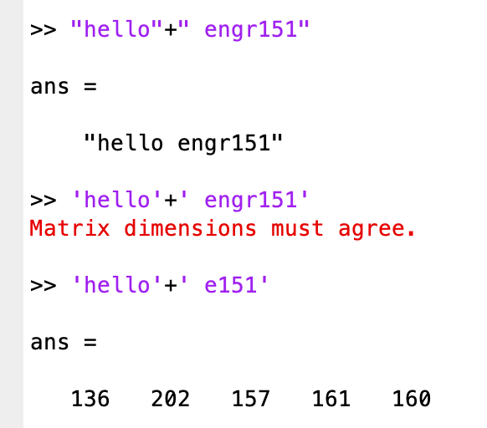
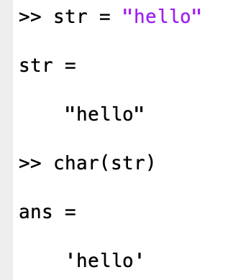
string arrays
MATLAB introduced string arrays in 2016b - these use “” quotation marks
  Flexible width of each string
String arrays have different (or error) response to mathematical operators e.g. + concatenates strings:
Can typecast between types with <type> (variable)
Notes:
Demo:
name = [‘hello’;’Matlab’];
Demo things on the right for + “” ‘’

Slide 13
String arrays: Some useful operators
A + B - concatenates strings in array element-by-element
A == B - returns true if strings A and B are identical
Relational operators all work as if names were in a dictionary
A < B - returns true if A comes before B dictionary-wise (e.g. Alesha comes after Aled, Fox is before Goat, and uppercase comes before lowercase)
Similar for A <= B, A > B, A >= B
Notes:
Uppercase comes before lower case

Slide 14
String arrays: Some useful functions
join(A) / split(A) - concatenates strings in array A into one string with spaces or visa versa
str2double(A) - Convert strings to number (vectorized)
num2str(A) - Convert numbers to character array
Notes:
Wonder how this would work, best thing to do is look for manual to understand the details
search for ‘join’

Slide 15
Summary
‘string’ with single quotes = char arrays
“string” with double quotes = string arrays
String arrays have more functionality, flexibility and are more intuitive
Char arrays are still used as inputs in built-in functions etc.
Notes:
12:30

Slide 16



Challenge: Star-Wars call sign generator
Pilots in the rebel starfighter fleet named by a squadron color (red, green, blue, gold, gray, black) and a pilot number (leader, two, three, four, …
Write code that randomly generates a squadron color and pilot number and outputs “<color> <number>, standing by”
Red five, standing by

Slide 17
Contents
Structures and Strings
Working with Data and File I/O
Cells and structs

Slide 18
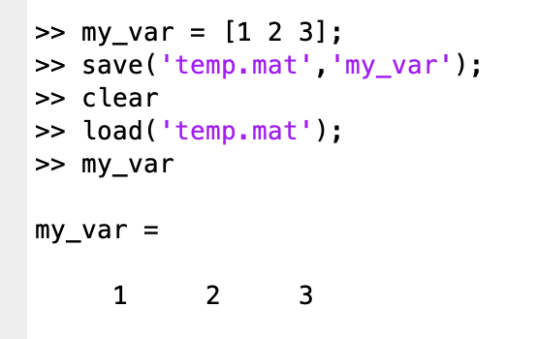
File I/O in MATLAB
Can load and save variables into workspace in MATLAB file format
load(filename,variables)
save(filename,variables)
.mat extension
ENGR 101 2/12/19
Notes:
Several ways to do this:
First way: save and load variables into a binary file (MAT-file).

Slide 19
File I/O in MATLAB
Other I/O methods
Input
  A = readmatrix(filename)
  dlmread, csvread, xlsread [all not recommended by MatLab]
Output
writematrix(A,filename)
  dlmwrite, csvwrite, xlswrite [all not recommended by MatLab]
ENGR 101 2/12/19
Notes:
Second way: readmatrix for different supported types
readmatrix performs automatic detection of file format
Obsolete functions. dlmread, delimited numeric data

Slide 20
readmatrix from a CSV File
CSV stands for "Comma Separated Values"
Files contain one line for each row of data, with the entries of each row separated by commas, and may contain headers and/or labels for the data.
These files generally have the extension .csv
City,Population,Latitude,Longitude
Shanghai,24256800,31.20,121.50
Karachi,23500000,24.87,67.02
Beijing,21516000,39.90,116.40
Delhi,16349831,28.62,77.22
Lagos,16060303,6.45,3.40
...
readmatrix automatically extracts numerical data, ignoring the headers
Notes:
Demo reading this test.csv
Should only contain numeric values, otherwise it will be processed as NaN

Slide 21
readmatrix from a CSV File
To extract text entries from a file, can make use of the option ‘OutputType’:
A = readmatrix(<filename>,’OutputType',<datatype>)
e.g. A = readmatrix(‘addresses.csv’,’OutputType’,’string’)
Notes:
can read data as string

Slide 22
Challenge: Load mixed string/numerical data from csv file
solar_system.csv on canvas (under Files/Matlab_files) has the following data
Load and place data into
  a vector of strings for the planet names
  three vectors of numbers for the other table entries
Planet | Diameter [km] | Mass / Earth | Period / Earth Days
Sun | 1,392,000 | 332,946.00 | 27 H
Mercury | 4,879 | 0.055274 | 58.646
Venus | 12,104 | 0.815005 | 243.019
Earth | 12,756 | 1 | 0.9973
Mars | 6,794 | 0.107447 | 1.026
Jupiter | 142,980 | 317.833 | 0.4101
Saturn | 1,120,540 | 95.159 | 0.444
Uranus | 51,120 | 14.5 | 0.7183
Neptune | 49,530 | 17.204 | 0.6712
Notes:
planet = A(:,1)
diameter = str2double(A(:,2))…

Slide 23
Reading text and other data formats
Can be done using C = textscan(fileID,formatSpec,N)
  Tricky - not recommended
To import data from table including headers need readtable/writetable - imports into new “table” data type.
MATLAB also supports many other scientific data formats e.g. hierarchical data format (H5)
data = h5read(filename,datasetname)
Notes:
hdf5: open source file format that supports large, complex and heterogeneous data (file directory)
12:45

Slide 24
Contents
Structures and Strings
Working with Data and File I/O
Cells and structs
Notes:
up to now, array are homogeneous, either numeric values or strings

Slide 25
Cell Arrays
In MATLAB, a cell array allows us to construct a
heterogeneous array
All elements in a cell array are of type "cell", but a cell may subsequently refer to any other type of data
Use the curly brackets { and } to create a cell array
>> test = {1, 'hello', [1,2,3]}
test =
[1] 'hello' [1x3 double]

Slide 26
Cell Arrays
The syntax for creating cell arrays is similar to normal arrays.
>> test = {1, 'hello'; [1,2,3], ['a';'b';'c']}
test =
[ 1] 'hello'
[1x3 double] [3x1 char]
For convenience, MATLAB will show the contents of cells containing strings (i.e. vectors of char).
MATLAB shows each cell in the cell array, as well as the type of data inside the cell.
1
'h' | 'e' | 'l' | 'l' | 'o'
The cell array is nice and "rectangular", but the contents of each cell can be whatever we want.
'a'
'b'
'c'
1 | 2 | 3

Slide 27
Indexing Into Cell Arrays
There are two different ways to index a cell array:
  Content Indexing – uses { }
  Use this form if you want to
  select and work with the content
  of a cell.
  Cell Indexing – uses ( )
  Use this form of indexing if you
  would like to select the cell itself.
test = {1, 'hello'; [1,2,3], ['a';'b';'c']};
Returns a 1x3 double vector
>> test{2,1}
ans =
1 2 3
Returns a cell (which contains the vector)
>> test(2,1)
ans =
[1x3 double]

Slide 28
Cell Arrays – Content Indexing
Use the curly brackets { } for content indexing.
You can use content indexing to read or write the element inside an individual cell.
>> test = {1, 'hello'; [1,2,3], ['a';'b';'c']}
test =
[ 1] 'hello'
[1x3 double] [3x1 char]
>> test{2,1} = 4
test =
[1] 'hello'
[4] [3x1 char]
>> x = test{1,1}
x =
1
Replace the vector in the selected cell with a 4 instead.
Read the contents of the cell at row 1, column 1.
Notes:
Demo: the RHS can be content - any type

Slide 29
Cell Arrays – Content Indexing
Caution! Content indexing from a cell array to select multiple elements doesn't work like a regular array.
  It yields multiple values, rather than a subarray.
>> test = {1, 'hello'; [1,2,3], ['a';'b';'c']}
test =
[ 1] 'hello'
[1x3 double] [3x1 char]
>> test{2,:} = 4
Expected one output from a curly brace or dot indexing expression, but there were 2 results.
>> x = test{2,:}
x =
1 2 3
Only the first result is used, since there was only one variable on the LHS.
ENGR 101 2/12/19

Slide 30
Cell Arrays – Cell Indexing
Use parentheses ( ) for cell indexing.
Use cell indexing to select or change the cells themselves.
>> test = {1, 'hello'; [1,2,3], ['a';'b';'c']}
test =
[ 1] 'hello'
[1x3 double] [3x1 char]
>> test(1,2) = {[1,2,3,4,5]}
test =
[ 1] [1x5 double]
[1x3 double] [3x1 char ]
>> x = test(2,2)
x =
[3x1 char]
Replace the entire cell with a new cell.
Extract the cell in row 2, column 2.
Notes:
Demo: the RHS must be a cell

Slide 31
Storing Strings in Cell Arrays
Because each cell in a cell array may contain a totally different type, we can store a list of strings like this:
>> states = cell(233,1);
>> states{1} = 'Afghanistan';
>> states{2} = 'Albania'
states =
'Afghanistan'
'Albania'
[]
[]
[]
>> [states{2}, ' hello']
ans =
Albania hello
This gives us a 233x1 cell array with empty cells.
Use content indexing to assign the 1x7 char vector 'Albania' into cell 2.
There are no extra spaces, because each char vector is exactly the right size for its string.

Slide 32
Converting Between Regular and Cell Arrays
To create a cell array from a regular array of numbers: C = num2cell(A)
To create a cell array from a space-padded array of char: C = cellstr(S)
To create a regular array from a cell array containing numbers: A = cell2mat(C)
To create a space-padded array of char from a cell array: S = char(C)

Slide 33
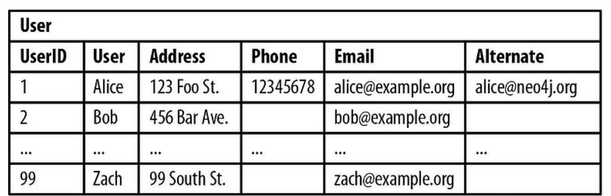
structs: why need structure data
…
alice@umich.edu
UserIDs
Names
Addresses
User 1
ID (1)
1
2
…
99
Alice
Bob
…
Zach
123 Foo st.
456 Bar Ave.
…
99 South st.
Name (‘Alice’)
Address (‘123 Foo St.’)
…
…
User 2
ID (2)
Name (‘Bob’)
Users
Address (‘456 Bar Ave.’)
…
Notes:
Why want structure? Why not multiple arrays?
call functions (long arguments) vs add a field (nothing would change on the function
2. Add/remove personel

Slide 34
structs
We can define any type of ‘fields’ data within a structure
  Name, phone number and address are the “fields” of the structure
Access data in a field using dot notation in the form: structName.fieldName
Notes:
Compare to cell, can access filed through name rather than index

Slide 35
Challenge: Generate array of 9 planet structs with fields name, diameter, mass and period
Planet | Diameter [km] | Mass / Earth | Period / Earth Days
Sun | 1,392,000 | 332,946.00 | 27 H
Mercury | 4,879 | 0.055274 | 58.646
Venus | 12,104 | 0.815005 | 243.019
Earth | 12,756 | 1 | 0.9973
Mars | 6,794 | 0.107447 | 1.026
Jupiter | 142,980 | 317.833 | 0.4101
Saturn | 1,120,540 | 95.159 | 0.444
Uranus | 51,120 | 14.5 | 0.7183
Neptune | 49,530 | 17.204 | 0.6712
Read file solar_system.csv from canvas for data
Notes:
for i =1:9
planets(i).name = A(i,1)
planets(i).diameter = str2double(A(i,2));

Slide 36
Matlab arrays, cells, structs
arrays are indexed with parentheses () and contain numeric types, char or strings etc. with each element of the same type. Elements must be in a rectangular array.
cells are indexed with braces { } and are arrays of types with each cell allowed to have a different type. Cells must be in a rectangular array.
structs are referenced by “field” with a period ., e.g. person.name with each field allowed a different type.

Slide 37
Next lecture
Project 2 / Debugging / Midterm exam review

