Slide 1








Sprint – Linked lists

Slide 2

Table of Contents
About our team
Our goal
Stages of Realisation
Apps/Language that we used
Block Scheme
Demonstration

Slide 3

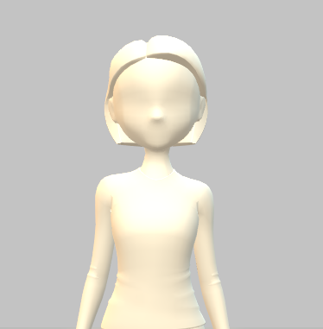
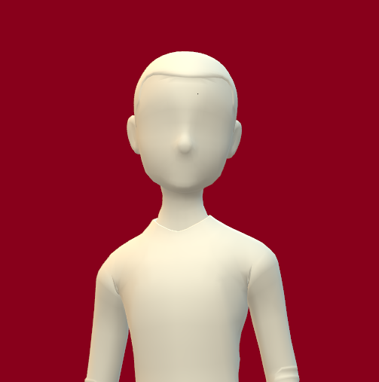
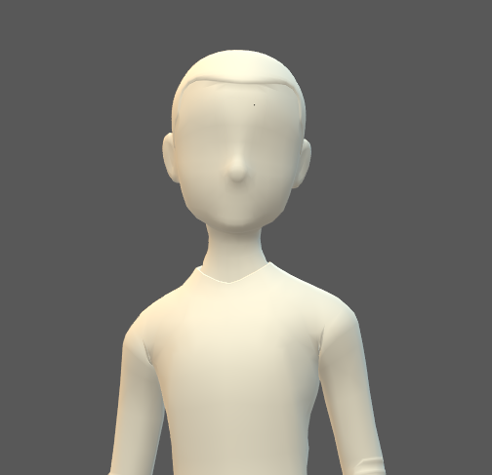
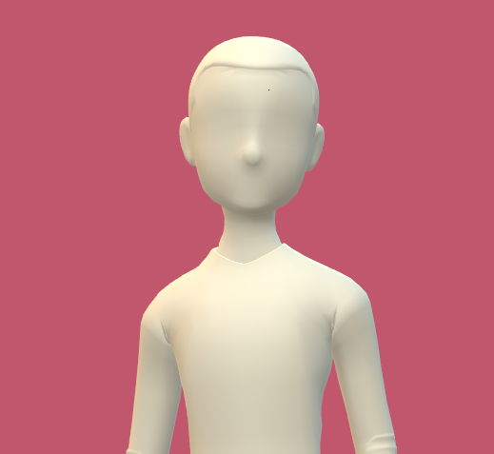
About our team
Petya Petkova
Scrum Trainer
Ivelin Vasilev
QA Engineer
Daniel Georgiev
Front-End Developer
Vasil Mladenov
Back-End Developer

Slide 4



Our Goal
An application for registration and management of historical events, using linked lists.

Slide 5



Stages of Realisation
ORGANIZATION
REALISATION
PRESENTATION

Slide 6






Apps/Language that we used

Slide 7
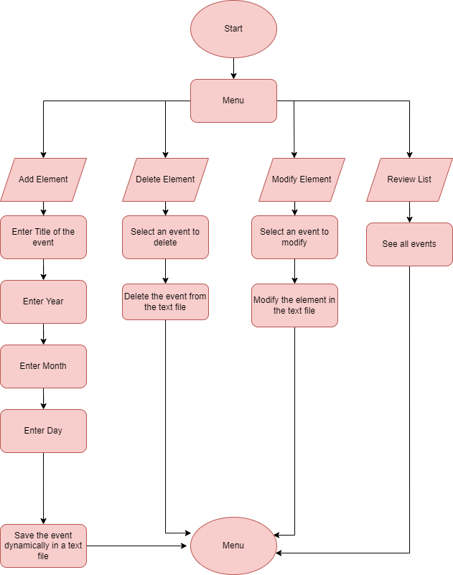

Block Scheme

Slide 8
Demonstration
?
?
?

Slide 9

Thank you for your attention!

