Slide 1






Sprint – Linked lists

Slide 2

Table of Contents
About our team
Our goal
Stages of Realisation
Apps/Language that we used
Block Scheme
Demonstration

Slide 3

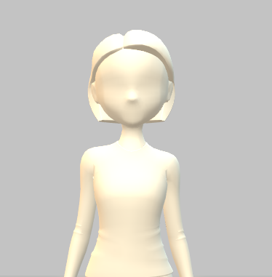

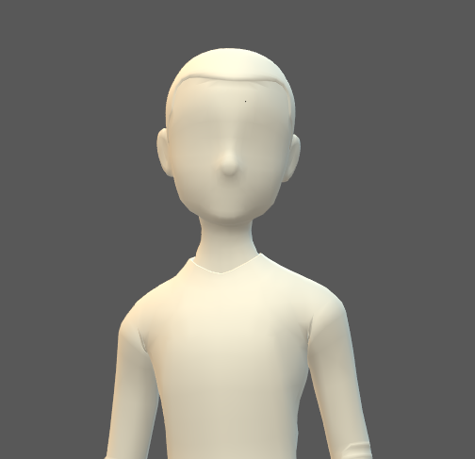
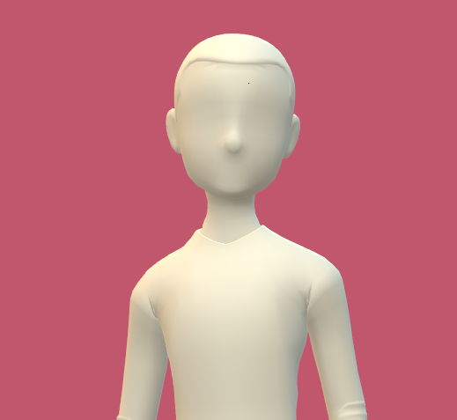
About our team
Petya Petkova
Scrum Trainer
Ivelin Vasilev
QA Engineer
Daniel Georgiev
Front-End Developer
Vasil Mladenov
Back-End Developer

Slide 4


Our Goal
An application for registration and management of historical events, using linked lists.

Slide 5



Stages of Realisation
Organization
Realisation
Presentation

Slide 6







Apps/Language that we used

Slide 7



Block Scheme

Slide 8

Demonstration

Slide 9

Thank you for your attention!

