Slide 1

CO-1 – Probability Session-01 & 02: Session Topic: Introduction to probability: Sample space and Events Probability, Statistics and Queueing Theory (Course code: 21MT2103RA)
1
Notes:
1

Slide 2
CO1 (Probability) - Introduction to Probability: Sample Space and Events - Probabilities defined on Events, Conditional Probabilities - Independent Events, Bayes Formula. - Random Variables, Probability Distribution Function
- Cumulative Distribution Function
- Discrete Random Variables: Bernoulli, Binomial, and Poisson.
2
Notes:
2

Slide 3
Course Handout
Complete Discussion About Course Handout
LTP Structures
Moocs Details
Evaluation Components and their details
source: https://ncert.nic.in/textbook.php?kemh1=16-16
3
Notes:
3

Slide 4
Probability: Review of concepts
Probability is a measure of uncertainty of various phenomenon. The role of probability theory is to provide a framework for analyzing phenomena with uncertain outcomes.
The three approaches:
The classical theory of probability: The probability of an event is computed as the ratio of the number of outcomes favorable to the event, to the total number of equally likely outcomes. This could be a thought experiment; example: tossing a coin; outcomes: head or tail
The statistical approach of probability: the probability on the basis of observations and collected data.
The above two approaches assume that all outcomes are equally likely.
The axiomatic approach of probability: Here, the outcomes need not have equal chances of occurrence. We may have reason to believe that one outcome is more likely to occur than the other. In this approach, some axioms are stated to interpret probability of events. To understand this approach, let us learn a few basic terms viz. random experiment, sample space, events
source: https://ncert.nic.in/textbook.php?kemh1=16-16
4
Notes:
4

Slide 5
Random experiments
Random experiment: In life, we perform many experimental activities, where the result may not be same, when the experiments are repeated under identical conditions. We are not sure which one of many possible results will actually be obtained. Such experiments are called random experiments.
A possible result of a random experiment is called its outcome.
An experiment is called random experiment if it satisfies the following two
conditions:
(i) It has more than one possible outcome.
(ii) It is not possible to predict the outcome in advance.
Two steps in description of a random experiment:
Describe possible outcomes of a random experiment
Describe beliefs about likelihood (chance) of outcomes
5
Notes:
5

Slide 6
Random experiments: examples
Example 1: Tossing a fair coin
Two outcomes: Head (H) and Tail (T)
Both are equally likely.
Example 2: Tossing a fair dice
Set of outcomes = {1,2,3,4,5,6} = sample space
All 6 outcomes are equally likely.
Example 3: Mathematics examination grade
The likelihood of a student getting first class is smaller than
the likelihood of getting pass class.
Example 4: Winner of world cup
The likelihood of India winning the next world cup in cricket is …
6
Notes:
6

Slide 7
Sample space
The sample space S is a list (set) of possible outcomes.
The list must be
Mutually exclusive, and
Collectively exhaustive
Types of outcomes:
Discrete
Continuous
Examples of experiments with discrete outcomes:
Tossing a coin: sample space, S = {H, T}
Tossing a dice: sample space, S = {1,2,3,4,5,6}
Each element of the sample space is called a sample point. In other words, each outcome of the random experiment is also called sample point.
7
Notes:
7

Slide 8
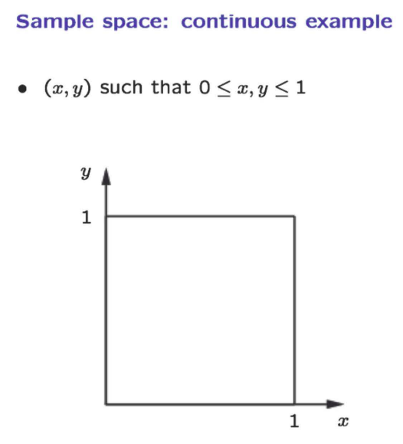
source: https://ocw.mit.edu/courses/res-6-012-introduction-to-probability-spring-2018/91864c7642a58e216e8baa8fcb4a5cb5_MITRES_6_012S18_L01.pdf
8
Notes:
8

Slide 9
Event
Any subset E of a sample space S is called an event.
Consider the experiment of throwing a dice.
Description of events Corresponding subset of S
the number is exactly 2 A = {2}
the number is an even integer B = {2,4,6}
the number is greater than 6 φ = {}
Occurrence of an event: The event E of a sample space S is said to have occurred if the outcome ω of the experiment is such that ω ∈ E.
If the outcome ω is such that ω ∉ E, we say that the event E has not occurred.
In the above example, if the outcome is 6, event B has occurred, and event A has not occurred. On the other hand, if the outcome is 2, both events A and B have occurred.
9
Notes:
9
ω – lower case Omega

Slide 10
Types of events
Impossible event : The null set φ={} is called an impossible event
Sure event : S, i.e., the whole sample space is called the sure
event.
Simple Event : If an event E has only one sample point of a sample space, it is called a simple (or elementary) event.
Compound Event : If an event has more than one sample point, it is called a Compound event.
10
Notes:
10
Φ - Phi

Slide 11
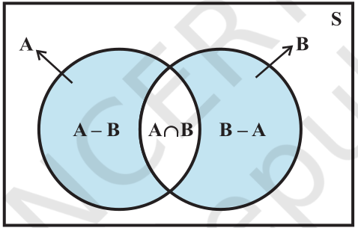
Algebra of events
We can combine two or more events to form new events.
Let A, B, C be events associated with an experiment whose sample space is S.
Complementary event : For every event A, there corresponds another event
A′ called the complementary event to A. It is also called the event ‘not A’.
A′ = {ω : ω ∈ S and ω ∉A} = S – A
A or B A ∪ B = {ω : ω ∈ A or ω ∈ B}
A and B A ∩ B = {ω : ω ∈ A and ω ∈ B}
A but not B A – B = A ∩ B´
source: https://ncert.nic.in/textbook.php?kemh1=16-16
11
Notes:
11

Slide 12
Events (contd.)
Mutually exclusive events : two events A and B are called mutually exclusive events if the occurrence of any one of them excludes the occurrence of the other event, i.e., if they can not occur simultaneously. In this case the sets A and B are disjoint.
For example, If A = {2,4,6} and B = {1,3},
A and B are mutually exclusive events.
Exhaustive Events : if E₁ , E₂ , ..., E_{n} are n events of a sample space S and if
E₁ ∪ E₂ ∪ E₃ ∪ ... ∪ E_{n} = ∪ E_{i} = S
i = 1 to n
then E₁ , E₂ , ..., E_{n} are called exhaustive events.
In other words, events E₁ , E₂ , ..., E_{n} are said to be exhaustive if at least one of them necessarily occurs whenever the experiment is performed.
12
Notes:
12

Slide 13
Events (contd.)
Mutually exclusive and exhaustive events
if E i ∩ E j = φ for i ≠ j i.e., events E i and E j are pairwise disjoint
and
E₁ ∪ E₂ ∪ E₃ ∪ ... ∪ E_{n} = ∪ E_{i} = S
i = 1 to n
then events E₁ , E₂ , ..., E_{n} are called mutually exclusive and exhaustive events.
A partition of a set S is a set of nonempty subsets of S, such that every element x in S is in exactly one of these subsets.
13
Notes:
13

Slide 14
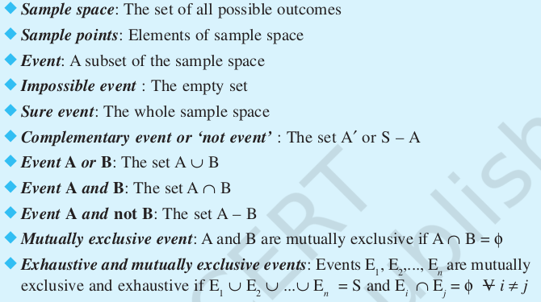
References
* https://ncert.nic.in/textbook.php?kemh1=16-16
* Notes: sections 1 to 1.3 of
http://www.statslab.cam.ac.uk/~rrw1/prob/prob-weber.pdf
Chapter 1 of TP1: William Feller, An Introduction to Probability Theory and Its Applications: Volume 1, Third Edition, 1968 by John Wiley & Sons,Inc.
14
Notes:
14

