Slide 1
안녕하세요
ㅇㅋ

Slide 3


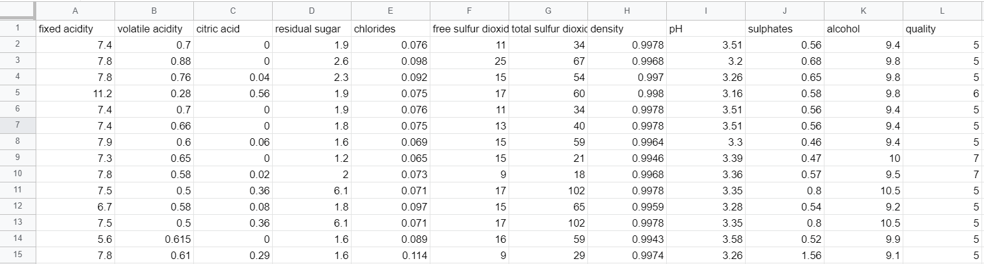
사용한 데이터셋
winequality-red.csv
Notes:
https://www.kaggle.com/uciml/red-wine-quality-cortez-et-al-2009

Slide 4
Feature 소개
free
sulfur
dioxide
total
sulfur
dioxide
fixed
acidity
volatile
acidity
citric
acid
residual
sugar
chlo-
rides
sulpha-tes
density
pH
alcohol
quality
주석산
농도
아세트산
농도
구연산
농도
잔류 당분
농도
염화
나트륨
농도
유리
아황산
농도
총
아황산
농도
밀도
(점성)
pH
황산
칼륨
농도
알코올
도수
와인
등급
Notes:
교재 182쪽.

Slide 5
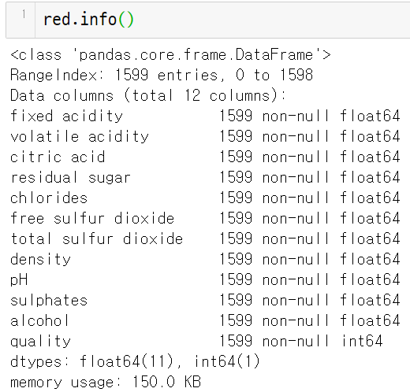
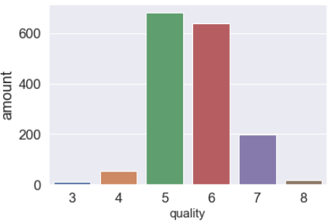
데이터 전처리
결측값, 데이터형식 확인
타겟 확인
→ 결측값 없음
→ 타겟 수정
(5이하 = 0, 6이상 = 1)

Slide 6
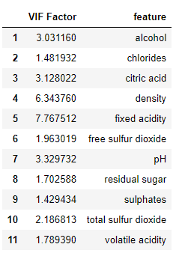
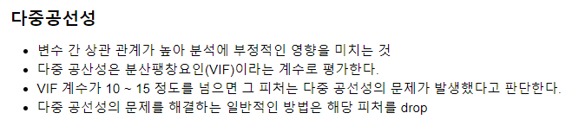
VIF 계수가 10을 넘는게 없으므로 변수 간 상관 관계가 높지 않은 것으로 판단.

Slide 7

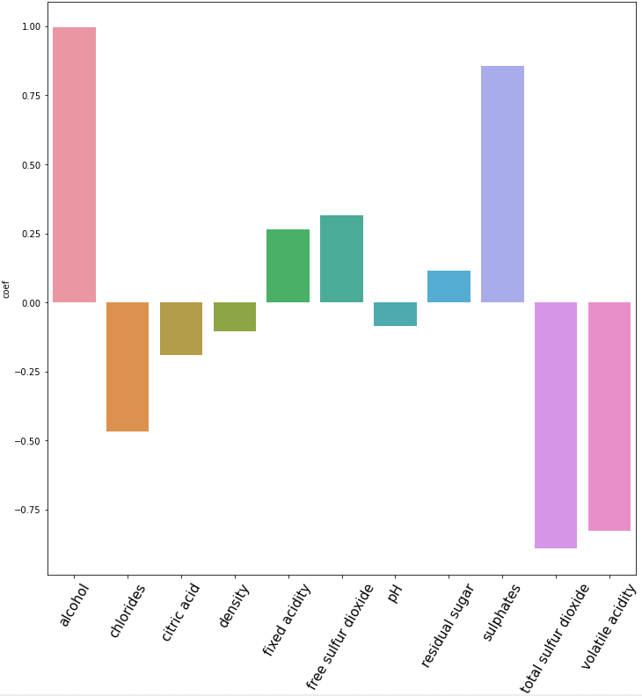
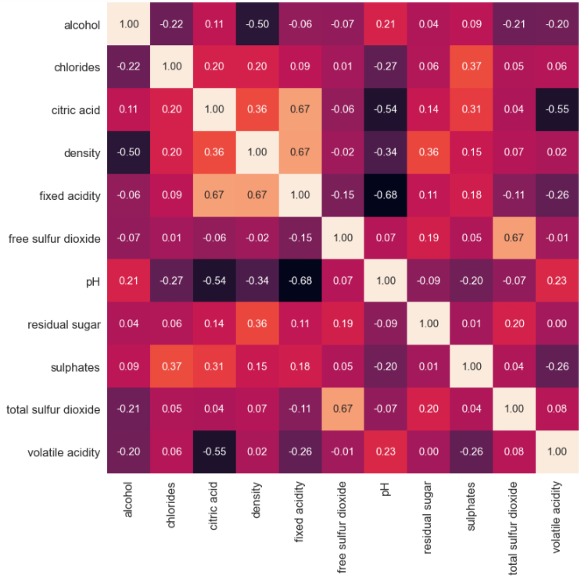
데이터 전처리 피처 상관도 분석
coef
→ 피처 삭제
free sulfur dioxide , total sulfur dioxide

Slide 8
데이터 예측 앙상블 기법
# 로지스틱, 결정트리, 최근접이웃
logistic = LogisticRegression(C=0.1, random_state=42)
tree = DecisionTreeClassifier(max_depth=20, criterion='entropy', random_state=42)
knn = KNeighborsClassifier(n_neighbors=1, p=2, metric='manhattan') # metric='minkowski'
voting_estimators = [('logistic', logistic), ('tree', tree), ('knn', knn)]
voting = VotingClassifier(estimators = voting_estimators, voting='soft')
clf_labels = ['Logistic regression', 'Decision tree', 'KNN', 'Majority voting']
all_clf = [logistic, tree, knn, voting]
voting.fit(X_train, y_train)
pred = voting.predict(X_test)
print('보팅 분류기의 정확도 : {0:.4f}'.format(accuracy_score(y_test, pred)))
보팅 분류기의 정확도 : 0.7969

Slide 9
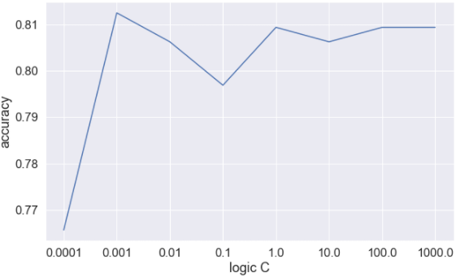
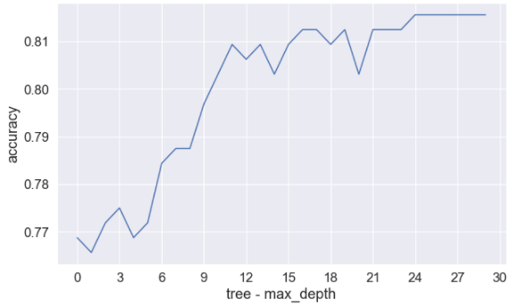
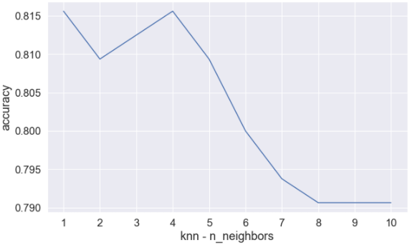
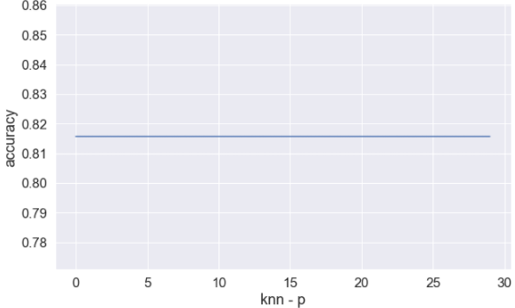
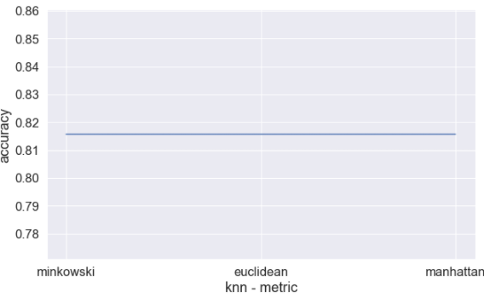
데이터 예측 앙상블 기법 - 하이퍼 파라미터 튜닝
Logic C (penalty)
Tree max_depth
knn n_neighbors
knn p
knn metric

Slide 11
ANN 모델

Slide 12
SVM 모델

Slide 13
Logistic Regression
### ‘valitile acidity’ 피처 제거
red_final2 = red_final[red_final.columns[:-1]]
red_final2 = red_final[red_final.columns[:-1]]
# red_final2 , y 데이터 split
from sklearn.model_selection import train_test_split
x_train, x_test, y_train, y_test = \
train_test_split(red_final2, y, stratify=y, test_size=0.2, random_state=42)
### red_final2 데이터 LogisticReression 모델 훈련 및 평가
x1 = x_train.values
y1 = y_train.values
from sklearn.linear_model import LogisticRegression
clf = LogisticRegression(C=10, solver='newton-cg', max_iter=100, random_state=42).fit(x1, y1)
predict = clf.predict(x_test)
accuracy= (predict == y_test).sum() /len(y1)
print(accuracy) = > 0.2501954652071931

Slide 14
Logistic Regression
# X_scaled, y 데이터 split
from sklearn.model_selection import train_test_split
x_train2, x_test2, y_train2, y_test2 = train_test_split(X_scaled, y, stratify=y, test_size=0.2, random_state=42)
# X_scaled 데이터 RogisticRegression 모델 훈련 및 평가
x3 = x_train2.values
y3 = y_train2.values
from sklearn.linear_model import LogisticRegression
clf = LogisticRegression(solver='newton-cg', max_iter=100).fit(x3, y3)
predict = clf.predict(x_test2)
accuracy= (predict == y_test2).sum() /len(y3)
print(accuracy) => 0.18451915559030493

Slide 15
경사하강법 클래스
from sklearn.linear_model import SGDClassifier
sgd = SGDClassifier(loss='log', max_iter=100, tol=1e-3, random_state=42)
sgd.fit(x_train2, y_train2)
sgd.score(x_test2,y_test2) => 0.71875

Slide 16
CNN(합성곱 신경망)
from tensorflow import keras
from sklearn.model_selection import train_test_split
x_train, x_test, y_train, y_test = train_test_split(red_final2,y,
stratify=y, test_size=0.2, random_state=42)
# 검증세트
train_scaled, val_scaled, train_target, val_target =\
train_test_split(x_train, y_train, stratify=y, test_size=0.2,random_state=42)

Slide 17
CNN(합성곱 신경망)
model = keras.Sequential()
model.add(keras.layers.Dense(128, #kernel_size=3, activation='relu', #padding='same', input_shape=(9,)))
model.add(keras.layers.MaxPool2D(2))
model.add(keras.layers.Conv2D(64, kernel_size=3, activation='relu', padding='same'))
model.add(keras.layers.MaxPool2D(2))
model.add(keras.layers.Dense(100, activation='relu'))
model.add(keras.layers.Dropout(0.4))
model.add(keras.layers.Dense(10, activation='softmax'))
model.summary()

Slide 18
CNN(합성곱 신경망)
model.compile(optimizer = 'adam', loss='sparse_categorical_crossentropy',metrics=['accuracy'])
# 복구점
checkpoint_cb = keras.callbacks.ModelCheckpoint('best-cnn-model.h5')
# 조기종료
early_stopping_cb = keras.callbacks.EarlyStopping(patience=2,
restore_best_weights=True)
history = model.fit(train_scaled, train_target, epochs=20,
validation_data=(val_scaled, val_target),
callbacks=[checkpoint_cb, early_stopping_cb])

Slide 19
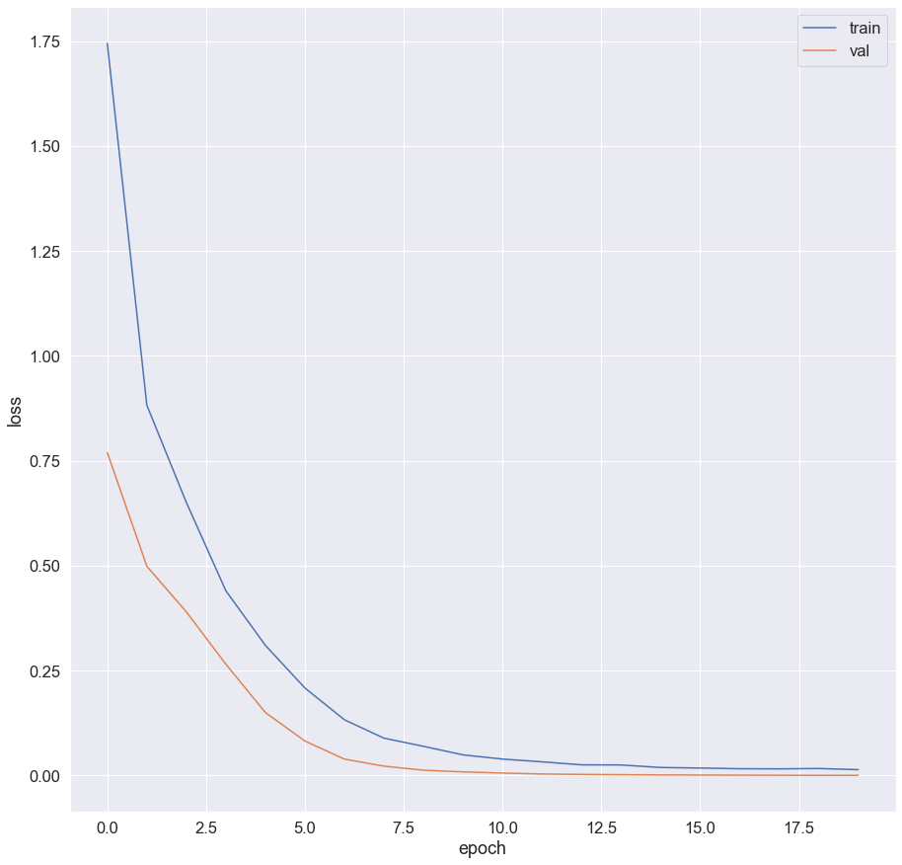
CNN(합성곱 신경망)
# 훈련손실과 검증손실 시각화
plt.plot(history.history['loss'])
plt.plot(history.history['val_loss'])
plt.xlabel('epoch')
plt.ylabel('loss')
plt.legend(['train','val'])
plt.show()
model.evaluate(train_scaled, train_target)
[0.0005498099538148494, 1.0]

Slide 20
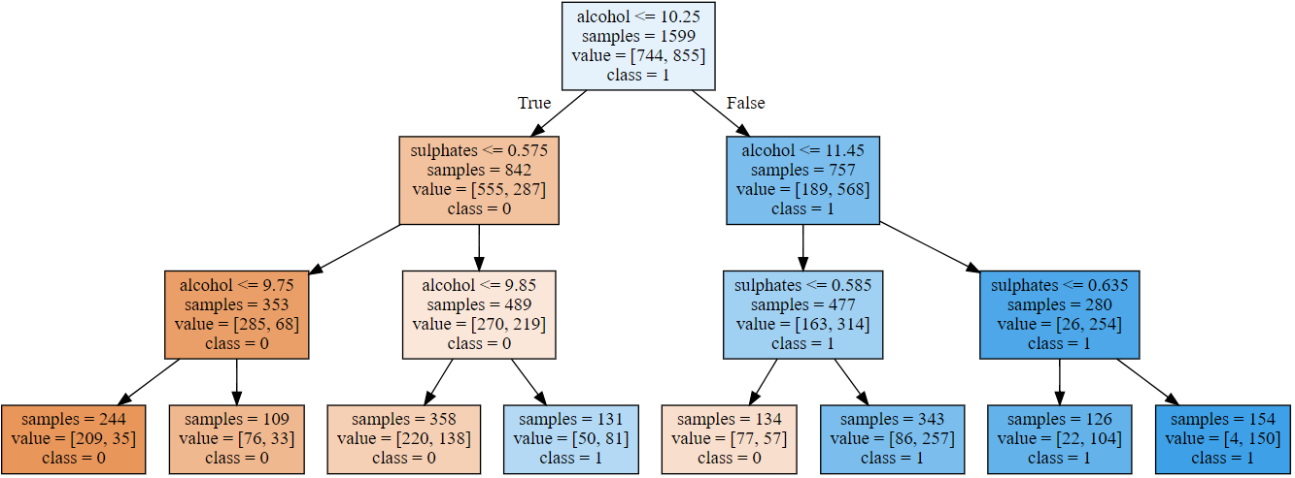
의사결정 나무 & 랜덤 포레스트
R_P

Slide 21
의사결정 나무
ㅋㅋ

Slide 22
랜덤포레스트 적용
적용했다.

