Slide 1


Slide 2

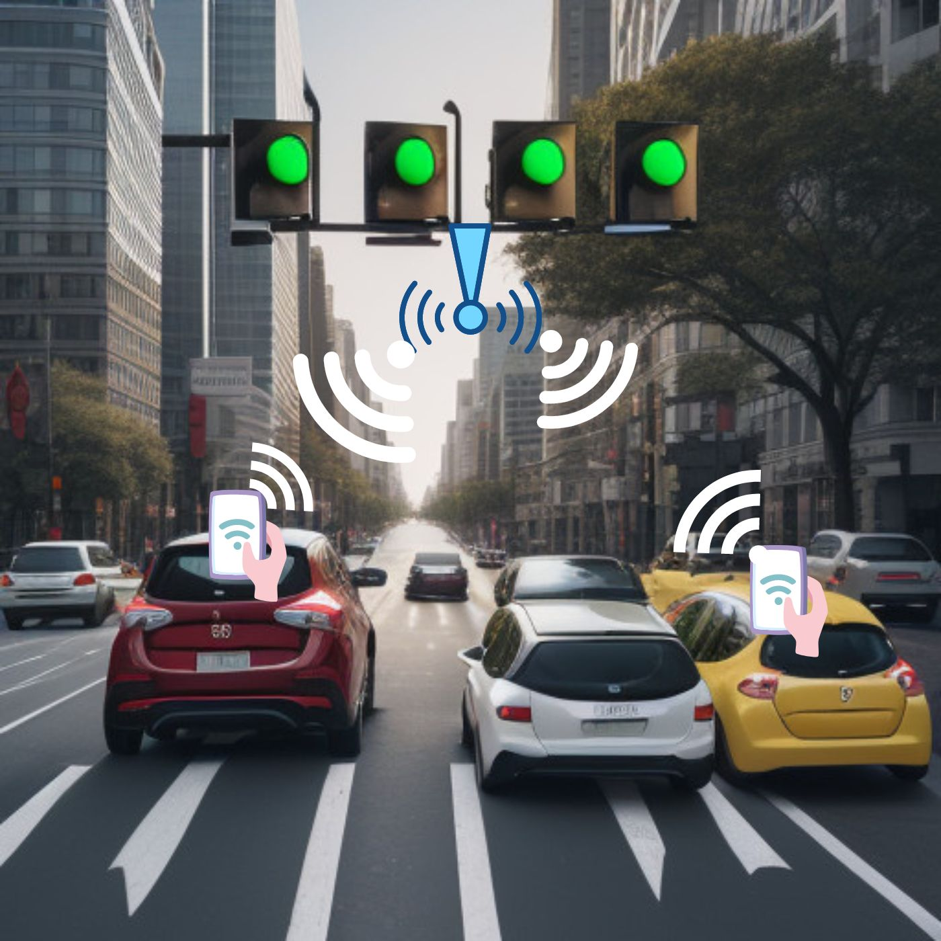
Topic :- Traffic Flow Guardian : A Smart Traffic Management System Prioritizing Efficiency through WiFi Technology
Idea Brief:-
General Traffic Optimization:
Utilize WiFi technology for real-time counting and analysis of traffic flow between signals.
Implement machine learning to predict and manage general traffic patterns efficiently.
Real-time Traffic Management:
Employ a responsive alert system to notify traffic authorities and users of potential congestion.
Enable authorities to make real-time decisions for optimized traffic flow.
Machine Learning Model:
Train the machine learning model to not only predict general traffic patterns routes based on real-time traffic conditions.
but also to dynamically adapt to emergency scenarios.
User App Participation:
Develop a user-friendly app for voluntary participation, contributing to the system's data pool.
Optionally, provide alerts to users suggesting alternative

Slide 3






Tech Stack Used
Tech Stack
user interface: by an app
Machine Learning:
Framework: TensorFlow or PyTorch ; Language: Python.
WiFi Counting System:
Hardware: Raspberry Pi , Software: Python or C++.
Communication:
Protocols: MQTT or HTTP.
Alert System:
Notification Service: FCM or Twilio.
Data Processing:
Cloud Services: AWS or Google Cloud; Processing: Apache Kafka
Security:
Encryption: SSL/TLS; Authentication: OAuth

Slide 4
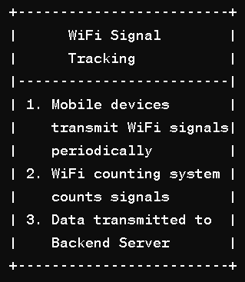
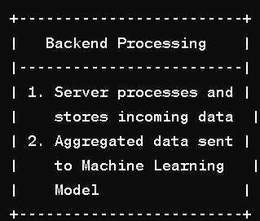
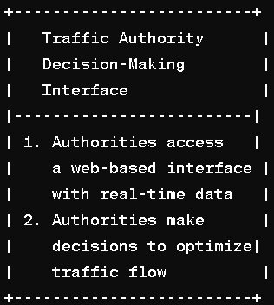
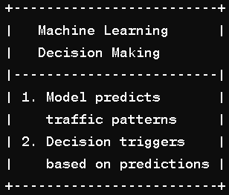
Architecture Design
Signal Tracking & | | Decision Workflow
Tracking Mechanism:
The WiFi counting system continuously scans for unique device signals between two signals.
User devices, transmitting WiFi signals, contribute to the count without compromising personal information.
Machine learning analyzes the count, predicting potential congestion or abnormal traffic conditions.
If the model identifies a critical situation, an alert is triggered, notifying traffic authorities.
Backend Processing
Server processes and stores incoming data
Aggregated data sent o Machine Learning Model
Alert Generation & Authority Notification
1 If congestion or abnormal traffic is predicted, an alert is triggered
2. Communication module sends alert to Traffic Authorities

Slide 5
What positive and unique solutions your idea have?
Low-Cost Implementation:
Unique Solution: Utilizes cost-effective WiFi counting systems like Raspberry Pi or Arduino, enabling widespread deployment without incurring exorbitant infrastructure costs. This approach makes the solution accessible for various communities and regions.
Machine Learning for Traffic Optimization:
Unique Solution: Leverages machine learning to predict traffic patterns and trigger alerts, enabling proactive and dynamic traffic management. This ensures timely interventions and enhances the efficiency of traffic flow in response to conditions
Integration with DigiLocker for Document Management:
Unique Solution: Provides a feature for users to securely save and manage their driving license and other documents using DigiLocker. This contributes to digital document storage and retrieval, aligning with the vision of a paperless and organized documentation system.
Easy Deployment
Allows for incremental deployment, meaning it can be introduced in specific regions or alongside existing systems.

Slide 6
Summary
impact on urban mobility challenges. Traffic Flow Guardian is a groundbreaking traffic flow management solution, uniquely blending user privacy, affordability, and advanced technology. By leveraging anonymized WiFi signals volunteered by users, it ensures privacy while encouraging active participation through a user-friendly mobile app. Cost-effective implementation, utilizing devices like Raspberry Pi or Arduino, makes it accessible for widespread adoption, particularly beneficial for regions with budget constraints. The integration of DigiLocker adds a digital dimension to document management, aligning with the global trend towards paperless solutions. WiFiFlow Guardian's machine learning predicts traffic patterns, triggering real-time alerts with low bandwidth usage. The system prioritizes public safety with an emergency SOS feature and dynamic adjustments for emergency vehicles on highways. Designed for seamless integration, it accommodates existing traffic management models, ensuring adaptability and widespread

Slide 7
Team Member Details :-
Team Member 1 Name: Rajtilak Joshi
Branch : Btech (CSE) Year (II nd)
Team Member 2 Name: Abhishek YADAV
Branch : B.tech (CSE) Year (II nd)
Team Member 3 Name: Piyush Joshi
Branch : B.tech (CSE) Year (II nd)
Team Member 4 Name: Hitesh Patel
Branch : B.tech (CSE) Year (II nd)

