Slide 1
PROJECT PRESENTATION ON
POLICYGPT
Government Policy & Public Scheme Intelligence Platform
Team-1

Slide 2
Features and Functionality
1
Policy Search System
Public Scheme Intelligence
Policy & Scheme Comparison
2
3
Search government policies
Advanced filtering
Category-wise search
State-wise search
Eligibility checker
Scheme recommendation
Scheme comparison
Application guidance
Scheme Repository
Eligibility Checking
Personalized Recommendations
Application Guidance
4
Notifications & Feedback
System
5
Analytics & Reporting
Dashboard
1
Policy & Scheme Management
Department Analytics
Usage Statistics
Policy & Scheme Reports
Citizen Engagement Insights
Policy Upload & Approval Workflow
Scheme Registration & Updates
Categorization & Archiving
Centralized Repository Management
Policy Update Alerts
Scheme Notifications
Application Status Updates
Citizen Feedback Management

Slide 3
Technology Stack: MERN
Frontend
Backend
Database
Tools
React
Tailwind CSS
Node.js
Express.js
MongoDB
Mongoose
GitHub
VS Code

Slide 4
Outcomes and Impact
1
Improved Access to
Government Information
2
Better Transparency
Citizens can quickly discover relevant policies and schemes.
Centralized platform for government documents.
3
Data-Driven Decision Making
4
Efficient Scheme Discovery
Analytics dashboards and reports help administrators monitor engagement
Eligibility checking and comparison simplify benefit identification.

Slide 5
User Registration & Roles
1
User Registration
Citizen Registration
Government Official Registration
Researcher Access
Organization Access
2
Secure Authentication
JWT Authentication
Role-Based Access Control
3
Supported Roles
Administrator
Government Official
Citizen
Researcher
Organization

Slide 6

Challenges And Solutions
Challenges:
Managing Large Volumes of Policy Data
Ensuring Secure User Access.
Providing Accurate Search Results
Generating Meaningful Analytics
Solutions:
Implemented structured categorization and centralized storage
for efficient policy and scheme management.
Used JWT Authentication and Role-Based Access Control (RBAC) to
protect sensitive operations and data.
Developed advanced filtering and search mechanisms based on
categories, states, ministries, and departments.
Built analytics dashboards and reporting modules to visualize application
trends and departmental performance.

Slide 7

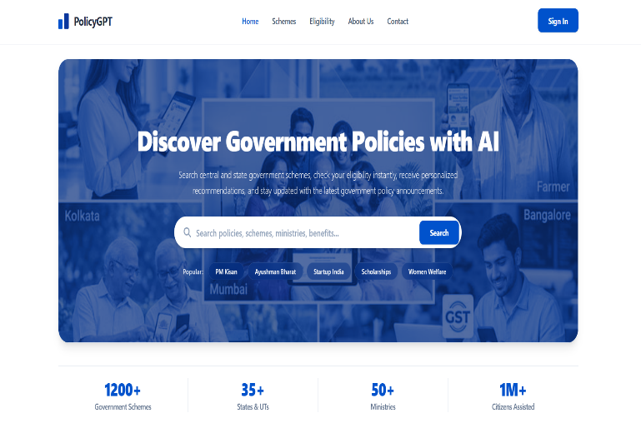
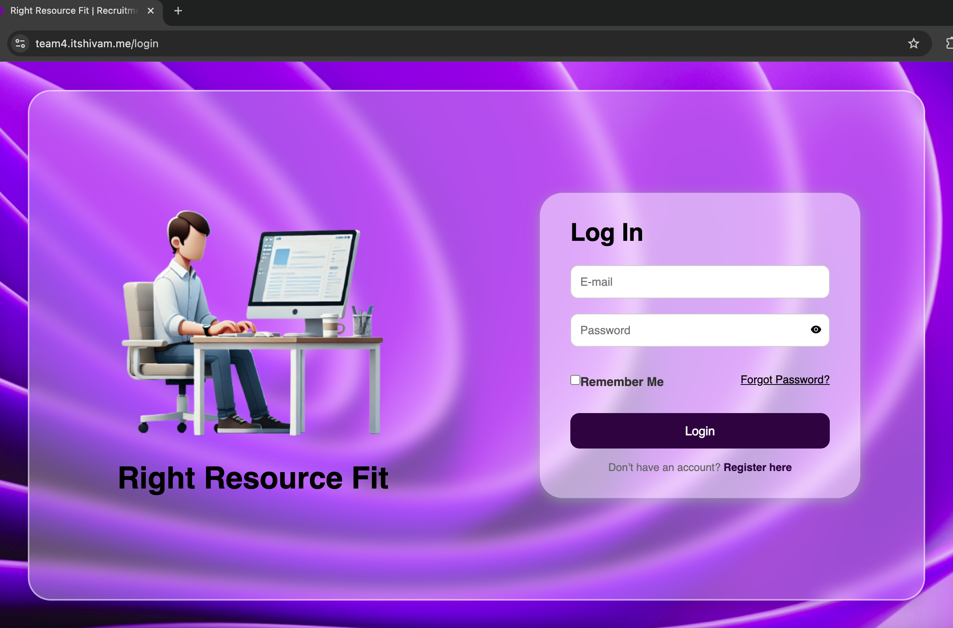



UI/UX Design
User-centric
Designed for citizens, officials, researchers, and organizations.
Responsive Design
Supports desktop, tablet, and mobile devices.
Dashboard-Based Experience
Separate dashboards for:
Citizens
Government Officials
Administrators

Slide 8

User Interfaces (UI) Mock-ups
Showcase screenshots of key UI components:
Landing page

Slide 9
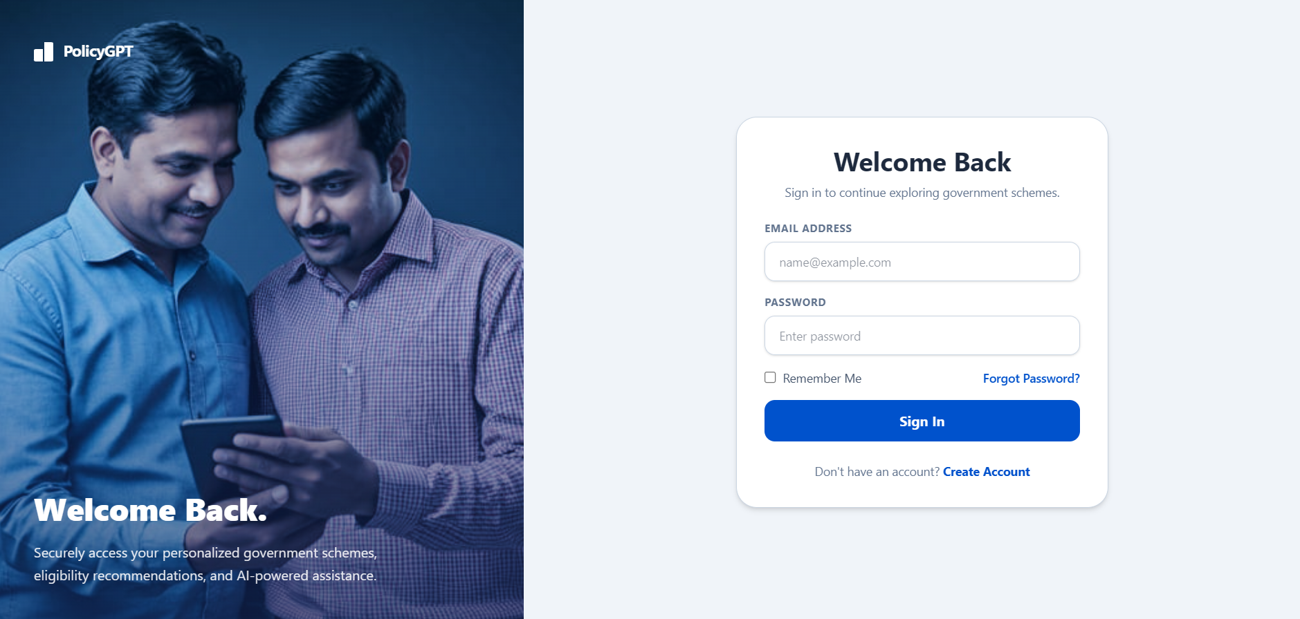
2. Login Page:

Slide 10
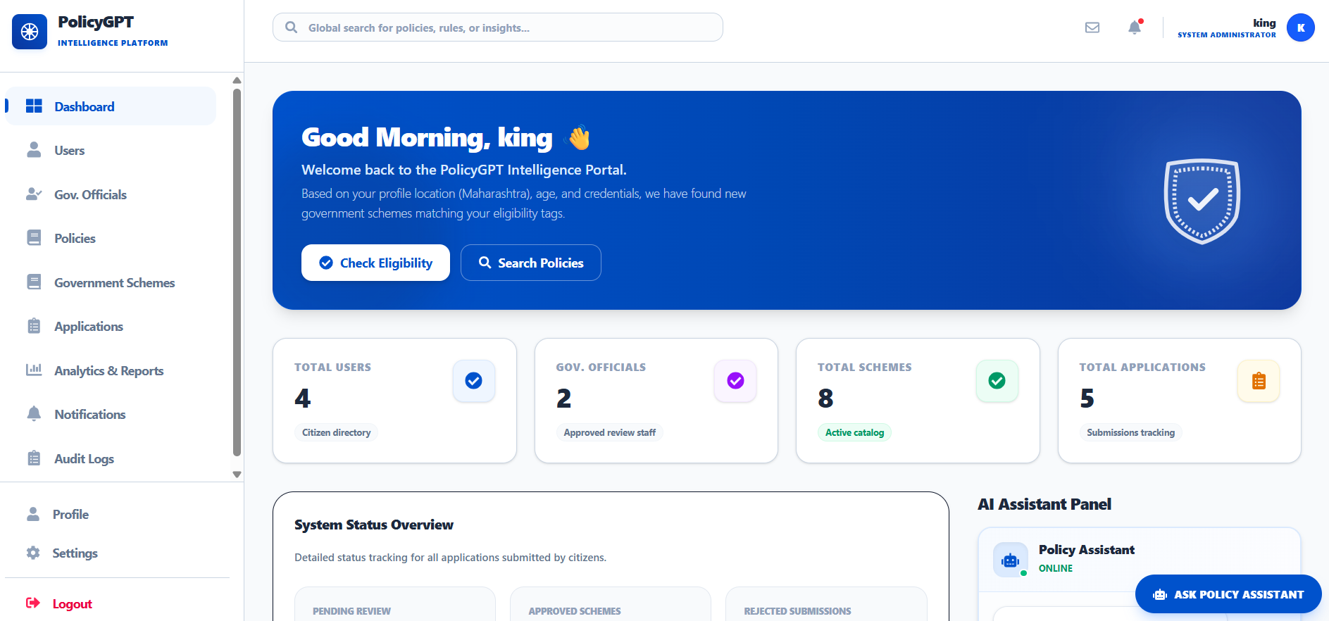
3. Admin Dashboard:

Slide 11
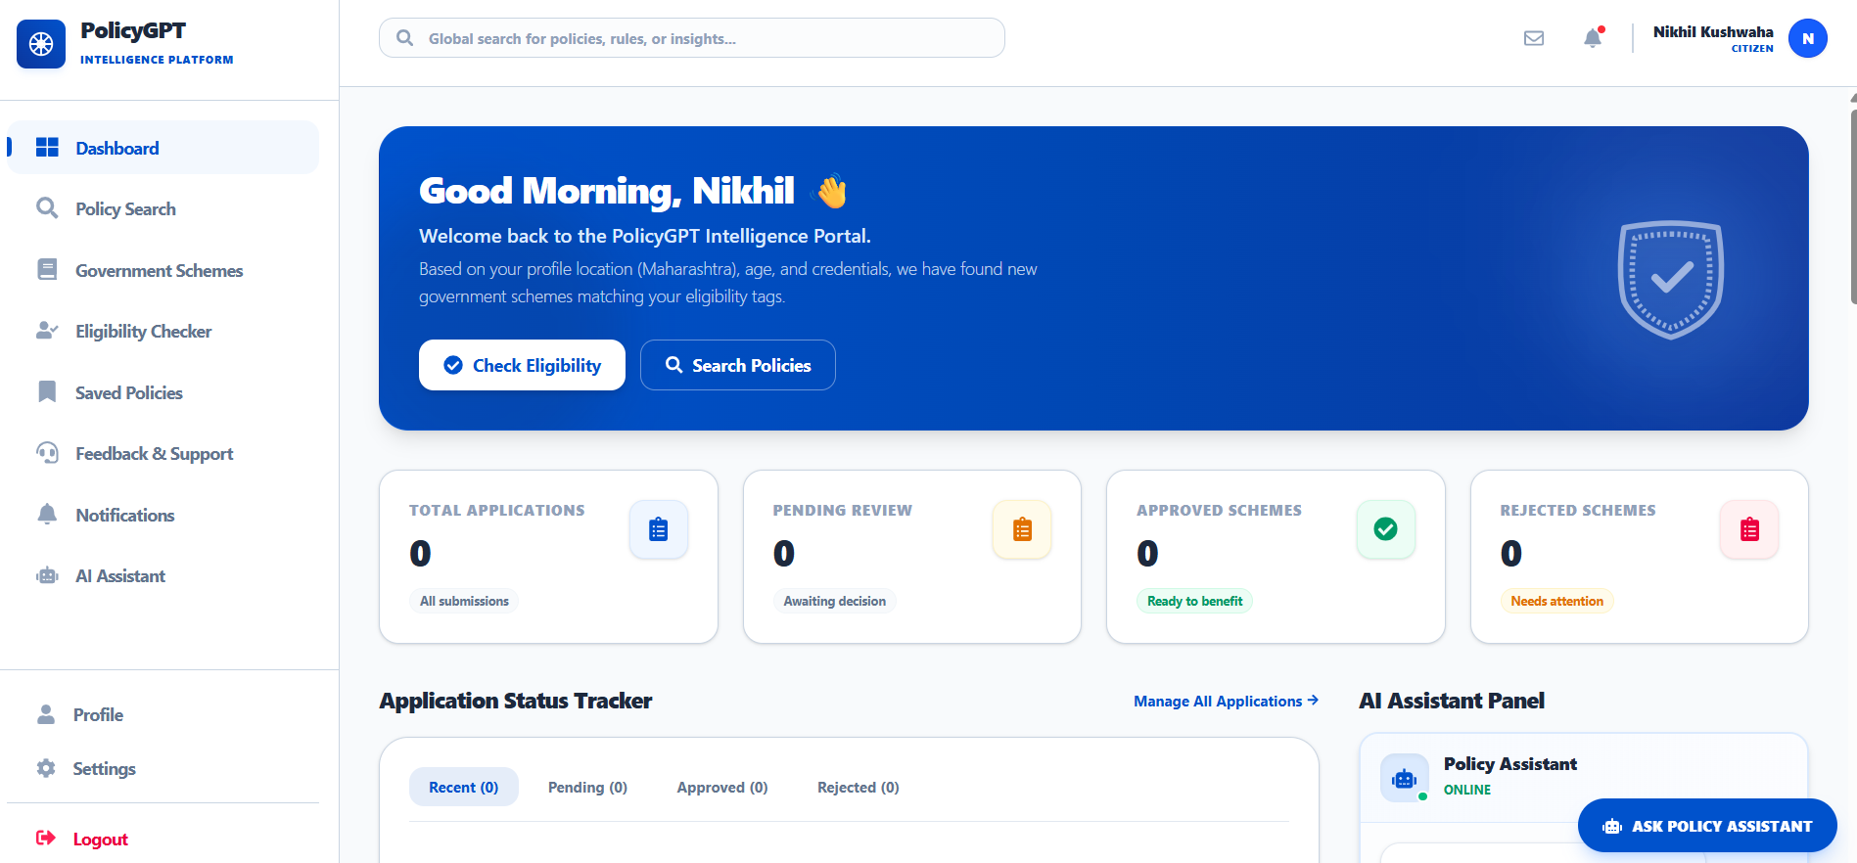
4. Citizen Dashboard:

Slide 12
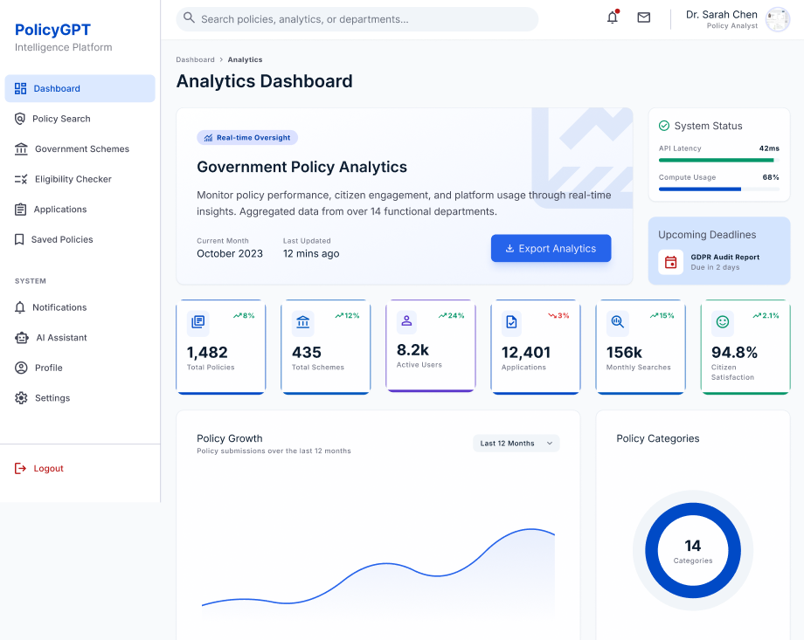
5. Analytics Dashboard:

Slide 13
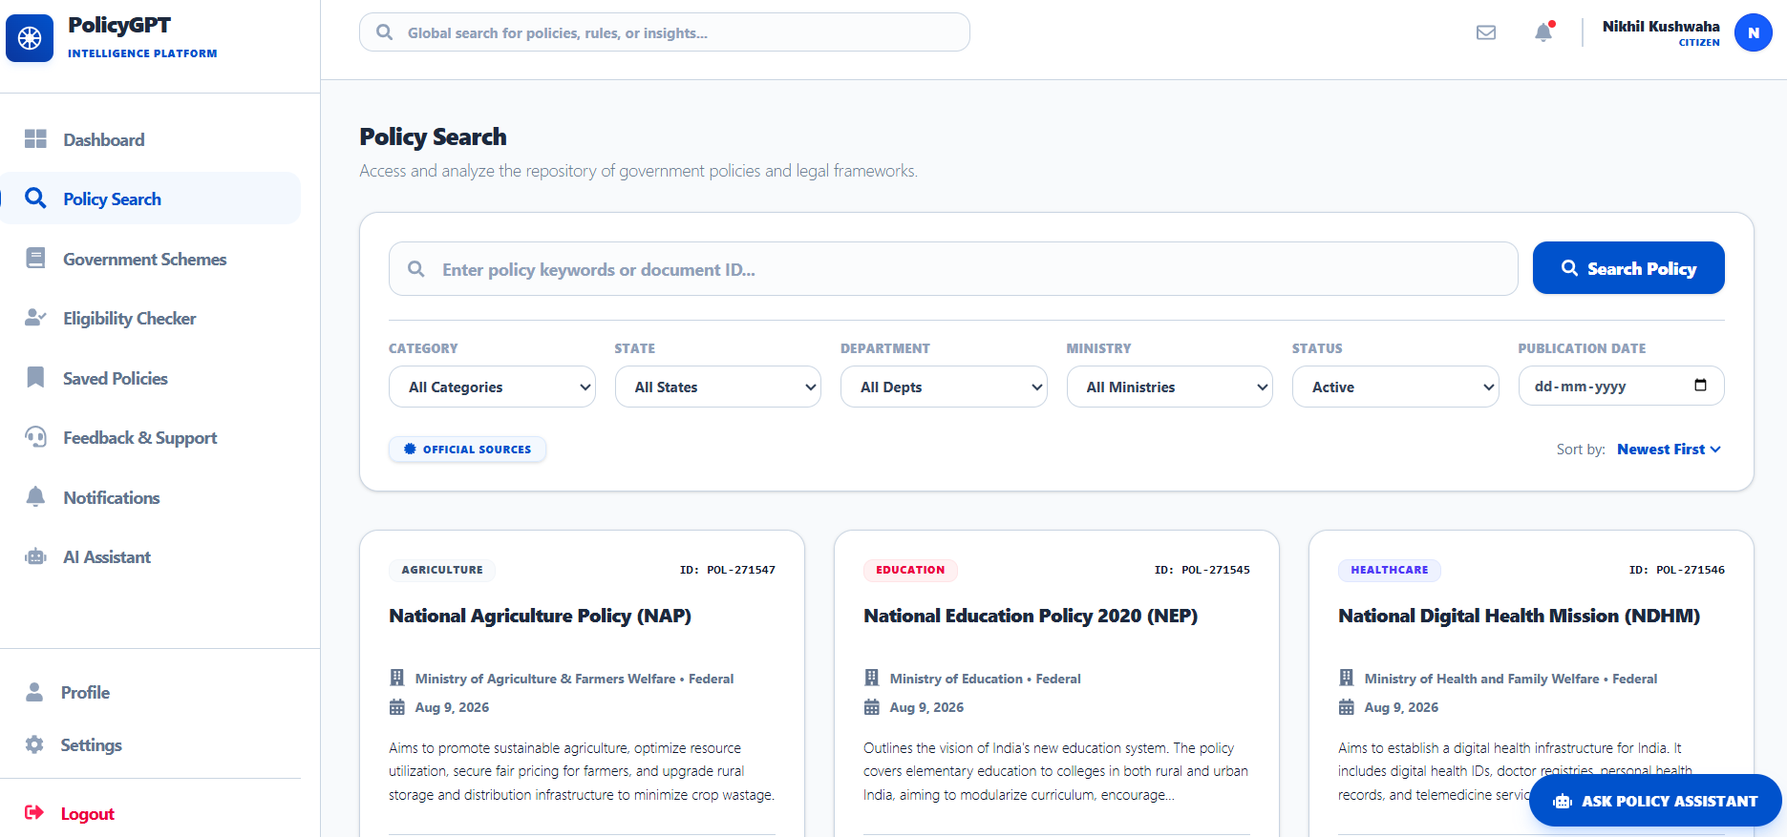
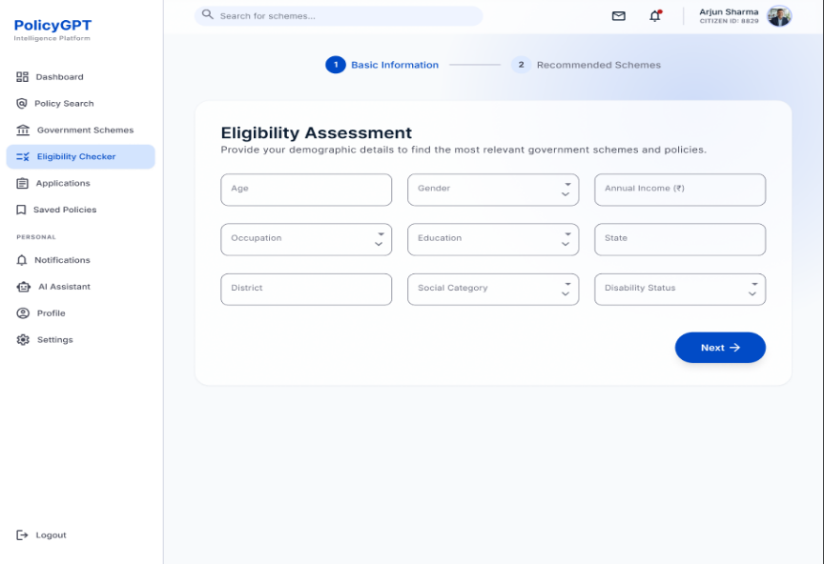
6. Policy Search & Eligibility checker:

Slide 14
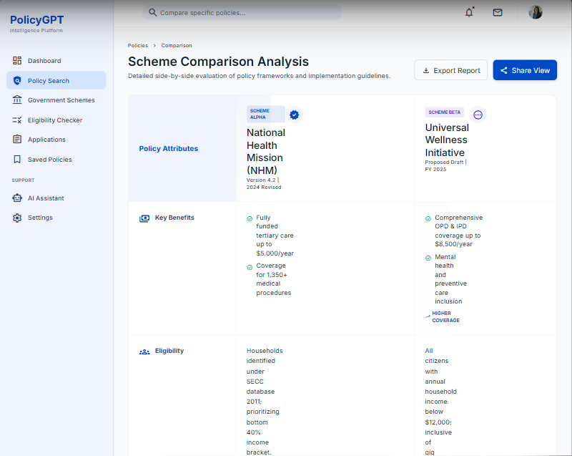
7. Policy Comparison:

Slide 15
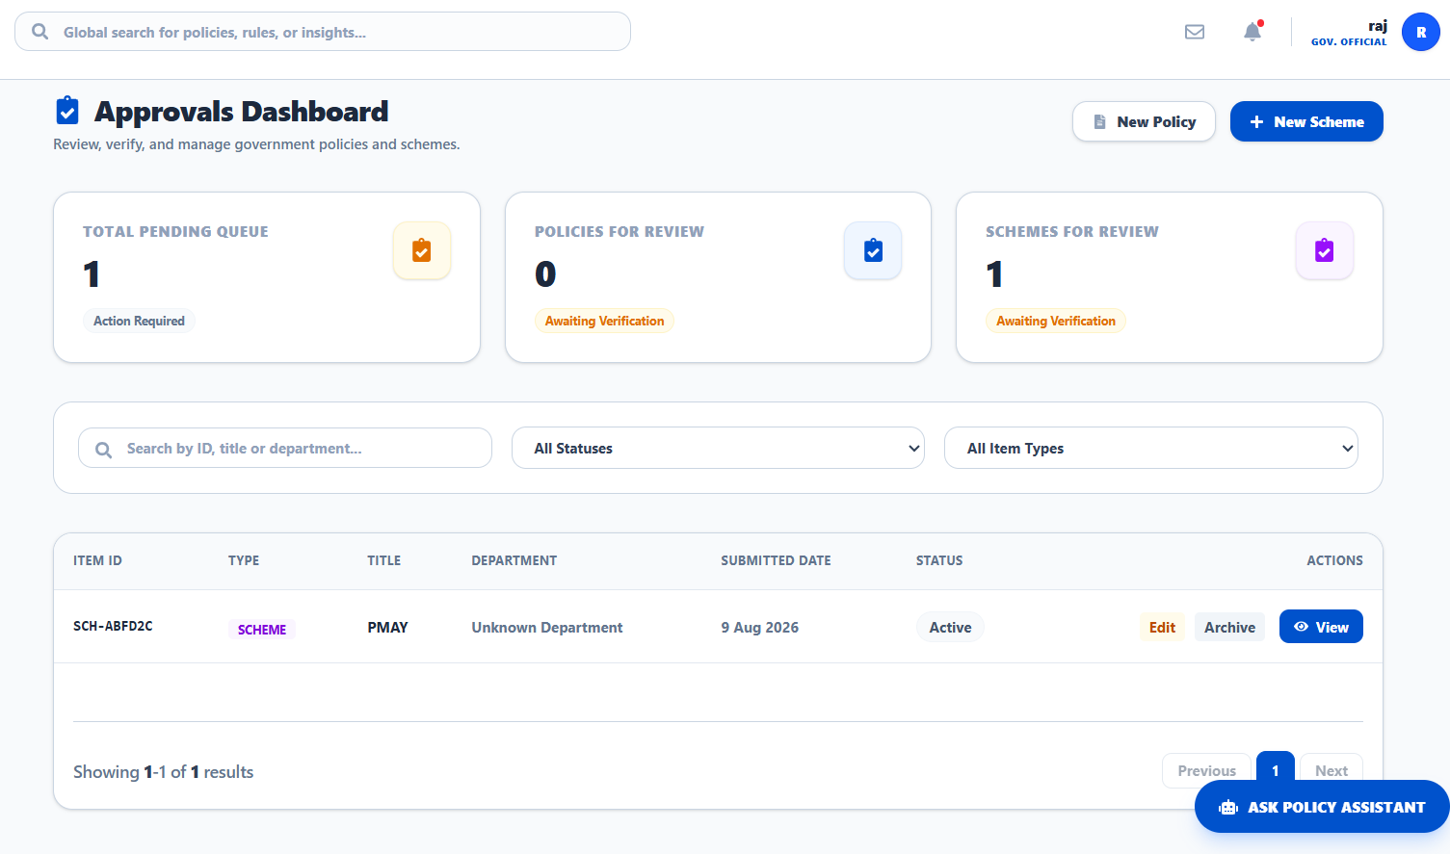
8. Approval Dashboard:

Slide 16
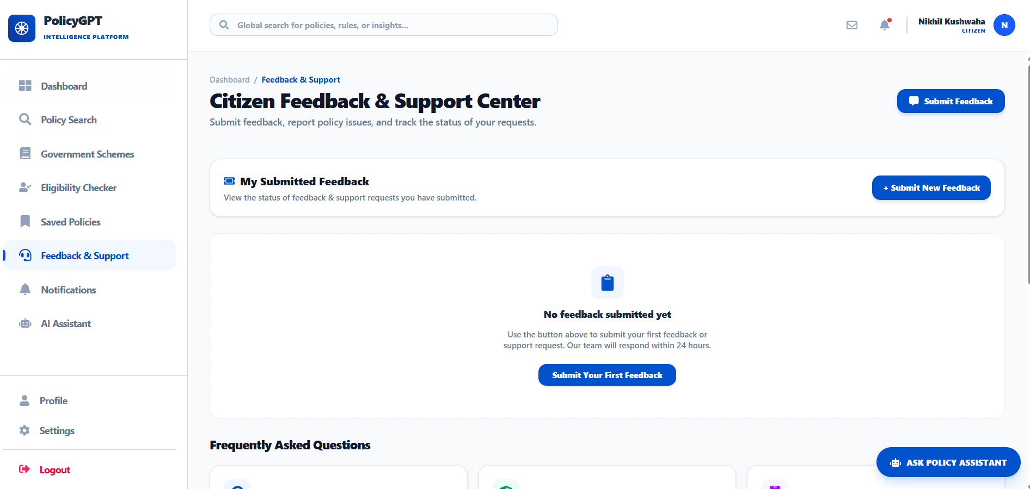
9. Feedback Page:

Slide 17


Our Team:-
Piyush
Ashit
Sujitha
Nikhil

Slide 18




Q&A

Slide 19
Thank you

