Slide 1
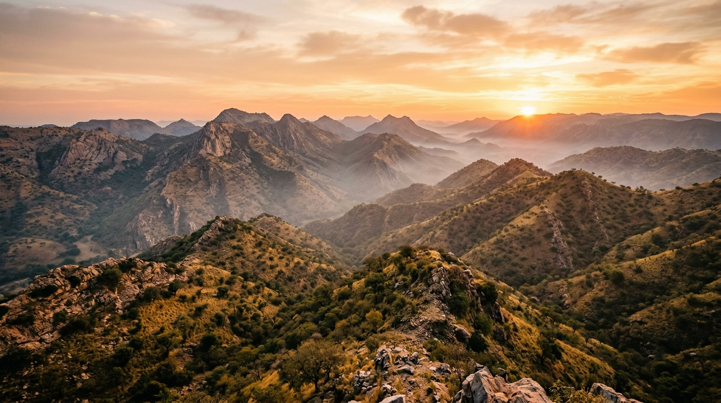
🏆 ARAVALLI BUILD CHALLENGE • ABC — Aravali Build Championship by GDG Udaipur
ARAVALLI SENTINEL
AI-Powered Ecological Early-Warning & Satellite Action Platform
PROBLEM STATEMENT:
Halting illegal mining, large-scale deforestation, and toxic dumping in the fragile Aravalli mountain corridor through vernacular multimodal citizen reporting, Google Gemini AI triage, and Sentinel-2 satellite change detection.
⭐ GOOGLE TECHNOLOGIES TRACK: Built with Google Gemini 1.5 Pro/Flash, Google Earth Engine (Sentinel-2 MSI), Google Maps Platform, Google Cloud Run & Android Health Connect.
TEAM
Team Sentinel
[Aravalli Guardians]
TRACK
Sustainability, AI & Climate Action
Google Cloud & Gemini Track
TEAM MEMBERS
Member 1: Team Lead & Full-Stack
Member 2: AI & Satellite • Member 3: UI/UX & Mobile
ABC — Aravali Build Championship by GDG Udaipur | Aravalli Sentinel — AI-Powered Ecological Protection
1 / 7

Slide 2

🌿 ABC — Aravali Build Championship
GDG UDAIPUR • BUILD CHALLENGE
PROBLEM STATEMENT — Everyday Environmental Crises
Citizens witness illegal destruction daily, but face broken helplines, fear of retaliation, and zero accountability.
⚠️ No Official Helpline
⚠️ Fear of Intimidation
⚠️ Unchecked Night Dumping
⚠️ Zero Tracking & Action
1. Tree Felling & Charcoal Kilns
2. Illegal Dynamite Blasting
3. Toxic Waste Dumping
4. The 'Complaint Black Hole'
Morning commuters and villagers see mature Dhau trees chopped and illegal kilns smoking, but don't know who the local beat guard is or where to lodge a report.
Stone crushing blasts shake rural homes, fracture groundwater aquifers, and generate silica dust clouds. Citizens fear mafia intimidation if they report openly.
Tankers and dumpers stealthily unload hazardous chemical effluent and industrial debris into dry seasonal riverbeds and hill gaps overnight, poisoning wells.
When people post on social media or dial helplines, reports vanish into a black hole: no Case ID, no status updates, no satellite proof, and zero feedback.
🎯 TARGET USERS: Concerned Daily Commuters • Rural Villagers & Farmers • Forest Beat Guards • District Forest Officers (DFO) • Environmental NGOs
ABC — Aravali Build Championship by GDG Udaipur | Aravalli Sentinel — AI-Powered Ecological Protection
2 / 7

Slide 3
🌿 ABC — Aravali Build Championship
GDG UDAIPUR • BUILD CHALLENGE
SOLUTION & WORKFLOW — The Ecological Defense Pipeline
An AI-assisted, satellite-verified workflow from zero-friction evidence capture to official resolution.
💡 OUR SOLUTION: A two-portal intelligence platform where citizens report environmental crimes in seconds using vernacular voice notes and photos, while Forest Authority officers receive Gemini AI severity scores and Sentinel-2 satellite NDVI verification.
01
02
03
04
05
06
Step 1: Capture Evidence
Step 2: Auto-Telemetry
Step 3: Gemini AI Triage
Step 4: Case ID Generated
Step 5: Satellite Analysis
Step 6: Resolution & Rewards
Photo, Video or Multilingual Voice Note (Hindi / English / Hinglish). No lengthy forms.
Browser captures precise GPS coordinates and auto-fetches ambient weather context.
Multimodal visual forensics classifies damage, rates severity & maps forest violation codes.
Collision-proof ARV-2026-XXXXXX docket dispatched instantly with confidential officer notes.
Officer console verifies vegetation delta via Sentinel-2 MSI NDVI (B8-B4)/(B8+B4).
Citizen tracks milestone updates via /track & earns verified Eco-Points via /rewards.
🎤 Multilingual Voice AI
Hindi & Hinglish voice reporting
🛰️ Sentinel-2 MSI NDVI
Multi-temporal satellite change scan
🔒 Dual-Portal RBAC
Confidential officer notes protection
🏆 Eco-Points Wallet
Health Connect verified rewards
ABC — Aravali Build Championship by GDG Udaipur | Aravalli Sentinel — AI-Powered Ecological Protection
3 / 7

Slide 4

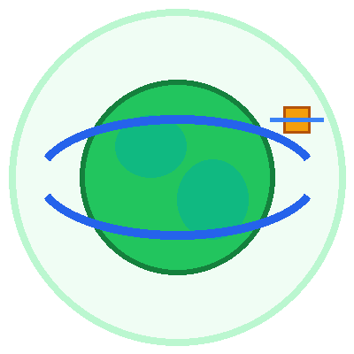
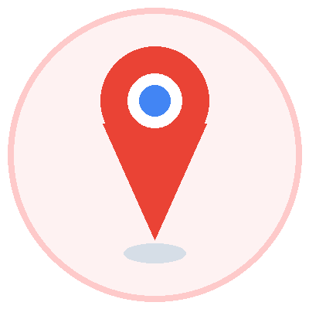


🌿 ABC — Aravali Build Championship
GDG UDAIPUR • BUILD CHALLENGE
GOOGLE AGENTS & TECHNOLOGIES — Powering Aravalli Sentinel
Deep integration with Google Cloud, Gemini Multimodal AI, Earth Engine and Maps Platform.
⭐ HACKATHON FOCUS: 'Using Google/Google Cloud Technologies and AI in your solutions will earn you bonus marks.' We deployed 5 core Google technologies across our full stack.
Google Gemini 1.5 Pro / Flash
Google Earth Engine (GEE)
Google Maps Platform
Google Cloud Run & Storage
Android Health Connect
Multimodal AI Intelligence
Satellite Planetary Intelligence
Geospatial GIS & Geocoding
Scalable Serverless Infrastructure
Mobile Citizen Health Integration
• Visual Forensics: Detects tree stumps, heavy earthmovers & debris in uploaded photos.
• Multilingual Speech-to-Text: Transcribes Hindi, English & Hinglish voice notes into structured incident reports.
• Legal Mapping: Auto-suggests Indian Forest Act violations & assigns ecological severity scores.
• Multispectral Telemetry: Ingests Sentinel-2 MSI surface reflectance data over Aravalli coordinates.
• NDVI Engine: Mathematical vegetation index computation: (B8_NIR - B4_Red) / (B8_NIR + B4_Red).
• Canopy Loss Alert: Flags temporal vegetation drop with honest disclaimer for field inspection.
• Interactive Risk Heatmap: Renders color-coded threat clusters across Rajasthan & Haryana.
• Protected Zone Polygons: Overlays legal boundaries of Sariska, Sajjangarh, and buffer zones.
• Reverse Geocoding: Auto-translates raw latitude/longitude into human-readable landmarks.
• Low-Latency APIs: Containerized microservices hosting Node.js/Express with auto-scaling.
• Forensic Cloud Storage: Tamper-proof encrypted evidence storage for citizen photos & videos.
• Enterprise Security: HTTPS TLS encryption, rate limiting, and 99.9% uptime SLA.
• Eco-Volunteer Tracking: Simulates androidx.health.connect step counter for patrolling guards.
• Green Fitness Rewards: Connects physical tree-planting walks to Environmental Contribution Points.
• Civic Engagement: Gamified incentive model turning eco-protection into a community habit.
ABC — Aravali Build Championship by GDG Udaipur | Aravalli Sentinel — AI-Powered Ecological Protection
4 / 7

Slide 5
🌿 ABC — Aravali Build Championship
GDG UDAIPUR • BUILD CHALLENGE
TECH STACK — Production-Grade Full-Stack Architecture
Engineered for high reliability, explainable AI risk scoring, and zero dummy data dependencies.
FRONTEND
BACKEND
DATABASE
AI & SATELLITE
DEPLOYMENT & QA
Interactive UI / UX
REST Microservices
Geospatial Storage
Ecological Intelligence
DevOps & Quality
✔ React 18 & Vite (Ultra-fast build)
✔ Tailwind CSS (Nature Light System)
✔ Leaflet & Google Maps JS API
✔ Lucide React Modern Iconography
✔ HTML5 Audio & Video Stream Recording
✔ Canvas Confetti & Toast Feedback
✔ Node.js (v18+) & Express.js
✔ RESTful Resource Architecture
✔ Multer (Multipart Evidence Upload)
✔ JSON Web Tokens (JWT Auth)
✔ Helmet Security & Rate Limiting
✔ Role-Based Access Control (RBAC)
✔ MongoDB Atlas & Mongoose ODM
✔ Geospatial 2dsphere Spatial Indexing
✔ GeoJSON MultiPolygon Forest Zones
✔ Indexed Collision-Proof Case IDs
✔ Confidential Internal Notes Separation
✔ Reward Ledger & Points Wallet
✔ Google Gemini 1.5 Multimodal SDK
✔ Sentinel-2 MSI Spectral Engine
✔ NDVI = (B8-B4)/(B8+B4) Engine
✔ Open-Meteo Real-Time Weather API
✔ Multilingual Voice Audio Transcriber
✔ Exif & Image Forensic Metadata
✔ Google Cloud Run (Auto-scaling)
✔ Vercel Edge CDN Deployment
✔ Docker Containerization
✔ Vitest Suite: 72/72 Tests Passed
✔ 100% Passing Integration Tests
✔ Git / GitHub Action CI/CD
🧪 TEST VERIFICATION: 72 / 72 Vitest Automated Unit & Integration Tests Passing (100%) • Vite Production Build: 0 Errors • Real MongoDB & Satellite Queries
ABC — Aravali Build Championship by GDG Udaipur | Aravalli Sentinel — AI-Powered Ecological Protection
5 / 7

Slide 6
🌿 ABC — Aravali Build Championship
GDG UDAIPUR • BUILD CHALLENGE
IMPACT & SCALABILITY — From Udaipur Ridges to a Pan-India Shield
Demonstrated local impact with a scalable architecture ready for nationwide expansion.
🌟 REAL IMPACT
Prevents irreversible destruction of 3.2-billion-year-old rock formations, stops groundwater depletion, and protects native Dhau forest flora.
🌟 MORE USERS
Vernacular voice-first reporting in Hindi & Hinglish eliminates literacy and tech hurdles for rural farmers, grazers, and forest-fringe communities.
🌟 BUILT TO SCALE
Cloud-native microservices, geospatial indexing, and serverless satellite APIs engineered to process thousands of simultaneous reports.
UDAIPUR — Local Impact
RAJASTHAN — Regional Corridor
INDIA — National Blueprint
• Preserves Udaipur Lake Catchment Ridges (Pichola, Fateh Sagar & Badi).
• Shields Sajjangarh Wildlife Sanctuary eco-sensitive buffer.
• Real-time monitoring of Gogunda & Sukher marble slurry dumping.
• Defends the 692 km natural barrier stopping Thar Desert expansion.
• Protects Sariska & Ranthambore wildlife crossing corridors.
• Connects Jaipur, Alwar, Rajsamand & Sirohi district forest offices.
• Scalable blueprint for Western Ghats, Shivaliks & Central Indian forests.
• Unified interface for Ministry of Environment, Forest & Climate Change.
• Empowers millions of citizens as verified ecological guardians.
🚁 Autonomous Drone Patrols
Edge AI aerial surveys for inaccessible high ridge illegal mining pits.
💬 WhatsApp / Telegram Bot
Zero-app citizen reporting: send photos & voice notes directly via chat.
⚖️ Automated Legal FIRs
Auto-drafts legal complaints mapped to Indian Forest Act & NGT orders.
🌱 Carbon Credit Ledger
Exchange verified citizen Eco-Points for local partner green rewards.
ABC — Aravali Build Championship by GDG Udaipur | Aravalli Sentinel — AI-Powered Ecological Protection
6 / 7

Slide 7



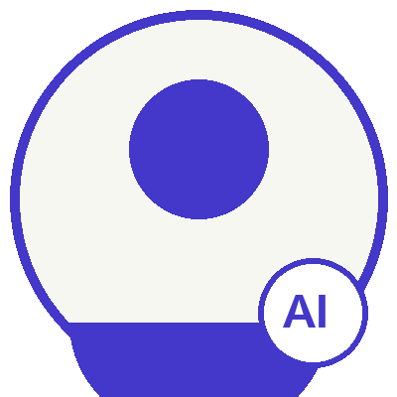

🌿 ABC — Aravali Build Championship
GDG UDAIPUR • BUILD CHALLENGE
OUR INSTITUTION & TEAM — Aravali Guardians
Engineered with dedication for the Aravali Build Championship by GDG Udaipur.
COLLEGE OF TECHNOLOGY AND ENGINEERING (CTAE), UDAIPUR
Department of Computer Science & Engineering | Maharana Pratap University of Agriculture and Technology (MPUAT)
[Team Lead Name]
Team Lead & Full-Stack
[Member 2 Name]
AI & Satellite Engineer
[Member 3 Name]
UI/UX & Mobile Lead
• Role: Architecture & Full-Stack Development
• React 18 frontend & Node.js REST API
• Dual-portal authentication & RBAC security
• 72/72 automated Vitest test suite
• Contact: github.com/teamlead • email
• Role: Google AI & Earth Observation
• Google Gemini 1.5 Multimodal vision triage
• Sentinel-2 MSI NDVI vegetation engine
• Open-Meteo real-time atmospheric context
• Contact: github.com/ai-engineer • email
• Role: Product Design & Mobile Systems
• Nature Light Environmental Design System
• Public Case Tracking Portal (/track)
• Android Health Connect reward simulation
• Contact: github.com/ux-lead • email
🌿 'Protecting the Aravalli is not just conservation — it is securing the air, water, and climate of North India.' • Thank You GDG Udaipur!
ABC — Aravali Build Championship by GDG Udaipur | Aravalli Sentinel — AI-Powered Ecological Protection
7 / 7

