Slide 1
Cloud Native
Steve Hostettler*
*With a lot of reuse of Reinout Waelput slides

Slide 2
Cloud What?

Slide 3
Why the cloud?
Share resources to reduce the Total Cost of Ownership
Elasticity (a.k.a. no fixed costs)
Improved Time to Market (continuous deployment)
New Feature and rich ecosystem (API economy)

Slide 4
Cloud Approaches
3 options to go cloud:
Re-hosting (a.k.a. lift and shift) : Essentially take what runs “on premises” and deploy it in a cloud environment on a dedicated set of VMs. Re-hosting usually do not benefit of the main cloud features such as elasticity.
Re-platforming : Migrate some part of the ecosystem to cloud native features to benefit of some elasticity. Usually starting with the DB.
Refactoring (a.k.a. cloud native) : Massive investment to bring the whole ecosystem to benefit of full elasticity and maximize cost savings
These options are not mutually exclusive, and we can mix and match.

Slide 5
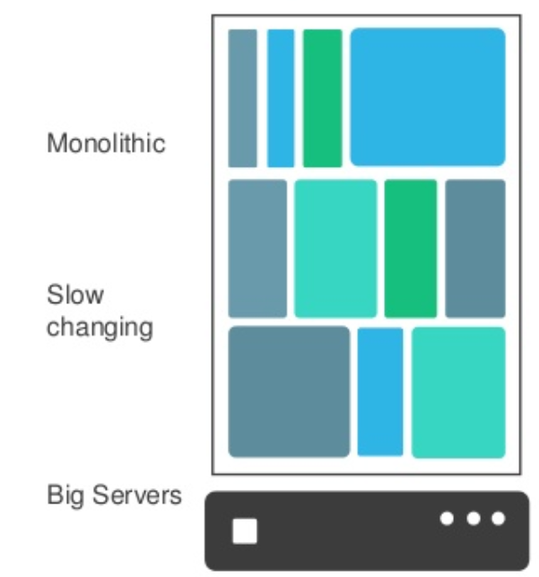
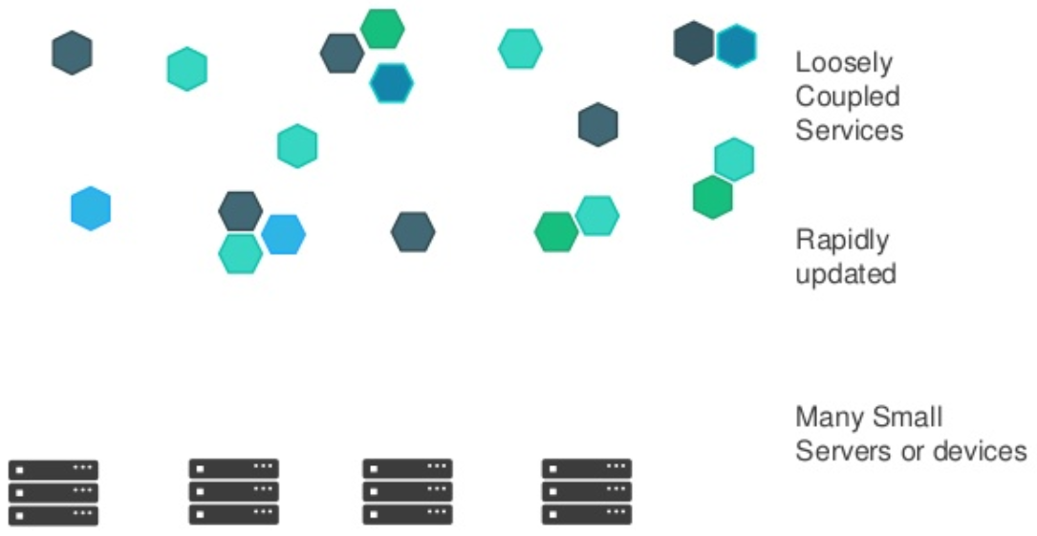
Applications are evolving
2000
today
Courtesy Reinout Waelput

Slide 6
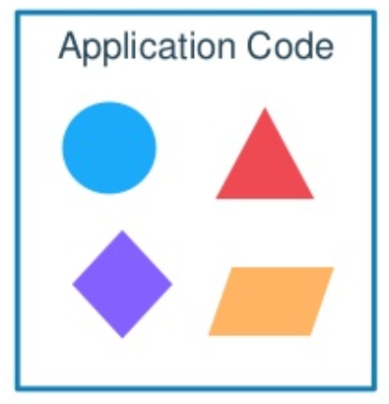
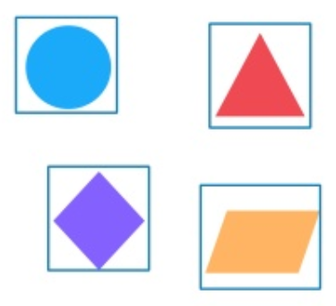
Modern applications
Courtesy Reinout Waelput
Notes:
Monolythic approach:
Developer issues:
Minor code changes require full recompile and retest everything
Application becomes a single point of failure
Application is difficult to scale
-> In the end teams start to prefer releasing hotfixes instead of revision…
Microservice approach:
Break application into separate operations
12-factor apps: make the application independently scalable, stateless, highly available by design

Slide 7
Containerization

Slide 8
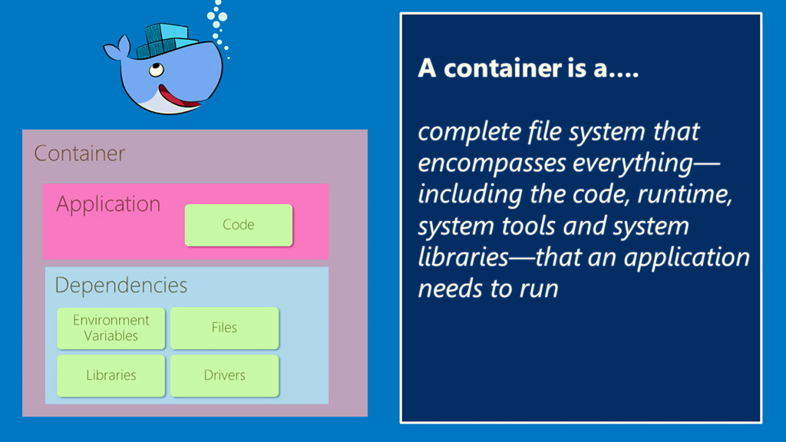
What are Docker containers?
Courtesy Reinout Waelput

Slide 9
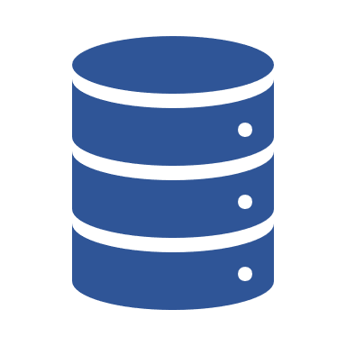



Containers vs Virtual Machines
VM-1
VM-2
VM-3
App1
App1
App1
Container-1
Container-2
Container-3
3rd Party/Libs
3rd Party/Libs
3rd Party/Libs
App1
App1
App1
OS
OS
OS
3rd Party/Libs
3rd Party/Libs
3rd Party/Libs
HYPERVISOR
Container Engine
OS
INFRASTRUCTURE
INFRASTRUCTURE

Slide 10
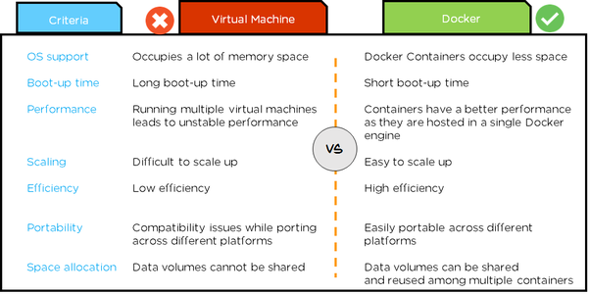
Containers vs Virtual Machines
Courtesy Reinout Waelput

Slide 11
Vocabulary
Images
An image is a read-only template with instructions for creating a Docker container.
Dockerfile
To build your own image, you create a Dockerfile with a simple syntax for defining the steps needed to create the image and run it.
Registry
A Docker registry stores Docker images.
Container
A container is a runnable instance of an image.
Courtesy Reinout Waelput

Slide 12
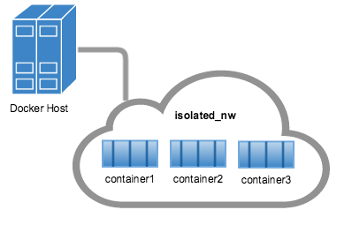
Docker Terminology and Components
Networks
Volumes
Volumes are the preferred mechanism for persisting data generated by and used by Docker containers.
Courtesy Reinout Waelput

Slide 13
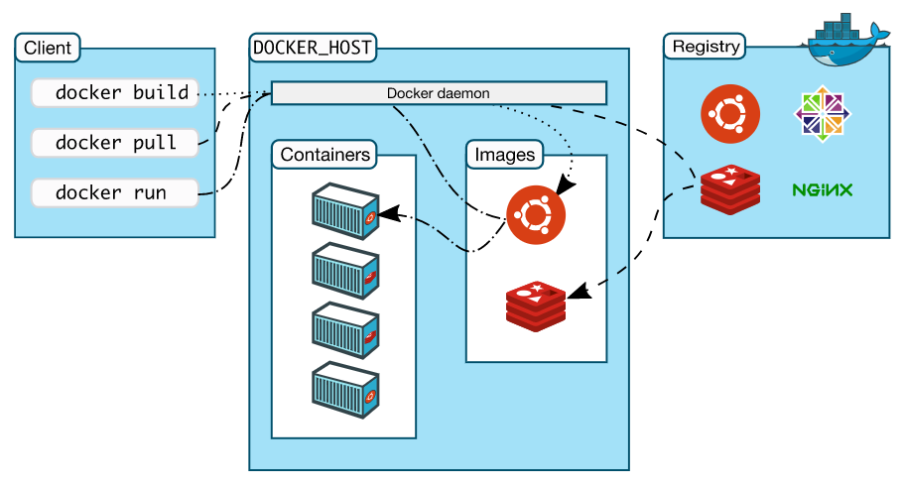
Docker Architecture
Courtesy Reinout Waelput

Slide 14
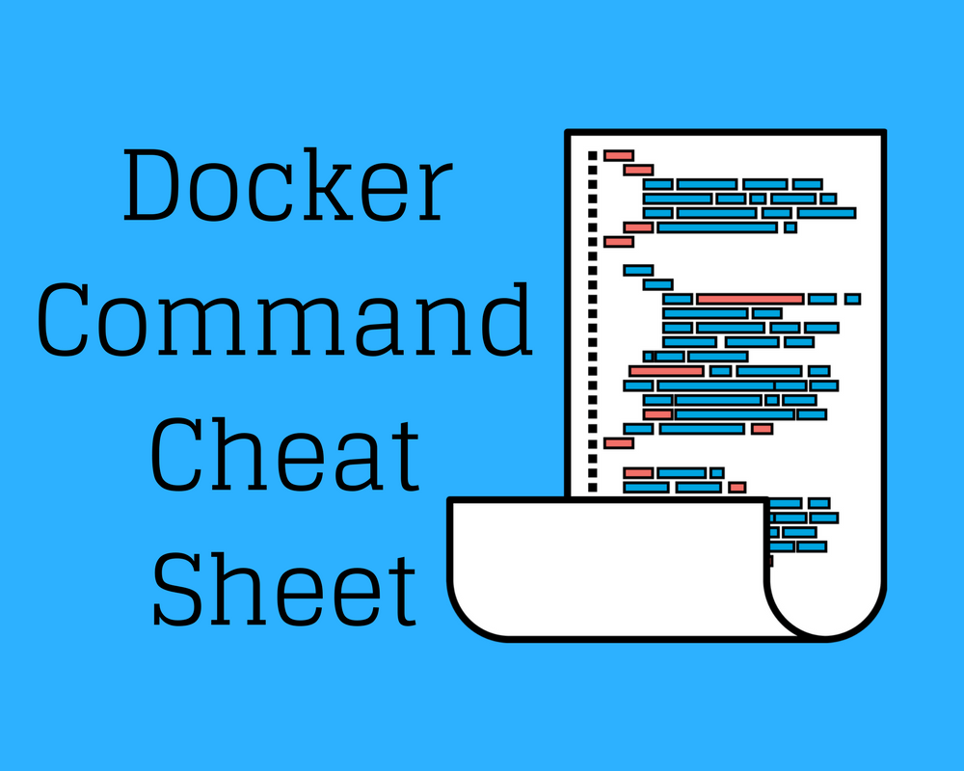
Basic Docker commands
Pull
Build
Run
docker pull <image_name>:<version>
docker build –f <docker_file_name> -m=12g -t <image_name>:<version>
docker run -m=12g -ti <image_name>:<version>
Courtesy Reinout Waelput

Slide 15
Container Orchestration

Slide 16
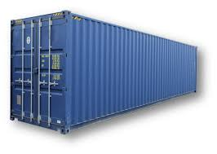
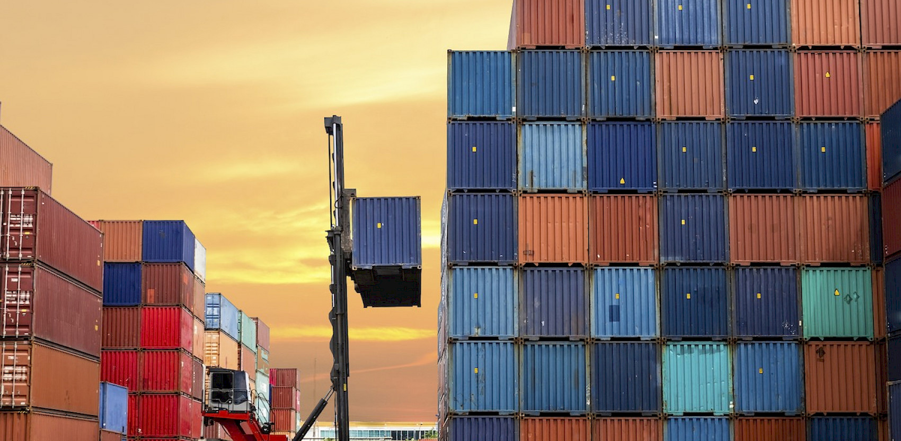
What is this one fails?

Slide 17
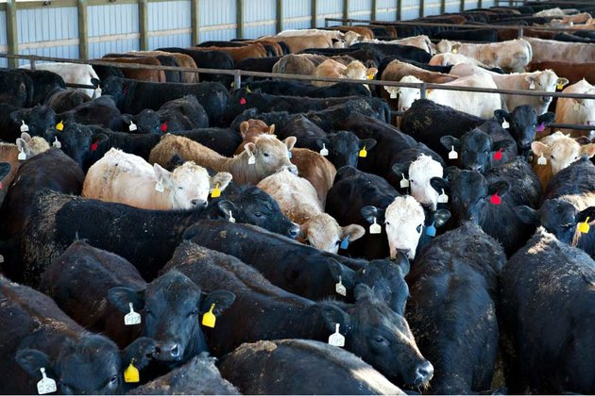
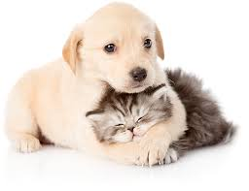
Pet vs Cattle
vs

Slide 18
Kubernetes ?
a.k.a. κυβερνήτης (pilot), a.k.a. K8S
The operating system of the cloud
Implements the Pet vs Cattle paradigm
Orchestrator : Container Management and Scheduling

Slide 19
Kubernetes
Cluster Management
If the load is increasing and the resources are scarce, add more resources (new nodes) to the clusters
If load is decreasing, then resources can be freed
If a node failed, restart a new new one
Container Orchestration
Add new containers to cope with increased load
Kill containers if load is decreasing
Provide Health checks and restart containers if required

Slide 20
Architecture
Kubelet
Node
Container
Container
Kubelet
POD
POD
Replication set
Node
Container
Kubernetes Cluster
POD

Slide 21
Master
Expose a REST API
Is composded of a scheduler, a file system etcd, a node controller and a replication controller.
Handle Jobs, namespaces AND SECRET
Node Controller checks the status of the nodes, add and remove nodes depending of the load

Slide 22
POD
smallest logical entity of the cluster
Contains one or more container (best practice is to have only one container per pod)
Has one IP, a set of volumes
Can be replicated
Is linked to one and only one node
Is transient

Slide 23
Replication Controller
Defines a template for the pods
Supervise pods in the cluster (create, delete)
Keep the right numbers of replicas
Does not load balance (there is another component for that)

Slide 24
Service
Expose a given pod or a set of pods via a selector that selects a label. All pods with that label will be exposed via the service
Does load balancing between the pods (supports session affinity) for stateful services

Slide 25
Ingress
Provides Routing
TLS termination
Expose public IPs

Slide 26
Helm Charts
Kubernetes is great but
…it quickly ends up in chaos of yaml files
Lifecycle management of the application is hard
Helm is a package and deployment manager that enables reuse and provides lifecycle management (install, status, versioning, upgrade or rollback) … with more yaml files ☺

Slide 27
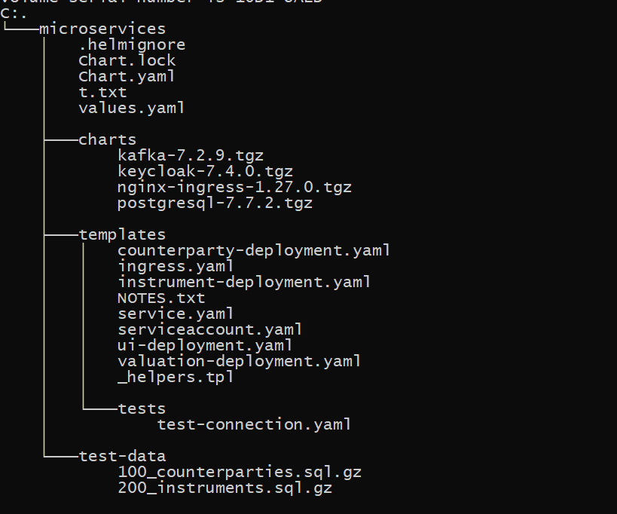
HELM Directory structure
Describe the chart
Configuration
Downloaded dependecies
Templates

Slide 28
Vocabulary
Chart: a package
Release: an instance of a package deployed in a K8S. A release is deployed in a specific namespace
Repository: place from where you can reuse packages
Template: a K8S configuration that is replaced by actual configurations

