Slide 1


Vehicle Control Unit (VCU)
Review-I
AY 2025-26
Capstone Project – Introduction (PROJ2999)
GITAM (Deemed-to-be) University
Department of Electrical Electronics and Communication Engineering
Project Team:
Shravani C L
Ch Pavan Kumar
P Janardhan Reddy
Project Mentor:
Dr. Seetha Chaithanya
Project In-charge:
Kshitij Shakya
www.gitam.edu

Slide 2
Objective and Goals
Objective
To implement and control the BLDC Motor with a programmable VCU and integrate it with BMS to manage the powertrain, battery and associated subsystems for EVs.
Goals
Main Goals
Act as Brain of the Electric Vehicle
Read Driver Inputs
Driver Command Processing
BMS Coordination
Power Distribution and Safety
Additional Goals
Learn about STM32 Microcontroller
Data Logging
Diagnostics and Monitoring

Slide 3
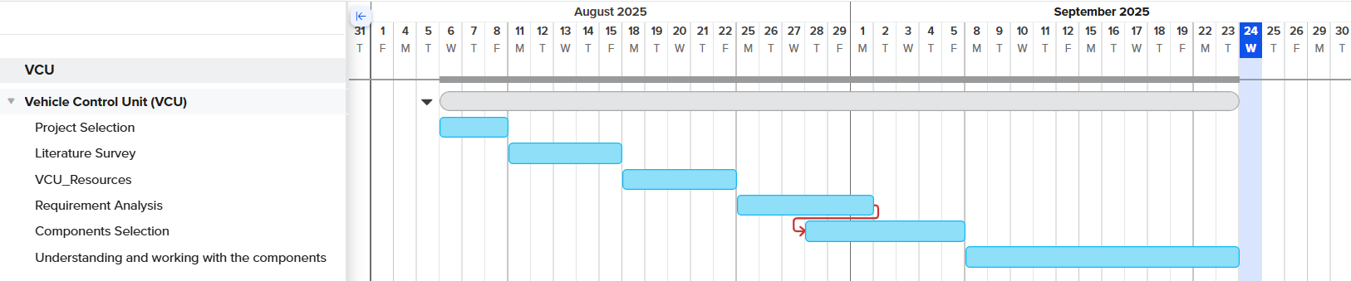
Project Plan
Gantt Chart - Milestones and Activities
Resources : https://www.officetimeline.com/gantt-chart/how-to-make/excel & https://www.teamgantt.com/
Fig 1: Gantt Chart

Slide 4
Literature Survey
S.No | Article | Authors | Published On | Description
1 | Evolving Electric Mobility Energy Efficiency: In-Depth Analysis of Integrated Electronic Control Unit Development in Electric Vehicles | Syed Shehryar Ali Naqvi, Harun Jamil, Naeem Iqbal, Salabat Khan, Murad Ali Khan, Faiza Qayyum, Do-Hyeun Kim | 22 Jan 2024 | Comprehensive review of integrated ECUs in EVs, examining development approaches, algorithms, subsystems (VCU, EPS, ESC, BCU), their roles in energy efficiency, real-world applications, and future research directions.
2 | Automotive Software in Connected and Autonomous Electric Vehicles: A Review | Hrvoje Vdovic, Jurica Babic, Vedran Podobni | 27 Nov 2019 | Summarizes the architecture of ECUs, the importance of centralized software for VCU, AUTOSAR, drive-by-wire, and modern EV control strategies; highlights trends and challenges in software-driven VCU development.
3 | Requirements-Driven Automotive Electrical/Electronic Architecture: A Survey and Prospective Trends | Hailong Zhu, Wei Zhou, Zhiheng Li, Li Li, Tao Huang | 21 Jul 2021 | Reviews state-of-the-art and future trends in automotive electrical/electronic (EE) architecture, zone-based and centralized computing, software-driven VCU evolution, and implications for integrating advanced control units.
4 | Electronic Control System Design and Test of Pure Electric Vehicle Battery Management System | Yeqin Wang, Yixing Liu | 2011 | Modular BMS and ECU integration using CAN and RS485 communication, with real-time battery data collection, fault diagnosis, and SOC estimation for vehicle control units.
Table 1: Literature Survey

Slide 5
Resources:
Manufacturers:
      1. Electra EV
      2. Saietta VNA + HCLTech (India)
      3. NXP S32K VCU Solutions

Slide 6
Block Diagram
Fig 2: Block diagram representation of VCU along with ECU

Slide 7
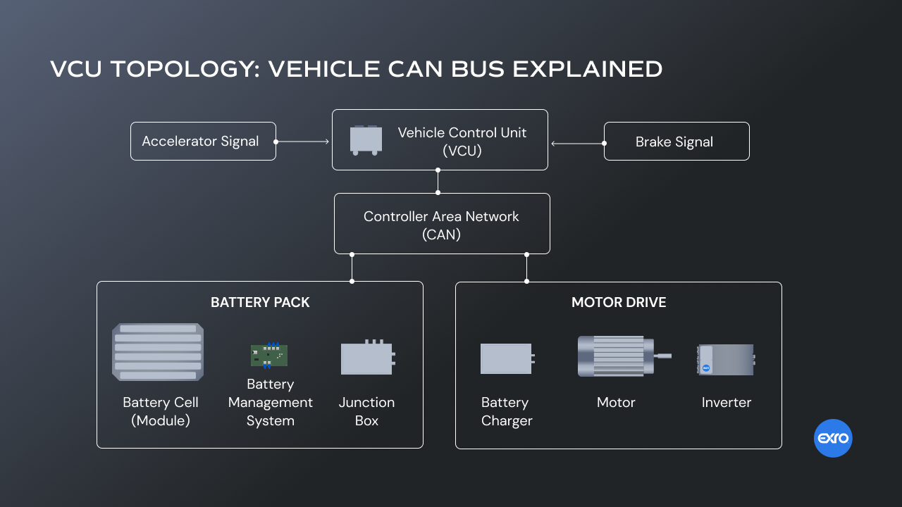
Block Diagram Continuation…
Fig 3: Proposed block diagram representation of VCU

Slide 8
Use Cases & Testing
Use Cases
Vehicle Startup (OFF->Ready)
Driving (Torque Request)
Battery Monitoring (BMS)
CAN Communication loss
System Shutdown
Test Cases
Turn ignition ON->VCU checks system readiness-> READY LED ON
Vary accelerator potentiometer -> Torque command on CAN -> Motor RPM increases proportionally
Simulate SOC < 20% from BMS -> VCU limits torque or blocks DRIVE mode
Disconnect CAN to Inverter/BMS -> VCU detects timeout -> Enters FAULT, disables torque
Turn ignition OFF -> VCU disables contactors, motor stops, system enters OFF state

Slide 9
Requirement Analysis:
Motor Control:
Fig 3: Schematic representation of Motor Control Unit
Estimation Parameters:
Control Torque/speed
Read brake pedal sensor %
Map brake pedal sensor% for Regenerative Braking
VCU monitors BPS or vehicle deacceleration

Slide 10
Battery Parameters:
Monitor
  SoC, SoH
  Charging current
  Battery Temperature
  Faults or warnings
Check for PLC, PP, CP
Stop charging when:
  Target SoC reached
  User unplugs connector
  Faults or Warnings
Communications:
CAN 2.0 / CAN FD
OBD-II for diagnostics
Ethernet for future OTA upgrades

Slide 11
THANK YOU
Have a Great Day !

Slide 12
Implementation and Results – Iteration 1
Iteration 1 : Results

Slide 13
Implementation and Results – Iteration 2
Iteration : Results + Validation against the use cases and test cases

Slide 14
Implementation and Results – Iteration 3 (Optional)
Iteration : Results + Validation against the use cases and test cases

Slide 15
Conclusion & Future Work
Summary and Conclusion
Future Work

