Slide 1
CS 43105 Data Mining Techniques Chapter 9 Clustering (2)
Xiang Lian
Department of Computer Science
Kent State University
Email: xlian@kent.edu
Homepage: http://www.cs.kent.edu/~xlian/
Notes:
References
Ian H. Witten, Eibe Frank, and Mark A. Hall. Data Mining: Practical Machine Learning Tools and Techniques: 3rd Edition. ISBN-13: 9780123748560, Publisher: Elsevier Science, Publication date: 1/20/2011.
https://hanj.cs.illinois.edu/bk3/bk3_slidesindex.htm
http://www.cs.kent.edu/~jin/DM11/DM11.html

Slide 2
k-Means Clustering
K=2
Arbitrarily partition objects into k groups
Update the cluster centroids
The initial data set
Loop if needed
Reassign objects
Partition objects into k nonempty subsets
Repeat
Compute centroid (i.e., mean point) for each partition
Assign each object to the cluster of its nearest centroid
Until no change
Update the cluster centroids
2
Notes:
2

Slide 3
Hierarchical Clustering
Use distance matrix as clustering criteria. This method does not require the number of clusters k as an input, but needs a termination condition
Step 0
Step 1
Step 2
Step 3
Step 4
agglomerative
a
a b
b
a b c d e
c
c d e
d
d e
e
divisive
Step 4
Step 3
Step 2
Step 1
Step 0
3
Notes:
3

Slide 4
Distance between Clusters
X
X
Single link: smallest distance between an element in one cluster and an element in the other, i.e., dist(K_{i}, K_{j}) = min(t_{ip}, t_{jq})
Complete link: largest distance between an element in one cluster and an element in the other, i.e., dist(K_{i}, K_{j}) = max(t_{ip}, t_{jq})
Average: avg distance between an element in one cluster and an element in the other, i.e., dist(K_{i}, K_{j}) = avg(t_{ip}, t_{jq})
Centroid: distance between the centroids of two clusters, i.e., dist(K_{i}, K_{j}) = dist(C_{i}, C_{j})
Medoid: distance between the medoids of two clusters, i.e., dist(K_{i}, K_{j}) = dist(M_{i}, M_{j})
Medoid: a chosen, centrally located object in the cluster
4
Notes:
4

Slide 5
Density-Based Clustering: DBSCAN
Two parameters:
Eps: Maximum radius of the neighbourhood
MinPts: Minimum number of points in an Eps-neighbourhood of that point
N_{Eps}(p): {q belongs to D | dist(p,q) ≤ Eps}
Directly density-reachable: A point p is directly density-reachable from a point q w.r.t. Eps, MinPts if
p belongs to N_{Eps}(q)
core point condition:
|N_{Eps} (q)| ≥ MinPts
p
MinPts = 5
Eps = 1 cm
q
5
Notes:
5

Slide 6
Advanced Clustering Analysis
Probability Model-Based Clustering
Each object may take a probability to belong to a cluster
Clustering High-Dimensional Data
Curse of dimensionality: Difficulty of distance measure in high-D space
Clustering Graphs and Network Data
Similarity measurement and clustering methods for graph and networks
Clustering with Constraints
Cluster analysis under different kinds of constraints, e.g., that raised from background knowledge or spatial distribution of the objects
6
Notes:
6

Slide 7
Fuzzy Set and Fuzzy Cluster
Clustering methods discussed so far
Every data object is assigned to exactly one cluster
Some applications may need for fuzzy or soft cluster assignment
Ex. An e-game could belong to both entertainment and software
Methods: fuzzy clusters and probabilistic model-based clusters
Fuzzy cluster: A fuzzy set S: F_{S} : X → [0, 1] (value between 0 and 1)
Example: Popularity of cameras is defined as a fuzzy mapping
Then, A(0.05), B(1), C(0.86), D(0.27)
7

Slide 8
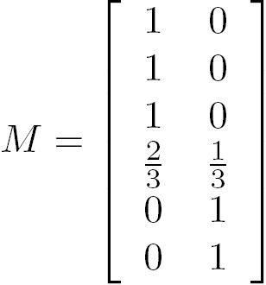


Fuzzy (Soft) Clustering
Example: Let cluster features be
C₁ :“digital camera” and “lens”
C₂: “computer“
Fuzzy clustering
k fuzzy clusters C₁, …,C_{k} ,represented as a partition matrix M = [w_{ij}]
P1: for each object o_{i} and cluster C_{j}, 0 ≤ w_{ij} ≤ 1 (fuzzy set)
P2: for each object o_{i}, , equal participation in the clustering
P3: for each cluster C_{j} , ensures there is no empty cluster
Let c₁, …, c_{k} as the center of the k clusters
For an object o_{i}, sum of the squared error (SSE), p is a parameter:
For a cluster C_{i}, SSE:
Measure how well a clustering fits the data:
8

Slide 9
Outline
Probability Model-Based Clustering
Clustering High-Dimensional Data
Clustering Graphs and Network Data
Clustering with Constraints
9
9
Notes:
9

Slide 10
Clustering High-Dimensional Data
Clustering high-dimensional data (How high is high-D in clustering?)
Many applications: text documents, DNA micro-array data
Major challenges:
Many irrelevant dimensions may mask clusters
Distance measure becomes meaningless—due to equi-distance
Clusters may exist only in some subspaces
10
Notes:
10

Slide 11
Clustering High-Dimensional Data (cont'd)
Methods
Subspace-clustering: Search for clusters existing in subspaces of the given high dimensional data space
CLIQUE, ProClus, and bi-clustering approaches
Dimensionality reduction approaches: Construct a much lower dimensional space and search for clusters there (may construct new dimensions by combining some dimensions in the original data)
Dimensionality reduction methods and spectral clustering
11
Notes:
11

Slide 12
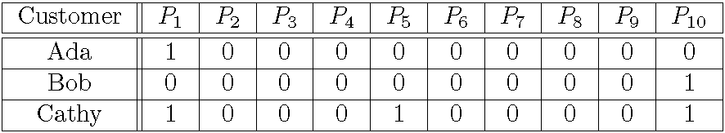
Traditional Distance Measures May Not Be Effective on High-D Data
Traditional distance measure could be dominated by noises in many dimensions
Ex. Which pairs of customers are more similar?
By Euclidean distance, we get,
despite Ada and Cathy look more similar
Clustering should not only consider dimensions but also attributes (features)
Feature transformation: effective if most dimensions are relevant (PCA & SVD useful when features are highly correlated/redundant)
Feature selection: useful to find a subspace where the data have nice clusters

Slide 13
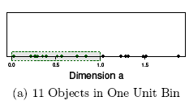
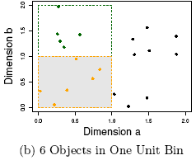
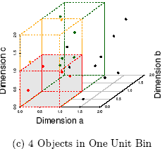
The Curse of Dimensionality (graphs adapted from Parsons et al. KDD Explorations 2004)
Data in only one dimension is relatively packed
Adding a dimension “stretch” the points across that dimension, making them further apart
Adding more dimensions will make the points further apart—high dimensional data is extremely sparse
Distance measure becomes meaningless—due to equi-distance
13
Notes:
13

Slide 14
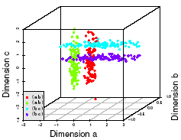
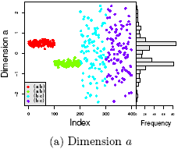
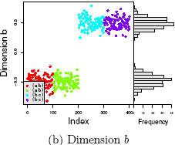
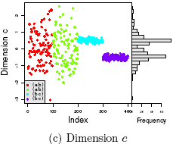
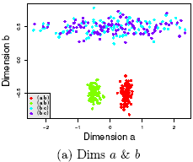
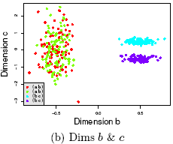
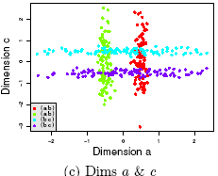
Why Subspace Clustering? (adapted from Parsons et al. SIGKDD Explorations 2004)
Clusters may exist only in some subspaces
Subspace-clustering: find clusters in all the subspaces
14
Notes:
14

Slide 15
Subspace Clustering Methods
Subspace search methods: Search various subspaces to find clusters
Bottom-up approaches
Top-down approaches
Correlation-based clustering methods
E.g., PCA based approaches
Bi-clustering methods
Optimization-based methods
Enumeration methods

Slide 16
Subspace Clustering Method (I): Subspace Search Methods
Search various subspaces to find clusters
Bottom-up approaches
Start from low-D subspaces and search higher-D subspaces only when there may be clusters in such subspaces
Various pruning techniques to reduce the number of higher-D subspaces to be searched
Ex. CLIQUE (Agrawal et al. 1998)
Top-down approaches
Start from full space and search smaller subspaces recursively
Effective only if the locality assumption holds: restricts that the subspace of a cluster can be determined by the local neighborhood
Ex. PROCLUS (Aggarwal et al. 1999): a k-medoid-like method

Slide 17
CLIQUE: Subspace Clustering with Apriori Pruning
Salary (10,000)
Vacation (week)
7
7
6
6
5
5
4
4
3
3
2
2
1
1
0
age
0
age
20
30
40
50
60
20
30
40
50
60
τ = 3
Vacation
Salary
30
50
age
17
Notes:
17

Slide 18
Subspace Clustering Method (II): Correlation-Based Methods
Subspace search method: similarity based on distance or density
Correlation-based method: based on advanced correlation models
Ex. PCA-based approach:
Apply PCA (for Principal Component Analysis) to derive a set of new, uncorrelated dimensions
then mine clusters in the new space or its subspaces
Other space transformations:
Hough transform
Fractal dimensions

Slide 19
Dimensionality-Reduction Methods
Dimensionality reduction: In some situations, it is more effective to construct a new space instead of using some subspaces of the original data
Ex. To cluster the points in the right figure, any subspace of the original one, X and Y, cannot help, since all the three clusters will be projected into the overlapping areas in X and Y axes.
Construct a new dimension as the dashed one, the three clusters become apparent when the points projected into the new dimension
Dimensionality reduction methods
Feature selection and extraction: But may not focus on clustering structure finding
Spectral clustering: Combining feature extraction and clustering (i.e., use the spectrum of the similarity matrix of the data to perform dimensionality reduction for clustering in fewer dimensions)
Normalized Cuts (Shi and Malik, CVPR’97 or PAMI’2000)
The Ng-Jordan-Weiss algorithm (NIPS’01)
19

Slide 20
Outline
Probability Model-Based Clustering
Clustering High-Dimensional Data
Clustering Graphs and Network Data
Clustering with Constraints
20
20
Notes:
20

Slide 21
Clustering Graphs and Network Data
Applications
Bi-partite graphs, e.g., customers and products, authors and conferences
Web search engines, e.g., click through graphs and Web graphs
Social networks, friendship/coauthor graphs
Similarity measures
Geodesic distances
Distance based on random walk (SimRank)
Graph clustering methods
Minimum cuts: FastModularity (Clauset, Newman & Moore, 2004)
Density-based clustering: SCAN (Xu et al., KDD’2007)
21

Slide 22
Two Approaches for Graph Clustering
Two approaches for clustering graph data
Use generic clustering methods for high-dimensional data
Designed specifically for clustering graphs
Using clustering methods for high-dimensional data
Extract a similarity matrix from a graph using a similarity measure
A generic clustering method can then be applied on the similarity matrix to discover clusters
Ex. Spectral clustering: approximate optimal graph cut solutions
Methods specific to graphs
Search the graph to find well-connected components as clusters
Ex. SCAN (Structural Clustering Algorithm for Networks)
X. Xu, N. Yuruk, Z. Feng, and T. A. J. Schweiger, “SCAN: A Structural Clustering Algorithm for Networks”, KDD'07
22

Slide 23
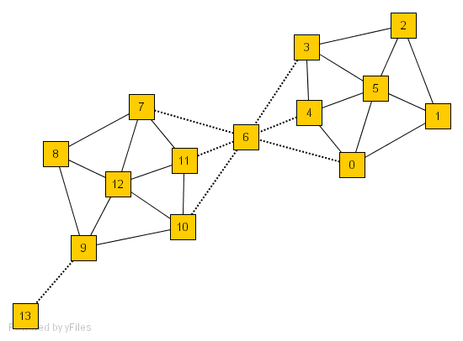
SCAN: Density-Based Clustering of Networks
How many clusters?
What size should they be?
What is the best partitioning?
Should some points be segregated?
An Example Network
Application: Given simply information of who associates with whom, could one identify clusters of individuals with common interests or special relationships (families, cliques, terrorist cells)?
23
Notes:
23

Slide 24
A Social Network Model
Cliques, hubs and outliers
Individuals in a tight social group, or clique, know many of the same people, regardless of the size of the group
Individuals who are hubs know many people in different groups but belong to no single group. Politicians, for example bridge multiple groups
Individuals who are outliers reside at the margins of society. Hermits, for example, know few people and belong to no group
The Neighborhood of a Vertex
Define Γ(ν) as the immediate neighborhood of a vertex (i.e. the set of people that an individual knows )
24

Slide 25
Structure Similarity
The desired features tend to be captured by a measure we call Structural Similarity
Structural similarity is large for members of a clique and small for hubs and outliers
25

Slide 26
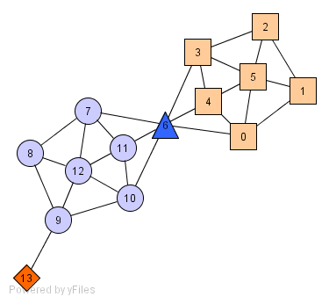
Structure-Connected Clusters
hub
outlier
26
Structure-connected cluster C
Connectivity:
Maximality:
Hubs:
Not belong to any cluster
Bridge to many clusters
Outliers:
Not belong to any cluster
Connect to less clusters

Slide 27
Outline
Probability Model-Based Clustering
Clustering High-Dimensional Data
Clustering Graphs and Network Data
Clustering with Constraints
27
Notes:
27

Slide 28
Why Constraint-Based Cluster Analysis?
Need user feedback: Users know their applications the best
Less parameters but more user-desired constraints, e.g., an ATM allocation problem: obstacle & desired clusters
28
Notes:
28

Slide 29
Categorization of Constraints
Constraints on instances: specifies how a pair or a set of instances should be grouped in the cluster analysis
Must-link vs. cannot link constraints
must-link(x, y): x and y should be grouped into one cluster
Constraints can be defined using variables, e.g.,
cannot-link(x, y) if dist(x, y) > d
Constraints on clusters: specifies a requirement on the clusters
E.g., specify the min # of objects in a cluster, the max diameter of a cluster, the shape of a cluster (e.g., a convex), # of clusters (e.g., k)
Constraints on similarity measurements: specifies a requirement that the similarity calculation must respect
E.g., driving on roads, obstacles (e.g., rivers, lakes)
Issues: Hard vs. soft constraints; conflicting or redundant constraints
29
Notes:
29

Slide 30
Constraint-Based Clustering Methods (I): Handling Hard Constraints
Handling hard constraints: Strictly respect the constraints in cluster assignments
Example: The COP-k-means algorithm
Generate super-instances for must-link constraints
Compute the transitive closure of the must-link constraints
To represent such a subset, replace all those objects in the subset by the mean.
The super-instance also carries a weight, which is the number of objects it represents
Conduct modified k-means clustering to respect cannot-link constraints
Modify the center-assignment process in k-means to a nearest feasible center assignment
An object is assigned to the nearest center so that the assignment respects all cannot-link constraints
30
Notes:
30

Slide 31
Constraint-Based Clustering Methods (II): Handling Soft Constraints
Treated as an optimization problem: When a clustering violates a soft constraint, a penalty is imposed on the clustering
Overall objective: Optimizing the clustering quality, and minimizing the constraint violation penalty
Ex. CVQE (Constrained Vector Quantization Error) algorithm: Conduct k-means clustering while enforcing constraint violation penalties
Objective function: Sum of distance used in k-means, adjusted by the constraint violation penalties
Penalty of a must-link violation
If objects x and y must-be-linked but they are assigned to two different centers, c₁ and c₂, dist(c₁, c₂) is added to the objective function as the penalty
Penalty of a cannot-link violation
If objects x and y cannot-be-linked but they are assigned to a common center c, dist(c, c′), between c and c′ is added to the objective function as the penalty, where c′ is the closest cluster to c that can accommodate x or y
31

Slide 32
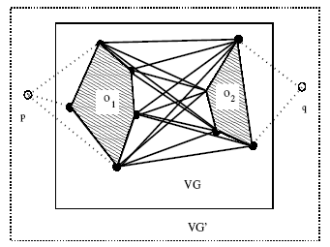
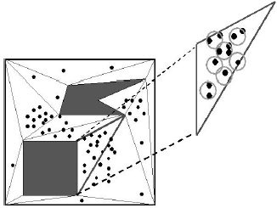
Speeding Up Constrained Clustering
It is costly to compute some constrained clustering
Ex. Clustering with obstacle objects: Tung, Hou, and Han. Spatial clustering in the presence of obstacles, ICDE'01
K-medoids is more preferable since k-means may locate the ATM center in the middle of a lake
Visibility graph and shortest path
Triangulation and micro-clustering
Two kinds of join indices (shortest-paths) worth pre-computation
VV index: indices for any pair of obstacle vertices
MV index: indices for any pair of micro-cluster and obstacle indices
32
Notes:
32

Slide 33
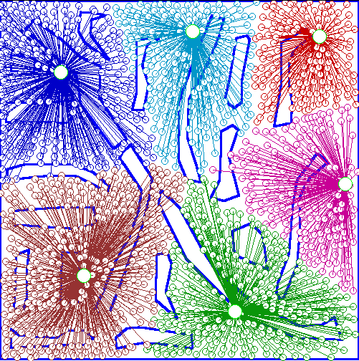
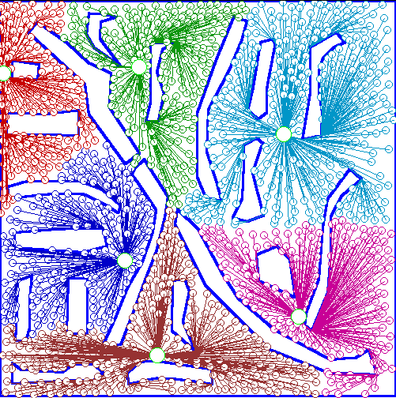
An Example: Clustering With Obstacle Objects
Not Taking obstacles into account
Taking obstacles into account
33
Notes:
33

Slide 34
User-Guided Clustering: A Special Kind of Constraints
Work-In
Professor
Open-course
Course
person
name
course
course-id
group
office
semester
name
position
instructor
area
Publish
Publication
Group
Advise
author
title
name
professor
title
year
area
student
conf
degree
Register
User hint
student
Student
course
name
semester
Target of clustering
office
unit
position
grade
X. Yin, J. Han, P. S. Yu, “Cross-Relational Clustering with User's Guidance”, KDD'05
User usually has a goal of clustering, e.g., clustering students by research area
User specifies his clustering goal to CrossClus
34
Notes:
34

Slide 35
Comparing with Classification
User hint
User-specified feature (in the form of attribute) is used as a hint, not class labels
The attribute may contain too many or too few distinct values, e.g., a user may want to cluster students into 20 clusters instead of 3
Additional features need to be included in cluster analysis
All tuples for clustering
35
Notes:
35

Slide 36
Comparing with Semi-Supervised Clustering
Semi-supervised clustering: User provides a training set consisting of “similar” (“must-link) and “dissimilar” (“cannot link”) pairs of objects
User-guided clustering: User specifies an attribute as a hint, and more relevant features are found for clustering
Semi-supervised clustering
User-guided clustering
x
All tuples for clustering
All tuples for clustering
36
Notes:
36

Slide 37
Why Not Semi-Supervised Clustering?
Much information (in multiple relations) is needed to judge whether two tuples are similar
A user may not be able to provide a good training set
It is much easier for a user to specify an attribute as a hint, such as a student’s research area
Tom Smith | SC1211 | TA
Jane Chang | BI205 | RA
Tuples to be compared
User hint
37
Notes:
37

Slide 38
CrossClus: An Overview
Measure similarity between features by how they group objects into clusters
Use a heuristic method to search for pertinent features
Start from user-specified feature and gradually expand search range
Use tuple ID propagation to create feature values
Features can be easily created during the expansion of search range, by propagating IDs
Explore three clustering algorithms: k-means, k-medoids, and hierarchical clustering
38
Notes:
38

Slide 39
Multi-Relational Features
A multi-relational feature is defined by:
A join path, e.g., Student → Register → OpenCourse → Course
An attribute, e.g., Course.area
(For numerical feature) an aggregation operator, e.g., sum or average
Categorical feature f = [Student → Register → OpenCourse → Course, Course.area, null]
areas of courses of each student
Values of feature f
f(t₁)
Tuple | Areas of courses
 | DB | AI | TH
t₁ | 5 | 5 | 0
t₂ | 0 | 3 | 7
t₃ | 1 | 5 | 4
t₄ | 5 | 0 | 5
t₅ | 3 | 3 | 4
Tuple | Feature f
 | DB | AI | TH
t₁ | 0.5 | 0.5 | 0
t₂ | 0 | 0.3 | 0.7
t₃ | 0.1 | 0.5 | 0.4
t₄ | 0.5 | 0 | 0.5
t₅ | 0.3 | 0.3 | 0.4
f(t₂)
f(t₃)
f(t₄)
f(t₅)
39
Notes:
39

Slide 40
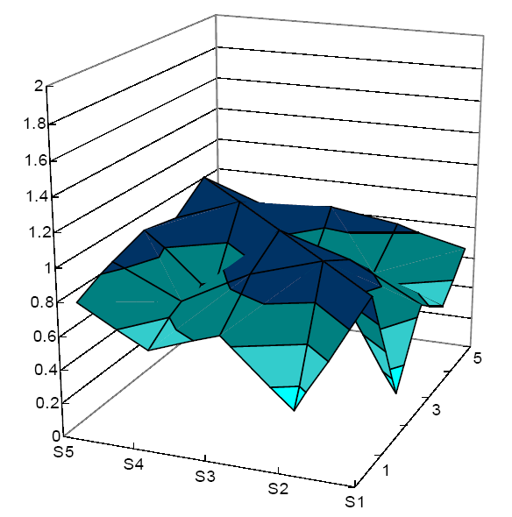
Representing Features
Similarity between tuples t₁ and t₂ w.r.t. categorical feature f
Cosine similarity between vectors f(t₁) and f(t₂)
Similarity vector V^{f}
Most important information of a feature f is how f groups tuples into clusters
f is represented by similarities between every pair of tuples indicated by f
The horizontal axes are the tuple indices, and the vertical axis is the similarity
This can be considered as a vector of N x N dimensions
40
Notes:
40

Slide 41
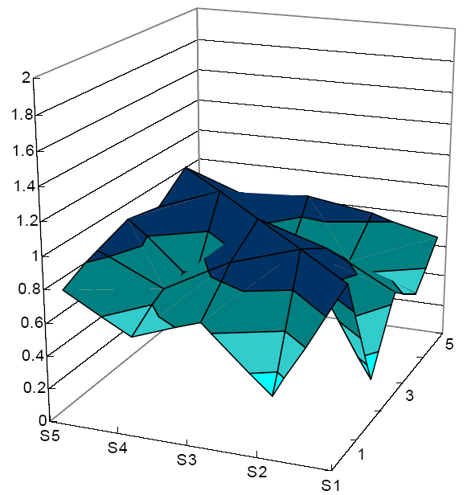
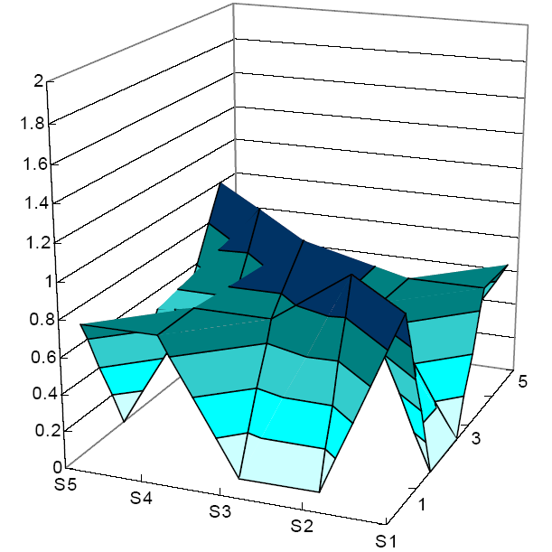
Similarity Between Features
Values of Feature f and g
V^{f}
 | Feature f (course) |  |  |  | Feature g (group)
 | DB | AI | TH |  | Info sys | Cog sci | Theory
t₁ | 0.5 | 0.5 | 0 |  | 1 | 0 | 0
t₂ | 0 | 0.3 | 0.7 |  | 0 | 0 | 1
t₃ | 0.1 | 0.5 | 0.4 |  | 0 | 0.5 | 0.5
t₄ | 0.5 | 0 | 0.5 |  | 0.5 | 0 | 0.5
t₅ | 0.3 | 0.3 | 0.4 |  | 0.5 | 0.5 | 0
V^{g}
Similarity between two features – cosine similarity of two vectors
41
Notes:
41
But, how to compute the similarity efficiently? Computing inner product of two NxN matrices is too expensive.

Slide 42
Computing Feature Similarity
Tuples
Feature g
Similarity between feature values w.r.t. the tuples
Feature f
DB
Info sys
sim(f_{k},g_{q})=Σ_{i=1 to N} f(t_{i}).p_{k}∙g(t_{i}).p_{q}
AI
Cog sci
DB
Info sys
TH
Theory
Tuple similarities, hard to compute
Feature value similarities, easy to compute
DB
Info sys
Compute similarity between each pair of feature values by one scan on data
AI
Cog sci
TH
Theory
42
Notes:
42
Very expensive to compute directly
We convert it into another form

Slide 43
Searching for Pertinent Features
Different features convey different aspects of information
Features conveying same aspect of information usually cluster tuples in more similar ways
Research group areas vs. conferences of publications
Given user specified feature
Find pertinent features by computing feature similarity
Research area
Academic Performances
Demographic info
GPA
Research group area
Permanent address
GRE score
Conferences of papers
Nationality
Number of papers
Advisor
43
Notes:
43

Slide 44
Heuristic Search for Pertinent Features
Work-In
Professor
Open-course
Course
person
name
course
course-id
group
office
semester
name
Overall procedure
1. Start from the user- specified feature
2. Search in neighborhood of existing pertinent features
3. Expand search range gradually
2
position
instructor
area
Group
Advise
Publish
Publication
name
professor
author
title
1
area
student
title
year
degree
conf
User hint
Register
student
Student
course
name
semester
Target of clustering
office
unit
position
grade
Tuple ID propagation is used to create multi-relational features
IDs of target tuples can be propagated along any join path, from which we can find tuples joinable with each target tuple
44
Notes:
44

Slide 45
Clustering with Multi-Relational Features
Given a set of L pertinent features f₁, …, f_{L}, similarity between two tuples
Weight of a feature is determined in feature search by its similarity with other pertinent features
Clustering methods
CLARANS [Ng & Han 94], a scalable clustering algorithm for non-Euclidean space
K-means
Agglomerative hierarchical clustering
45
Notes:
45

Slide 46
Experiments: Compare CrossClus with
Baseline: Only use the user specified feature
PROCLUS [Aggarwal, et al. 99]: a state-of-the-art subspace clustering algorithm
Use a subset of features for each cluster
We convert relational database to a table by propositionalization
User-specified feature is forced to be used in every cluster
RDBC [Kirsten and Wrobel’00]
A representative ILP clustering algorithm
Use neighbor information of objects for clustering
User-specified feature is forced to be used
46
Notes:
46

Slide 47
Measure of Clustering Accuracy
47
Accuracy
Measured by manually labeled data
We manually assign tuples into clusters according to their properties (e.g., professors in different research areas)
Accuracy of clustering: Percentage of pairs of tuples in the same cluster that share common label
This measure favors many small clusters
We let each approach generate the same number of clusters
Notes:
47

Slide 48
DBLP Dataset
48
Notes:
48

Slide 49
References (I)
R. Agrawal, J. Gehrke, D. Gunopulos, and P. Raghavan. Automatic subspace clustering of high dimensional data for data mining applications. SIGMOD’98
C. C. Aggarwal, C. Procopiuc, J. Wolf, P. S. Yu, and J.-S. Park. Fast algorithms for projected clustering. SIGMOD’99
S. Arora, S. Rao, and U. Vazirani. Expander flows, geometric embeddings and graph partitioning. J. ACM, 56:5:1–5:37, 2009.
J. C. Bezdek. Pattern Recognition with Fuzzy Objective Function Algorithms. Plenum Press, 1981.
K. S. Beyer, J. Goldstein, R. Ramakrishnan, and U. Shaft. When is ”nearest neighbor” meaningful? ICDT’99
Y. Cheng and G. Church. Biclustering of expression data. ISMB’00
I. Davidson and S. S. Ravi. Clustering with constraints: Feasibility issues and the k-means algorithm. SDM’05
I. Davidson, K. L. Wagstaff, and S. Basu. Measuring constraint-set utility for partitional clustering algorithms. PKDD’06
C. Fraley and A. E. Raftery. Model-based clustering, discriminant analysis, and density estimation. J. American Stat. Assoc., 97:611–631, 2002.
F. H¨oppner, F. Klawonn, R. Kruse, and T. Runkler. Fuzzy Cluster Analysis: Methods for Classification, Data Analysis and Image Recognition. Wiley, 1999.
G. Jeh and J. Widom. SimRank: a measure of structural-context similarity. KDD’02
H.-P. Kriegel, P. Kroeger, and A. Zimek. Clustering high dimensional data: A survey on subspace clustering, pattern-based clustering, and correlation clustering. ACM Trans. Knowledge Discovery from Data (TKDD), 3, 2009.
U. Luxburg. A tutorial on spectral clustering. Statistics and Computing, 17:395–416, 2007

Slide 50
References (II)
G. J. McLachlan and K. E. Bkasford. Mixture Models: Inference and Applications to Clustering. John Wiley & Sons, 1988.
B. Mirkin. Mathematical classification and clustering. J. of Global Optimization, 12:105–108, 1998.
S. C. Madeira and A. L. Oliveira. Biclustering algorithms for biological data analysis: A survey. IEEE/ACM Trans. Comput. Biol. Bioinformatics, 1, 2004.
A. Y. Ng, M. I. Jordan, and Y. Weiss. On spectral clustering: Analysis and an algorithm. NIPS’01
J. Pei, X. Zhang, M. Cho, H. Wang, and P. S. Yu. Maple: A fast algorithm for maximal pattern-based clustering. ICDM’03
M. Radovanovi´c, A. Nanopoulos, and M. Ivanovi´c. Nearest neighbors in high-dimensional data: the emergence and influence of hubs. ICML’09
S. E. Schaeffer. Graph clustering. Computer Science Review, 1:27–64, 2007.
A. K. H. Tung, J. Hou, and J. Han. Spatial clustering in the presence of obstacles. ICDE’01
A. K. H. Tung, J. Han, L. V. S. Lakshmanan, and R. T. Ng. Constraint-based clustering in large databases. ICDT’01
A. Tanay, R. Sharan, and R. Shamir. Biclustering algorithms: A survey. In Handbook of Computational Molecular Biology, Chapman & Hall, 2004.
K. Wagstaff, C. Cardie, S. Rogers, and S. Schr¨odl. Constrained k-means clustering with background knowledge. ICML’01
H. Wang, W. Wang, J. Yang, and P. S. Yu. Clustering by pattern similarity in large data sets. SIGMOD’02
X. Xu, N. Yuruk, Z. Feng, and T. A. J. Schweiger. SCAN: A structural clustering algorithm for networks. KDD’07
X. Yin, J. Han, and P.S. Yu, “Cross-Relational Clustering with User's Guidance”, KDD'05

