Slide 1
Abstract Factory
Design Pattern
making abstract things

Slide 2
Abstract vs. Concrete
a number of design patterns use abstract and concrete classes
  abstract class – provides a list of abstract functions to be used by the pattern
  concrete class – provides implementation for the abstract functions
abstract class pointers may point to concrete class objects and the abstract functions are overridden by concrete implementations
  clients may not be concerned with implementations
  various concrete objects may be assembled into a single container and operated uniformly
    virtual functions would provide customized functionality per object

Slide 3
Factory and Factory Methods
factory – an object for creating other objects called products
  important when control over object creation is necessary: e.g. instead of just creating an object, factory may dynamically allocate it from an object pool, do complex configurations
  contains methods for object creation
factory method (design pattern)- implements the actual object creation
  usually returns a pointer to created object
  specifies interface to be implemented (overridden) by subclasses, hence known as virtual constructor
    why not regular constructor? cannot be overridden
  example of behavior pattern
singleton class is an example of a factory, why?

Slide 4
Abstract Factory
regular factory encodes product class names. May be inconvenient
  in case need to make modification
  in case need to re-use code for several related factories
abstract factory design pattern – separates interface and implementation
  abstract factory – specifies creation interface
  abstract product – specifies product interface to be manipulated by abstract factory
  abstract factory method - product creation interface
  concrete factory, product, method – implementation of respective interfaces
benefit of abstract factory pattern – client may not need to know (concrete) implementations to operate objects
abstract factory pattern is a creational pattern
abstract factory is often designed as a singleton pattern
a factory may be part abstract/part concrete

Slide 5
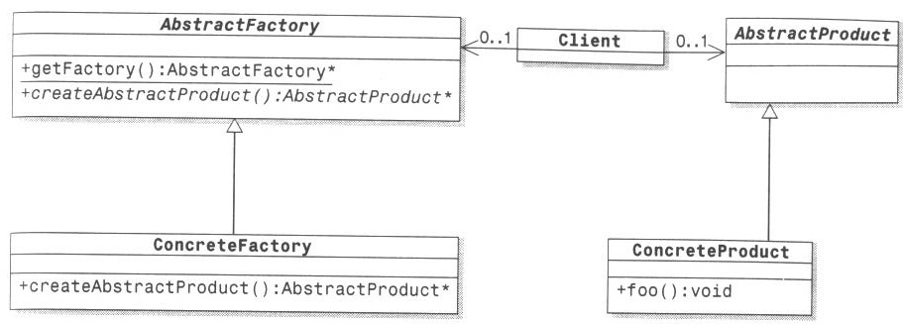
Abstract Factory UML Diagram

Slide 6
Review Questions
what is the difference between abstract and concrete classes? How can a client benefit from this difference?
what is: factory? product? factory method?
why are the factory and product separated into abstract and concrete?

