Slide 1
Adapter Design Pattern
Modifying Existing Interfaces

Slide 2
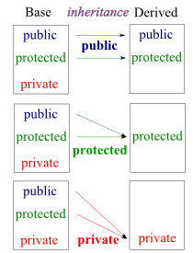
Access Methods Revisited
  base class features: public protected private
access modifiers derived class features
  public: public protected inaccessible
  protected: protected protected inaccessible
  private: private private inaccessible
public inheritance – allows to inherit the
interface: is-a relationship
  abstract functions of base class – only
  interface
  concrete functions of base class – both
  interface and implementation
private inheritance – allows to inherit implementation,
interface is not inherited (by default):
implemented-in-terms-of relationship
  features may be added to interface with using

Slide 3
Making Private Feature Pubic
If inheriting a private base class feature, it may be made public by stating this in public portion of derived class definition:
using BaseClass::BaseClassFeature;
example:
    Class Figure{
    public:
    int findCenter();
    };
    class Square: private Figure{
    public:
    using Figure::findCenter;
    };
client code:
Square small;
small.findCenter();

Slide 4
Multiple Inheritance
may need to inherit from multiple classes:
  toy car: has features of a toy and a car
different access methods possible
  example: class C needs to inherit interface from class A and implementation from class B:
    class C: public A, private B {…};
  what would be access methods for toy car?

Slide 5
Adapter Design Pattern
if have interface class and an implementation class with incompatible interface
  why not change implementation?
    it might be okay as it is (used elsewhere)
    may take effort, rather reuse code as is
adapter (wrapper) - concrete class that inherits from interface
adaptee – implementation class whose interface is modified (adapted)
two approaches
  class adapter – uses multiple inheritance
  object adapter – uses delegation from adapter to adaptee
structural design pattern

Slide 6
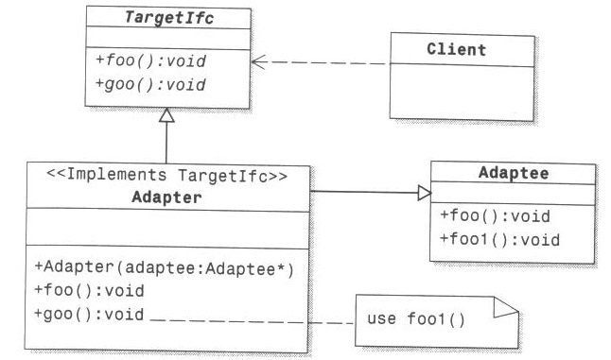
Class Adapter
Adapter (publicly) inherits interface from Target and (privately) implementation from Adaptee

Slide 7
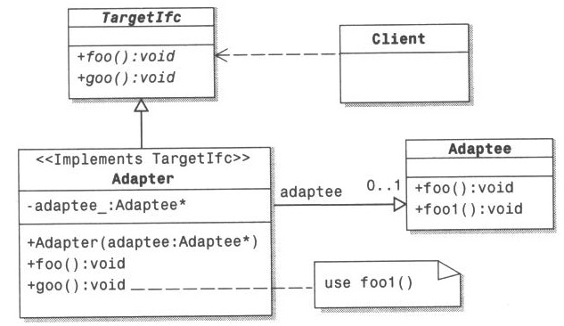
Object Adapter
Adapter uses aggregation to delegate requests to Adaptee

Slide 8
Difference between Adapter and Bridge
patterns look similar
difference is in usage
  bridge: build new class hierarchy
  adapter: modify existing classes to particular use

Slide 9
Adapter Review
what is the major difference between public and private inheritance
  in access methods of class members?
  in usage?
what is the motivation for Adapter use?
what is adapter (wrapper) ? adaptee?
how does Class Adapter use multiple inheritance to accomplish the task?
how does Object Adapter use delegation to accomplish the task?
what is the difference between Adapter and Bridge?

