Slide 1
Bridge Design Pattern
separating interface from implementation inheritance hierarchy

Slide 2
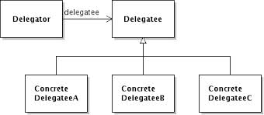
Delegation
delegation – delegator object relying upon another delegatee object to provide a specified set of functionality
  commonly implemented using a pointer from delegator to delegatee and then invoking a method of delegatee within delegator method

Slide 3
Casting
C++ implements several type of casts (explicit type conversions)
static_cast <new type> (expression) – compile time casting (early binding for pointers)
dynamic_cast – run-time casting (vtable is consulted), if incorrect returns nullptr and throws std::bad_cast
reinterpret_cast – no type checking, potentially unsafe
const_cast – adds/removes const-ness, only safe if const-ness removed from non-constant (useful for non-const compliant API functions)
old-style casting
newtype(expression) or (newtype)expression
try static_cast, then dynamic_cast then reinterpret_cast
  since devolve to reinterpret_cast, unsafe, avoid

Slide 4
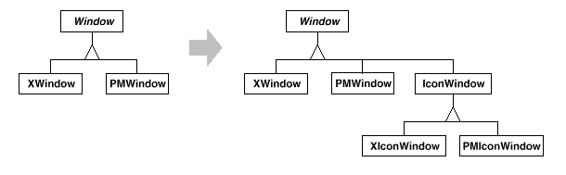
Bridge Pattern Motivation
abstract interfaces are implemented using concrete implementation through inheritance
  may not be flexible enough: permanently binds implementation to interface
example problem:
  Square and Triangle inherit from Figure
  what if need to draw red and blue figures?
    have to create RedSquare, RedTriangle, BlueSquare BlueTriangle
another example problem
  graphics system has window class, need to support multiple window managers – have to sublcass
    what if need to sublcass Window? e.g. IconWindow

Slide 5
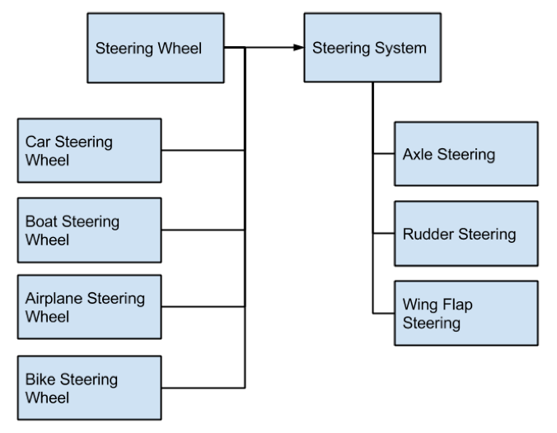
Example Problem 3
steering wheel – interface abstraction (abstract way of controlling a vehicle)
steering system – implementation of steering

Slide 6
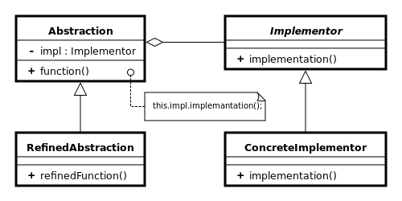
Bridge Design Pattern
decouples interface hierarchy from implementation hierarchy through delegation (pointer)
  abstract interface class (handle) refers to abstract implementor class (body)
  abstractions have concrete derived classes
is a structural design pattern – controls relationships between classes
handle
body

Slide 7
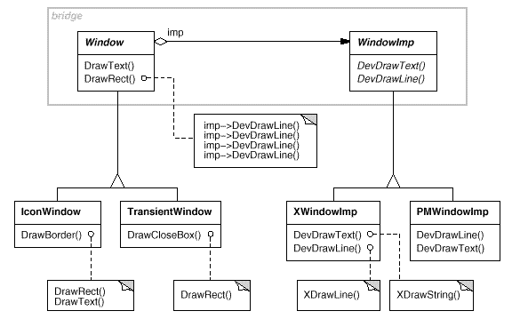
Implementation Example

Slide 8
Bridge Review
what is delegation?
what is the difference between static_cast , dynamic_cast and reinterpret_cast? What does const_cast do? What is wrong with casting like int *(myptr) or (int *)myptr?
Why is Bridge design pattern used? what is handle, body? abstract/concrete? How does bridge use delegation?

