Slide 1
Chain of Responsibility
Design Pattern
passing the responsibility

Slide 2
Invoking Overridden Function
possible to invoke overridden function by stating scope
  // definition
  Class A{
  ...
  virtual void myfunc();
  ...
  };
  Class B: public A{
  void myfunc() override{
  A::myfunc() // invoking base class function
  }
  ...
  };

Slide 3
Chain of Responsibility
have the (handlers) able to handle a request
  with limited abilities (responsibility)
  if one handler cannot handle request, needs to pass it on to next
this chain of responsibility is formed at run-time and maintained by the abstract handler
abstract class keeps track of the chain of handlers
  dispatches to next handler if previous pushes it up
behavioral pattern

Slide 4
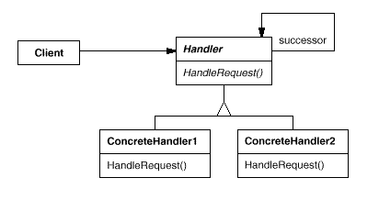
Chain of Responsibility

Slide 5
Chain of Responsibility Review
how to invoke an overridden function in an overriding function?
what is the purpose of Chain of Responsibility Design Pattern?
what are handlers?
how is the abstract handler used to invoke successive handlers?

Slide 6
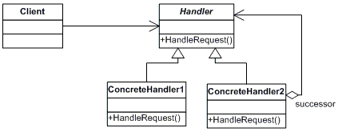
Chain of Responsibility
UML Diagram

