Slide 1
Decorator Design Pattern
adding features

Slide 2
Decorator
needs run-time extension (decoration) of functionality of an object (component)
may subclass, but is inflexible, what if needed to change decoration on the fly
  i.e. need to add decoration to a single object, not entire class
approach: subclass decorator and then reference the original component
  decorator invokes the original component methods optionally decorating it before or after invocation
behavioral pattern
components/decorators can be abstract and concrete

Slide 3
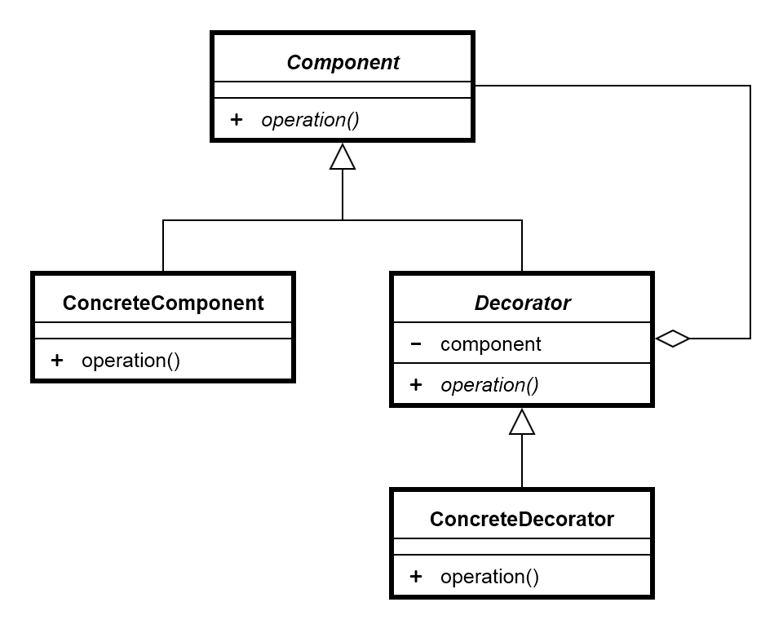
Decorator UML Diagram

Slide 4
Relation to Other Patterns
somewhat similar to adapter, however
  decorator does not change interface, just behavior

Slide 5
Decorator Review
how to invoke an overriden function?
what is the purpose of Decorator Programming Pattern? How is it used?
what are component? decorator?

