Slide 1
Flyweight Design Pattern
when space needs to be saved

Slide 2
Resource Pool
pool – collection of resources to be kept ready to use
  rather than acquired when needed and released when done
reasons
  resource savings on acquisition and release
  predictable time to obtain resource
situations
  expensive to compute objects (graphics, fonts, bitmaps)
  high rate of requests, predictable concurrent number of requests
examples
  thread pools
  memory (RAM) pools
  connection pools

Slide 3
Flyweight
motivation: need to share frequently occurring repeated data
  ex: representation of characters in word processor
flyweight – creates a pool of objects to be shared and reused
terms
  intrinsic (immutable) – state independent part to be stored in the Flyweight object
  extrinsic (mutable) – stateful part to be stored in the client
participants
  abstract flyweight – defines interface for the intrinsic part
  concrete flyweight – implements the intrinsic part
  client – stores the extrinsic part of the object
  factory – maintains the collection of flyweight objects
notes
  uses Factory pattern to maintain flyweights
  often used in composite to maintain leaf nodes

Slide 4
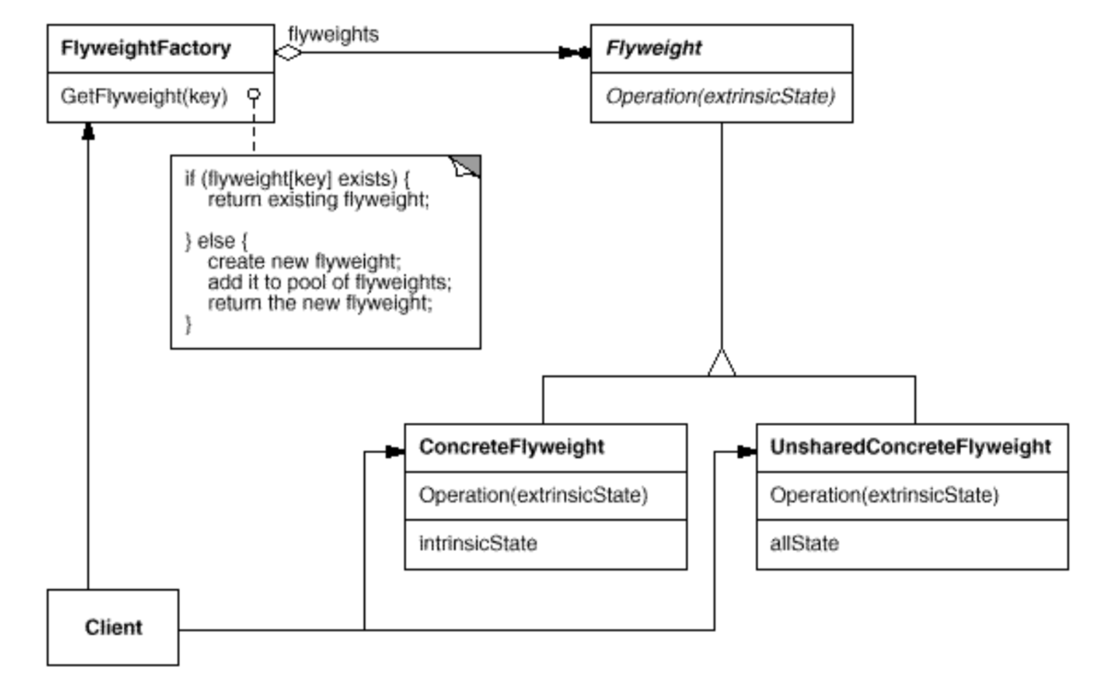
Flyweight UML Diagram

