Slide 1
Memento
Design Pattern
saving state

Slide 2
Copying Object State In and Out
MyClass {
…
  MyClass * copyOut();
  void copyIn(const MyClass&};
…
};
MyClass * MyClass::copyOut(){
return new MyClass(*this); // make sure copy constructor works
}
void MyClass::copyIn(const MyClass& inObj){
*this = inObj; // make sure assignment works
}

Slide 3
Why Memento and Where to Use
to capture and encapsulate the state of an object for later restoration
to implement
  checkpoints/rollbacks
  undo mechanisms
  history

Slide 4
Memento Participants
originator – creates memento containing snapshot of current state, uses memento to restore state
memento – stores internal state of originator, only originator may see internals
caretaker – keeps memento, does not access or examine memento’s contents

Slide 5
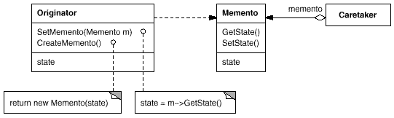
Memento UML Diagram

Slide 6
Memento Review
What is the motivation for Memento Design Pattern use?
what is memento? originator? caretaker?

