Slide 1
Observer Design Pattern
observing changes

Slide 2
Using Elaborated Type Specifier for
Forward Declaration
allows to state forward declaration class right in the place of variable declaration
  have to repeat for every variable declaration
  makes forward declaration easier to read
  Class B{
  // first forward declaration
  B(class A *p):p_(p){}
  private:
  // second forward declaration
  class A *p_;
  };
// definition
Class A{
...
};

Slide 3
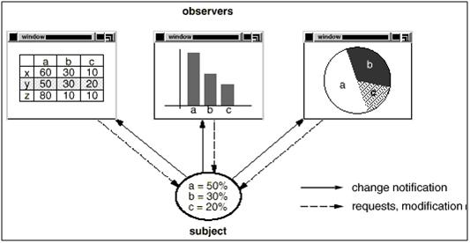
Observer Motivation
objects (observers) need to synchronize behavior with some other object (subject): observe changing subject’s state
  ex: bar chart and bar graph need to know when original spreadsheet values change

Slide 4
Observer Implementation
observers subscribe to change state notifications, while subjects publish changes by notifying observers or sending them messages (synonymous terms)
another name for pattern – publish-subscribe
common way to implement GUI interfaces (foundation of so-called model-view-controller architectural pattern)
  the “business logic” is in subject hierarchy
  the “presentation logic” is in observer hierarchy
if using abstract/concrete classes
  abstract observer/subject – implement registration/notification functionality
  concrete observer/subject – implement subject state and state acquisition by observer
there may be a registry of subjects for observers to subscribe to
behavioral pattern

Slide 5
Communication Methods: Push & Pull
subject needs to communicate state change information to obervers
two communication methods
  push – state change is in message itself
    may require large message
    not all concrete observers need all the data
    subject may push a reference to itself
  pull – observer queries the state of subject after receiving notification
    observer needs to keep reference to subject
    subject needs to implement getters

Slide 6
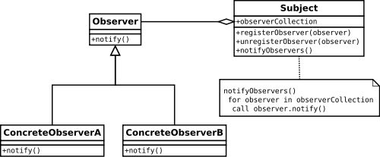
Observer UML Diagram
(Push Method)
+notify()

Slide 7
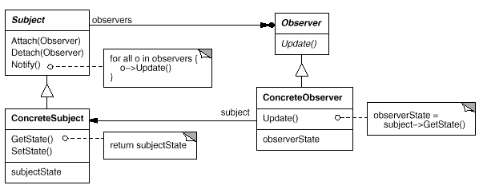
Observer UML Diagram
(Pull Method)

Slide 8
Observer Review
what’s elaborated type specifier and how is it different from forward class declaration?
what is the purpose for Observer Design Pattern?
what is observer? subject? subscribe? publish? notify? message?
what are push and pull methods of observer notification? What are their specifics?
why may registry be needed in this pattern?

