Slide 1
Prototype Design Pattern
clone to create

Slide 2
enum Classes
enum: a sequence of named constants:
  enum Example1 {One, Two, Three};
what’s wrong with pre C++ 11 enum?
  constants are unscoped:
    enum Example1 {One, Two, Three};
    enum Example2 {Three, Four, Five}; // is illegal
  constants are untyped:
    Example1 myEnum1=One; Example2 myEnum2=Five;
    if(myEnum1 != myEnum2) // is legal
C++11 addition
    enum class Gender {Male, Female};
enum classes are scoped, and typed
to refer to constant need to use scope: Example1::One

Slide 3
Type Covariance
overriding virtual function of derived class may accept or return types of derived class (valid only for pointers and references)
  even if the base class virtual function specified base class types in its signature
  example:
    virtual Figure *Figure::create();
    virtual Square *Square::create();
this mechanism is called type covariance
this allows the derived class to have richer interface.
  example: if Square implemented function fill(), it won’t be accessible if create() returned Figure*

Slide 4
Prototype
creating objects from scratch may be undesirable
  too expensive – i.e. regenerating an SQL table view
  little difference between newly created objects
  need to create an object in a particular (prototype) state
instead: create a prototype object and create a copy of it with a clone() operation
  clone() returns the pointer to the copy of the prototype
abstract prototype (prototype interface) - allows clients to abstract from prototype details (prototype implementations)
clone() is virtual – implemented in derived classes
concrete clone may return a covariant type
why can’t just use a copy constructor instead of clone()? Cannot overload
prototype is a creational pattern

Slide 5
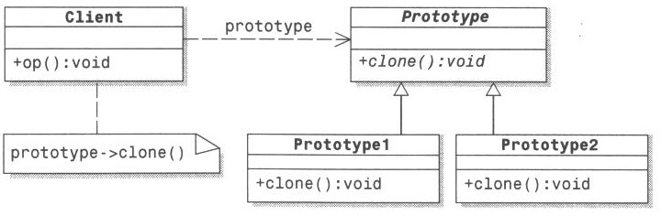
Prototype Diagram

Slide 6
Relation to Other Patterns and Usage
factory is another creational pattern
  yet, prototype clones while factory typically creates objects from scratch
if multiple prototypes – create a registry of prototypes, associate (factory) creation method with each: design a prototype factory

Slide 7
Prototype Review
why is there a need for enum Classes? What is wrong with simple enum types in pre-C++11?
what is type covariance and why is it useful?
what is the motivation for Prototype Pattern?
what does clone() do?
how and why can prototypes be organized into a registry? How is factory used for that?

