Slide 1
State Design Pattern
self-modifying interface

Slide 2
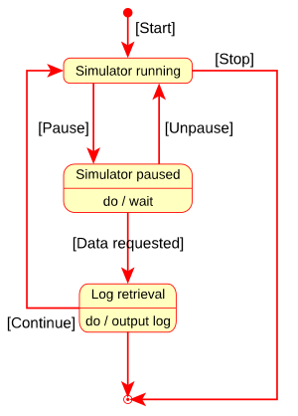
UML State Diagram
depicts an object transitions through states
  what it object state again?
notation
  filled circle – initial state
  hollow/filled circle – final state
  rounded rectangle – state
    top: name of state
    bottom: activities done in this state
  arrow – transition
    label in square brackets – name of the event causing transition
useful for illustrating state design patten
  context goes through states
Notes:
need to add forks/joins

Slide 3
(Forward) Class Declaration
in C++, any named construct must be declared before use
a class may be declared by
  class definition
  (forward) class declaration. Syntax:
      class NameOfClass;
types
  incomplete – forward declared class
  complete – defined class
incomplete type can be used to declare pointers/references (but not objects) of this class
used when classes mutually refer to each other, or for better program structure
  Class A; // declaration
  Class B{
  B(A*p):p_(p){}
  private:
  A *p_;
  };
// definition
Class A{
...
};

Slide 4
State
problem – object’s behavior depends on a state it is in
  usually implemented as a sequence of cases of a switch statement
    inelegant, difficult to observe and modify
state design pattern – provides extensibility and cleaner interface to state transitions
  context – “concentrator” class whose objects actually have states, passes operations to the state class
    not aware of the number and relationships between states
    clients interact with context
  state – abstract class representing state with the set of abstract operations on states
  concrete states, implement abstract operations, including changing of the state
    usually implemented as singletons – object may be in only one state
state is a behavioral design pattern – prescribes behavior between objects
  object design pattern – uses object composition
    class design pattern (like Template Method) uses class hierarchy
Notes:
introduce the concepts of behaviors/handles

Slide 5
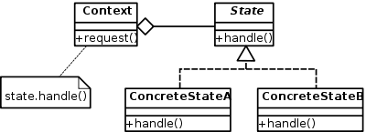
State Pattern Diagram

Slide 6
Relation to Other Patterns and Usage
there may be multiple concrete states, added as necessary during development
multiple objects may be in different states
prototype may be used to clone the states – if efficiency is required

Slide 7
State Pattern Review Questions
What are the components of UML state diagram and how are they used?
What is a forward class declaration? What is incomplete type? What variables can be declared of incomplete type? Why is this used?
What is the purpose of State Design Pattern?
What is concentrator, abstract and concrete state?
How is delegation used in State?
How is state change carried out in context?

