Slide 1
Visitor Design Pattern
When Need to Add Methods Often

Slide 2
Double Dispatch
static dispatch - compile time selection of which version of the polymorphic function to execute
dynamic dispatch – run-time selection
  single dispatch – selection based on a single object, supported in C++ using virtual functions
  double dispatch – selection based on multiple objects, not directly supported by C++ but implemented using Visitor Design Pattern

Slide 3
Visitor
separates data from operations on it by defining visitor class that implements the operations
  allows to easily add the operations since they are added to visitor
participants
  element – has accept() method that take visitor as argument, calls visit()method of the visitor, element passes itself to the visit() method
  visitor – defines visit() with parameter corresponding to the particular concrete element
when accept()is invoked, its implementation is based on type of (concrete) element
when visit() within accept() is invoked, its implementation is based on
  (concrete) type of the visitor and
  (concrete) type of the element (passed as parameter to visit())
  that is, the implementation depends on two objects

Slide 4
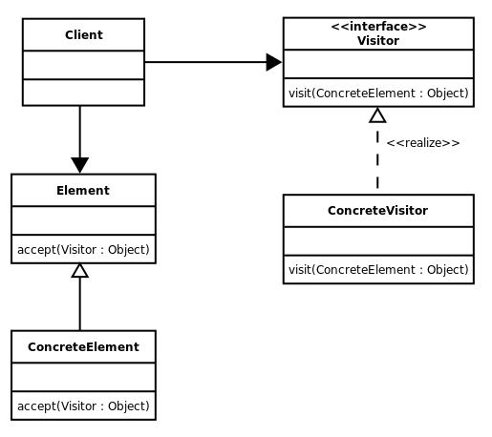
Visitor UML Diagram

Slide 5
Visitor Review
what is static/dynamic/single/double dispatch? How is single/double dispatch implemented in C++
what is the motivation for Visitor Design Pattern?
  what is data/operations?
what is element? visitor?
  what is easier to add to the code element or visitor?
what is accept()? visit()?

