Slide 1
Object-Oriented Programming
when inheritance is needed

Slide 2
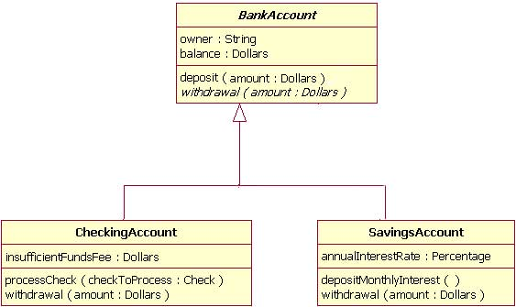
Terminology
class D may inherit the features of another class B, or extend class B
    B – base class, superclass – provides generalization of class D
    D – derived class, subclass – provides specialization of class B
example: Figure class may have three derived classes: Triangle, Box and Diamond
inheritance relation
forms inheritance hierarchy
inheritance in UML
denoted as a triangle
pointing to base class

Slide 3
Example Figures
class Square is derived from class Figure
    class Figure { // base class
    public:
    Figure(int);
    protected:
    int size_; // will be accessible to derived methods
    };
    class Square: public Figure{ // derived class
    public:
    Square(int);
    void draw();
    };

Slide 4
Access Methods
  base class features: public protected private
access modifiers derived class features
  public: public protected inaccessible
  protected: protected protected inaccessible
  private: private private inaccessible
put another way
public inheritance – provides is-a relationship; or derived class inherits interface of base class: all public methods of base class available for derived class
private inheritance – provides implemented in terms of relationship; or derived class inherits implementation of base class: functions of base class available only for derived class member functions

Slide 5
Overloading vs. Overriding
function overloading – using multiple function names with different signatures in the same scope (compiler resolves invocations)
  function overloading does not work across inheritance: attempt to define a function with the same name in derived class makes base class function inaccessible (can still be accessed with scope resolution operator), or shadows the base class function
function overriding – replacing base-class functions with derived class functions, signatures must match, resolution is done at run-time
  done with virtual functions

Slide 6
Virtual Functions
what if necessary to manipulate objects regardless of specifics of derived class?
  need to draw figures regardless whether square or triangle
can be done through pointers (or references) to objects
    Figure *fig1 = new Square(3);
    Figure *fig2 = new Triangle(5);
    fig1 -> draw();
    fig2 -> draw();
which function (base or derived class) is invoked?
early (compile-time) binding – resolving function by compiler
    Figure::draw() is invoked
late (run-time) binding – resolving function by program itself on the basis of object class pointed-to
    Square::draw() and Triangle::draw() are invoked
to enable late binding, declare function as virtual in base class:
    virtual void draw();
  function so used is called polymorphic, technique – polymorphism
virtual function may be a destructor but not a constructor

Slide 7
override and final (C++11)
function overriding a virtual remains virtual: may be further overridden in derived classes
  virtual in overriding functions is not necessary
override specifier following function head signifies that this function must override a virtual base class function, if not – compile-time error
final specifier following function head signifies that derived classes must not override this function, if try – compile-time error
  class Figure {
  virtual void draw()=0;
  void redraw();
  };
  class Square: public Figure{
  void draw() override final; // ok
  void redraw() override; // error, attempt to override non-virtual function
  void newdraw() override; // error, not an override
  };
  class EmptySquare: public Square{
  void draw(); // error, attempt to override final
  };

Slide 8
Abstract Functions
abstract function (method/operation) - defines only signature but not implementation
  pure virtual function – abstract function, prototype followed by =0
      virtual void draw() =0; // pure virtual
    to be implemented in derived class
    must be public
concrete operation (method/function) – function whose implementation is provided
abstract class – class that has at least one abstract function
  cannot have instances (objects), only pointers and references
concrete class – has no abstract functions
  if derived from abstract class, has to implement all abstract functions
    if does not, remains abstract

Slide 9
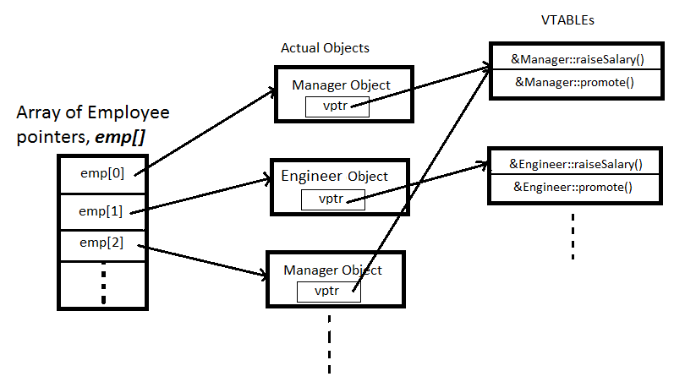
Implementation of Virtual Functions
hierarchy
vtable – a per-class table of function pointers
vptr – a per-object pointer to vtable
code
every constructor has internal code to set up vptr
every polymorphic function invocation adds a function pointer lookup

Slide 10
Construction and Destruction with Inheritance
constructors
default base-class constructor is invoked before derived class constructor
derived class constructor must explicitly invoke non-default base class constructor
done using a construct similar to member initialization list
    // base class constructor
    Figure::Figure(int size): size_(size){}
    // derived class constructor
    Square::Square(int size): Figure(size){}
destructors
destructors are executed in reverse order of constructors (derived first)
always declare destructors virtual or destructors bound at compile-time and derived constructor may not be executed leaking memory
default base class constructor idiom
  virtual ~Figure() {}

Slide 11
Constructor Delegation
C++11 feature
one constructor invokes another in initialization list
avoids code duplication
  class Figure {
  public:
  Figure():Figure(0){} // delegates
  // to regular constructor
  Figure(int size): size_(size){}
  protected:
  int size_;
  };

Slide 12
Template Method Pattern
specify an abstract class that implements most of functionality
primitive operations – functions to be implemented (overridden) in concrete classes
hook operations – may be overridden by concrete classes, provide default behavior
template method – function of the base class that uses primitive operations (in effect, concrete implementations) to accomplish a certain task
is a behavioral pattern – deals with class behavior
  what kind was singleton pattern?
template method is used to design frameworks – the base class invokes subclass methods

Slide 13
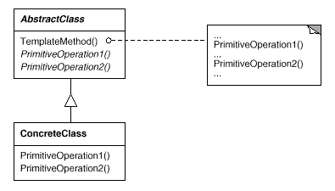
Template Method UML Diagram
in UML abstract functions are shown in italics

Slide 14
Review Questions
what is base/derived class?
how is inheritance indicate in UML?
how is private inheritance different from public inheritance?
what is a virtual function? how is it denoted in UML?
what is an abstract function? abstract class?
why is destructor always declared virtual?
what is constructor delegation
template method pattern, purpose?
  what is template method?
  what is a hook/primitive function?

Slide 15
Upcasting and Downcasting
downcasting – changing pointer (reference) type by moving down the inheritance tree (from base to derived classes)
        Figure *f = new Triangle(4); // f is downcast
  downcast pointer can access only base class features, to access derived class features use with dynamic_cast:
    dynamic_cast<type>(pointer)
    if pointer points to object of type, returns pointer converted to derived type, 0 (zero) otherwise
    run-time type identification (RTTI) construct
  often used idiom
  if (Triangle* tp = dynamic_cast<Triangle*>(f)){
  … use tp as pointer to Triangle …
  }
upcasting – changing pointer (reference) type by moving up the inheritance tree
Notes:
Muldner is using the opposite of accepted terminology

