Slide 1
CS 44001/54001
CS III: Programming Patterns
Mikhail Nesterenko

Slide 2
Procedural Programming
without classes: using standalone functions, primitive types and simple control structures

Slide 3
Before We Go
a computer program is governed by rules
what are
  syntax rules?
  semantic rules?
  stylistic rules?
Notes:
any data may be declared const – cannot be modified
typedef creates synonym for existing type: typedef ExistingType NewType;
typedef bool Boolean;

Slide 4
Types, Variables
primitive (basic/built-in) types – string, int, bool, char, double
  exist but won’t need
    int may be long or short, signed or unsigned
    char may be signed or unsigned
    floating point types may be float, double or long double
  auto – type to be determined by compiler (C++11)
    auto i =7; // nice for type of loop variables
    could also be auto & and const auto
  decltype(expr) – type is same as expr (C++11)
    decltype(i) j =8;
variable – denotes memory location of particular type, holds values
  what is block? what is local variable? Can a variable be local to a block? what is scope of a variable?
Notes:
any data may be declared const – cannot be modified
typedef creates synonym for existing type: typedef ExistingType NewType;
typedef bool Boolean;

Slide 5
Operators, Arity
operators – built-in functions
fixed number of operands (parameters)
arity – the number of operands
unary
  ++ and -- prefix/sufix(postifx) preincrement/postincrement or predecrement /postdecrement
    use prefix porm
    prefix form returns an l-value (what’s that?)
binary
  assingment, compound assingment
ternary – what’s that?
What are these operators? What is their arity?
= ! - ++ += << ||

Slide 6
Expressions
what is a constant? Literal constant? What other kind of constant is there?
  how is contant type determined?
What is expression? What is expression evaluation? How is expression type determined?

Slide 7
Conditionals and Loops
conditionals
  if/else
  switch
  ternary expression
loops
  while
  do-while
  for
    for(init_statement; expression; post_statement)
    action
    range-based-for (C++11)
      int a[] = {10,20,30,40};
      for(auto e: a)
        cout << e;
    can be auto &e or const auto &e
    how do I write a range-based-for to add 5 to each element of the array?

Slide 8
Functions
what is function invocation/call/definition/declaration?
what is the difference between argument and parameter?
in procedural programming functions are standalone
function definition – includes head and body (implementation)
can be declared (with prototype/signature – definition that omits body)
function overloading – multiple different functions within the same scope provided that they have different signatures
  double max(double, double);
  int max(int, int);
resolution (of function call) – compile time process of associating function invocation with function declaration
  int i = max(10, 20); // resolved to second declaration
client/caller – function that invokes another function
  when dealing with programming patterns, function that uses the pattern
void – no return value, if no parameters – keep parentheses empty
  void myFunc();

Slide 9
Function Parameters, Default Values
parameters may be passed by value, by reference, what’s the difference?
default values
  default parameter value may be specified at function declaration
    void move(int from, int to=0, int by =1);
    or definition, but not both
      convention – specify at declaration.
  client has an option of specifying parameter or using default value
    move (2, 3, 4);
    move (2, 3);
    move (2);
  provides convenient alternative to overloading
  only trailing parameters may have default values
      void move(int from, int to=0, int by); // illegal

Slide 10
References
reference – alias (another name) for data
declared as type&
has to be initialized at declaration and cannot be changed
  int& b = a;
  ++b; // changes a
can hold only lvalues – values that refer to memory location, can be used on the left-hand-side of assignment
  as opposed to rvalues
used for parameter passing
  void swap(int &a; int &b){
  int tmp = a;
  a = b;
  b = tmp;
  }

Slide 11
References (cont.)
reference can be used to return values
in which case function can be used on the left-hand side of assignment
  int& getElement(int x[], int i) {
  return x[i];
  }
  ...
  int a[] = {10, 20, 30};
  cout << getElement(a, 1);
  getElement(a, 2) = 55;
careful with returning local function variables by reference: they are destroyed when function returns, why?

Slide 12
Pointers, Arrays and Dynamic Memory
(review)
what is stack, heap, frame?
what is the relationship between array name and a pointer?
what is dynamic variable and how is it allocated? deallocated? why is it needed?
what is dynamic array and how is it allocated?

Slide 13
Pointers and Functions
function may also return a pointer
  int* getElement(int x[], int i) {
  return &x[i];
  }
  ...
  int a[] = {10, 20, 30};
  cout << *getElement(a, 2);
  *getElement(a, 5) = 55;
  dereferenced pointer is an lvalue

Slide 14
nullptr
nullptr – null pointer constant (C++11 addition)
  is of type pointer unlike NULL and 0, which are integer type
what’s wrong with NULL and zero?
  void myFunc(int); // overloaded function
  void myFunc(char *);
  func(NULL); // invokes first function
use nullptr to signify uninitialized pointer

Slide 15
const
keyword
uses
  named constants: const int MyConst = 55;
  parameter protection void myFunction(const double myValue);
  reference protection void myFunction(const MyClass& myObj);
const casting - allows a constant to be modified
  const int i = 3;
  const_cast<int>(i) = 1;
what’s constant pointer? pointer to constant? can I have both?

Slide 16
Arrays
What does these lines do?
  int myArray[10];
  int myArray[10]={0}; // this one is tricky
  int myArray[10]={2};

Slide 17
Strings
what is the difference between c-style and C++ style strings?
how to convert c-style <-> c++-style string?
what is argc argv ?
what is concatentation?
what do find() substr() insert(), replace(), erase() do?
what is the difference between
  myfunc(string); myfunc(string &) and myfunc(const string&);
Notes:
to c-style string c_str()
to c++ style string: initialize string s(cStyleString);

Slide 18
Static Variables
static variables are initialized only once and retain their value across function invocations
      void login() {
      static int number1 = 0;
      int number2 = 0;
      ++number1; ++number2;
      cout << number1 << number2;
      }
      int main(){
      login();
      login();
      login();
      }
prints 112131

Slide 19
Conditional Compilation and
Include Guards (review)
what is preprocessor directive?
what’s the difference between #include <file> and #include ”file” ?
what does this code do?
    #ifndef MYHEADER_H
    #define MYHEADER_H
    ...
    #endif MYHEADER_H
Notes:
#pragma once
is a windows-originated non-standard replacement that is widely supported
may speed up computation
may introduce sublte errors as header files are copied sym-linked, etc

Slide 20
Namespaces
what are namespaces and why are they needed?
what are the three ways of importing names from a namespace? What are their advantages and disadvantages?
how should the names be imported in a header file?
how does this apply to std namespace?
namespace definition is open – can be added to by defining another namespace with the same name (note that class definition is closed)
  common idiom:
    class interface is in a namespace in the header – exposed to clients
    class implementation is the added namespace in the source file
variable shadows another variable with the same name in outer block or namespace, may refer to shadowed variable with scope resolution
  what does this construct mean?
    ::myName = 55;
Notes:
referring to a name in the global namespace

Slide 21
Comma Operator
comma operator – binary operator that evaluates first operand, discards result (used for side effect), evaluates second and returns value, has lowest precedence
    int i = (a += 2, a+b); // what does this do?
somewhat confusing, seldom used outside idioms, common for for-loop initialization:
      int i,j;
      for(i=1, j=i; i < 10 && j < 10; ++i, ++j)
      cout << i << j;

Slide 22
Casting
(implicit) casting – type conversion without using specific type conversion operators
  (explicit) casting – otherwise
promotion – casting with precision gain (ex: int to double)
demotion – casting with precision loss (ex: double to int)
explicit casting: static_cast<type>(value)
  int i =1; double d = 3.21;
  i = static_cast<int>(d);
constant cast – allows a constant to be modified
  const int i = 3;
  const_cast<int>(i) = 1;

Slide 23
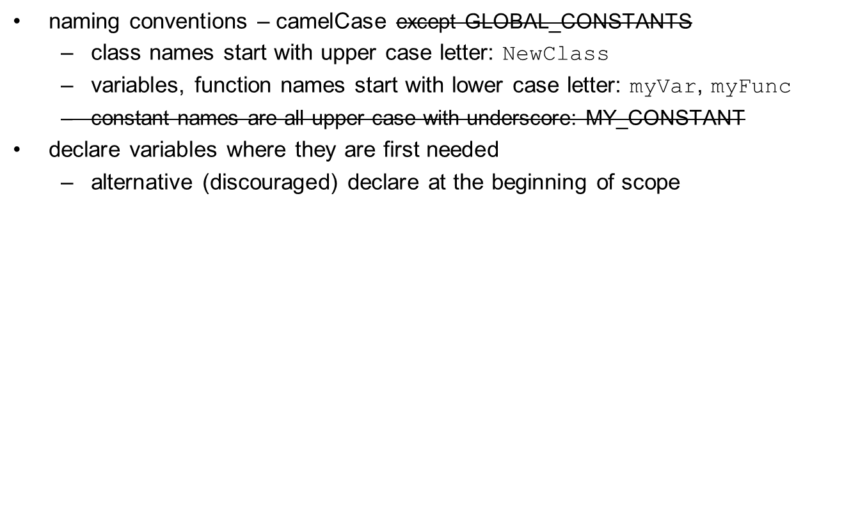
Naming Conventsion
Notes:
use class attributes rather than global variables (violate modularity)

