Slide 1
STL
Associative Containers
navigating by key

Slide 2
Pair Class
aggregates values of two, possibly different, types
used in associative containers
defined in <utility>
may use a two-argument constructor
  pair<int,int>(arg1,arg2)
may copy and compare
may access individual elements with first and second
may create with std::make_pair(arg1,arg2) function that returns a pair composed of arg1 and arg2

Slide 3
Associative Containers
do not store elements in linear order, provide mapping from keys to values
usually insertion, deletion, lookup times are equivalent
kinds
ordered containers (preserve iterator order of elements)
  map – stores pairs, first element is key, lookup by key
  multimap – map with multiple elements with same key
  set – element and key are the same
  multiset – multiple elements allowed
unordered containers (hashes) – C++11, do not order elements, quicker access
unordered_map
unordered_multimap
unordered_set
unordered_multiset

Slide 4
Maps, Accessing
stores sorted key/value pairs
sorting is based on key
insertion/deletion/lookup takes logarithmic time
need <map> and std::map
declaring: map <int, string> employees;
looking up elements
  with indexing
    cout << employee[123]; // access and prints value
  with find, returns end()if not found
    auto it = employees.find(123);
    if (it != employees.end()) cout << “Found it!”
accessing all elements
  may iterate over map (in order of keys) to access elements
    for (auto it=employees.cbegin();
    it!=employees.cend(); ++it)
    cout << “Name: ” << it -> second << endl;
  using range-based for (C++11)
    for(const auto& e: employees)
    cout << e.first << ": " << e.second << endl;

Slide 5
Maps, Inserting
const-maps and maps of constant elements are allowed
key is always implicitly const
inserting
  “unsafe” with overloaded indexing operator, overwrites old key value if exists, creates new if does not
    employees[123] = ”Joe”;
  “safe” with insert()
  auto ret=employees.insert(make_pair(123, ”Joe”));
    returns pair<map<int, string>::iterator, bool> does not overwrite old pair with same key
      second pair element indicates whether insert was successful
        -- true if element inserted
        -- false if already exists
      first pair element iterator to existing or inserted map element
    if(ret.second) cout << ”insert successful!” << endl;

Slide 6
Maps, Inserting with Iterator/Range
can insert initializer list, if constant value
auto ret=employees.insert({123, ”Joe”});
can insert close to a “hint” iterator: inserts before iterator’s position
auto result=employees.insert(myit, make_pair(123, ”Joe”));
  may ignore hint
  returns iterator to inserted or existing pair
can insert range
managers.insert(employees.begin(), employees.end());
  if keys equal, unspecified behavior
  no return value

Slide 7
Maps, Erasing
may erase at iterator, or iterator range (same as sequential containers)
  returns iterator to the next element past erased
may erase by key: employee.erase(123);
  returns number of nodes erased

Slide 8
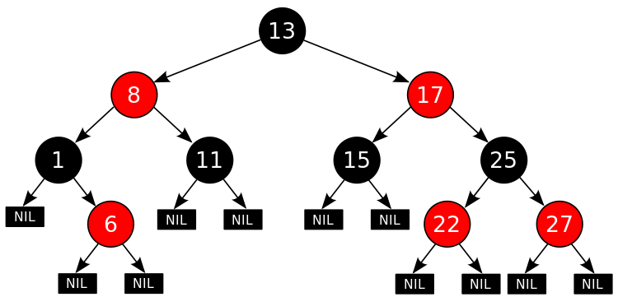
Maps, Implementation
usually implemented using
red-black tree
variant of balanced binary
search tree with extra properties
  red node’s children are always black, hence:
longest path leaf-to-root
is no more than twice shortest
path
guarantees O(log N)
  lookups
  insertions/deletions
Notes:
root is always black, leaf nodes do not contain data, leaves are always black, if node is red, all its children are black
property: the path from the root to the farthest leaf is no more than twice as long as the path from the root to the nearest leaf.
insertion: adding a node and coloring it red

Slide 9
Multimaps
may store several elements with same key
interface similar to maps
  does not provide indexing operator (does not make sense)
lookup
  elements with same key are stored together
  find returns iterator to one of elements (not necessarily first)
  upper_bound() and lower_bound() provide a range of iterators for particular key, specifically
    lower_bound(key) returns iterator to first element not smaller than key
    upper_bound(key) returns iterator to first element greater
    than key
  both return end() if key is not there
  equal_range() returns a pair of iterators for the range
updates: same as map
  erase(key) removes all elements with key
Notes:
lower_bound()/upper_bound() are defined for associative containers, not defined for hashes. There are similarly named algorithms that can be used on non-associative containers
multimaps use red-black trees with non-unique keys

Slide 10
Sets and Multisets
key and value are the same
  put another way: operates on scalar variables (not pairs)
need <set> and
  using std::set or using std::multiset
keep elements sorted
does not implement indexing (nothing to index)
as key, element is constant and cannot be modified
  to update use erase() followed by insert()
all expected insert()s and erase()s
  inserts: by element, with iterator hint, by iterator range
  erases: by element, iterator, range
  erase(element) removes all elements from multiset

Slide 11
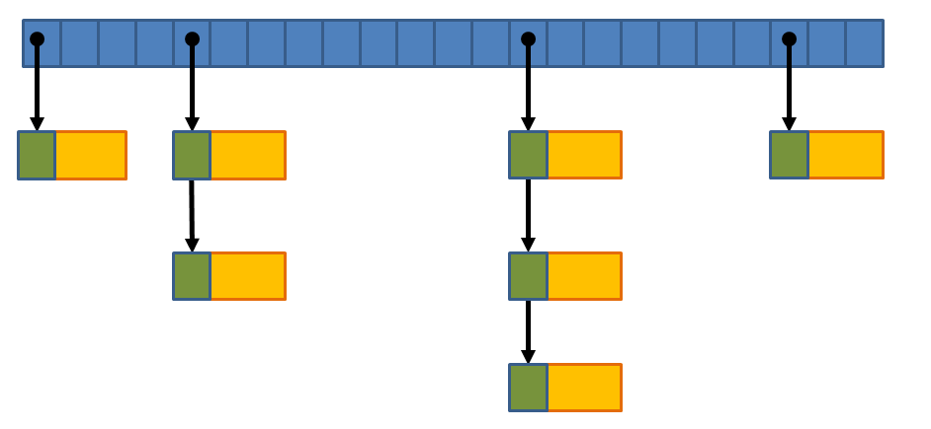
Unordered Containers (Hashes)
defined in C++11
hash container contains a sequence of
buckets of elements
hash function translates (hashes) key to
bucket index
collision – hashing different keys to same bucket
  usually resolved through pointer to linked list of elements
unordered map – needs <unordered_map> and using std::unordered_map
  same interface as map
  plus: transparent memory implementation
    bucket_count() – number of buckets
    load_factor() = size()/bucket_count()
    max_load_factor() – returns or sets maximum load factor before bucket count increases (1 by default)
    bucket(key) – bucket for key
    begin(key), end(key) returns local_iterator for the chain of elements in a bucket
unordered set – needs <unordered_set> and using std::unordered_set
  same interface as set and above bucket functions
unordered multimap and multiset exist with expected interfaces
Notes:
To ensure O(1) hash table traversal, all elements are linked into (a singly or double) linked list with buckets pointing to the beginning
element.

Slide 12
Associative Containers Review
What is pair class? what is first/second? what is make_pair()?
What are associative containers? How are they different from sequential?
How are ordered associative different from unordered? Name specific containers in both categories.
How is map declared? How are elements in a map accessed?
How are elements inserted into a map? erased from a map? What is the difference between safe and unsafe insert?
What is multimap? How is it different from map? Does multimap provide indexing operator? Why/why not? what are lower_bound()/upper_bound()?
What is set/multiset?
What are unordered containers? What are their advantages/disadvantages over ordered associative containers?
What are bucket_count(), load_factor(), max_load_factor() ?

