Slide 1
Standard Template Library
a collection of useful tools

Slide 2
Before We Start: Time Complexity
estimates efficiency of algorithm
measured in the number of elementary operations performed by algorithm
estimated in worst case
relates to size of input n
common complexities
  constant (independent of input size)
  logarithmic (log n)
  linear (n)
  quasilinear (n log n)
  quadratic (n²)
  polynomial
  exponential (2^{n})
what is the complexity of
  finding smallest number in sorted array? unsorted array?
  finding a particular number in a sorted array?
  sorting an array?
  sorting an array with insertion or bubble sort?

Slide 3
STL Organization
idea: separate data from operations on it
concepts:
  container – data structure that stores values organized in a certain manner
  iterator – way to access values in a container
  algorithm – way to manipulate data through iterator regardless of container type
  callback – reference to code, way to customize algorithm's operation
what’s not in STL
  thread safety
  tree or graph structures
STL is template-based and extensible

Slide 4
Containers
container provides implementation of commonly used data structure
element – stored data
  homogeneous – elements of only one type
container kinds
  ordered – elements may be efficiently accessed in order
    sequential
    container adapters – limit operations of sequential containers for specialized purpose
    associative – element access by value: mapping from keys to values
  unordered associative (C++11) – hash tables
  others – specialized purpose, legacy

Slide 5
Sequential Containers
vector – random access to elements, amortized (on average) constant insertions in back, linear insertions elsewhere
deque (double-ended queue) – random access to elements, amortized constant insertion in front/back, linear elsewhere
list (doubly linked list) – linear access to elements, constant insertion/deletion once located
std::array (C++11) – fixed size array, knows its size (unlike C-style) can be copied, returned, no insertion/deletion
std::forward_list (singly-linked list, C++11) – forward search only, less memory for storage than list

Slide 6
Container Declaration Syntax
container is a template, hence to declare:
  container_class <type_parameter> container_name;
  where
  container_class - vector, deque, list, etc.
  type_parameter- type/class of elements
  container_name – identifier
  example
  vector<int> items; // declares vector with no elements

Slide 7
Common Container Functions
c.empty() const; // true if there are no entries in c
c.size() const; // number of entries in container c
c.erase(); // removes one or more specific elements of the container
c.clear(); // removes all elements from the container
c = v; // replace contents of c with contents of v
c.swap(v) // swaps contents of c and v
for sequential containers
c.push_back(e) // adds element to back
c.pop_back() // removes last element, does not return it
c.front() c.back() // return first, last elements

Slide 8
Random Access Containers
major distinguishing feature: constant time access to any element
vector and deque

Slide 9
Vector
need #include <vector>, using std::vector;
declaring, initializing, destroying
  vector<int> myVector; // vector of zero elements
  vector<int> myVector(10, 100); // vector of 10 ints with value of 100
  vector<int> myVector={1,2,3}; // use of initializer list C++11
  vector <Element>* eVector = new vector<Element>(10); // allocated on the heap
  delete eVector; // note, not delete [] eVector;
copying and assigning
  copy constructor and assignment operator perform deep copies of vectors: use pass-by-reference for efficiency
  intVector.assign(5,100); // removes old values and stores 5 elements of 100
  intVector.assign({1,2,3}); // as of C++11
  there is a range-based version of assign(), studied later
comparing
  !=, <, >, <= and >= implemented
  “less than” is by first unequal element

Slide 10
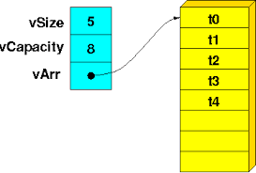
Vector Space Allocation
vector implementation
size() – current number of elements in
the container
resize() – makes vector specified size,
discards extra elements
vector is memory transparent container: below
operations are available
  capacity() – returns storage size currently allocated to container
    at least size()
    as vector grows (with push_back()), most implementations double the capacity when limit is reached
    when vector shrinks – capacity is usually not changed
  reserve() – allocates space but does not change size
    just a suggestion, also does not have to make container smaller

Slide 11
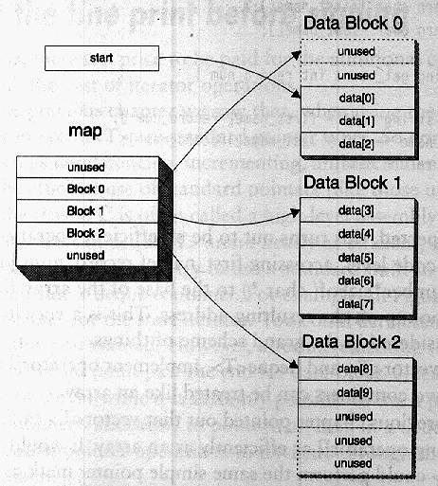
Deque
main purpose: adding in front as well as in back
deque interface similar to vector,
but
  implements constant
  push_front(),
  pop_front()
  insertions/deletions are more consistent in time
  indexing is a bit slower
deque is memory opaque: capacity() and reserve() are unavailable

Slide 12
Iterators
iterator – abstraction for accessing elements of containers
  have specific interface regardless of container, hence common way to manipulate all containers
  is a design pattern that is realized as language feature
  not necessarily a pointer
declaring iterator
  container_class <type_parameter>::iterator_type iterator_name;
  where
  container_class – vector, deque, list, etc.
  type_parameter – type/class of elements
  iterator_type – iterator, const_iterator (more later)
  iterator_name – identifier
  example
  vector <int>::iterator p;

Slide 13
Iterators Operations
iterator arithmetic
++ (pre- and postfix) and -- (decrement) to advance to the next (previous) container element
== and != operators to test whether two iterators point to the same element
dereferencing (*) provides element access
member functions
c.begin() returns an iterator pointing to the first element of container c
c.end() returns an iterator pointing past the last element of container c
  analogous to the null pointer. Unlike the null pointer, can apply --(decrement) to iterator returned by c.end() to get an iterator pointing to last element in the container
half-open range – sequence of elements from first past last

Slide 14
Example Usage, Classic
  vector <int> v; // declare vector
  …
  for (
  // declare and initialize iterator
  vector<int>::iterator p = v.begin();
  p != v.end(); // check if end is not reached
  ++p // move iterator to next element
  ){
  cout << *p; // manipulate element in loop body
  }
style: use != rather than < in for expression (may not be implemented for all containers)

Slide 15
Example Usage, auto Type
  vector <int> v; // declare vector
  …
  // C++11 addition
  for (
  auto p = v.begin(); // determine type on basis of RHS
  p != v.end(); // check if end is not reached
  ++p ){ // move iterator to next element
  cout << *p; // manipulate element in loop body
  }

Slide 16
Example Usage, Range-Based for
// C++11 addition
vector <int> v; // declare vector
…
for (auto e: v){ // works for any construct with begin() and end()
cout << e; // manipulate element in loop body
}
for (auto &e: v){ // reference is more efficient if copy is expenisive
cout << e;
}
can also be const auto and const auto &e
range-based-for does not have a loop variable
works on: arrays, containers, initializer lists and any object that has begin(), end() , prefix++ and !=

Slide 17
Using Const Iterator
  const_iterator type prevents element from modification through iterator
  can be converted from regular iterator (but not back). Useful when assigning from begin()
  for(vector<int>::const_iterator it=intVector.begin();
  it != intVector.end();
  ++it)
  or just use auto
  for(auto it=intVector.cbegin();
  it != intVector.cend();
  ++it)

Slide 18
Indexing and Iterator Arithmetic
indexing operations, as well as iterator arithmetic can be applied to vector/deque and their iterators,
  iterator arithmetic – adding/subtracting integers or subtracting iterators, comparing iterators for inequality
examples:
  vector<int> v={1,2,3}; // initializer list, C++11 addition
  v[1] = 23; // indexing operation for vector
  it[0] = 44; // indexing iterator
// iterator arithmetic for vectors and deques
  vector<int>::iterator it=v.begin()+5;
  cout << it – v.begin();
  deque<char> d(10); auto dit = d.begin();
  dit +=5;

Slide 19
Update Operations: insert()
variants
  container.insert(position, value); // value insert
  container.insert(position, repeats, value); // fill insert
  container.insert(position, from, to); // range insert
  where
    value – to be inserted
    repeats – number of value repeats
    position – iterator to insert at
    from – beginning of range iterator
    to – past the range iterator
examples
    // appending vTwo to the tail of vOne
  vOne.insert(vOne.end(), vTwo.begin(), vTwo.end());
  vOne.insert(it, 55); // adding single element
Notes:
there is no vOne.append(), and vOne.assign() assigns the whole vector
vOne.insert(vOne.begin()+5, 4, 10); // adding four 10-s

Slide 20
Update Operations: erase()
variants
    container.erase(position);
    container.erase(from, to);
  where
    position – iterator to erase value at
    from – beginning of range iterator
    to – past the range iterator
examples
  // removing middle of vOne
  vOne.erase(vOne.begin()+3, vOne.end()-2);
  vOne.erase(it); //remove single element
  vOne.clear(); // empties container
Notes:
there is no vOne.append(), and vOne.assign() assigns the whole vector

Slide 21
Iterator Invalidation
for sequential containers update operations invalidate iterators in the container (due to storage reallocation) specifically
  vector: all iterators past the point of insertion unless capacity reached
  deque: all iterators unless insertion is at front/back
  list: iterators unaffected
erase() returns iterator to next element past erased
insert() returns iterator to the first of inserted
loop modification idiom
    for(auto it=vect.begin(); it != vect.end();)
    if (/* need to erase */)
    it = vect.erase(it);
    else
    ++it;

Slide 22
Iterator Errors
iterators are as (un)safe as pointers
however, some errors are iterator specific.
  what’s wrong with this code?
    vector<int> v;
    auto it=v.end();
    *it = 20;
  or with this?
    vector<int> one(10), two(10);
    for(auto it = one.begin(); it != two.end(); ++it)
      cout << *it;

Slide 23
Move Semantics
a lot of internal copying happens with containers
  when re-allocated/enlarged
  when returned, when temporary object is created
  when initialized in certain situations
a copy constructor is invoked
  inefficient on large objects
define move-constructor and move-assignment
  MovableClass(MovableClass&& src)
  MovableClass& operator= (const MovableClass &&rhs)
  the semantics is to use the original rather than create copy. The original should be left in a “legal but undefined” state
move may be forced on non-termporary object with std::move()
  result = std::move(objToDestroy);
  MovableClass newObj(std::move(objToDestroy));
  myVector.push_back(std::move(objToDestroy));
  myVector.insert(locationIt,move(objToDestroy));
std::move() may be applied to whole containers
  vector<int> v, v2 = {1,2,3,4};
  v = std::move(v2);

Slide 24
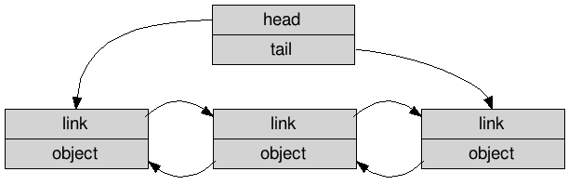
Lists
implemented as doubly linked list
  supports constant time insertion/deletion of elements once location is stated
  linear time access to elements
no indexing or arithmetic on iterators – only increment/decrement
front(), back(), begin(), end() are constant time
updating operations: push_front(), pop_front(), push_back() pop_back() all variants of insert(), erase() – supported and run in constant time
  clear() is linear
size() , empty(),
resize() are supported,
but not capacity() –
memory model is opaque
splice() – constant
time insert of another
list to a position in this list – another list is destroyed
  variants: single element or range of elements is spliced

Slide 25
Specialized List Algorithms
STL general algorithms (studied later) are inefficient on lists
list provides specialized algorithms
  remove() – removes elements from list
  unique() – eliminates consecutive duplicates
  merge() – merges two sorted lists
  sort() – sorts a list
  reverse() – reverses a list

Slide 26
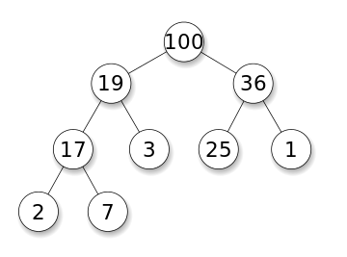
Container Adapters
use adapter pattern to modify a sequential container for specific purpose by limiting interface: no iterators, no indexing, few functions
  underlying container differs by adapter
size(), empty() , swap() are supported
stack needs <stack>
  push() – adds to top
  pop() – removes from top, does not return
  top() – returns top element
queue needs <queue>
  push() – adds to tail
  pop() – removes from head, does not return, use front()
  front(), back() – return first/last element
priority_queue – greatest element is at the head
needs <queue>
  push()/pop() – add/remove
  top() – returns head element,
  no way to get tail
Notes:
heap: largest always on top, implemented as balanced tree, insertion – add element to leftmost leaf and then sift-up; removal of top: remove, then add leftmost to top and sift-down; in both procedures need to compare parent and two children
implemented as array where children are at indexes 2n+1 and 2n+2

Slide 27
Sequential Cont. Review
what are containers/interators/algorithms?
what are ordered/unordered/sequential/associative containers?
how to declare container/iterator?
what is the difference between vector/deque space allocation?
what is memory opaque/transparent container? what is reserve()/capacity()?
how do insert()/erase() operate?
what is iterator arithmetic? what are begin()/end()/ cbegin()/cend() ? how to iterate over container?
what is iterator invalidation? What is loop modification idiom?
what is move semantics? What is move-constructor? move-assignment?
what are lists? how is list memory allocation different from vector/deque?
what are container adapters?

