Slide 1
CS 43105 Data Mining Techniques Chapter 8 Clustering (1)
Xiang Lian
Department of Computer Science
Kent State University
Email: xlian@kent.edu
Homepage: http://www.cs.kent.edu/~xlian/
Notes:
References
Ian H. Witten, Eibe Frank, and Mark A. Hall. Data Mining: Practical Machine Learning Tools and Techniques: 3rd Edition. ISBN-13: 9780123748560, Publisher: Elsevier Science, Publication date: 1/20/2011.
https://hanj.cs.illinois.edu/bk3/bk3_slidesindex.htm
http://www.cs.kent.edu/~jin/DM11/DM11.html

Slide 2
What is Cluster Analysis?
Finding groups of objects such that the objects in a group will be similar (or related) to one another and different from (or unrelated to) the objects in other groups
Inter-cluster distances are maximized
Intra-cluster distances are minimized

Slide 3
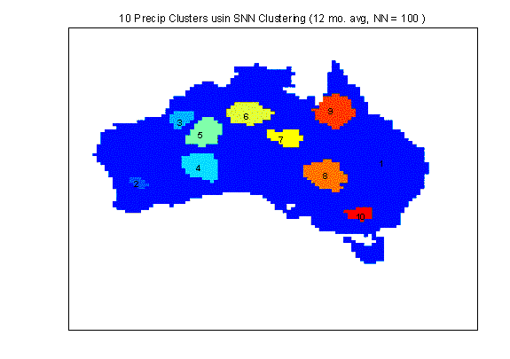
Applications of Cluster Analysis
Understanding
Group related documents for browsing, group genes and proteins that have similar functionality, or group stocks with similar price fluctuations
Summarization
Reduce the size of large data sets
Clustering precipitation in Australia

Slide 4
Notion of a Cluster can be Ambiguous
How many clusters?
Six Clusters
Two Clusters
Four Clusters

Slide 5
Types of Clustering
A clustering is a set of clusters
Important distinction between hierarchical and partitional sets of clusters
Partitional Clustering
A division data objects into non-overlapping subsets (clusters) such that each data object is in exactly one subset
Hierarchical clustering
A set of nested clusters organized as a hierarchical tree

Slide 6
Partitional Clustering
Original Points
A Partitional Clustering

Slide 7
Hierarchical Clustering
Traditional Hierarchical Clustering
Traditional Dendrogram
Non-traditional Hierarchical Clustering
Non-traditional Dendrogram

Slide 8
Other Distinctions Between Sets of Clusters
Exclusive versus non-exclusive
In non-exclusive clusterings, points may belong to multiple clusters.
Can represent multiple classes or ‘border’ points
Fuzzy versus non-fuzzy
In fuzzy clustering, a point belongs to every cluster with some weight between 0 and 1
Weights must sum to 1
Probabilistic clustering has similar characteristics
Partial versus complete
In some cases, we only want to cluster some of the data
Heterogeneous versus homogeneous
Cluster of widely different sizes, shapes, and densities

Slide 9
Clustering Algorithms
K-means and its variants
Hierarchical clustering
Density-based clustering

Slide 10
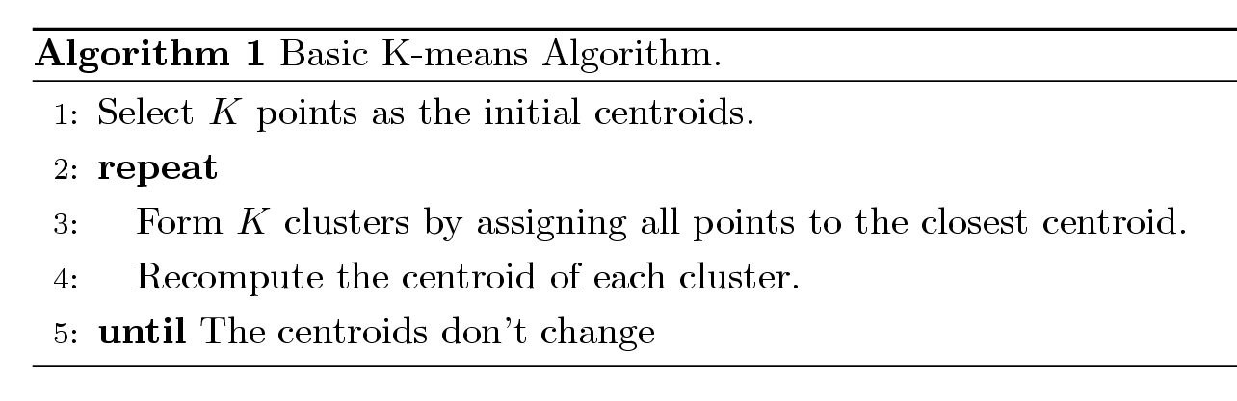
K-Means Clustering
Partitional clustering approach
Each cluster is associated with a centroid (center point)
Each point is assigned to the cluster with the closest centroid
Number of clusters, K, must be specified
The basic algorithm is very simple

Slide 11
K-Means Clustering – Details
Initial centroids are often chosen randomly.
Clusters produced vary from one run to another.
The centroid is (typically) the mean of the points in the cluster.
‘Closeness’ is measured by Euclidean distance, cosine similarity, correlation, etc.

Slide 12
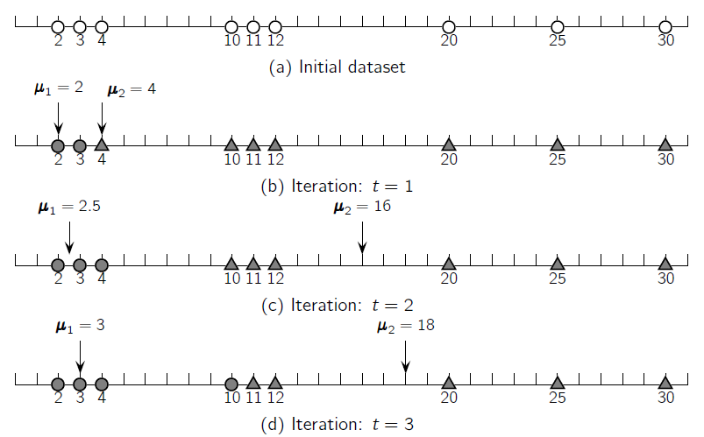

Slide 14
K-Means Clustering – Details
K-means will converge for common similarity measures mentioned above.
Most of the convergence happens in the first few iterations.
Often the stopping condition is changed to ‘Until relatively few points change clusters’
Complexity is O( n * K * I * d )
n = number of points, K = number of clusters, I = number of iterations, d = number of attributes

Slide 15
Evaluating K-Means Clusters
Most common measure is Sum of Squared Error (SSE)
For each point, the error is the distance to the nearest cluster
To get SSE, we square these errors and sum them.
x is a data point in cluster C_{i} and m_{i} is the representative point for cluster C_{i}
can show that m_{i} corresponds to the center (mean) of the cluster
Given two clusters, we can choose the one with the smallest error
One easy way to reduce SSE is to increase K, the number of clusters
A good clustering with smaller K can have a lower SSE than a poor clustering with higher K

Slide 20
Issues and Limitations for K-Means
How to choose initial centers?
How to choose K?
How to handle Outliers?
Clusters different in
Shape
Density
Size

Slide 21
Two Different K-Means Clusterings
Original Points
Optimal Clustering
Sub-optimal Clustering

Slide 22
Importance of Choosing Initial Centroids

Slide 23
Importance of Choosing Initial Centroids

Slide 24
Importance of Choosing Initial Centroids …

Slide 25
Importance of Choosing Initial Centroids …

Slide 26
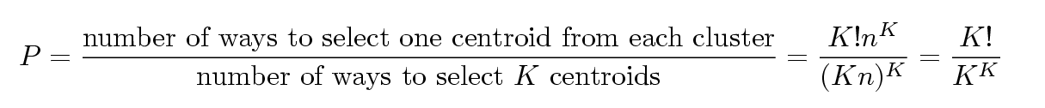
Problems with Selecting Initial Points
If there are K ‘real’ clusters then the chance of selecting one centroid from each cluster is small.
Chance is relatively small when K is large
If clusters are the same size, n, then
For example, if K = 10, then probability = 10!/10¹⁰ = 0.00036
Sometimes the initial centroids will readjust themselves in ‘right’ way, and sometimes they don’t
Consider an example of five pairs of clusters

Slide 27
Solutions to Initial Centroids Problem
Multiple runs
Helps, but probability is not on your side
Sample and use hierarchical clustering to determine initial centroids
Select more than k initial centroids and then select among these initial centroids
Select most widely separated
Postprocessing
Bisecting K-means
Not as susceptible to initialization issues

Slide 28
Hierarchical Clustering
Produces a set of nested clusters organized as a hierarchical tree
Can be visualized as a dendrogram
A tree like diagram that records the sequences of merges or splits

Slide 29
Strengths of Hierarchical Clustering
Do not have to assume any particular number of clusters
Any desired number of clusters can be obtained by ‘cutting’ the dendrogram at the proper level
They may correspond to meaningful taxonomies
Example in biological sciences (e.g., animal kingdom, phylogeny reconstruction, …)

Slide 30
Hierarchical Clustering
Two main types of hierarchical clustering
Agglomerative:
Start with the points as individual clusters
At each step, merge the closest pair of clusters until only one cluster (or k clusters) left
Divisive:
Start with one, all-inclusive cluster
At each step, split a cluster until each cluster contains a point (or there are k clusters)
Traditional hierarchical algorithms use a similarity or distance matrix
Merge or split one cluster at a time

Slide 31
Agglomerative Clustering Algorithm
More popular hierarchical clustering technique
Basic algorithm is straightforward
Compute the proximity matrix
Let each data point be a cluster
Repeat
Merge the two closest clusters
Update the proximity matrix
Until only a single cluster remains
Key operation is the computation of the proximity of two clusters
Different approaches to define the distance between clusters distinguish the different algorithms

Slide 32
Starting Situation
Start with clusters of individual points and a proximity matrix
p1
p2
p3
p4
p5
. . .
p1
p2
p3
p4
p5
.
.
.
Proximity Matrix

Slide 33
Intermediate Situation
C1
C2
C3
C4
C5
C1
C2
After some merging steps, we have some clusters
C3
C4
C5
C3
Proximity Matrix
C4
C1
C2
C5

Slide 34
Intermediate Situation
C1
C2
C3
C4
C5
C1
We want to merge the two closest clusters (C2 and C5) and update the proximity matrix
C2
C3
C4
C5
C3
Proximity Matrix
C4
C1
C2
C5

Slide 35
After Merging
C2 U C5
C1
C3
C4
C1
?
The question is “How do we update the proximity matrix?”
C2 U C5
? ? ? ?
C3
?
C4
?
C3
Proximity Matrix
C4
C1
C2 U C5

Slide 36
How to Define Inter-Cluster Similarity
Similarity?
p1
p2
p3
p4
p5
. . .
p1
p2
p3
MIN
MAX
Group Average
Distance Between Centroids
Other methods driven by an objective function
Ward’s Method uses squared error
p4
p5
.
.
.
Proximity Matrix

Slide 37
How to Define Inter-Cluster Similarity
p1
p2
p3
p4
p5
. . .
p1
p2
p3
MIN
MAX
Group Average
Distance Between Centroids
Other methods driven by an objective function
Ward’s Method uses squared error
p4
p5
.
.
.
Proximity Matrix

Slide 38
How to Define Inter-Cluster Similarity
p1
p2
p3
p4
p5
. . .
p1
p2
p3
MIN
MAX
Group Average
Distance Between Centroids
Other methods driven by an objective function
Ward’s Method uses squared error
p4
p5
.
.
.
Proximity Matrix

Slide 39
How to Define Inter-Cluster Similarity
p1
p2
p3
p4
p5
. . .
p1
p2
p3
MIN
MAX
Group Average
Distance Between Centroids
Other methods driven by an objective function
Ward’s Method uses squared error
p4
p5
.
.
.
Proximity Matrix

Slide 40
How to Define Inter-Cluster Similarity
p1
p2
p3
p4
p5
. . .
×
×
p1
p2
p3
MIN
MAX
Group Average
Distance Between Centroids
Other methods driven by an objective function
Ward’s Method uses squared error
p4
p5
.
.
.
Proximity Matrix

Slide 41
Cluster Similarity: MIN or Single Link
Similarity of two clusters is based on the two most similar (closest) points in the different clusters
Determined by one pair of points, i.e., by one link in the proximity graph.
1
2
3
4
5

Slide 42
Hierarchical Clustering: MIN
5
1
3
5
2
1
2
3
6
4
4
Nested Clusters
Dendrogram

Slide 43
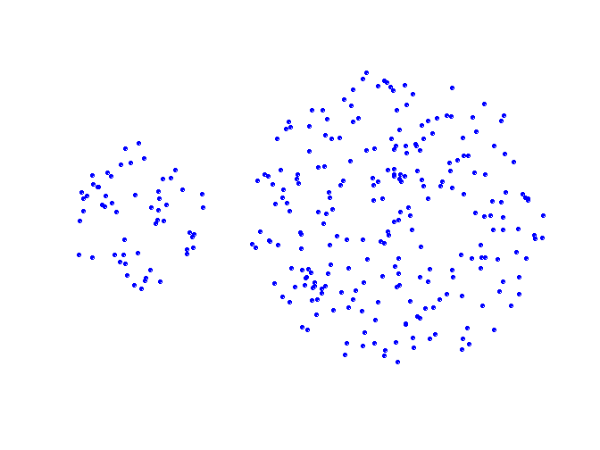
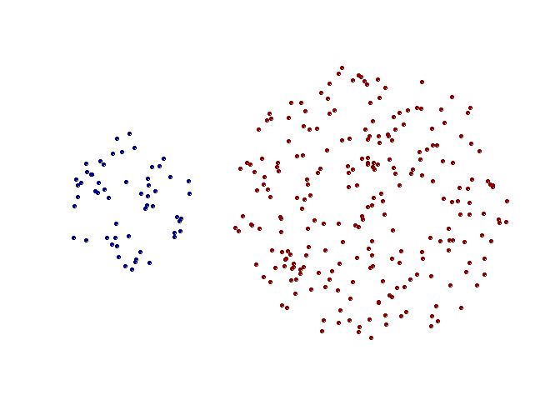
Strength of MIN
Original Points
Two Clusters
Can handle non-elliptical shapes

Slide 44
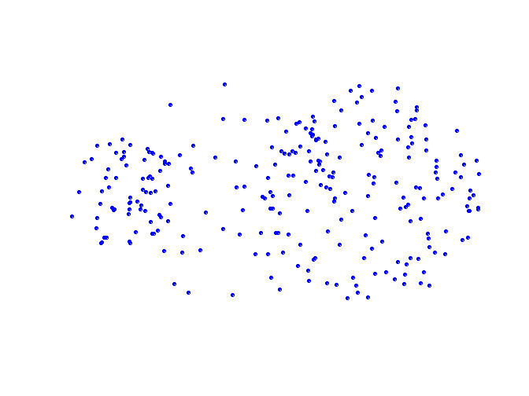
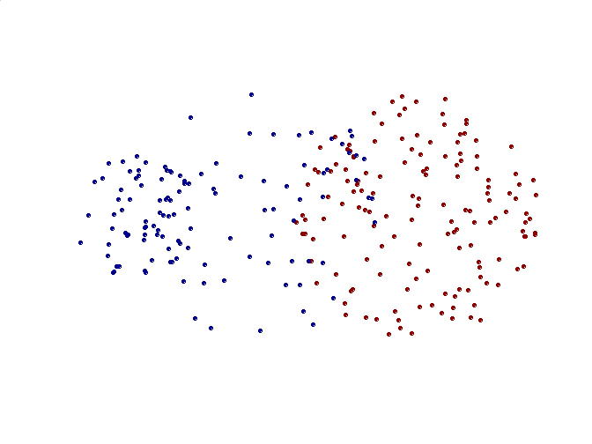
Limitations of MIN
Original Points
Two Clusters
Sensitive to noise and outliers

Slide 45
Cluster Similarity: MAX or Complete Linkage
Similarity of two clusters is based on the two least similar (most distant) points in the different clusters
Determined by all pairs of points in the two clusters
1
2
3
4
5

Slide 46
Hierarchical Clustering: MAX
4
1
2
5
5
2
3
6
3
1
4
Nested Clusters
Dendrogram

Slide 47
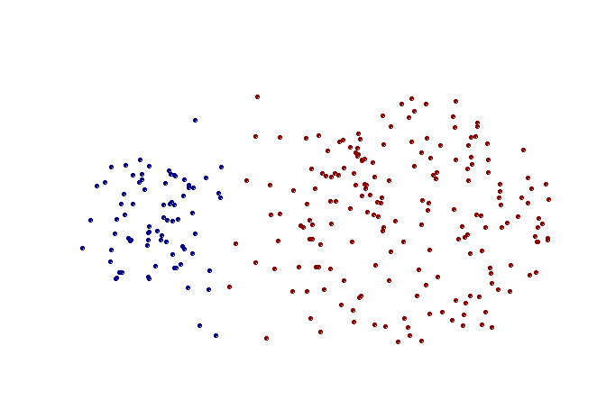
Strength of MAX
Original Points
Two Clusters
Less susceptible to noise and outliers

Slide 48
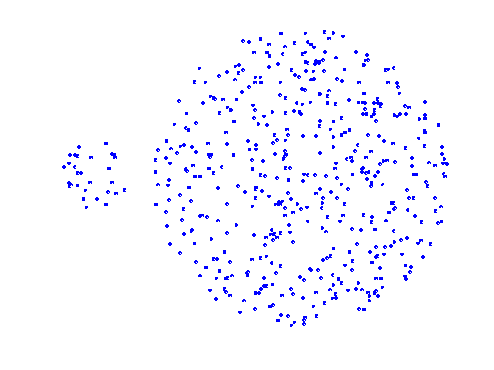
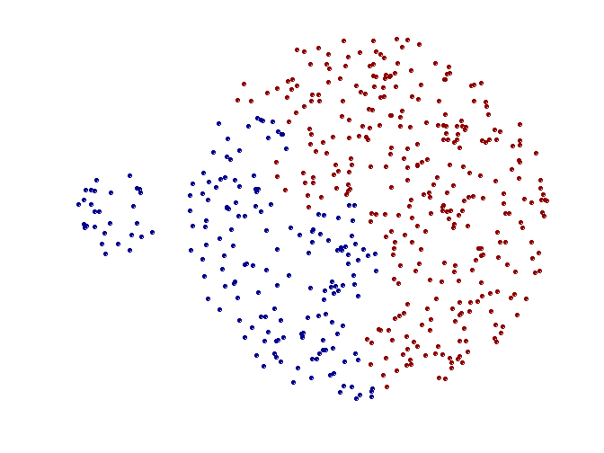
Limitations of MAX
Original Points
Two Clusters
Tends to break large clusters
Biased towards globular clusters

Slide 49
Cluster Similarity: Group Average
Proximity of two clusters is the average of pairwise proximity between points in the two clusters.
Need to use average connectivity for scalability since total proximity favors large clusters
1
2
3
4
5

Slide 50
Hierarchical Clustering: Group Average
5
4
1
2
5
2
3
6
1
4
3
Nested Clusters
Dendrogram

Slide 51
Hierarchical Clustering: Group Average
Compromise between Single and Complete Link
Strengths
Less susceptible to noise and outliers
Limitations
Biased towards globular clusters

Slide 52
Cluster Similarity: Ward’s Method
Similarity of two clusters is based on the increase in squared error when two clusters are merged
Similar to group average if distance between points is distance squared
Less susceptible to noise and outliers
Biased towards globular clusters
Hierarchical analogue of K-means
Can be used to initialize K-means

Slide 53
Hierarchical Clustering: Comparison
5
1
4
1
3
2
5
5
5
2
1
MIN
2
MAX
2
3
6
3
3
6
1
4
4
4
5
5
1
4
1
2
2
5
2
Ward’s Method
5
2
3
6
Group Average
3
3
6
4
1
1
4
4
3

Slide 54
Hierarchical Clustering: Time and Space requirements
O(N²) space since it uses the proximity matrix
N is the number of points
O(N³) time in many cases
There are N steps and at each step the size, N², proximity matrix must be updated and searched
Complexity can be reduced to O(N² log(N) ) time for some approaches

Slide 55
Hierarchical Clustering: Problems and Limitations
Once a decision is made to combine two clusters, it cannot be undone
No objective function is directly minimized
Different schemes have problems with one or more of the following:
Sensitivity to noise and outliers
Difficulty handling different sized clusters and convex shapes
Breaking large clusters

Slide 56
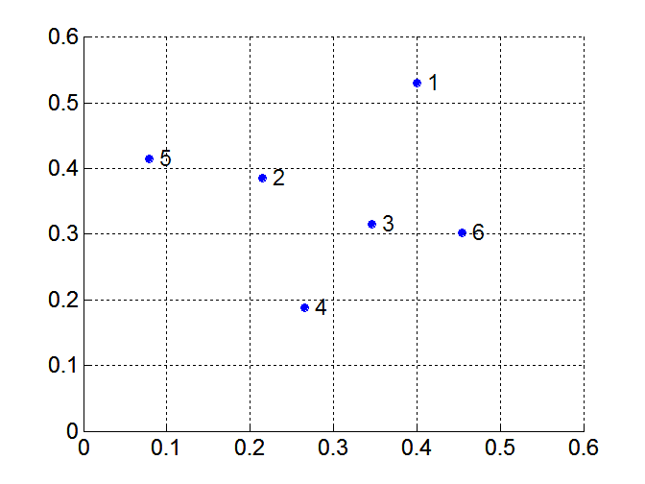
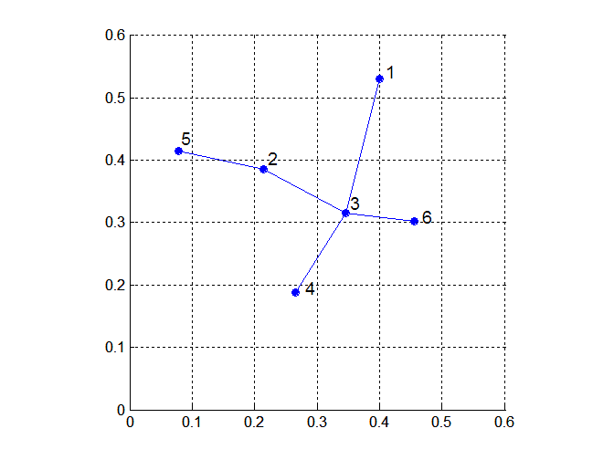
MST: Divisive Hierarchical Clustering
Build MST (Minimum Spanning Tree)
Start with a tree that consists of any point
In successive steps, look for the closest pair of points (p, q) such that one point (p) is in the current tree but the other (q) is not
Add q to the tree and put an edge between p and q

Slide 57
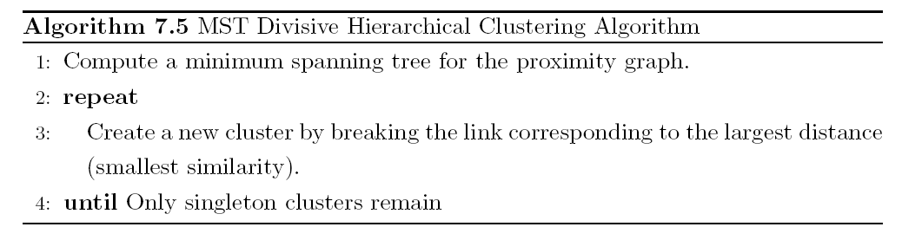
MST: Divisive Hierarchical Clustering
Use MST for constructing hierarchy of clusters

Slide 58
Density-Based Clustering Methods
Clustering based on density (local cluster criterion), such as density-connected points
Major features:
Discover clusters of arbitrary shape
Handle noise
One scan
Need density parameters as termination condition
Several interesting studies:
DBSCAN: Ester, et al. (KDD’96)
OPTICS: Ankerst, et al (SIGMOD’99).
DENCLUE: Hinneburg & D. Keim (KDD’98)
CLIQUE: Agrawal, et al. (SIGMOD’98) (more grid-based)

Slide 59
Density-Based Clustering: Basic Concepts
Two parameters:
Eps: Maximum radius of the neighbourhood
MinPts: Minimum number of points in an Eps-neighbourhood of that point
N_{Eps}(p): {q belongs to D | dist(p,q) ≤ Eps}
p
MinPts = 4
Eps = 1 cm
q

Slide 60
DBSCAN
DBSCAN is a density-based algorithm
Density = number of points within a specified radius (Eps)
A point is a core point if it has more than a specified number of points (MinPts) within Eps
These are points that are at the interior of a cluster
A border point has fewer than MinPts within Eps, but is in the neighborhood of a core point
A noise point is any point that is not a core point or a border point.

Slide 61
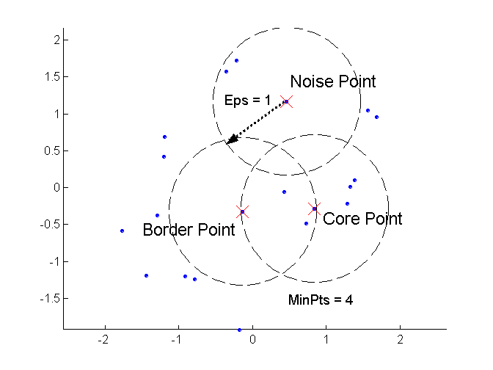
DBSCAN: Core, Border, and Noise Points

Slide 62
DBSCAN: Core, Border, and Noise Points (cont'd)
Outlier/noise
Border
Eps = 1cm
MinPts = 5
Core

Slide 63
Density Reachable
(Directly) density reachable
A point x is directly density reachable from another point y, if x ∈ N_{ε}(y) and y is a core point
A point x is density reachable from y, if there exists a chain of points, x=x₀,x₁,x₂,…x_{l}=y, such that x_{i} is directly density reachable from x_{i-1}
Density Connected
Two points x and y are density connected if there exists a core point z, such that both x and y are density reachable from z

Slide 64
Density-Reachable and Density-Connected
Density-reachable:
A point p is density-reachable from a point q w.r.t. Eps, MinPts if there is a chain of points p₁, …, p_{n}, p₁ = q, p_{n} = p such that p_{i+1} is directly density-reachable from p_{i}
Density-connected:
A point p is density-connected to a point q w.r.t. Eps, MinPts if there is a point o such that both, p and q are density-reachable from o w.r.t. Eps and MinPts
p
p₁
q
p
q
o

Slide 65
DBSCAN: The Algorithm
Arbitrarily select a point p
Retrieve all points density-reachable from p w.r.t. Eps and MinPts
If p is a core point, a cluster is formed
If p is a border point, no points are density-reachable from p and DBSCAN visits the next point of the database
Continue the process until all of the points have been processed

Slide 67
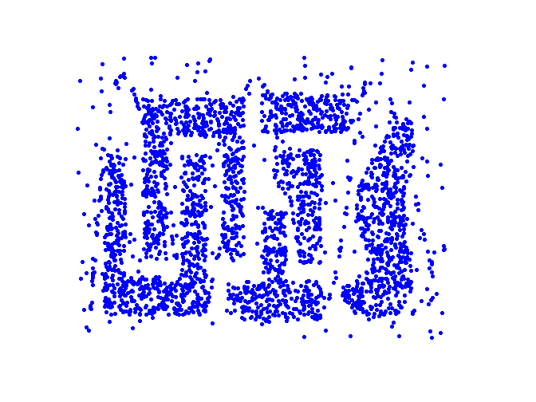
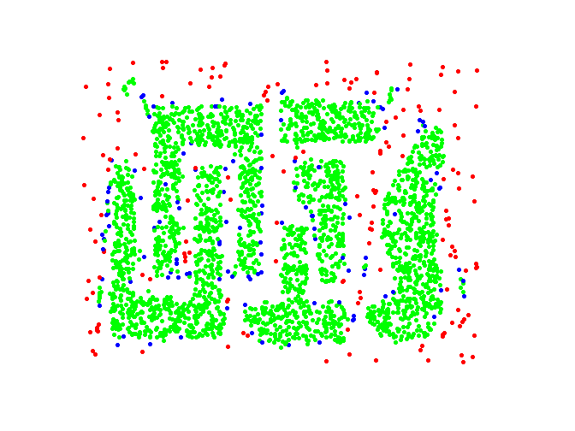
DBSCAN: Core, Border and Noise Points
Original Points
Point types: core, border and noise
Eps = 10, MinPts = 4

Slide 68
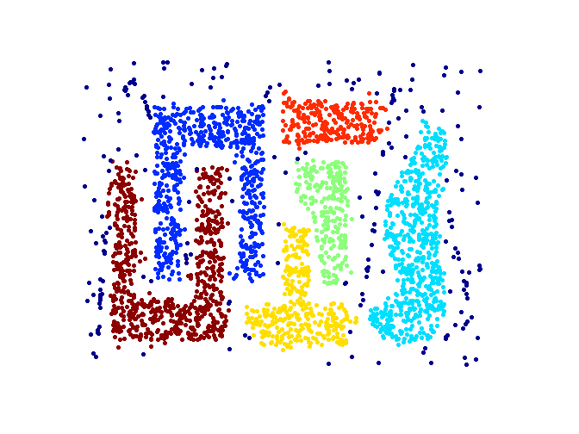
When DBSCAN Works Well
Original Points
Clusters
Resistant to Noise
Can handle clusters of different shapes and sizes

Slide 70
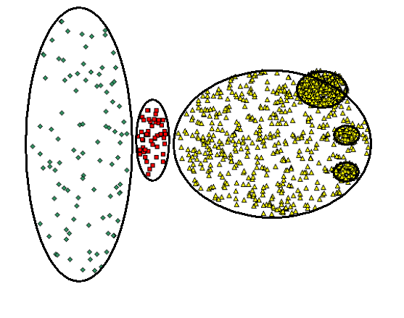
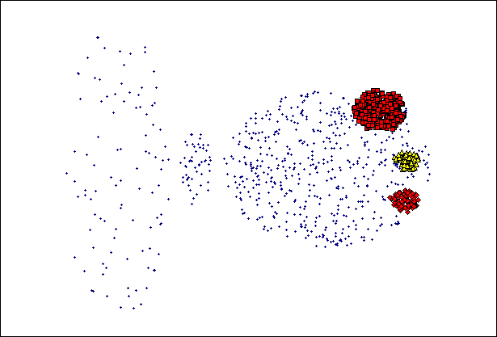
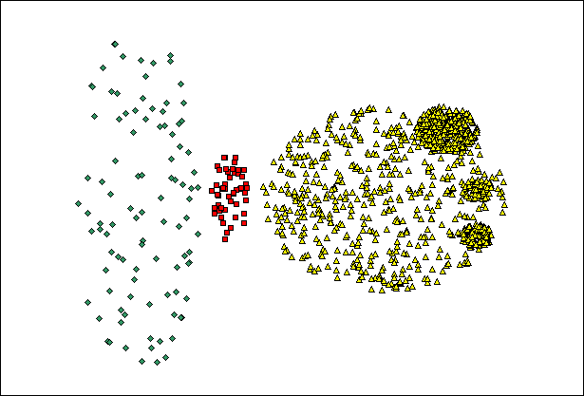
When DBSCAN Does NOT Work Well
(MinPts=4, Eps=9.75).
Original Points
Varying densities
High-dimensional data
(MinPts=4, Eps=9.92)

Slide 71
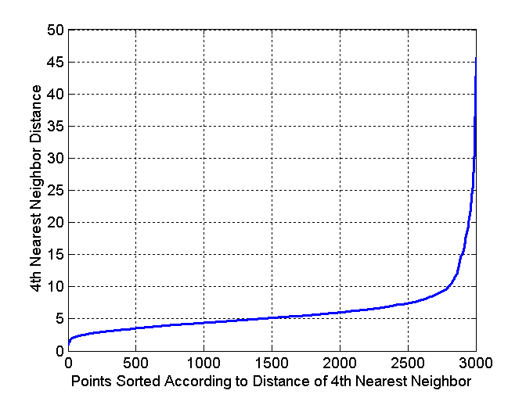
DBSCAN: Determining EPS and MinPts
Idea is that for points in a cluster, their k^{th} nearest neighbors are at roughly the same distance
Noise points have the k^{th} nearest neighbor at farther distance
So, plot sorted distance of every point to its k^{th} nearest neighbor

