Slide 1







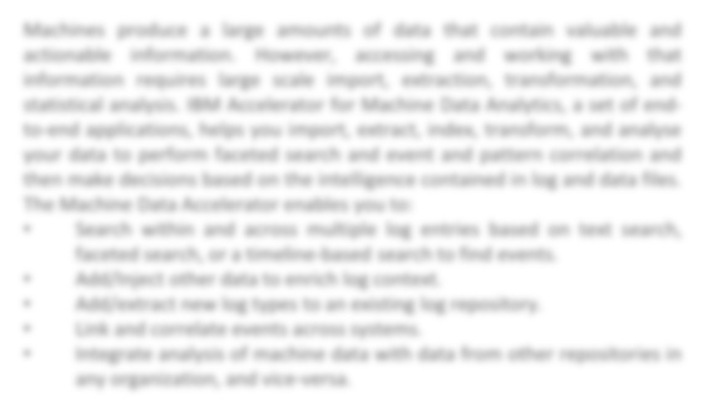

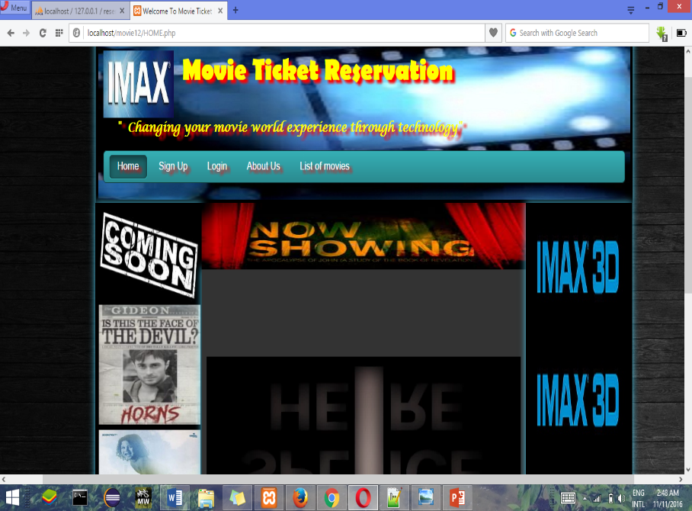





Article Search Engine
PUNEET JAIN(15BCE1351)
Under the guidance of Prof. . Dr. R. NANDHINI , Work done at VIT University, Chennai
B.Tech Computer Science Engineering (2016-2017)
SCHOOL OF COMPUTING SCIENCE & ENGINEERING, VIT UNIVERSITY
INTRODUCTION
SCOPE OF PROJECT
METHODOLOGY
The main purpose of our online ticket
booking system is to provide an alternate and convenient way for a customer to buy cinema tickets. It is an automatic system. After the data has been fed into the database, the staff does not need to do anything with the order once it is received through the system. In fact, there is similar system on the internet, but there is no refund method found in the existing system.
More features can be added like
Allow customers to comment on movies.
SMS notification after successful seat reservation.
3. Home delivery of ticket may be provided.
4. Online booking of purchases of eatables( cold drinks, popcorn etc ) can be provided.
The methodology applied in our project is the use frontend HTML , CSS and use of make the database and connect it to website which is done by php. Databases are implemented incrementally until we delivered the final project .To make the backend we have used xampp. XAMPP is a free and open source cross-platform local web server.
•
RESULTS AND OBSERVATIONS:
CONCLUSION
Use of this interface help customer having immediate information about running movies and reserve their seat without wasting their precious time.
User friendly interface also for the admin to add and delete movie information.
OBJECTIVE
The main purpose of online ticket booking system is
to another way for the customer to buy movie ticket, it provide a anytime anyplace service for the customer, minimize the number of staff at the ticket box, promote the film on the internet, increase the profit .It is an automatic system .
REFERENCES and ACKNOWLEDGEMENT
W3schools.com and tutorialspoint.com
We would like to thank our faculty Prof. Dr. R. NANDHINI for his constant support and guidelines throughout the project.
We would also like to thank our school, SCSE for this wonderful opportunity.

