Slide 1
Machine Learning for Space Situational Awareness
AMOS 2018 – Short Course Code Examples

Slide 2
Outline
Tooling (< 5m): Software and libraries for ML/DL
Dimensionality Reduction (10m): PCA, TSNE, UMAP
Supervised Learning (60m):
Tabular Data: TLE example with fully-connected network (MLP)
Time-Series Data: 1D-CNN and Recurrent Neural Network (RNN)
Break (10m)
Unsupervised Techniques (40m)
Transfer Learning
Self-Supervision: Auto-Encoders and Auto-Encoder Style Algorithms
Domain Adaptation on Synthetic Data

Slide 3
Disclaimer
Examples are intended to help convey the workflow of a machine learning approach to a problem. They certainly aren’t intended as optimal solutions to real problems.
All code can be found here:
https://github.com/PJ7668/ml-for-ssa

Slide 4
Tooling for Machine/Deep Learning
Primary Deep Learning platforms:
TensorFlow (Google)
PyTorch / Caffe2 (Facebook with support from Nvidia)
MXNet (apache project with Amazon support)
Use whatever environment you feel productive in:
R (keras interface)
MATLAB (Neural Networking Toolkit)
Python (keras+tensorflow or pytorch)
Hardware:
There may come a time you need a GPU, but you don’t need it to get started.
When you do, you’ll almost certainly be wanting Nvidia hardware running their CUDA libraries, which are well optimized for deep learning on GPUs.

Slide 5
Dimensionality Reduction
ML tasks can have many possible input features.
Deep Learning Rule of Thumb:
Avoid hand-selecting or engineering features.
When practical, give neural network access to raw data to identify its own combinations of features.
However, using “all the features” is not always practical. Dimensionality reduction techniques can be useful for:
Visualization
Reduce the feature space

Slide 6
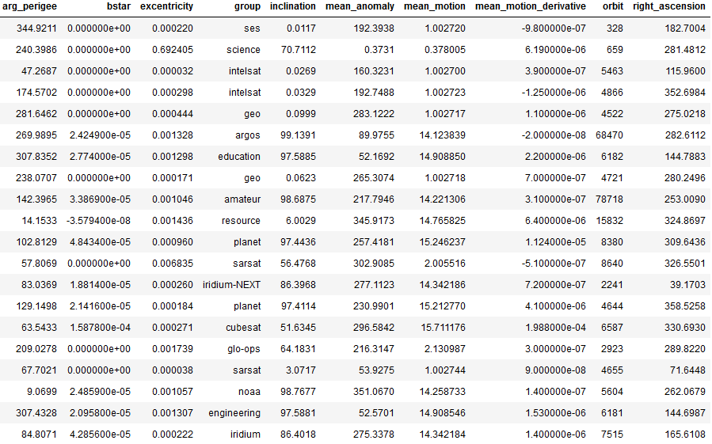
Dimensionality Reduction
Sample TLE data.
9 real valued fields
1 categorical field (group)
“group” comes from the way CelesTrak categorized the given TLE.

Slide 7
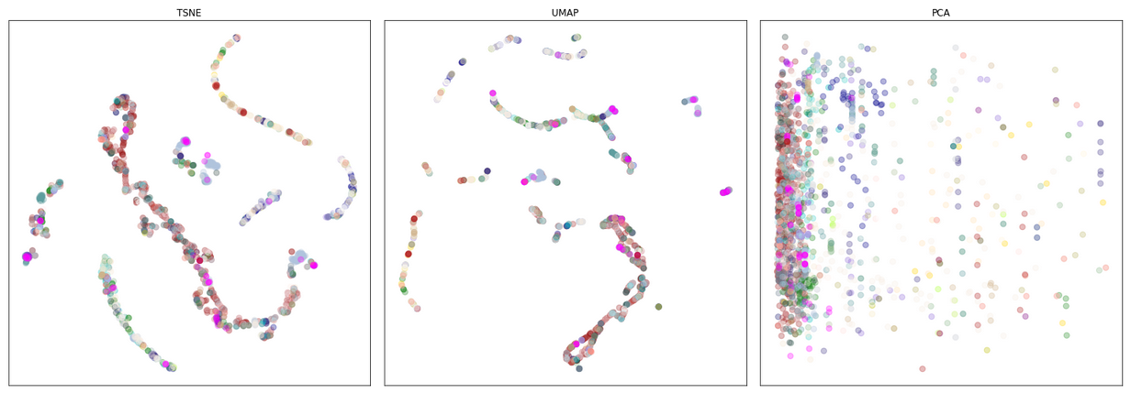
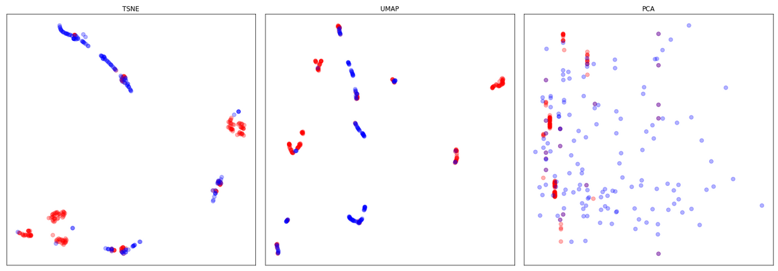
2D embeddings of the 9D feature vectors
Group field mapped to color
(right) Just “planet” and “resource” groups
The visualizations suggest we should be able to make some better-than-random guesses about the group field based just on the numeric fields.
Notes:
These embeddings are essentially unsupervised techniques. We’ll come back to that at the end.

Slide 8
Classification
Goal: Predict group field based on 9 TLE derived, numeric fields.
Machine Learning Work Flow
Split data into train, test, and validation sets
Choose a metric (preferably a single, real-valued number)
Choose a model
Train model on train set
Compute metric on test set
Adjust model and repeat
Evaluate model on validation set

Slide 9
Vocabulary
Train/Test/Validation Sets:
Train: Data used to update model parameters.
Test: Data used to update model hyper-parmeters.
Validation: Data used to measure performance of selected model.
Training Vocabulary:
Epoch – one full pass through test train set
Batch Size – how many examples to evaluate at once. Typically, a gradiant is computed on this data.
Loss – differentiable function comparing predictions and targets: model(x) vs y.
Stochastic Gradient Descent (SGD) – the algorithm for efficiently updating model parameters by computing partial derivatives of loss(model(x), y) over a batch of samples.

Slide 10
Classification
Rules of Thumb:
Avoid hand-selected/engineered features (at least initially)
Split train/test data based on some deterministic criteria
For example, test samples are precisely those for which SAT_ID % 5 == 0. This helps to avoid accidently letting the same or equivalent examples fall into your train and test sets.
Be very careful with metrics and class imbalance.
For example, if 95% of your data belongs to the same class, reporting a 96% accuracy needs some qualifications.
Identify a single-number metric to help simplify model comparisons.
Normalize your feature data.
Focus on the simplest version of a problem first and avoid extensive hyperparameter optimization until you can demonstrate that the most basic thing is working.
Make sure the model is learning the training data before even worrying about the test data. If your model can’t even memorize the training data well, either your problem is going to work or something else is broken.

Slide 11
Convolutional Neural Networks

Slide 12
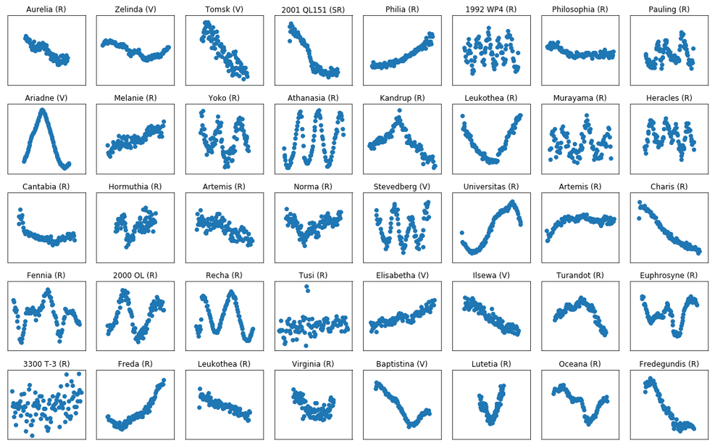
Example light curves from alcdef.org: Asteroid Lightcurve Photometry Database

Slide 13
Goal: Recognize asteroids based just on their light curves.
Our features are translationally invariant in the sense that:
If we happened to start collecting the light curve a few seconds earlier or later, then we would still be looking at the same object.
Likewise, if there was some property near the beginning of the light curve that was important for asteroid recognition, the same property located in the middle or near the end, should be just as important.
This is the motivation behind convolutional neural networks.

Slide 14
1D – CNN Diagram Goes Here

