Slide 1
Machine Learning for Space Situational Awareness
AMOS 2018 – Short Course Code Examples

Slide 2
Outline
Tooling (< 5m): Software and libraries for ML/DL
Dimensionality Reduction (10m): PCA, TSNE, UMAP
Supervised Learning (60m):
Tabular Data: TLE example with fully-connected network (MLP)
Time-Series Data: Asteroid light curve example with 1D-CNN
Break (10m)
Unsupervised Techniques (40m)
Transfer Learning
Self-Supervision: Auto-Encoders and Auto-Encoder Style Algorithms
Domain Adaptation on Synthetic Data

Slide 3
Disclaimer
The following examples illustrate some common machine learning workflows. They aren’t intended as optimal solutions to real problems.
Despite the slide footer, nothing presented here is actually “CACI Proprietary Information”
You can access the code here:
https://github.com/PJ7668/ml-for-ssa
The examples should all be runnable once you have:
Installed Anaconda (popular python distribution for data science and machine learning)
Downloaded the data

Slide 4
Tooling for Machine/Deep Learning
Primary Deep Learning platforms:
TensorFlow (Google)
PyTorch / Caffe2 (Facebook with support from Nvidia)
MXNet (apache project with Amazon support)
Best choice depends on your goal:
Fundamental Research
Proof-of-concept
Operational Pipeline
Deployment to Embedded System
Use whatever environment you feel productive in:
R (keras interface)
MATLAB (Neural Networking Toolkit)
Python (keras+tensorflow or pytorch)
Hardware:
There may come a time you need a GPU, but you don’t need it to get started.
When you do, you’ll almost certainly be wanting Nvidia hardware running their CUDA libraries.

Slide 5
Dimensionality Reduction
ML tasks can have many possible input features.
Deep Learning Rule of Thumb:
Avoid hand-selecting or engineering features.
When practical, give neural network access to raw data to identify its own combinations of features.
However, using “all the features” is not always practical. Dimensionality reduction techniques can be useful for:
Visualization
Reduce the feature space

Slide 6
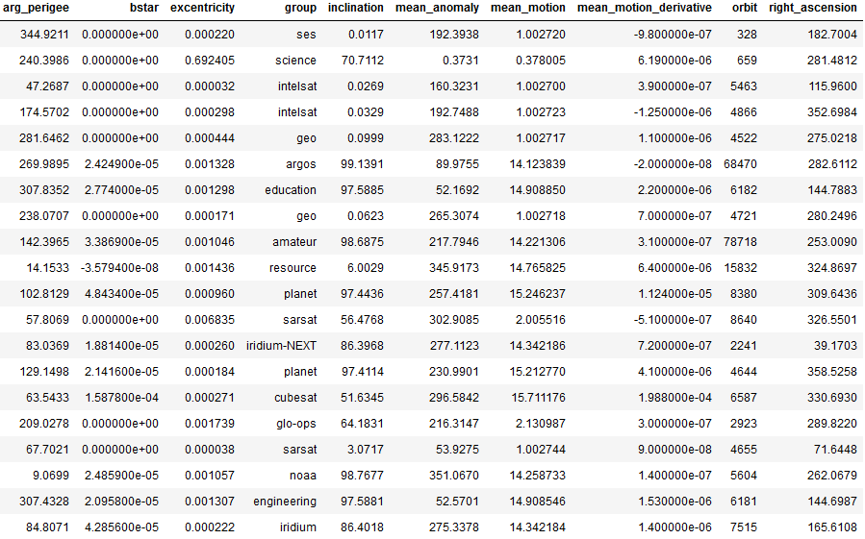
Dimensionality Reduction
Sample TLE data.
9 real valued fields
1 categorical field (group)
“group” comes from the way CelesTrak categorized the given TLE.

Slide 7
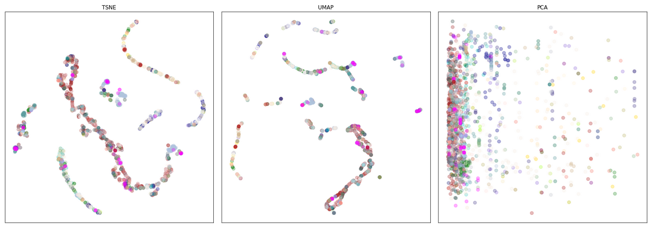
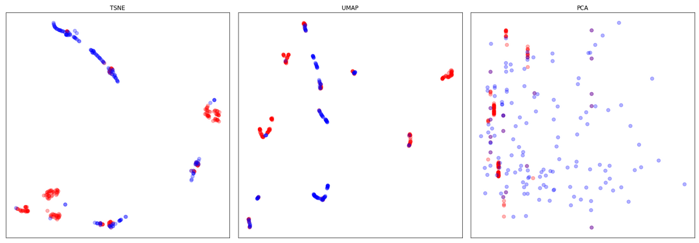
2D embeddings of the 9D feature vectors
Group field mapped to color
(right) Just “planet” and “resource” groups
The visualizations suggest we should be able to make some better-than-random guesses about the group field based just on the numeric fields.
Notes:
These embeddings are essentially unsupervised techniques. We’ll come back to that at the end.

Slide 8
Classification
Goal: Predict group field based on 9 TLE derived, numeric fields.
Machine Learning Work Flow
Split data into train, test, and validation sets
Choose a metric (preferably a single, real-valued number)
Choose a model
Train model on train set
Compute metric on test set
Adjust model and repeat
Evaluate model on validation set

Slide 9
Switch to TLE Notebook

Slide 10
Summary of TLE Example
Train/Test/Validation Sets:
Train: Data used to update model parameters.
Test: Data used to update model hyper-parmeters.
Validation: Data used to measure performance of selected model.
Training Vocabulary:
Epoch – one full pass through test train set
Batch Size – how many examples to evaluate at once. Typically, a gradiant is computed on this data.
Loss – differentiable function comparing predictions and targets: model(x) vs y.
Stochastic Gradient Descent (SGD) – the algorithm for efficiently updating model parameters by computing partial derivatives of loss(model(x), y) over a batch of samples.

Slide 11
Summary of TLE Example
Avoid hand-selected/engineered features (at least initially)
Split train/test data based on some deterministic criteria
For example, test samples are precisely those for which SAT_ID % 5 == 0. This helps to avoid accidently letting the same or equivalent examples fall into your train and test sets.
Be very careful with metrics and class imbalance.
For example, if 95% of your data belongs to the same class, reporting a 96% accuracy needs some qualifications.
Identify a single-number metric to help simplify model comparisons.
Normalize your feature data.
Focus on the simplest version of a problem first and avoid extensive hyperparameter optimization until you can demonstrate that the most basic thing is working.
Make sure the model is learning the training data before even worrying about the test data. If your model can’t even memorize the training data well, either your problem is going to work or something else is broken.
Even if you’re monitoring accuracy, looking at a confusion matrix is almost always helpful to understand how your model is performing.

Slide 12
Convolutional Neural Networks

Slide 13
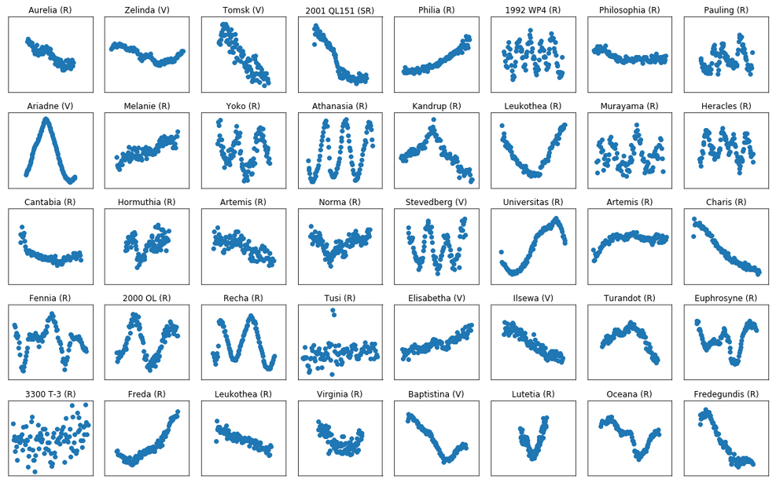
Example light curves from alcdef.org: Asteroid Lightcurve Photometry Database

Slide 14
Goal: Recognize asteroids based just on their light curves.
Our features are translationally invariant in the sense that:
If we happened to start collecting the light curve a few seconds earlier or later, then we would still be looking at the same object.
Likewise, if there was some property near the beginning of the light curve that was important for asteroid recognition, the same property located in the middle or near the end, should be just as important.
This is the motivation behind convolutional neural networks.

Slide 15
Convolutional Neural Networks
Discuss CNN Diagram
Switch to Asteroid Light Curve Notebook – Part 1

Slide 16
Summary of Asteroid Example
Outside knowledge about the structure of your data can greatly improve model performance and/or training speed.
Helpful to have a baseline model for comparison. This could be:
A “classical” ML algorithm like logistic regression or SVM.
A non-ML algorithm already being used to solve the problem.
How well a human can solve the problem (objective or subjective).
How well a human says an algorithm would need to perform for them to find it useful.
Remember there exists a Bayes Rate (performance of the “Bayes Model” that knows the “true” generation scheme)
Helpful to understand how a random model or a model that has only learned the background distribution will perform.
Neural networks can be adaptable to multi-modal input.
Combining different types of data into an analytic model can quickly become intractable, but it is fairly straightforward for a neural network.
Consider adding auxiliary tasks, i.e. predict additional outputs that you might not care about but could provide additional relevant “training signal” to improve performance on the primary task. For example, in our light curve example, we might predict the Filter value or the sampling rate as an auxiliary task.
RNNs can be a natural fit for time-series data
They are SOTA in some cases (e.g. natural language processing)
In practice, they tend to be much more finicky than CNNs.
There is some evidence that CNNs with attention mechanisms are generally a better choice.

Slide 17
Hard Lessons about Data and ML
You’ll spend 90% of your time tending to your data.
ML techniques are cheap and disposable.
Data pipelines are far more important.
Be suspicious of your data.
Be suspicious of people who give you data.
It’s easy to overlook biases in your data that were never a problem when humans or non-adaptive algorithms were the primary consumers of it.
People will greatly overestimate their ability to perform the task they want you to automate.
Be suspicious of yourself. When a model is working well, assume you’ve messed something up:
Misunderstood your class imbalance (e.g. Case 1 is 95% of your data)
Contaminated your test data with training data
Included some “feature” that amounts to cheating (e.g. one of the features is basically the target value)

Slide 18
Unsupervised Learning

Slide 19
Unsupervised Learning
Supervised learning uses known target values and a differentiable loss function to drive learning.
However, we often have:
Few or no target values because they are difficult/expensive to collect.
Related to zero-shot or low-sample learning.
No target values because we don’t really know what we’re looking for.
We may suspect that there are some latent factors that explain observations but we haven’t gotten far enough to express what those factors are, much less actually measure them.
Very active area of ML research but remains a hard problem.

Slide 20
Unsupervised Learning Techniques
Transfer Learning
Parameter initialization schemes have been greatly improved NN training.
You can often do even better by training a set of weights (parameters) on another data set and using these trained weights as the parameter initialization for your problem.
Very effective technique in computer vision.
Simple NN + transfer learning is considered the benchmark approach for many problems.
Domain Adaptation on Synthetic or Out-of-Domain Data
NNs tend to be sensitive to low-level features that a human would know are irrelevant to the problem (e.g. differences in quantization or compression artifacts)
Domain adaptation can refer to
Transforming data from one domain to another (e.g. from sensor A to sensor B)
Modifying a training process in such a way that performance generalizes well to a domain for which you have no labeled data (e.g. train on data from sensor A but model still performs well on sensor B).
Self-Supervision: Auto-Encoder Style Algorithms

Slide 21
Unsupervised Learning: Self-Supervision
Turn unsupervised problem into a supervised problem by inventing a surrogate target value. This usually amounts to solving a problem you don’t actually care about but hoping a network will learn something useful in the process.
Example 1: Auto-Encoder
Target values are the input features themselves
Introduces a low-dimensional “pinch point” in the network
A network able to recreate its input with high fidelity must have learned a low-dimensional representation of the data.
Example 2: Unsupervised Feature Learning
https://arxiv.org/abs/1805.01978 Unsupervised Feature Learning via Non-Parametric Instance-level Discrimination
Treats unsupervised learning as a classification problem where every example is the sole representative of its own class. This can lead to many 1000s of classes.
Like an auto-encoder, pinch point forces network to learn low-dimensional representation of the data.

Slide 22
Machine Learning for Space Situational Awareness
AMOS 2018

