Slide 1
Machine Learning for Space Situational Awareness
AMOS 2018 – Short Course Code Examples

Slide 2
Outline
Tooling (5m): Software and libraries for ML/DL
Dimensionality Reduction (10m): PCA, TSNE, UMAP
Supervised Learning (60m):
Tabular Data: TLE example with fully-connected network (MLP)
Time-Series Data: 1D-CNN and Recurrent Neural Network (RNN)
Break (10m)
Unsupervised Techniques (40m)
Transfer Learning
Self-Supervision: Auto-Encoders and Auto-Encoder Style Algorithms
Domain Adaptation on Synthetic Data

Slide 3
Tooling for Machine/Deep Learning
Primary Deep Learning platforms:
TensorFlow (Google)
PyTorch / Caffe2 (Facebook with support from Nvidia)
MXNet (apache project with Amazon support)
Use whatever environment you already like.
R (keras interface)
MATLAB (Neural Networking Toolkit)
Python (keras+tensorflow or pytorch)
Hardware:
There may come a time you need a GPU, but you don’t need it to get started.

Slide 4
Dimensionality Reduction Techniques
ML tasks can have many possible input features.
Deep Learning Rule of Thumb:
Avoid hand-selecting or engineering features.
When practical, give neural network access to raw data to identify its own combinations of features.
However, using “all the features” is not always practical. Dimensionality reduction techniques can be useful for:
Visualization
Reduce the feature space

Slide 5
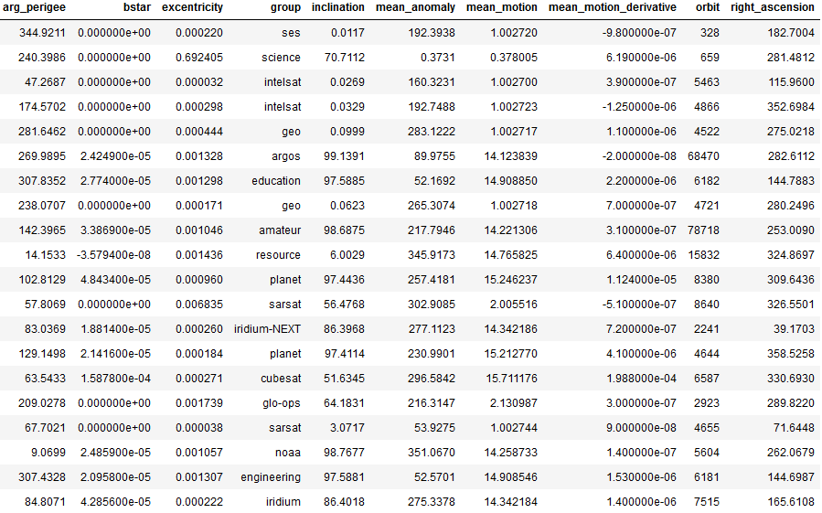
Dimensionality Reduction
Sample TLE data.
9 real valued fields
1 categorical field (group)
“group” comes from the way CelesTrak categorized the given TLE.

Slide 6
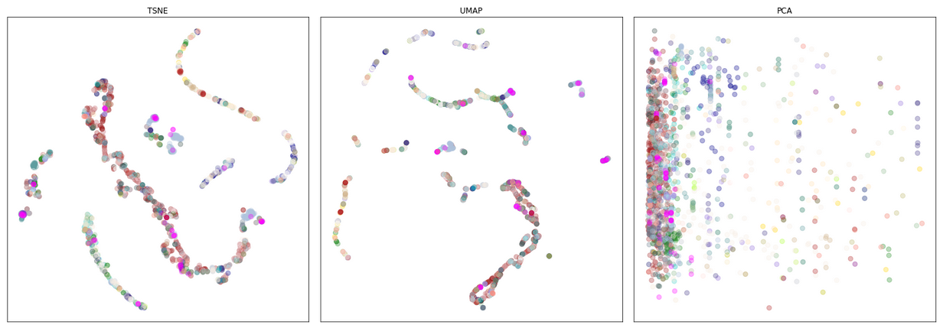
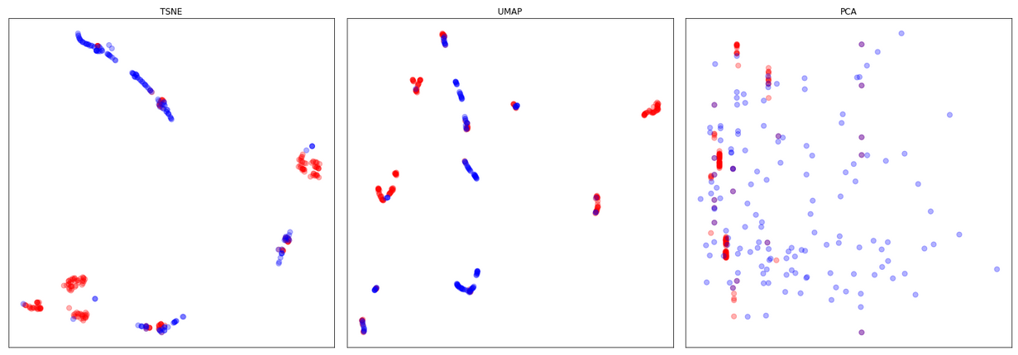
2D embeddings of the 9D feature vectors
Group field mapped to color
(right) Just “planet” and “resource” groups
The visualizations suggest we should be able to make some better-than-random guesses about the group field based just on the numeric fields.
Notes:
These embeddings are essentially unsupervised techniques. We’ll come back to that at the end.

Slide 7
Classification
Goal: Predict group field based on 9 TLE derived, numeric fields.
Split data into train, test, and validation sets
Choose a metric (preferably a single, real-valued number)
Choose a model
Train model on train set
Compute metric on test set
Adjust model and repeat
Evaluate model on validation set

Slide 8
Classification
[ See Notebook for this Section ]

Slide 9
Convolutional Neural Networks

Slide 10
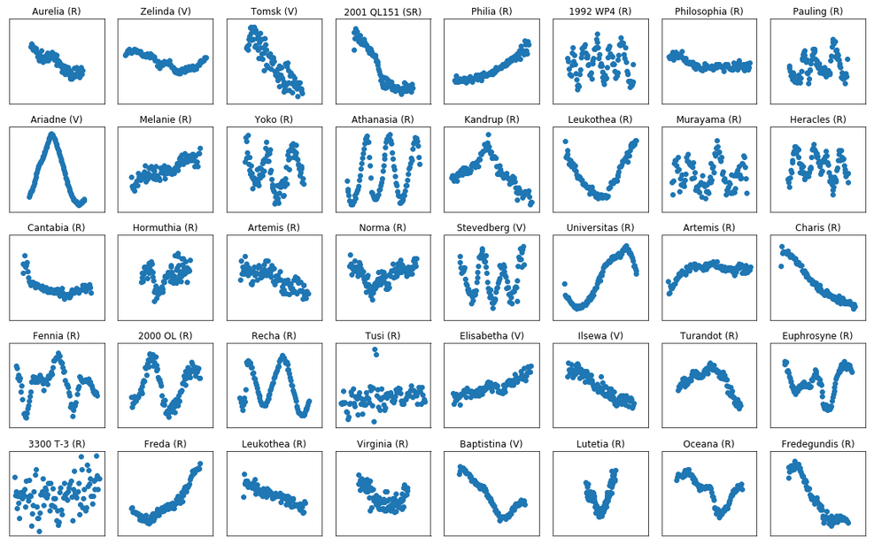
Example light curves from alcdef.org: Asteroid Lightcurve Photometry Database

Slide 11
Goal: Recognize asteroids based just on their light curves.
Our features are translationally invariant in the sense that:
If we happened to start collecting the light curve a few seconds earlier or later, then we would still be looking at the same object.
Likewise, if there was some property near the beginning of the light curve that was important for asteroid recognition, the same property located in the middle or near the end, should be just as important.
This is the motivation behind convolutional neural networks.

Slide 12
1D – CNN Diagram Goes Here

