Slide 1


Frederick Winslow Taylor
And his Influence on the Development of Modern Management
prepared by Maksym Lysenkov

Slide 2
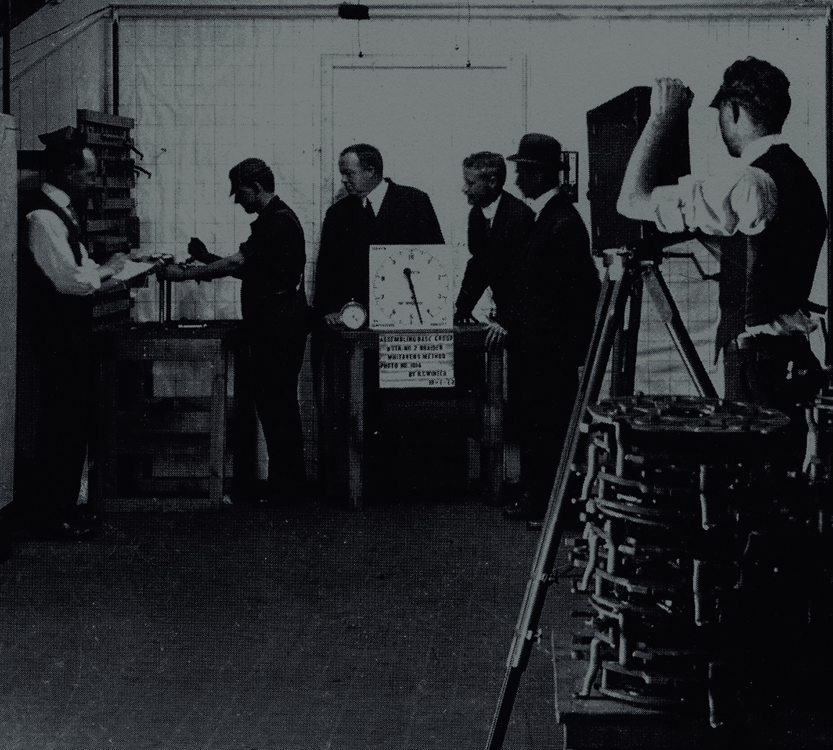
Taylor studied work scientifically — not by intuition.
He measured every movement to find the most efficient method.
His goal: “the one best way” to perform every job.

Slide 3
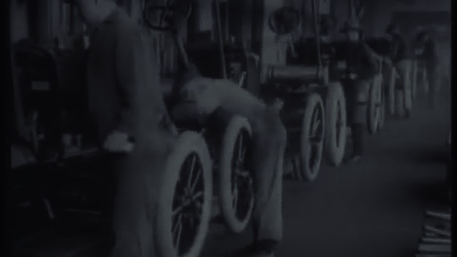
Main Achievements & Legacy
Published “The Principles of Scientific Management” in 1911.
Introduced time and motion studies that boosted productivity.
Inspired Henry Ford and the creation of the assembly line.
Laid the foundation for modern management theory.
“In the past, the man has been first; in the future, the system must be first.”
— F. W. Taylor

Slide 4

Taylor’s Lasting Impact
Taylor’s ideas turned management into a science.
His focus on efficiency and system thinking shaped modern organizations.
Even today, his message remains clear — “work smarter, not harder”.

