Slide 1
Introduction to management
Class no. 2
Schools of Management Thought

Slide 2

Introduction
The history of management can be traced back to 5000 B.C. when the agriculture revolution was at the initial stage
In Egypt, in 2900 B.C., the pyramids were built in a highly organised and coordinated manner
Management skills can also be found in the suave cities of Mohanjo-Daro in Pakistan
Great example of management was shown in the organised military of Alexander the Great and Sun Tzu

Slide 3

Exercise 1
The art of war or is it management?

Slide 4
Schools of Management Thought
Classical School of Management
  Scientific Management
  Administrative Management
Human-Relation School of Management
Mathematical or Quantitative School of Management
Systems School of Management
Contingency School of Management

Slide 5
Schools of Management Thought
Each school tries to explain the nature and content of management, but with different belief, view and formats.

Slide 6
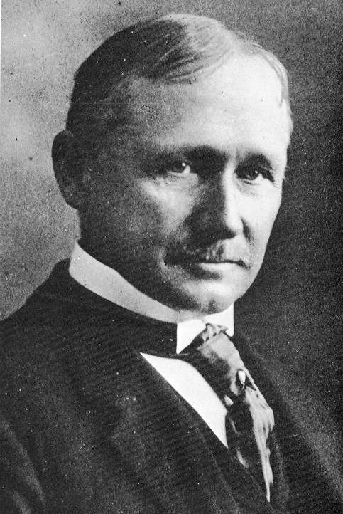
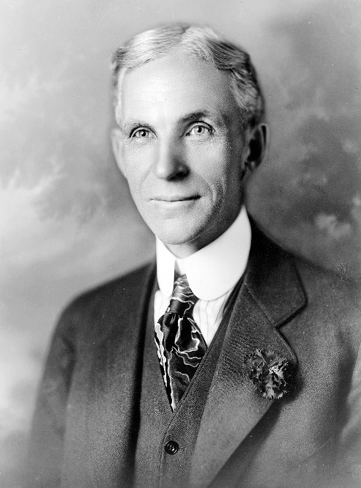
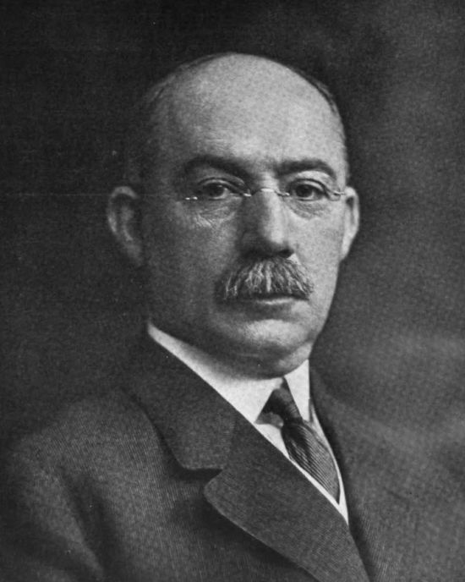
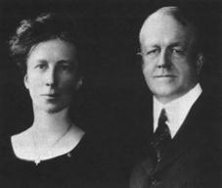
Scientific
Management
Fig. 4. Lilian and Frank Gilbreth
Source: http://mustafamemisoglu.
blogspot.com/2008/03/frank-bunker-lillian-moller-gilbreth.html
Fig. 1. Frederic Winslow Taylor
Source: https://en.wikipedia.org/wiki/
Frederick_Winslow_Taylor
Fig. 2. Henry Ford
Source: https://en.wikipedia.org/wiki/
Henry_Ford
Fig. 3. Henry Laurence Gantt
Source: https://en.wikipedia.org/wiki/
Henry_Gantt

Slide 7
Scientific
Management
Use the scientific method to study work and determine the most efficient way to perform specific tasks.
Match workers to their jobs based on capability and motivation, and train them to work at maximum efficiency.
Monitor worker performance, and provide instructions and supervision to ensure that they're using the most efficient ways of working.
Allocate the work between managers and workers so that the managers spend their time planning and training, allowing the workers to perform their tasks efficiently.

Slide 8
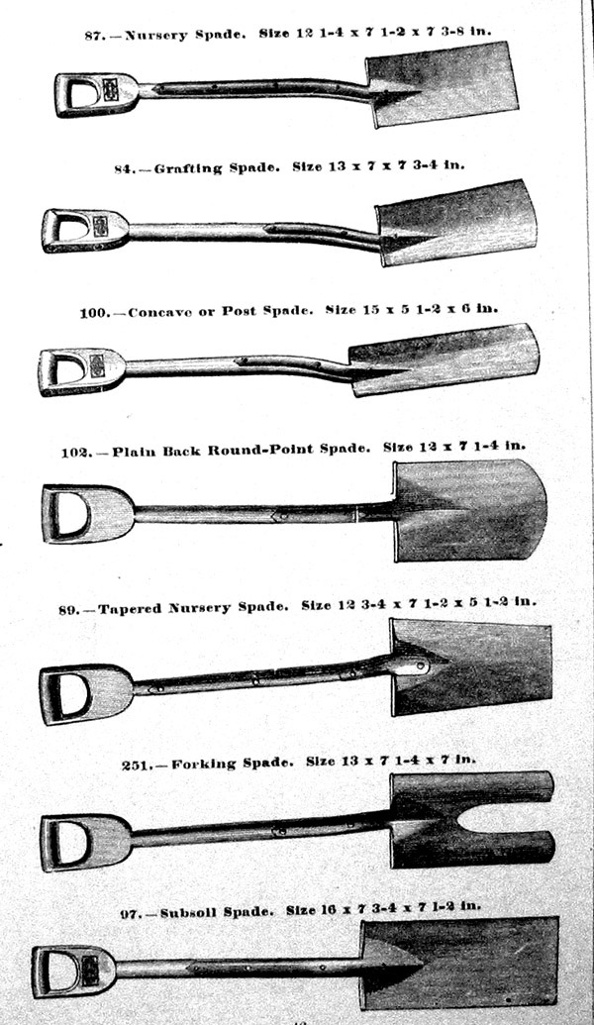
Frederick Winslow Taylor
The optimal weight that a worker should lift in a shovel was 21 pounds.
The shovel should be sized so that it would hold 21 pounds of the substance being shoveled.
The firm provided the workers with optimal shovels.
Result: Three to four fold increase in productivity

Slide 9
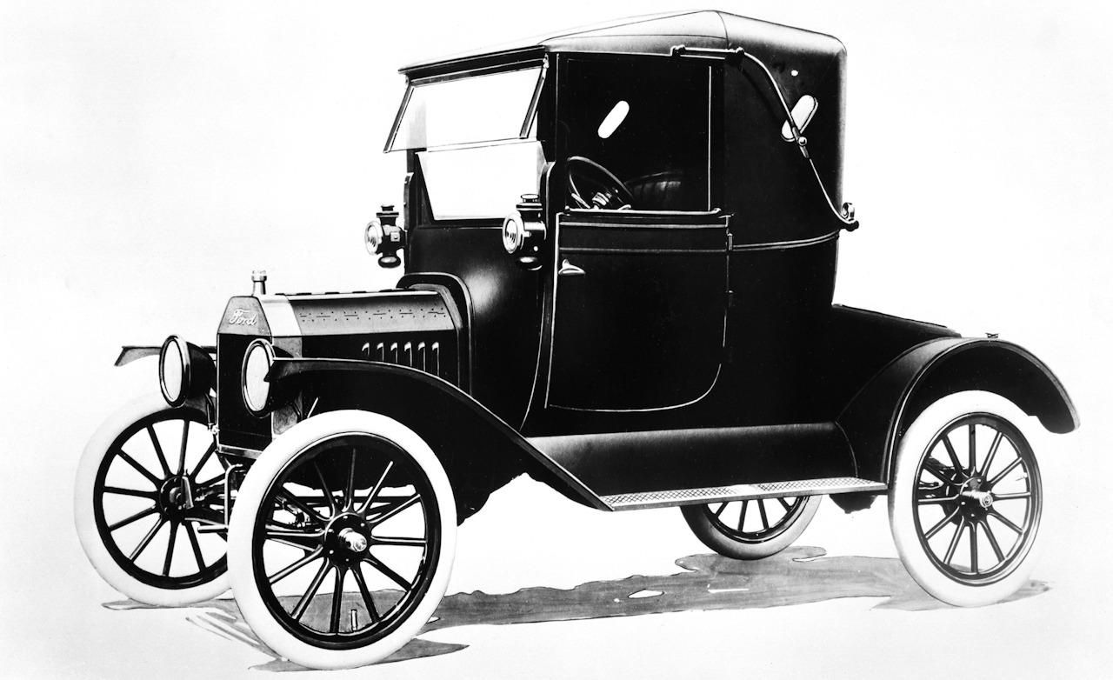
Exercise 2:
Henry Ford –
Facts & Summary
What were the changes in production and management introduced in Ford Motor Company?
Fig. 5. Model T
Source: http://zonderpump.com/image-post/1005-ford-model-t2-1.jpg.html#gal_post_1005_ford-model-t2-1.jpg

Slide 10
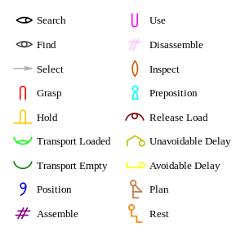
Lilian and
Frank Gilbreth
Frank and Lillian Gilbreth invented and refined therbligs, roughly between 1908 and 1924.
Therbligs comprise a system for analyzing the motions involved in performing a task.
The identification of individual motions, as well as moments of delay in the process, was designed to find unnecessary or inefficient motions and to utilize or eliminate even split-seconds of wasted time.
Fig. 6. Therbligs
Source: https://en.wikipedia.org/wiki/Therblig

Slide 11
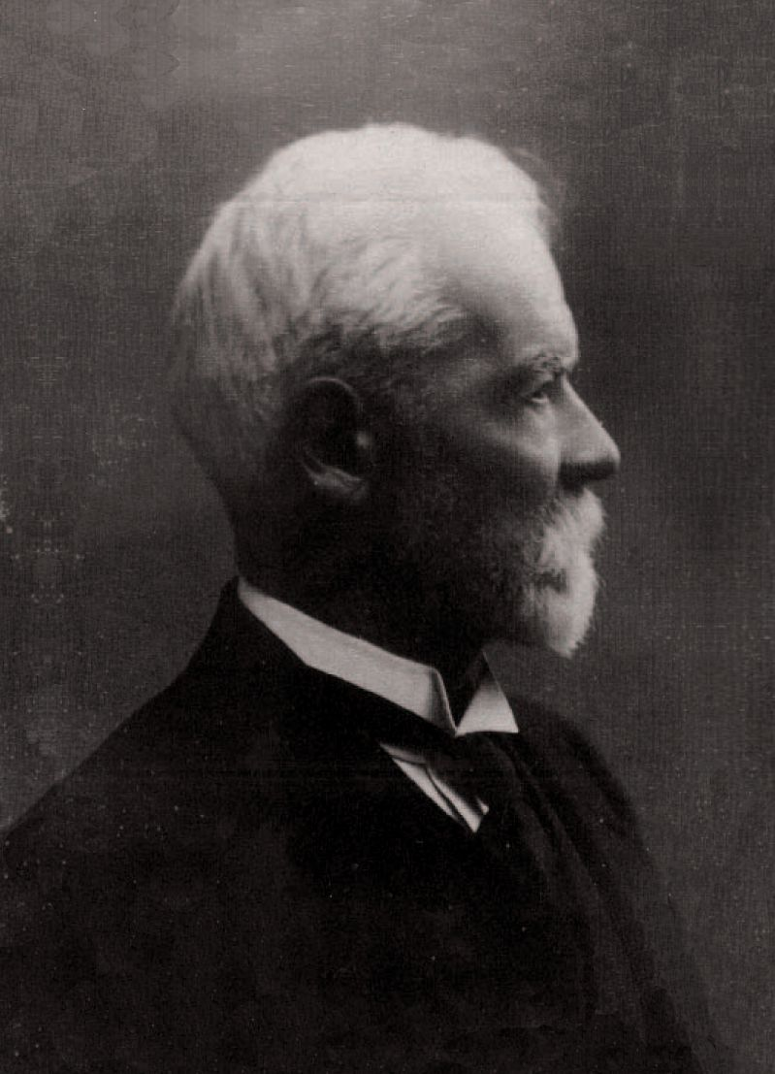
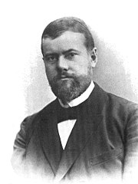
Administrative Management
Fig. 7. Henri Fayol
Source: https://en.wikipedia.org/wiki/
Henri_Fayol
Fig. 8. Max Weber
Source: https://pl.wikipedia.org/wiki/
Max_Weber

Slide 12

Administrative Management
A very formalized structure with clear lines of authority from the top down (hierarchical structure).
At the top is the board of directors who give directions to the CEO, who in turn gives directions the vice presidents of each corporate division. The vice presidents will then give directions to their middle managers, who in turn give directions to supervisors down to individual employees

Slide 13
Administrative Management
Division of labor - each department is responsible for a particular aspect of the organization's activities towards the achievement of organizational goals.
Marketing
Production
Distribution
Large corporation may have a production division, marketing division, distribution division, and administrative division. Each works on a particular aspect of the company's business: the production division produces the products, the marketing division markets the products, the distribution division sends the products to customers or retailers, and the administrative division provides administrative support to the other divisions.

Slide 14

Administrative Management
Delegation of power and authority
If you don't have the power and authority to engage in tasks necessary for achieving specific objectives you are charged with achieving, the organization can't meet its overall goal.

Slide 15
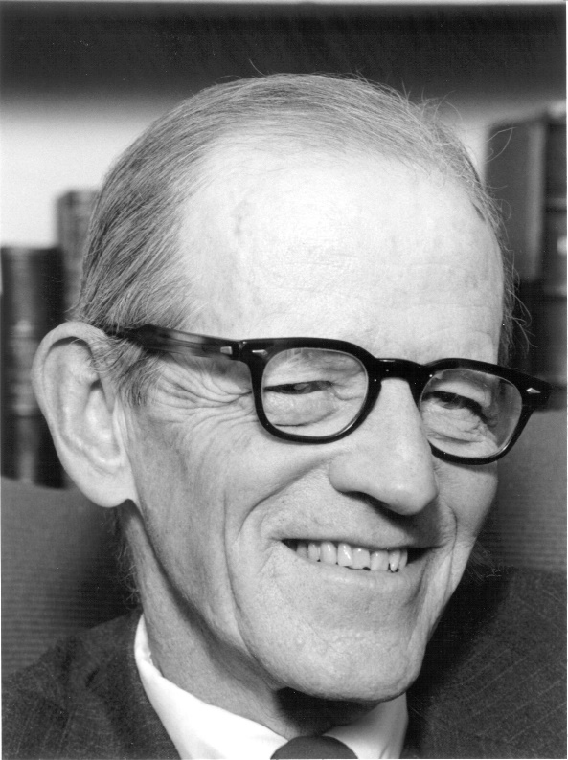
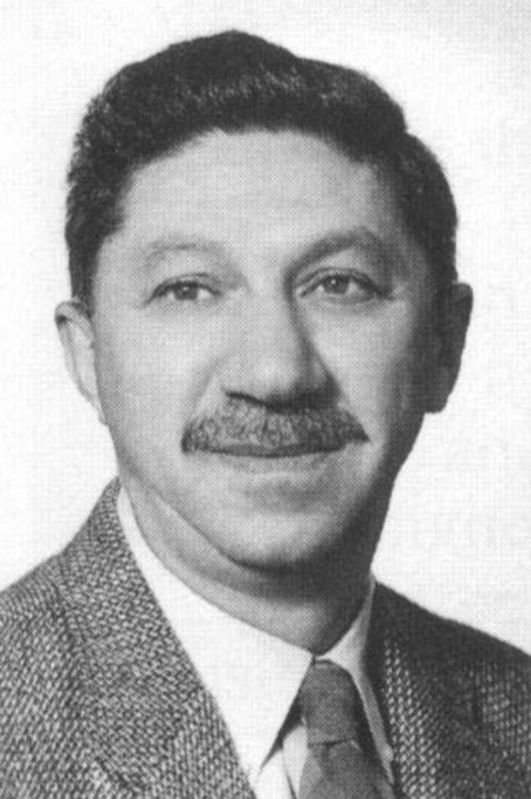
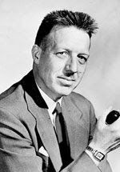
Human-Relation School of Management
Fig. 9. Elton Mayo
Source: https://pl.pinterest.com/pin/
136374694941934990/
Fig. 10. Abraham Maslow
Source: http://totallyhistory.com/
abraham-maslow/
Fig. 11. Douglas McGregor
Source: http://club-barcelona1.blogs pot.com/2007/09/american-sociologist -douglas-mcgregor.html

Slide 16
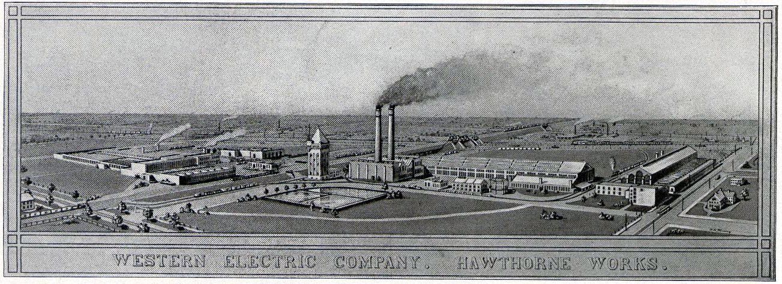
Elton Mayo –
Hawthorne Studies

Slide 17
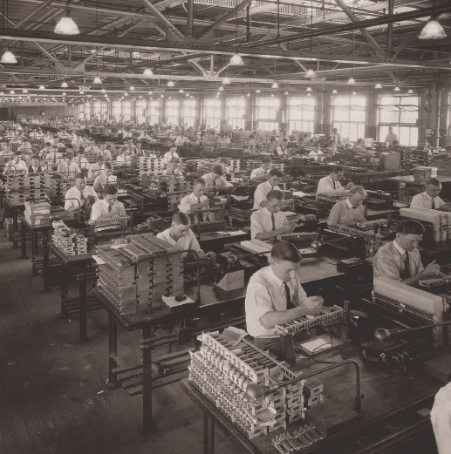
Elton Mayo - Hawthorne Studies
Elton Mayo was curious about ways to increase productivity in organizations. After being awarded a grant by the National Research Council of the National Academy of Sciences, he decided to study productivity at the Western Electric factory, Hawthorne Works, in Chicago. Initially, he thought that lighting levels would have an impact on worker productivity, and he predicted that the more light there was, the more productive the worker would be.

Slide 18
Elton Mayo - Hawthorne Studies
After three years of studying lighting, Mayo realized that lighting had no impact at all on his test groups - the productivity increased with brighter intensity, but also with lower intensity
The presence of the researcher and the attention that the workers received during these tests seemed to be the reason of increased employee productivity.

Slide 19
Conclusions of Hawthorne Studies
Workers’ attitudes are associated with productivity.
Workplace is a social system and informal group influence could exert a powerful effect on individual behavior.
The style of supervision is an important factor in increasing workers’ job satisfaction.
Organization should take steps to assist employees in adjusting to organizational life by fostering collaborative systems between labor and management.

Slide 20

Douglas McGregor - Theory X and theory Y
Theory X managers tend to take a pessimistic view of their people, and assume that they are naturally unmotivated and dislike work. As a result, they think that team members need to be prompted, rewarded or punished constantly to make sure that they complete their tasks.
Tasks in organizations that are managed like this can be repetitive and people are often motivated with a "carrot and stick" approach. Performance appraisals and renumeration are usually based on tangible results, such as sales figures or product output, and are used to control staff and "keep tabs" on them.

Slide 21

Douglas McGregor - Theory X and theory Y
Theory Y managers have an optimistic, positive opinion of their people, and they use a decentralized, participative management style. This encourages a more collaborative, trust-based relationship between managers and their team members.
People have greater responsibility, and managers encourage them to develop their skills and suggest improvements. Appraisals are regular but, unlike in Theory X organizations, they are used to encourage open communication rather than control staff.

Slide 22

Exercise 3 –
Theory X/Y

Slide 23

Quantitative School of Management
The Quantitative School of Management is a result of the research conducted during World War II.
The Quantitative Approach to management involves the use of quantitative techniques, such as statistics, information models, and computer simulations, to improve decision making.

Slide 24
The Systems
Perspective
Organization as an „open system”
ENVIRONMENT
INPUTS
Information
Energy
People
TRANSFORMATIONS
Social components
Technological
components
OUTPUTS
Goods
Services
Ideas
FEEDBACK

Slide 25


The Systems
Perspective
Entropy is the tendency of systems to deteriorate or break down over time.
Synergy is the ability of the whole system to equal more than the sum of its parts.
1 + 1 = 3

Slide 26
Contingency School of Management
The Contingency School of Management can be summarized as an
“it all depends” approach.
The appropriate management actions and approaches depend on the situation.
Managers with a contingency view use a flexible approach, draw on a variety of theories and experiences, and evaluate many options as they solve problems.
There is no one best way to manage

Slide 27
Test
What is not a core component of administrative management theory?
Formalized organizational structure
Flat organizational structure
Division of labor
Delegation of power

Slide 28
Test
2. Who came up with the concept of a therblig?
Frederick Taylor
Henry Ford
Frank and Lillian Gilbreth
Max Weber

Slide 29
Test
3. What were the Hawthorne Studies?
A series of studies on James Hawthorne, a Chicago factory worker
A series of studies on workers at a Western Electric plant near Chicago
A series of studies on workers in Hawthorne, Indiana
A series of studies on workers done by the Hawthorne Research Institute

Slide 30
Test
4. Which of the following is considered only by the quantitative school of management?
Analysing the behaviour of employees in order to make them more productive
Analysing the production process and striving to find ways to make it more profitable
Analysis of data using statistical models and simulations
Analysis of company productivity

Slide 31
Test - Answers
B.
C.
B.
C.

Slide 32

Thank you for your attention

