Slide 1
Introduction to management
Class no. 3
Organization’s environment

Slide 2
Definitions of organization
Organization - social unit (or human grouping) deliberately constructed and reconstructed to seek specific goals.
[Etzioni, 1964]
Organization - social invention for accomplishing goals through group effort.
[Johns, 1992]
Organization - collections of people (two or more) who work together to achieve a wide variety of goals.
[George and Jones, 2005]

Slide 3
Components of organization
TASK
PEOPLE
Social components
STRUCTURE
TECHNOLOGY
Technological components

Slide 4
Components of organization
TASK
PEOPLE
People are often the key consideration in any change initiative, because skill sets and staff attitudes greatly affect the success of change in any organization.
STRUCTURE
TECHNOLOGY
To help define your "people" component, consider the following:
    What are their beliefs, attitudes, and behaviors?
    What is their response to the proposed change?
    What are their skill levels?
    What are they trained to do?
    What are the rewards that motivate them?
    What is their work culture?

Slide 5
Components of organization
TASK
PEOPLE
Task - a mission or purpose of the existence of organization.
Identify your work unit's main tasks, including both routine and key tasks. For example, if your work unit is a restaurant, the key tasks could be taking orders, preparing meals, and serving meals. The routine tasks could be cleaning, setting tables, and so on.
STRUCTURE
TECHNOLOGY
To help define your tasks, consider these questions:
    What is the staff expected to do?
    How do staff get work done?
    Why does the work unit exist?

Slide 6
Components of organization
Structure – basic arrangement of people in the organization. If we go back to our restaurant example, the structure could be defined in terms of waiters, chefs, managers, cleaners, and so on.
TASK
PEOPLE
STRUCTURE
TECHNOLOGY
Ask yourself these questions:
    What is the hierarchy in your work unit?
    Is the unit centralized or decentralized?
    Where is the control at each level?
    How are the work units divided?

Slide 7
Components of organization
TASK
PEOPLE
Technology – intellectual and mechanical process used by an organization to transform inputs into products, services or ideas.
STRUCTURE
TECHNOLOGY
Identify the technology that your work unit uses by making these two lists:
    Key equipment and processes that enable and support your business functions, including computer systems, essential software, devices – anything that enables communication and work flow.
    Tools you can use to implement the proposed change, including things such as seminars and training materials.

Slide 8
Components of organization
ABC Company has decided to introduce a new skill-based assessment procedure for its field engineers. Under this system, the engineers will be evaluated primarily on their skills. They'll be expected to keep up with the latest developments in their field and use them effectively. Furthermore, instead of the boss, peers will be asked to rate other engineers.
What will the impacts be?

Slide 9
Components of organization
Task – The primary change will occur in the task component of the diamond. The work unit will have to take on the new task of conducting skill-based assessments.
People – Engineers may be uneasy about the new system. They may think "Am I good enough?" "Won't it involve a lot of work?" "Will I have time to track new developments?" "How do I rate my peers?" These concerns will need to be addressed if the change is to be successful.
Structure – Old career advancement patterns might not align with the new assessment procedure. The new procedure might create a more skilled pool of people. These people, in turn, might demand higher pay and better positions.
Technology – This change may need changes to be made to computer systems: Once established, the new procedure may need a database to store and track the skill-based assessments on an ongoing basis. The organization might also need technology and training seminars to help with continuous learning for engineers.

Slide 10
Organization as an „open system”
ENVIRONMENT
OUTPUTS
Goods
Services
Ideas
INPUTS
TRANSFORMATIONS
FEEDBACK

Slide 11



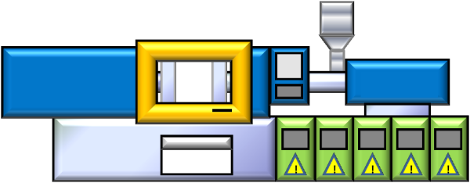
Major resources used by organizations
Human resources
Financial resources
Physical resources
Information resources

Slide 12
Organization as an „open system”
ENVIRONMENT
OUTPUTS
Goods
Services
Ideas
INPUTS
TRANSFORMATIONS
FEEDBACK

Slide 13
Organization’s environment
Organization’s environment - all the elements existing outside the boundry of organization that have the potencial to affect all or part of the organization
Outside the control of organization
ORGANIZATION’S ENVIRONMENT
GENERAL (MEGA) ENVIRONMENT
TASK ENVIRONMENT

Slide 14
PESTE Analysis
GENERAL (MEGA) ENVIRONMENT
Changes in business environment can create great opportunities for organizations – and cause significant threats
PESTEL analysis - is a simple and widely used tool that helps managers analyze general environment
    What are the key political factors?
    What are the important economic factors?
    What social aspects are most important?
    What technological innovations are likely to occur?
    What are the environmental considerations?

Slide 15
PESTE Analysis
P
E
S
T
E
OLITICAL
CONOMIC
OCIAL
ECHNOLOGICAL
NVIRONMENTAL

Slide 16

PESTE Analysis
STEP
PESTEL
PESTLIED
STEEPLED

Slide 17
PESTE Analysis
STEP
PESTEL(egal)
PESTLI(international)ED(empographic)
STEEPLED(ucational)

Slide 18
Exercise 1
Cost of living
Population growth rate
Trade restrictions
Age distribution
Improved quality of parts and end product
Inflation rate
Taxation regulations
Religious beliefs
Automation
Geographical location
Exchange rates
Employment laws
P
E
S
T
E

Slide 19
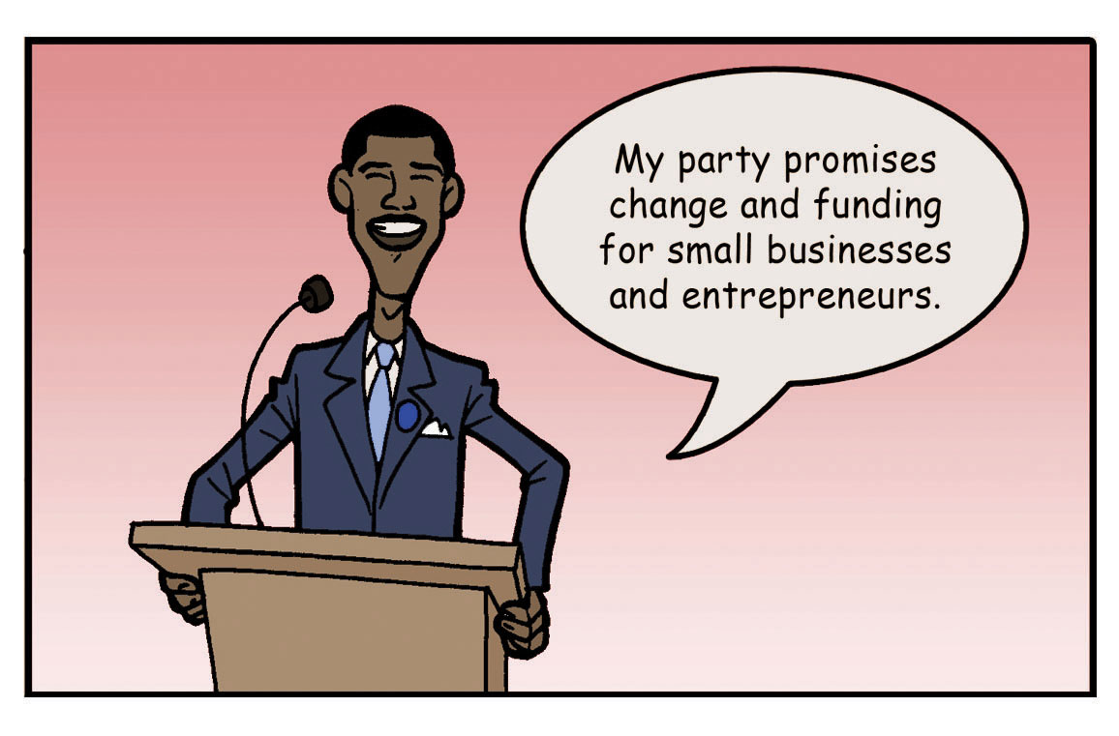
Political factors
Political factors include elements such as tax policies, changes in trade restrictions and tariffs, and the stability of governments
Proposals to provide support to businesses are often featured within political campaigns

Slide 20
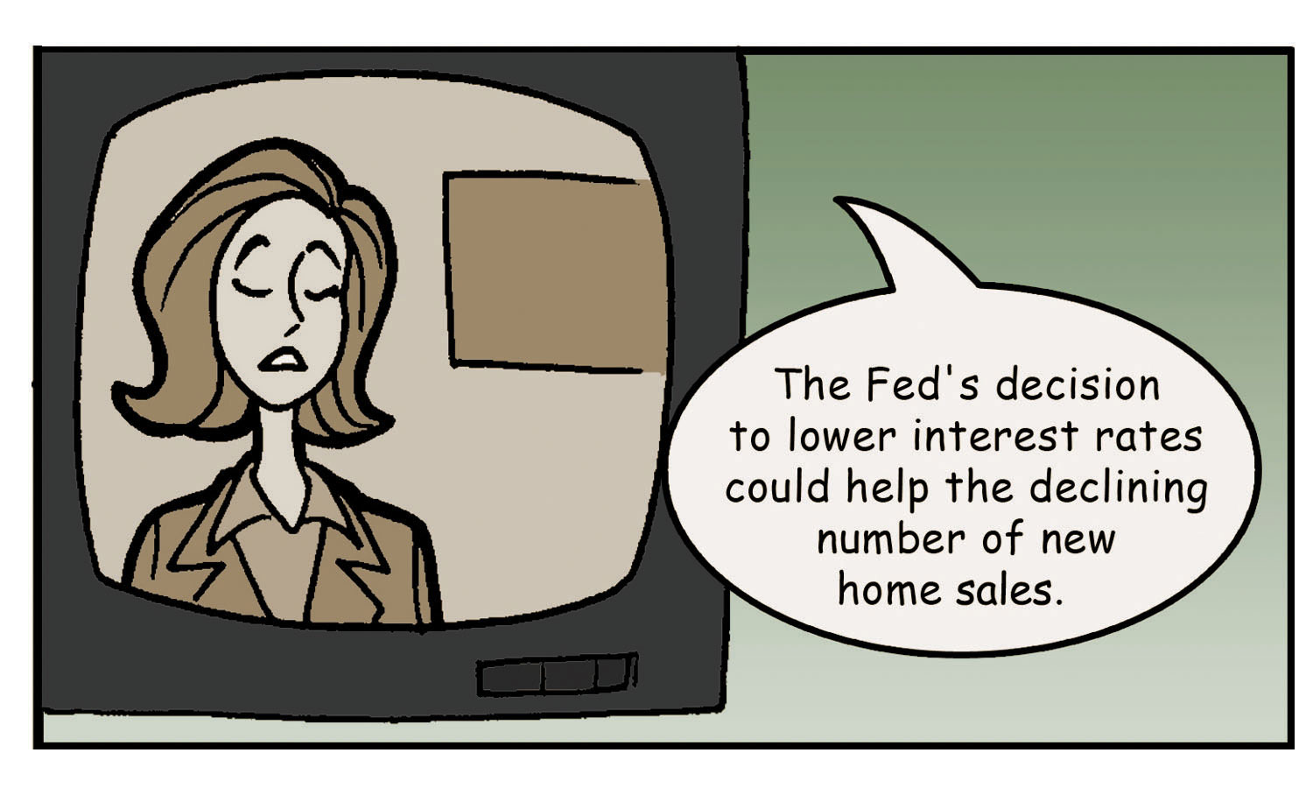
Economic factors
Economic factors include elements such as interest rates, inflation rates, gross domestic product, unemployment rates, levels of disposable income, and the general growth or decline of the economy
Decisions about interest rates made by the Federal Reserve create opportunities for some organizations and threats for others
The Federal Reserve System (commonly referred to as “The Fed”) is the United States’ central banking system. The Fed attempts to strengthen the economy through its decisions, such as setting short-term interest rates

Slide 21

Social factors
Social factors include trends in demographics such as population size, age, and ethnic mix, as well as cultural trends such as attitudes toward obesity and consumer activism
Women’s immense contributions to the war effort during World War II helped create positive social changes in the ensuing decades

Slide 22
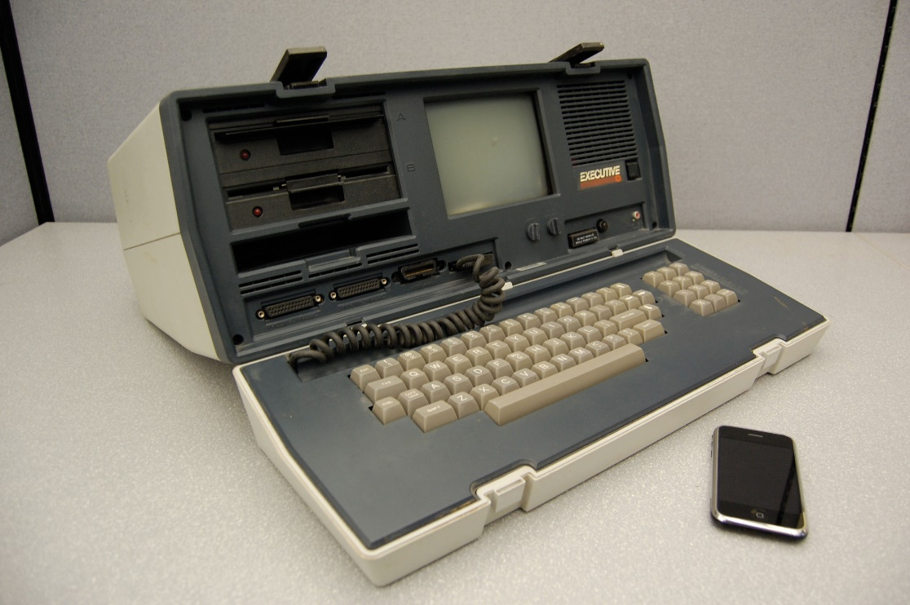
Technological factors
Technological factors include, for example, changes in the rate of new product development, increases in automation, and advancements in service industry delivery
Today’s iPhone can be one hundred times faster, one hundred times lighter, and ten times less expensive than a “portable” computer built in the 1980

Slide 23
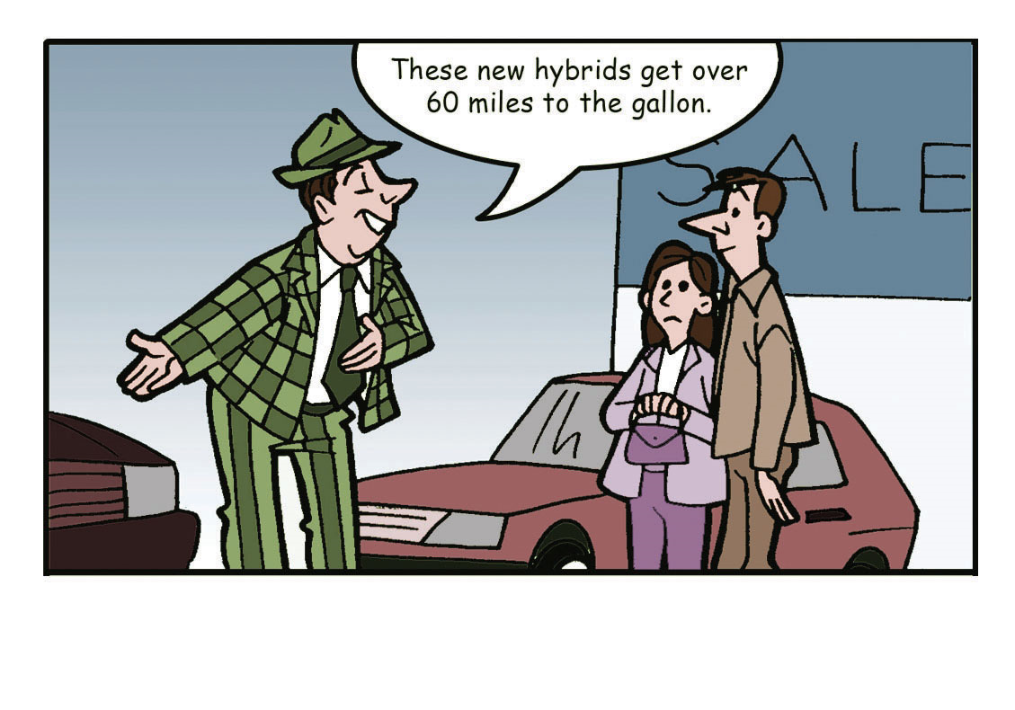
Environmental factors
Environmental factors include, for example, natural disasters and weather patterns
A key trend within the environmental segment is an increasing emphasis on conserving fossil fuels

Slide 24
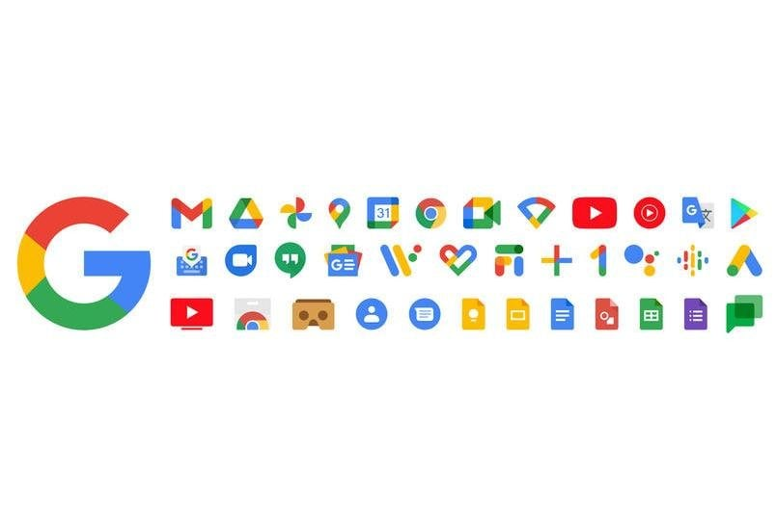
Exercise 2
Google Case Study: P.E.S.T.E. Analysis

Slide 25
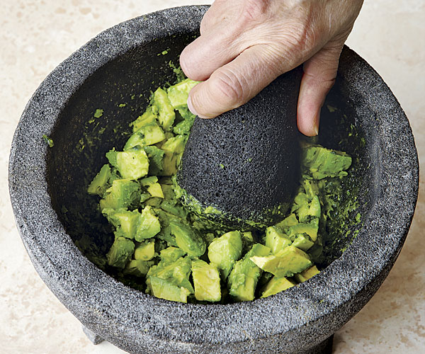
PESTE Analysis – one more time 1/2
To transform an avocado into guacamole,
a chef may choose to use a mortar and pestle. A mortar is a mashing device that is shaped liked a baseball bat, while a pestle is a sturdy bowl within which the mashing takes place. Similarly, PESTE reflects the general environment factors - political, economic, social, technological, environmental - that can crush an organization. In many cases, executives can prevent such outcomes by performing a PESTE analysis to diagnose where in the general environment important opportunities and threats arise.

Slide 26
PESTE Analysis – one more time 2/2
PESTE is often used when launching a new product or service, exploring a new route to market, or selling into
a new country or region
There are many different versions of this analysis tool, although the underlying method is the same in all cases

Slide 27
Porter’s Five Forces Analysis
TASK ENVIRONMENT
The tool was created by Harvard Business School professor Michael Porter, to analyze an industry's attractiveness and likely profitability.
Porter recognized that organizations likely keep a close watch on their rivals, but he encouraged them to look beyond the actions of their competitors and examine what other factors could impact the business environment. He identified five forces that make up the competitive environment, and which can erode your profitability.

Slide 28
Threat of New Entry
Supplier Power
Buyer
Power
Competitive Rivalry
Threat of
Subsitution

Slide 29
Porter’s Five Forces Analysis
Threat of New Entry
According to Porter, these Five Forces are the key sources of competitive pressure within an industry. He stressed that it is important not to confuse them with more fleeting factors that might grab your attention, such as industry growth rates, government interventions, and technological innovations. These are temporary factors, while the Five Forces are permanent parts of an industry's structure.
Supplier Power
Competitive Rivalry
Buyer
Power
Threat of
Subsitution

Slide 30
Test
An organizational environment is composed of forces or institutions surrounding an organization that affect which of the following?
Performance
Operations
Resources
All the answers are correct

Slide 31
Test
2. Which of the following are considered P - elements of PESTE?
Visa requirements and trading tariffs
Weather and climate
Currency inflation and interests rates
Age and gender

Slide 32
Test
3. Which of the following is NOT a part of the task environment?
Employees
Customers
Competitors
Suppliers

Slide 33
Test
4. If you sell in-home coffee makers, what is an example of a substitution product?
A coffee from Starbucks
A competing in-home coffee maker
A change in the design of the coffee maker
Buyers uniting to boycott the coffee maker

Slide 34
Test - Answers
D.
A.
A.
B.

Slide 35
Homework
Prepare a presentation about the organization’s culture of a company of your choice (for volunteers, up to 10 min)

Slide 36

Thank you for your attention

