Slide 1
Introduction to management
Class no. 4
Organizational culture

Slide 2


Slide 3
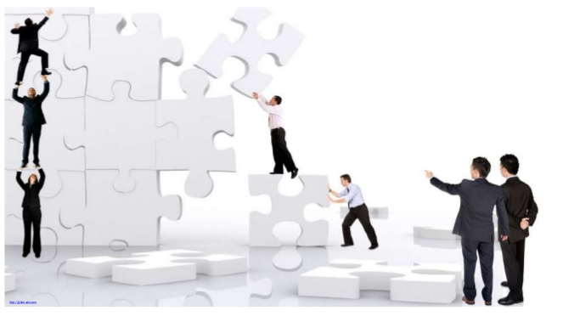
Defining organizational culture
Organizational culture - a set of shared, often implicit assumptions, beliefs, values and sensemaking procedures that influences and guides the behavior and thinking of organizational members, and is continuously enacted and in turn reinforced - or changed - by the behavior of organizational members.
The initial source of an organization's culture is the founder of the organization.

Slide 4
Levels and dimensions of organizational culture
Artifacts
Values
Assumptions

Slide 5
Artifacts
Visible elements of culture
Values
Ethical statements of rightness
Assumptions
Unconscious and taken for granted ways of seeing the world

Slide 6
Levels and dimensions of organizational culture
Artifacts
Easiest to recognize
Values
Assumptions
Most difficult to recognize

Slide 7


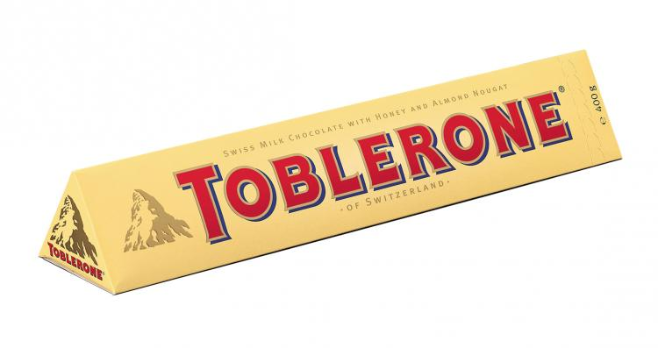
Artifacts
They are the visible elements in culture. Artifacts can be recognized by people not part of culture.
The outsider might easily see these artifiacts, but might not be able to fully understand why these artifacts have been established. To understand this, outsiders can look at the espoused values in the culture.
Categories of artifacts:
    Organizational stories, legends and language,
    Rituals and ceremonies,
    Physical structure and symbols.

Slide 8

Organizational language
To work judo:
Flat food:
Eating your own dog food:

Slide 9
Organizational language
To work judo:
    Work judo is used to mean "the art of deflecting a work assignment to someone else without making it appear that you're avoiding it”.
Flat food:
    Flat food is any food item that comes out of a vending machine and can be slid under a door. Flat food is often used by management to subsist software developers slaving long hours to meet a deadline.
Eating your own dog food:
    Eating your own dog food, also called dogfooding, is a slang term used to reference a scenario in which a company uses its own product to test and promote the product e.g. auto dealers' policy of making salespeople drive the brands they sell.

Slide 10

Organizational language
Facemail
    Facemail is a face-to-face talk
Death march
    Death march is a dysphemism or description for the end phase of
    a project when a hard deadline has to be met

Slide 11

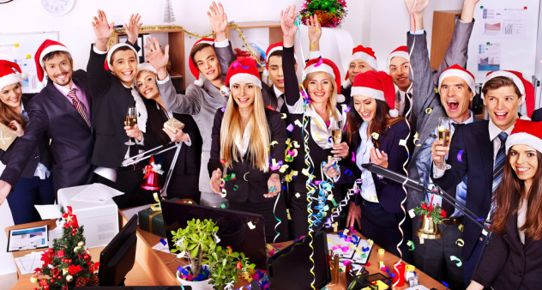


Organizational rituals and ceremonies
A.
B.
C.
D.

Slide 12




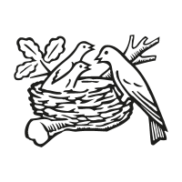
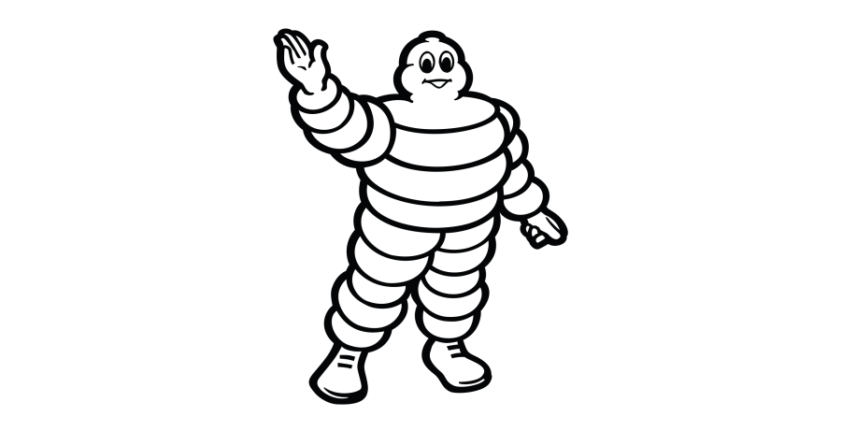


Exercise 1 - symbols
A.
B.
C.
D.
E.
F.
G.
H.

Slide 13
Exercise 1 - symbols
A. Lacoste
B. Starbucks
C. Chanel
D. DreamWorks
E. Twitter
F. Nestlé
G. NBC
H. Michelin

Slide 14

https://www.youtube.com/watch?v=FzcfZyEhOoI&ab_channel=TechVision

Slide 15
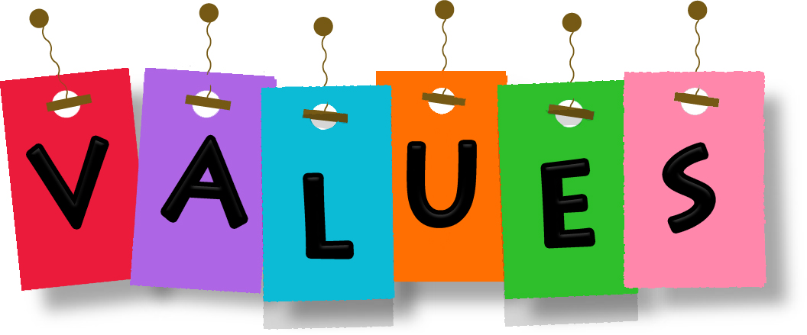
Values
Espoused values could be represented by the philosophies, strategies and goals realized by e.g. Leaders.
However, the value sought by leaders should be supported by some general and shared assumptions about e.g. how a company should be run, or how employees should be managed. If espoused values by leaders are not in line with the general assumptions of the culture, this might signal trouble.

Slide 16
BIG VALUES LIST
Acceptance
Accessibilty
Accomplishment
Accountability
Accuracy
Achievement
Activeness
Adaptability
Adventure
Aesthetics
Agility
Creativity
Credibility
Cunning
Curiosity
Daring
Decisiveness
Dedication
Dependability
Determination
Devotion
Dignity
Flexibility
Fluency
Focus
Frankness
Freedom
Friendliness
Friendship
Fun
Generosity
Gratitude
Growth
Modesty
Motivation
Neatness
Open-mindedness
Openness
Optimism
Order
Orderliness
Organization
Originality
Outlandishness
Self-control
Self-descipline
Self-reliance
Sensitivity
Serenity
Service
Sharing
Silliness
Simplicity
Sincerity
Skill

Slide 17

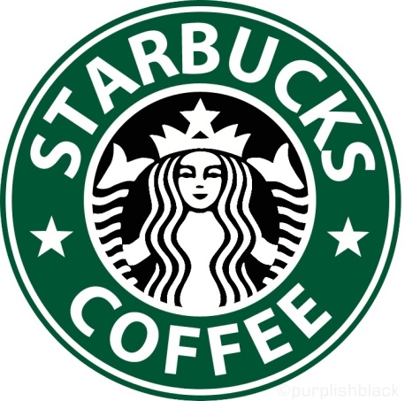
Organizational language
The University's core values are as follows:
    Freedom of thought and expression,
    Freedom from discrimination.
With our partners, our coffee and our customers at our core, we live these values:
    Creating a culture of warmth and belonging, where everyone is welcome,
    Acting with courage, challenging the status quo and finding new ways to grow our company and each other,
    Being present, connecting with transparency, dignity and respect,
    Delivering our very best in all we do, holding ourselves accountable for results.

Slide 18

Assumptions
The essence of culture is located at the level of basic assumptions which reflect how members of a culture experience reality, how they perceive the physical and social world, and how they think and feel.
These assumptions are taken for granted, and are rarely questioned.

Slide 19
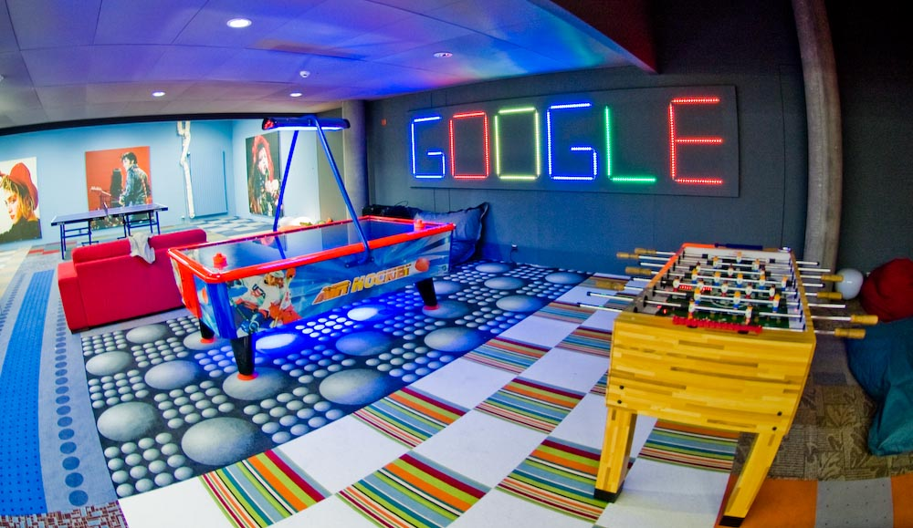
Exercise 2
Organizational culture at Google
https://www.youtube.com/watch?v=Z-pT0XDYvDM

Slide 20
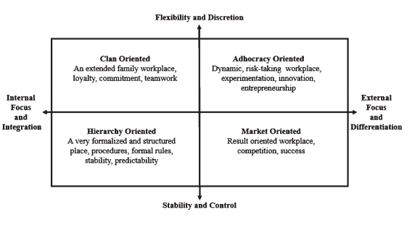
Cultural profiles based on Competing Values Framework

Slide 21
Clan culture
Clan culture identic with family type organization.
The basic assumption of Clan culture is that the best environment can be managed through team cooperation and employee empowerment, and customers is considered as partner.
Organization that intend to have Clan Culture tries to develop working environment that is humane with the main duty of management is to empower employee and facilitate their participation, commitment, and loyalty. Leader is considered as mentor and can be treated as parent figures. This organization is operating with loyalty and tradition as its base.

Slide 22
Adhocracy culture
Adhocracy Culture has assumption that innovation and initiative lead to success, so developing new products and services, encourage entrepreneurships, and creativity is the main priorities of company. This culture doesn’t have centralized power or authority relationships.
An effective leader in this culture is a visionary, innovative and dare to take risk leader. The glue of organization is commitment to market experiments and innovation.

Slide 23
Hierarchy culture
Hierarchy culture is based on formal rules, procedures and stability. Its Value Drivers are: efficiency, punctuality, consistency and uniformity while Quality Strategies are focused on: error detection, measurement, process control, systematic problem solving and quality tools.

Slide 24
Market culture
Market culture is result-oriented and the glue that holds the organization together is the emphasis on winning. While Value Drivers comprise market share, goal achievement and profitability, Quality Strategies are directed at measuring customer preferences, improving productivity, creating external partnerships, enhancing competitiveness and involving customers and suppliers.

Slide 25
Functions of organizational culture
(1) Corporate is deeply embedded form of social control.
(2) „Social glue” that bonds people together and make them feel part of organizational experience.
(3) Corporate culture helps employees make sense of the workplace.

Slide 26
Test
Schein used the metaphor of a(n) … to illustrate organizational culture
onion
iceberg
spider web
ladder

Slide 27

Test
2. What organization is the logo?
WHO
WTO
UNICEF
UNESCO

Slide 28
Test
3. What is the initial source of an organization's culture?
The founder of the organization
The environment in which the organization operates
The top manager of the organization
The country in which the organization operates

Slide 29
Test
4. Which is NOT true about Google's organizational culture?
There is minimal upper and middle-level management
There is a strong focus on innovation
Employees can make mistakes
Decisions are made by the senior person in charge and then implemented down

Slide 30
Test - Answers
B.
A.
A.
D.

Slide 31

Thank you for your attention

