Slide 1
Introduction to management
Class no. 5
Organizational structure

Slide 2
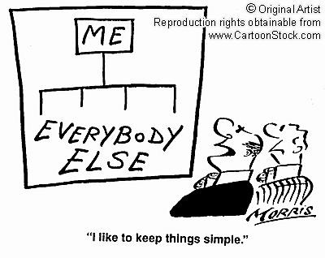
Organizational structure

Slide 3
Organizational structure - definitions
Organizational structure – the formal arrangement of task, communication and authority relationships that influence and control how people co-ordinate and conduct their work.
Organigram or organization chart – diagram which consists of boxes (representing groupings, positions or other structural units) and lines (depicting reporting relationships).

Slide 4
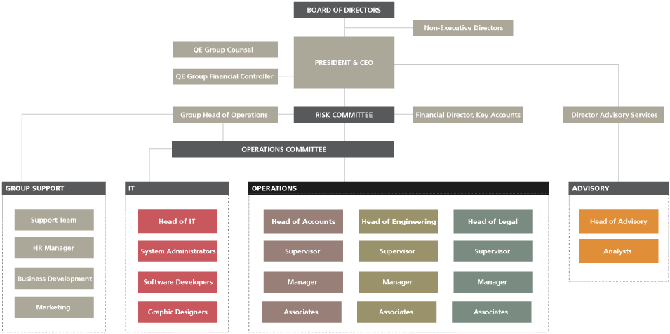
Organigram – example
LINES
BOXES

Slide 5
Organizational structure - definitions
Span of control – the number of subordinates that
a manager or supervisor can directly control.
Unity of command - provides that an employee is responsible to only one supervisor, who in turn is responsible to only one supervisor, and so on up the organizational hierarchy.

Slide 6
Organizational structure - types
Layers of management in the organization's hierarchy
Flat organizational structure
Tall organizational structure

Slide 7
Flat and tall structure
1
1
2
2
2
3
3
3
4
4
3–level hierarchy
5
5
6
6
7
7–level hierarchy

Slide 8
Differences between flat and tall structures
Structure | FLAT | TALL
Span of control | Wide span of control (each manager has to manage many subordinates) | Narrow span of control (each manager has to manage only few subordinates)
Control of subordinates | Loose control | Close control
Cost | Less costly because it has less managers | Costly because it has many managers
Communication | Communication will not be distorted and delayed because there are few layers of management | Communication may be distorted and delayed because there are many layers of management
Decision making | Decision making is quick because there are few levels of management | Extra levels of management slow down decision making
Promotional opportunities | Fewer promotions | More promotional opportunities

Slide 9
Exercise 1
Darren is the manager of a branch of well known tool hire firm
Anna is the assistant manager and she reports to Darren
Anna delegates to the department managers – Jane, Tom and Omar
Felicity, Matt and Ryan all report to Jane
Rachel, Sally and Pete are accountable to Tom
Omar is responsible for John, Mark, Sam and James
    Draw the organization chart for the tool hire firm
    Who has the largest span of control and how big is it?
    How many layers are in this hierarchy?
    Who does Tom delegate to?
    Would you consider this to be a tall or flat structure?
    Why?

Slide 10
Exercise 2

Slide 11
Organizational structure - types
Departmentation
    Functional structure
    Divisional structure
    Process-oriented structure
Departmentation – refers to the grouping of activities in organizational subunits

Slide 12
Functional structure
Functional structure – occurs when individuals and groups are located together based on the function their tasks have within the organization.
Board of directors
Chief executive
HR
Finance
Marketing
Production

Slide 13
Functional structure
Advantages
    Critical mass of a functional activity that supports efficiency within a function
    Skill development
Disadvantages
    Relatively slow speed of response to environmental change
    Lower innovation and change readiness
    Frequent decision overload at the top of the function
    Interfunctional communication and co-ordination problems due to different and even conflicting objectives and orientations (silo effect)

Slide 14
Divisional structure
Divisional structure – results in multiple subunits that are focused on different products, regions and markets or market segments.
Head office
Product division A
Product division B
Product division C
Product division D
Personnel
Sales
Finance
Manufacturing
The divisional structure is particulary appropriate where there are a number of very different product or service offerings, significantly different market conditions for different offerings, or large geographic dispersion.

Slide 15
Divisional structure
Advantages
    Fast response to changing environmental conditions
    Customer satisfaction is typically higher
Disadvantages
    Duplication of functions across divisions
    Poorer co-ordination across divisional boundaries
    Lower technical specialization and specialist competence in divisional functions
    Limitations to integration and standardization across divisions

Slide 16
Process-oriented structure
Process-oriented structure – seeks to align the structure of the organization with the workflows and core processes that aim at addressing and meeting customer needs.
CEO
Patient records
Pharmacy services
Purchising and procurement
Neonatal intensive care unit
Prenatal outpatient care
… (other core process groups)

Slide 17
Process-oriented structure
Advantages
    Flexible and responsive reactions to customer demands
    Minimize the disconnects in flows of information, materials or people
    Provides potentially satisfying work environment
    Customer satisfaction is typically higher
Disadvantages
    The level of failed applications is high (too complex to apply easily, the costs can outweight the benefits)

Slide 18
Process-oriented structure
Hybrid structures - these apply to more than one of the departmentation principles simultaneously. The best known of which is the matrix structure
Chef executive
Production director
Finance director
Marketing director
Project director 1
Project director 2
Project director 2

Slide 19
Process-oriented structure
The following situation was described by an employee who reported to more than one boss:
    My job has expanded and I now have three bosses to report to rather than one. I have tried to point out that I can only do a limited amount for each boss, but they don’t seem to understand the difficulties involved in reporting to three different masters. My initial idea was to get them all together to discuss what each can reasonably expect of me, but they don’t get on with one another and have found excuses to miss the meetings. How can I tackle this?
To what extent and how might such difficulties be avoided in
a matrix structure?

Slide 20


Mechanistic and organic organizational forms

Slide 21
Mechanistic organizational form
Mechanistic organizations - these provide a blueprint of an organizational structure that is often compared to a machine: all the parts are clearly aligned to work together in prescribed, predetermined and stable ways.

Slide 22
Organic organizational form
Organic organizations – sometimes referred to as organismic organizations. Reflects an organizational form emerging in fluid and relatively unpredictable situations. It is typified by a high level of flexibility in job responsibilities, also incorporating high levels of technical expertise at the lower level of the organization and recognition of the value of individual contribution.

Slide 23
Differences between mechanistic and organic organizational forms
Organizational form | MECHANISTIC | ORGANIC
Nature of tasks | Routine | Nonroutine
Degree of standardization | High | Low
Degree of formalization | High | Low
Differentation and specialization | Low to medium | Medium to high
Hierarchy of authority | Tall with narrow span of control | Flat with wide span of control
Decision making | Centralized | Decentralized

Slide 24
Test
Which type of structure is used when a company has locations in multiple cities?
Flat organizational structure
Functional organizational structure
Divisional organizational structure
Process-oriented structure

Slide 25
Test
2. What does the organizational matrix structure focus on?
The use of divisional work groups that focus on different tasks
The use of small, highly specialized teams to maximize efficiency
The use of strong hierarchical structure
The use of cross–functional teams

Slide 26
Test
3. Which of the following is NOT a characteristic of
a flat organizational structure?
Relatively few layers of management
Relatively large span of control
A graphical representation of its organizational structure will be relatively wide and short
More promotional opportunities

Slide 27
Test
4. Span of control is:
the number of employees a manager can feasibly oversee
the number of managers an employee can deal with
the number of top managers making decisions
the number of decisions top managers delegate to lower-level managers

Slide 28
Test - Answers
C.
D.
D.
A.

Slide 29

Thank you for your attention

