Slide 1
Introduction to management
Class no. 6
Leadership

Slide 2
Leadership - definition
Leadership – the ability to influence people toward the attainment of organizational goals.
Management and leadership are both important to organizations. Effective managers have to be leaders, too, because distinctive qualities are associated with management and leadership that provide different strengths for the organization.

Slide 3
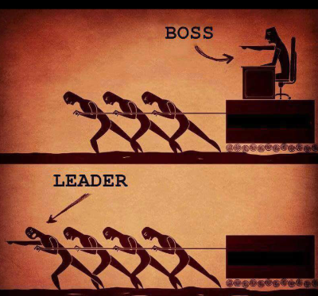
Manager vs leader

Slide 4
Manager vs leader
Manager qualities
Leader qualities
Rational
Consulting
Persistent
Problem solving
Tough-minded
Analytical
Structured
Deliberate
Authoritative
Stabilizing
Position power
Visionary
Passionate
Creative
Flexible
Inspiring
Innovative
Courageous
Imaginative
Experimental
Initiates change
Personal power

Slide 5
Exercise 1 – manager vs leader
The aim of this activity is to clearly show the difference between managers and leaders and how every leader can be a manager but not every manager can be a leader.

Slide 6
Manager or leader | Manager | Leader
Scheduling work Sharing a vision Plan and prioritize steps to task achievement Use analytical data to support recommendations Explain goals, plan and roles Provide feedback on performance Motivating staff Provide focus Create a ‘culture’ Inspiring people Delegating tasks Ensuring predictability Co-ordinate effort Co-ordinate resources Give orders and instructions Act as interface between team and outside Take risks Guide progress Check task completion Create a positive team feeling Monitor feelings and morale Look ‘over the horizon’ Appeal to peoples’ emotions Follow systems and procedures Provide development opportunities Ensure effective induction Monitor budgets, tasks etc. Use analytical data to forecast trends Unleashing potential Be a good role model Appeal to rational thinking Build teams

Slide 7
Exercise 2 – How I rank myself in qualities of being a leader
Quality | I definitely have this quality | I’m pretty good at this | I need to work on this | I need help in how to do this
Enthusiasm: I have energy, a positive attitude, and am motivated.
Prepared: I assess the situation, understand the audience, know how to prepare, how to report
Communicate well with others: effective speaker, able to work with all kinds of people, tactful, good listener.
Caring: I am sensitive to others, I accept others for who they are, compassionate, good sense of humor
Creativity: I can express ideas, can come up with helpful suggestions, I try to brainstorm for new ideas.
Character: I act in an ethical manner; honest, not led astray by peer pressure.
Adaptability: can cope with unexpected, can accept change.
Dependability: I am reliable, others can trust me, I make good on my promises. Keep on task.
Cooperation: work well with others (even those I may not like).

Slide 8
Types of
Leadership Power
COERCIVE POWER: Based on fear.
CONNECTION POWER: Based on links with important people.
EXPERT POWER: Based on the leader’s skill and knowledge.
INFORMATION POWER: Based on access to information.
LEGITIMATE POWER: Based on position.
REFERENT POWER: Based on personal traits.
REWARD POWER: Based on rewards, pay, promotion, or recogntion.

Slide 9
Exercise 3: Types of Leadership Power
Use the scale: 1= not at all true of me, 2= sometimes true, 3= often true of me, 4= very often true, 5=always true of me, to describe the extent to which each of the following seven statements is characteristic of the reasons why others respond positively to your attempts to influence their behavior.
    A. I can punish those who don’t do what I ask.
    B. I’m connected to powerful people in the organization.
    C. I have expertise in that particular area or subject.
    D. I have information that others need or see of value.
    E. After all, I am the boss.
    F. I’m personally liked or respected by others.
    G. I can reward those who do what I ask.

Slide 10
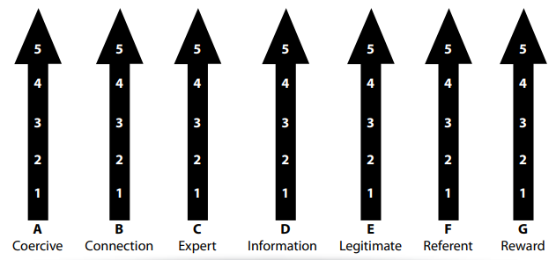
Exercise 3: Types of Leadership Power

Slide 11
The leadership Grid 1/2
The Blake & Mouton Managerial Grid is based on two behavioral dimensions:
    Concern for People: this is the degree to which a leader considers team members' needs, interests and areas of personal development when deciding how best to accomplish a task.
    Concern for Results (Production): this is the degree to which a leader emphasizes concrete objectives, organizational efficiency and high productivity when deciding how best to accomplish a task.

Slide 12
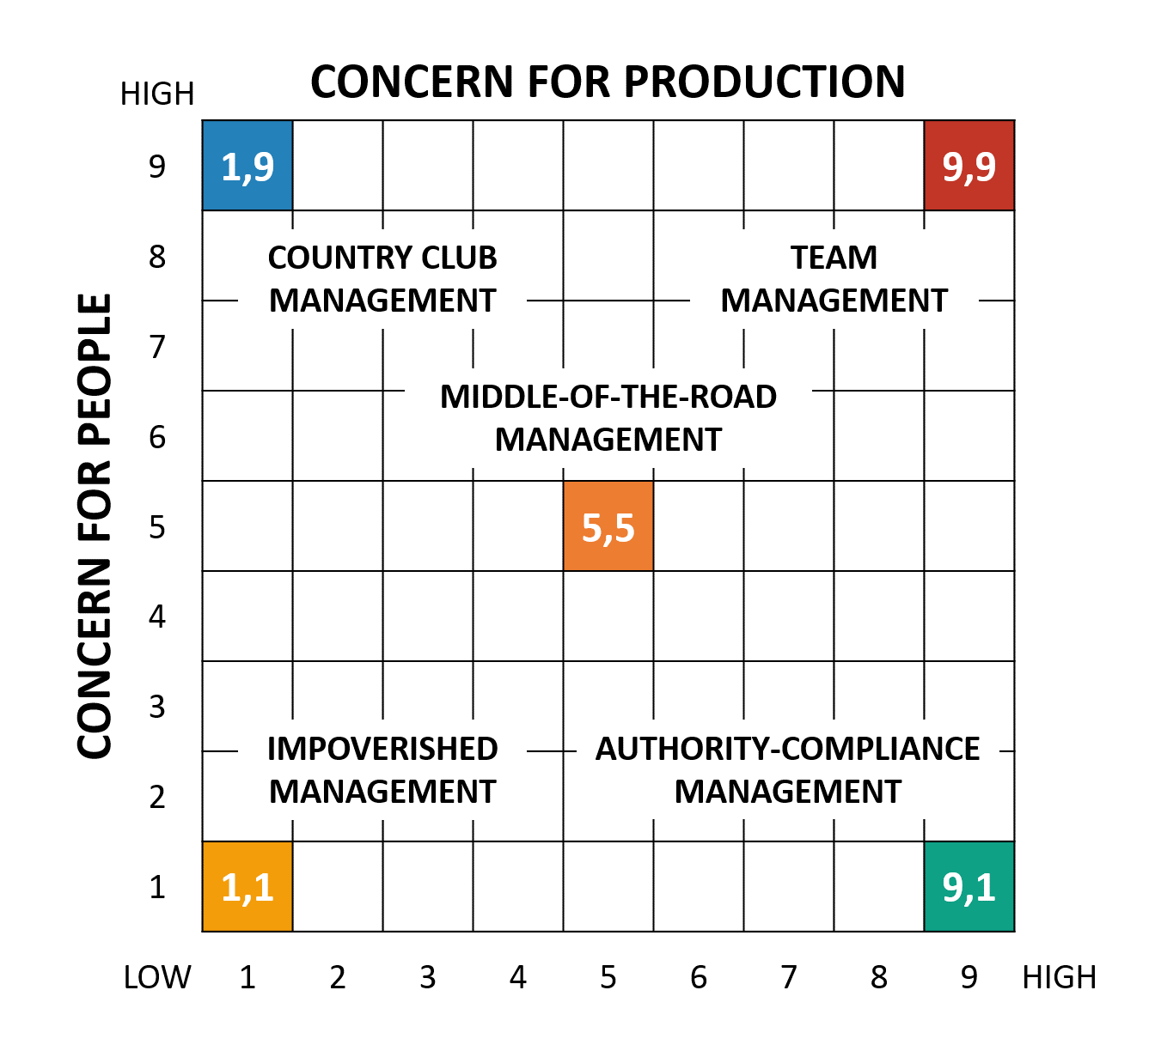
The leadership Grid 2/2

Slide 13
Contingency approach
1/3
Contingency approach – a model of leadership that describes the relationship between leadership styles and specific organizational situations.
Contingency approaches include:
    The situational theory of Hersey & Blanchard
    The leadership model developed by Fiedler

Slide 14
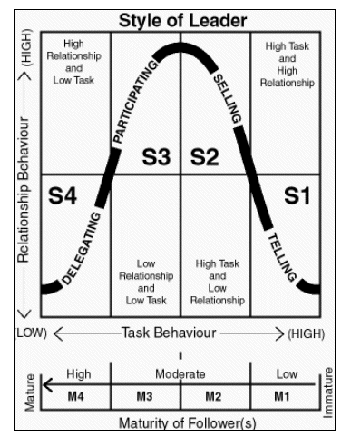
Contingency approach
2/3
Situational theory – a contingency approach to leadership that links the leader’s behavioral style with the task readiness of subordinates.

Slide 15
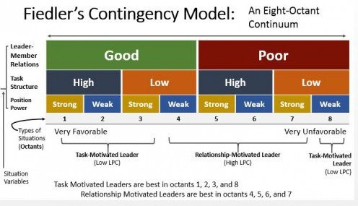
Contingency approach
3/3

Slide 16
Test
A leader:
Has a short-range perspective
Asks what and why
Does things right
Is risk-cautious

Slide 17
Test
2. What follower characteristic does Hersey & Blanchard’s (1971) situational leadership theory suggest a leader has to adjust their behavior to?:
subordinate readiness
subordinate willingness
subordinate maturity
subordinate technical ability

Slide 18
Test
3. Joe was 15 minutes late returning from lunch break today. Jill, his supervisor, tells Joe he must stay 15 minutes extra after work today to make it up. Jill is using ............ Power.
legitimate
coercive
referent
reward

Slide 19
Test
4. What is expert power?
The ability to apply power expertly
Expert power is based on upon the perception that any member of an organization has a high level of knowledge or a specialized set of skills that is relevant to his or her job
A manager who hires expert employees to support his management activities
A manager who hires outside consulting experts to manage special projects

Slide 20
Test
5. Individuals become leaders based on their:
Personal qualities
Position in a company
Professional qualifications
Education and training

Slide 21

Thank you for your attention

