Slide 1

Area and Speed Efficient Instruction-Set Accelerator based on RBLWE (Ring Binary Learn With Errors) Encryption for Cryptographic Operations
19ECE495 Project Phase-1
End Semester Evaluation
Batch Number: 37
Mentor:
Ms. Sonali Agrawal
Asst. Prof (Sr. Gr.)
Dept of ECE
Team Members:
Anagha Suresh, BL.EN.U4ECE22205
Aparna K, BL.EN.U4ECE22208
Prajwal J Gautham, BL.EN.U4ECE22237

Slide 2
CONTENTS
Introduction 10. Time Plan
Motivation 11. References
Objective and Subobjectives
Literature Survey
Summary of Literature Survey
Manual Calculations
Design and Implementation
Simulation Output and Parameter Comparison
Work done

Slide 3
INTRODUCTION
Polynomial arithmetic forms the basis of many advanced computational systems, where efficiency directly impacts overall performance.
The most critical operations include polynomial multiplication, random binary sampling, and modular additions, which are used repeatedly in higher-level algorithms.
Software implementations of these operations are computationally heavy and often unsuitable for real-time or resource-constrained environments.
Hardware acceleration through specialized cores allows significant gains in speed, efficiency, and parallelism, while also ensuring reusability.
This project focuses on the design and simulation of four fundamental building blocks: a polynomial multiplier, binary sampler, polynomial adder, and binary polynomial adder which can function both as independent modules and as part of larger integrated systems.

Slide 4

MOTIVATION
Polynomial multiplication is a complex and resource-intensive task that demands optimized hardware support.
Binary sampling plays a key role in generating structured randomness, which is vital for various algorithmic processes.
Polynomial addition and binary polynomial addition are lightweight operations, but when performed repeatedly, they contribute significantly to overall execution time, hence the need for accelerators.
A modular design approach ensures each block can be verified, reused, or scaled independently for different system requirements.
By combining these optimized blocks, the design demonstrates a pathway toward efficient, flexible, and lightweight computational accelerators.

Slide 5
OBJECTIVE
To design and implement a high-speed and area-efficient instruction-set accelerator based on RBLWE (Ring Binary Learn With Errors) encryption for Cryptographic Operations.
SUB-OBJECTIVES:
To understand the RBLWE encryption scheme and its hardware requirements, and analyze block diagrams, instruction flow, and accelerator architecture from the base paper and the relevant literature survey.
To design and simulate the polynomial multiplier core in Verilog.
To develop Binary Sampler, Polynomial Multiplier, Polynomial Adder and Binary Polynomial Adder to provide basis of design.
Design Instruction Decoder and integrate sub-modules and functionally verify accelerator and perform RTL synthesis and analysis.
Documentation of the project.

Slide 6
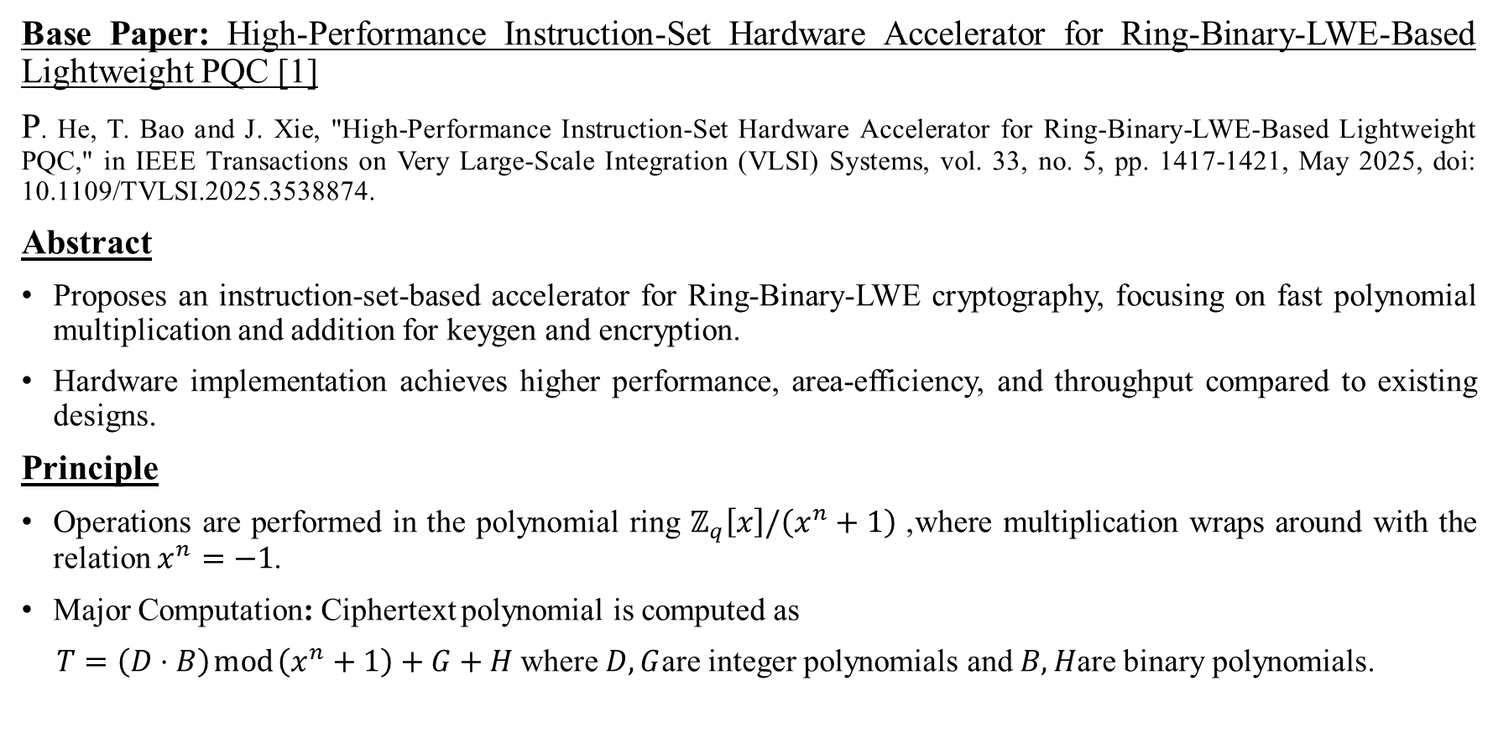
LITERATURE SURVEY
Base Paper: High-Performance Instruction-Set Hardware Accelerator for Ring-Binary-LWE-Based Lightweight PQC [1]
P. He, T. Bao and J. Xie, "High-Performance Instruction-Set Hardware Accelerator for Ring-Binary-LWE-Based Lightweight PQC," in IEEE Transactions on Very Large-Scale Integration (VLSI) Systems, vol. 33, no. 5, pp. 1417-1421, May 2025, doi: 10.1109/TVLSI.2025.3538874.
Abstract
Proposes an instruction-set-based accelerator for Ring-Binary-LWE cryptography, focusing on fast polynomial multiplication and addition for keygen and encryption.
Hardware implementation achieves higher performance, area-efficiency, and throughput compared to existing designs.
Principle
Operations are performed in the polynomial ring $ℤ_{q}\left[x\right]/\left(x^{n}+1\right)$, where multiplication wraps around with the relation $x^{n}=−1$.
Major Computation: Ciphertext polynomial is computed as
$T=\left(D⋅B\right) mod \left(x^{n}+1\right)+G+H$where $D,G$are integer polynomials and $B,H$are binary polynomials.

Slide 7
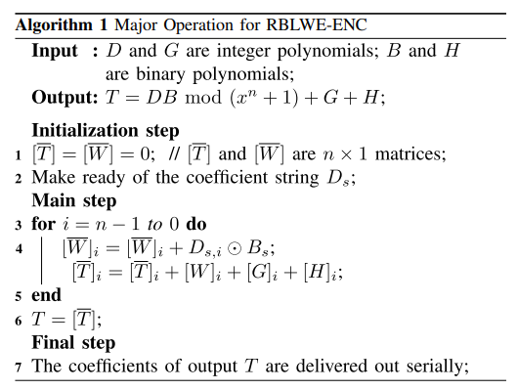
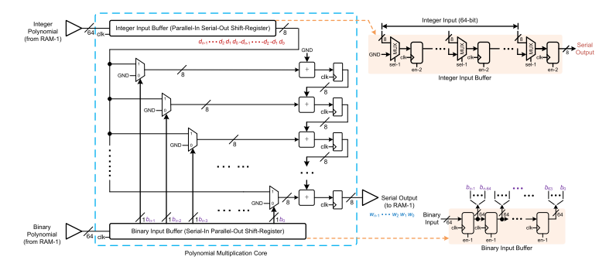
LITERATURE SURVEY (Contd.)
Base Paper: High-Performance Instruction-Set Hardware Accelerator for Ring-Binary-LWE-Based Lightweight PQC [1]
Algorithm for RBLWE Encryption
Polynomial multiplier core structure

Slide 8
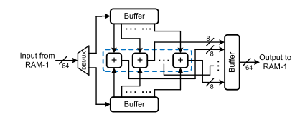
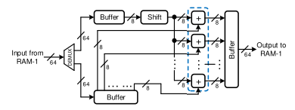
LITERATURE SURVEY (Contd.)
Base Paper: High-Performance Instruction-Set Hardware Accelerator for Ring-Binary-LWE-Based Lightweight PQC [1]
Structure of Polynomial Adder
Structure of Binary Polynomial Adder
Key Takeaway
Specialized instruction-set accelerators significantly improve the efficiency of polynomial operations central to RBLWE encryption.
Such designs highlight a path toward lightweight, high-performance, and scalable implementations of post-quantum cryptographic schemes.

Slide 9
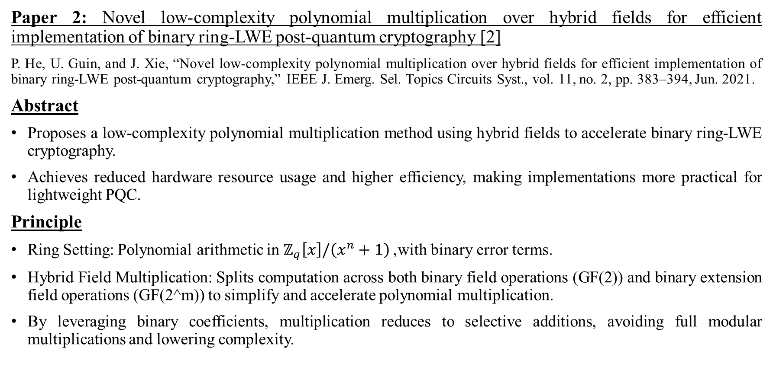
LITERATURE SURVEY(Contd.)
Paper 2: Novel low-complexity polynomial multiplication over hybrid fields for efficient implementation of binary ring-LWE post-quantum cryptography [2]
P. He, U. Guin, and J. Xie, “Novel low-complexity polynomial multiplication over hybrid fields for efficient implementation of binary ring-LWE post-quantum cryptography,” IEEE J. Emerg. Sel. Topics Circuits Syst., vol. 11, no. 2, pp. 383–394, Jun. 2021.
Abstract
Proposes a low-complexity polynomial multiplication method using hybrid fields to accelerate binary ring-LWE cryptography.
Achieves reduced hardware resource usage and higher efficiency, making implementations more practical for lightweight PQC.
Principle
Ring Setting: Polynomial arithmetic in $ℤ_{q}\left[x\right]/\left(x^{n}+1\right)$, with binary error terms.
Hybrid Field Multiplication: Splits computation across both binary field operations (GF(2)) and binary extension field operations (GF(2^m)) to simplify and accelerate polynomial multiplication.
By leveraging binary coefficients, multiplication reduces to selective additions, avoiding full modular multiplications and lowering complexity.

Slide 10
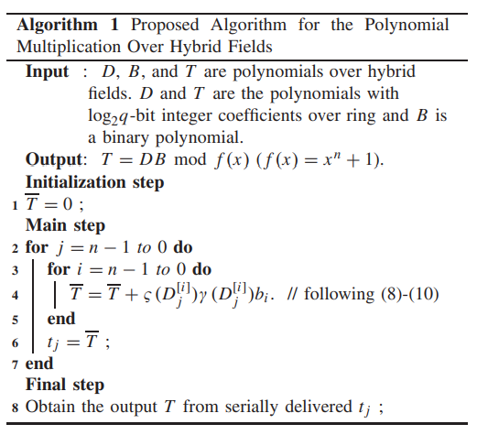
LITERATURE SURVEY(Contd.)
Paper 2: Novel low-complexity polynomial multiplication over hybrid fields for efficient implementation of binary ring-LWE post-quantum cryptography [2]
Algorithm
Key Takeaway
Hybrid-field-based multiplication significantly reduces computational cost while maintaining the security guarantees of binary ring-LWE.
Provides a foundation for lightweight and scalable PQC hardware/software designs in constrained environments.

Slide 11
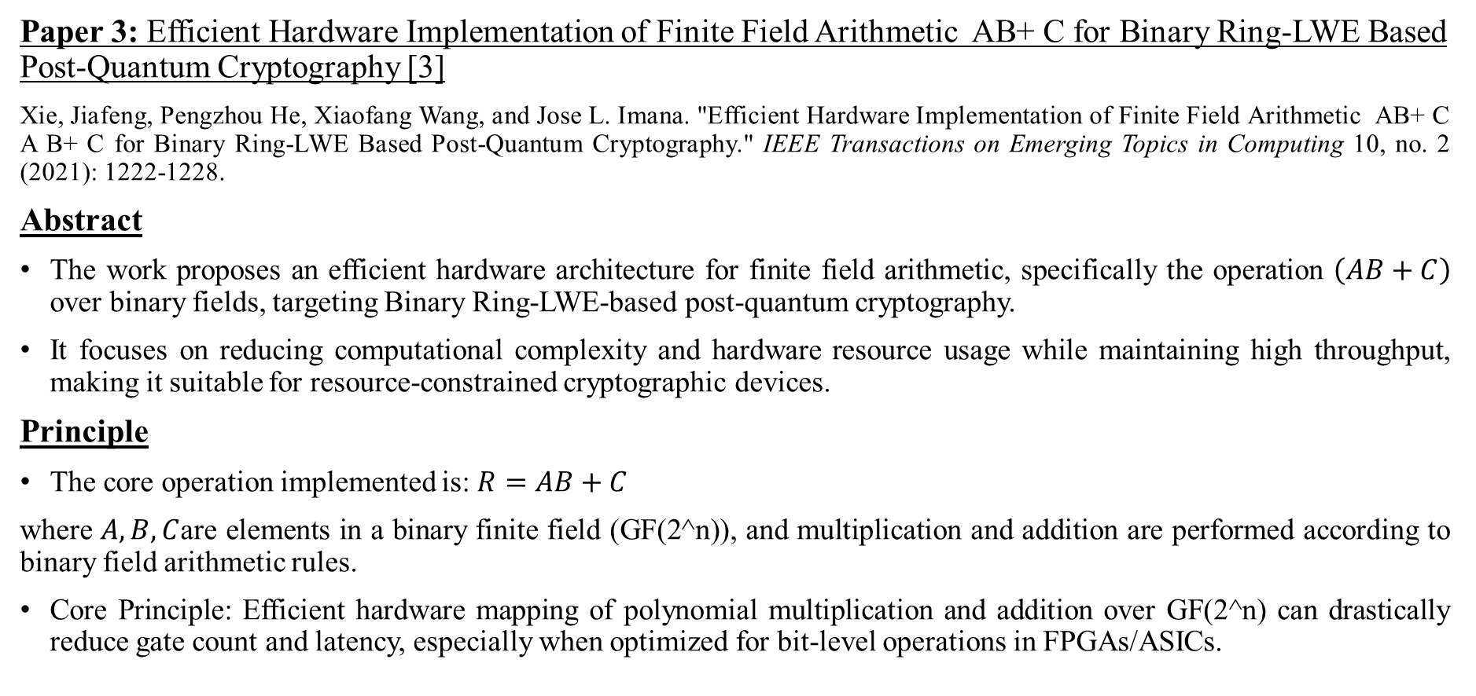
LITERATURE SURVEY(Contd.)
Paper 3: Efficient Hardware Implementation of Finite Field Arithmetic AB+ C for Binary Ring-LWE Based Post-Quantum Cryptography [3]
Xie, Jiafeng, Pengzhou He, Xiaofang Wang, and Jose L. Imana. "Efficient Hardware Implementation of Finite Field Arithmetic AB+ C A B+ C for Binary Ring-LWE Based Post-Quantum Cryptography." IEEE Transactions on Emerging Topics in Computing 10, no. 2 (2021): 1222-1228.
Abstract
The work proposes an efficient hardware architecture for finite field arithmetic, specifically the operation $\left(AB+C\right)$ over binary fields, targeting Binary Ring-LWE-based post-quantum cryptography.
It focuses on reducing computational complexity and hardware resource usage while maintaining high throughput, making it suitable for resource-constrained cryptographic devices.
Principle
The core operation implemented is: $R=AB+C$
where $A,B,C$are elements in a binary finite field (GF(2^n)), and multiplication and addition are performed according to binary field arithmetic rules.
Core Principle: Efficient hardware mapping of polynomial multiplication and addition over GF(2^n) can drastically reduce gate count and latency, especially when optimized for bit-level operations in FPGAs/ASICs.

Slide 12
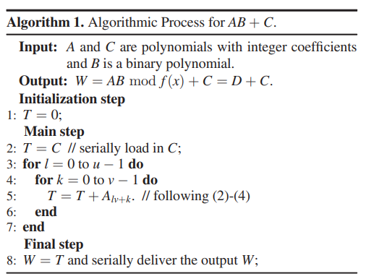
LITERATURE SURVEY(Contd.)
Paper 3: Efficient Hardware Implementation of Finite Field Arithmetic AB+ C for Binary Ring-LWE Based Post-Quantum Cryptography[3].
Algorithm
Key Takeaway
The paper demonstrates that careful architectural design for AB + C over binary fields can achieve both high-speed computation and low hardware overhead, making it highly practical for post-quantum cryptographic systems.
This work provides a foundation for implementing secure, lightweight cryptography in embedded systems without sacrificing performance.

Slide 13
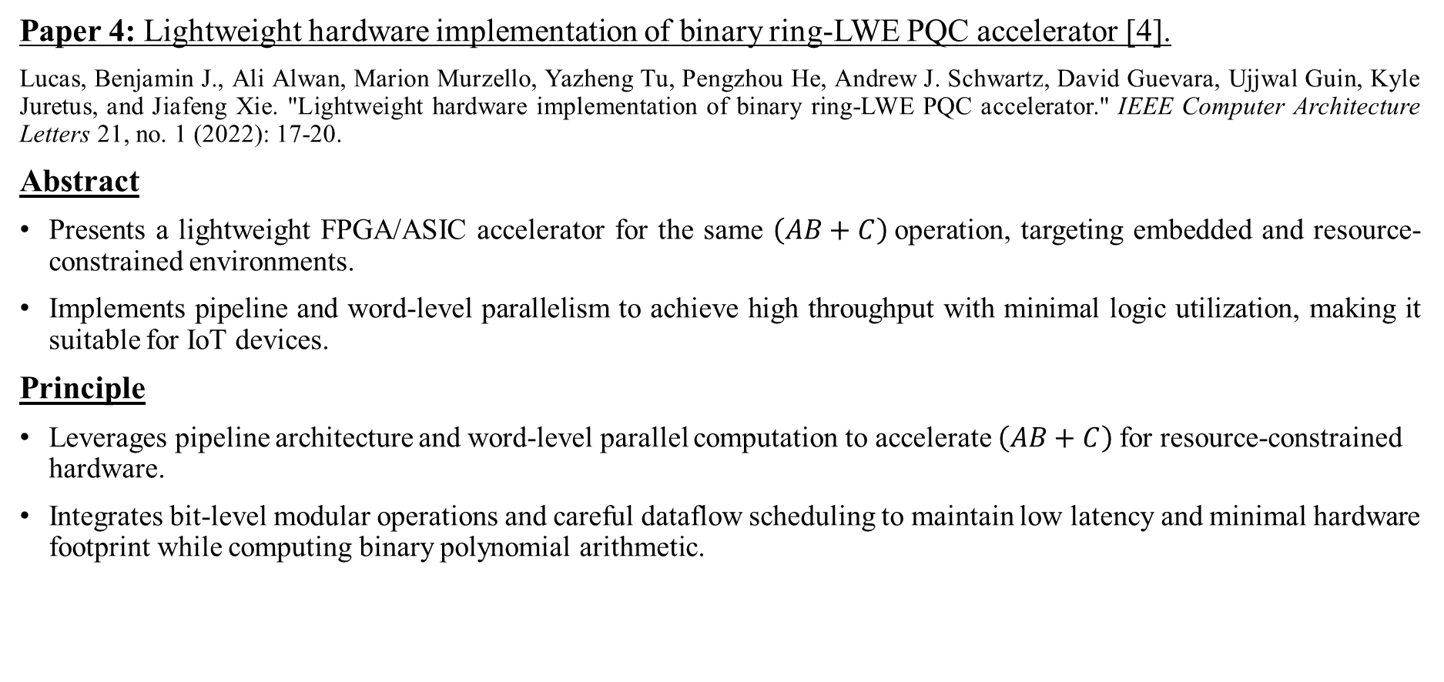
LITERATURE SURVEY(Contd.)
Paper 4: Lightweight hardware implementation of binary ring-LWE PQC accelerator [4].
Lucas, Benjamin J., Ali Alwan, Marion Murzello, Yazheng Tu, Pengzhou He, Andrew J. Schwartz, David Guevara, Ujjwal Guin, Kyle Juretus, and Jiafeng Xie. "Lightweight hardware implementation of binary ring-LWE PQC accelerator." IEEE Computer Architecture Letters 21, no. 1 (2022): 17-20.
Abstract
Presents a lightweight FPGA/ASIC accelerator for the same $\left(AB+C\right)$operation, targeting embedded and resource-constrained environments.
Implements pipeline and word-level parallelism to achieve high throughput with minimal logic utilization, making it suitable for IoT devices.
Principle
Leverages pipeline architecture and word-level parallel computation to accelerate $\left(AB+C\right)$for resource-constrained hardware.
Integrates bit-level modular operations and careful dataflow scheduling to maintain low latency and minimal hardware footprint while computing binary polynomial arithmetic.

Slide 14
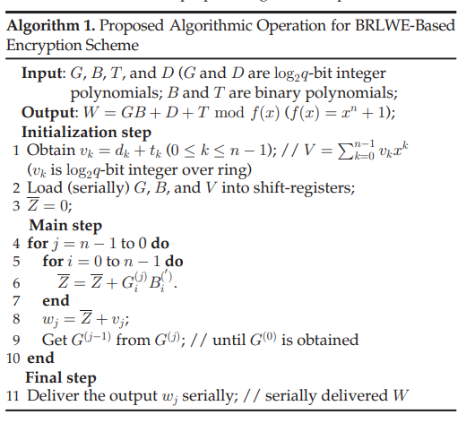
LITERATURE SURVEY(Contd.)
Paper 4: Lightweight hardware implementation of binary ring-LWE PQC accelerator[4].
Algorithm
Key Takeaway
Shows that high-speed PQC computation is feasible in low-area designs, emphasizing lightweight, energy-efficient architectures for embedded cryptography.
Highlights practical techniques for implementing binary polynomial arithmetic efficiently in real hardware.

Slide 15
SUMMARY OF LITERATURE SURVEY
Title | Focus Area | Method/Approach | Key Contribution | Shortcomings / Limitations
High-Performance Instruction-Set Hardware Accelerator for Ring-Binary-LWE-Based Lightweight PQC [1] | Lightweight PQC, Instruction-set Accelerator | Instruction-set architecture, FPGA, negacyclic multiplication | First instruction-set accelerator for RBLWE-ENC with complete crypto ops | Base paper forms foundation of this project
Novel low-complexity polynomial multiplication over hybrid fields [2] | Polynomial Multiplication | Hybrid field approach, low-complexity arithmetic | Reduced complexity polynomial multiplication for binary Ring-LWE | Focuses only on multiplication kernel, not a full cryptosystem
Special session: Advances in hardware PQC [5] | PQC Hardware Survey | Survey/overview | Overview of hardware implementations of PQC | Broad survey, does not propose new architectures
Binary ring-LWE hardware with power side-channel countermeasures [6] | Security-focused Hardware | Side-channel resistant design | First secure hardware for binary Ring-LWE against power attacks | Heavy focus on side-channel security, not performance/throughput
Optimized hardware modular multiplication of binary ring LWE [7] | Modular Arithmetic Hardware | Optimized modular multiplication | High-performance modular arithmetic implementation | modular multiplication only. lacks integration with full RBLWE scheme

Slide 16
SUMMARY OF LITERATURE SURVEY (Contd.)
Title | Focus Area | Method/Approach | Key Contribution | Shortcomings / Limitations
PQ cryptoprocessors optimized for IoT [8] | Lightweight PQC for IoT | Cryptoprocessors | PQ Cryptoprocessors optimized for edge devices | General PQC accelerator, not specifically tuned for binary Ring-LWE
Efficient Hardware Implementation of Finite Field Arithmetic AB+C [3] | Arithmetic Optimizations | Specialized finite field arithmetic | Efficient AB+C computation for binary Ring-LWE PQC | Optimizes arithmetic unit only. not a complete accelerator
Lightweight hardware implementation of binary ring-LWE PQC accelerator [4] | Lightweight PQC Accelerator | Hardware accelerator | Lightweight, resource-friendly RBLWE hardware | Focuses on lightweight multiplier core; does not support full instruction-set programmability
TINA: TMVP-initiated novel accelerator for lightweight Ring-LWE PQC [9] | Lightweight Accelerator Design | TMVP-based novel architecture | New accelerator method for lightweight Ring-LWE PQC | Specific to TMVP approach; flexibility for other RBLWE ops not addressed
Area and power efficient PQC for IoT devices [10] | PQC for IoT | Area/power optimization | Energy-efficient PQ cryptosystem design | Evaluates efficiency but lacks specialized design for RBLWE polynomial multiplication

Slide 17
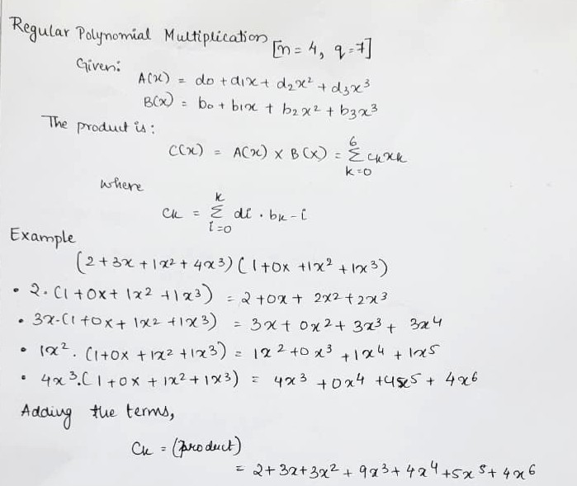
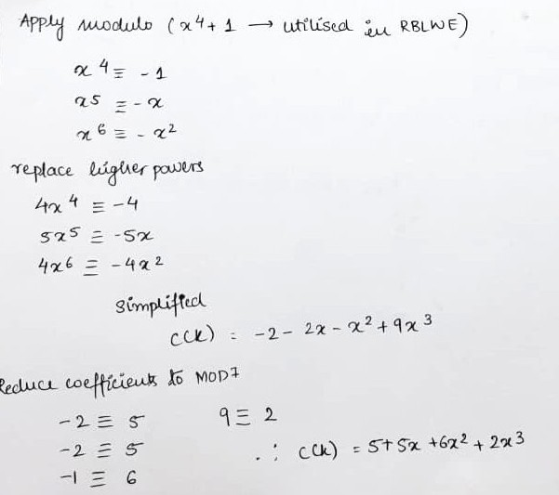
CALCULATIONS OF POLYNOMIAL MULTIPLICATION i)Schoolbook method

Slide 18
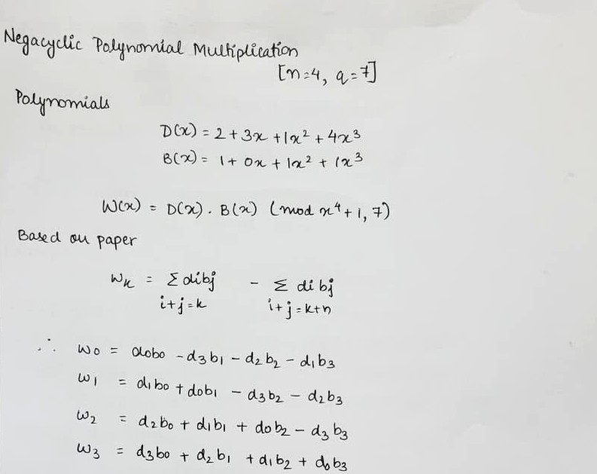
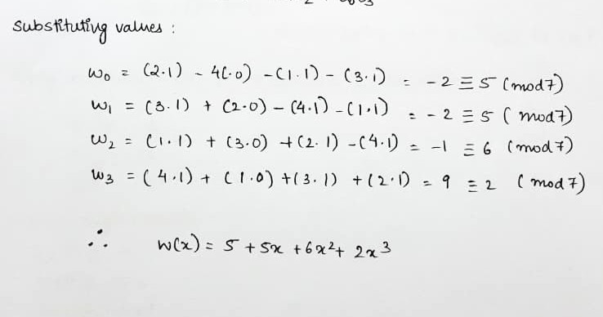
CALCULATIONS OF POLYNOMIAL MULTIPLICATION(Contd.) ii) Negacyclic Polynomial Multiplication

Slide 19
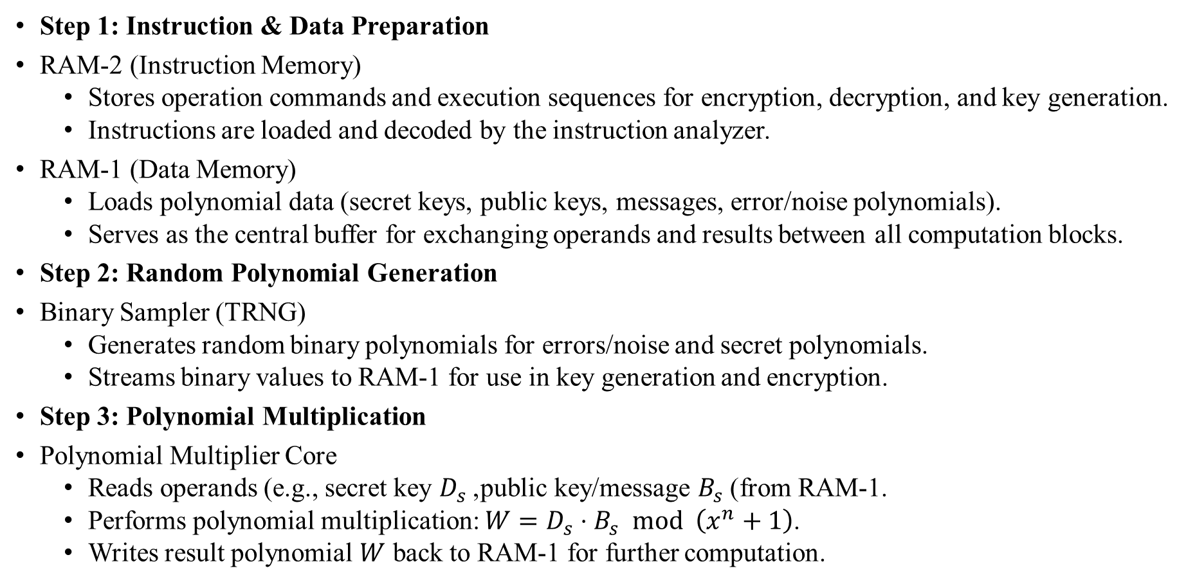
DESIGN AND IMPLEMENTATION
Step 1: Instruction & Data Preparation
RAM-2 (Instruction Memory)
  Stores operation commands and execution sequences for encryption, decryption, and key generation.
  Instructions are loaded and decoded by the instruction analyzer.
RAM-1 (Data Memory)
  Loads polynomial data (secret keys, public keys, messages, error/noise polynomials).
  Serves as the central buffer for exchanging operands and results between all computation blocks.
Step 2: Random Polynomial Generation
Binary Sampler (TRNG)
  Generates random binary polynomials for errors/noise and secret polynomials.
  Streams binary values to RAM-1 for use in key generation and encryption.
Step 3: Polynomial Multiplication
Polynomial Multiplier Core
  Reads operands (e.g., secret key $D_{s}$, public key/message $B_{s}$) from RAM-1.
  Performs polynomial multiplication: $W=D_{s}⋅B_{s} mod \left(x^{n}+1\right)$.
  Writes result polynomial $W$ back to RAM-1 for further computation.

Slide 20
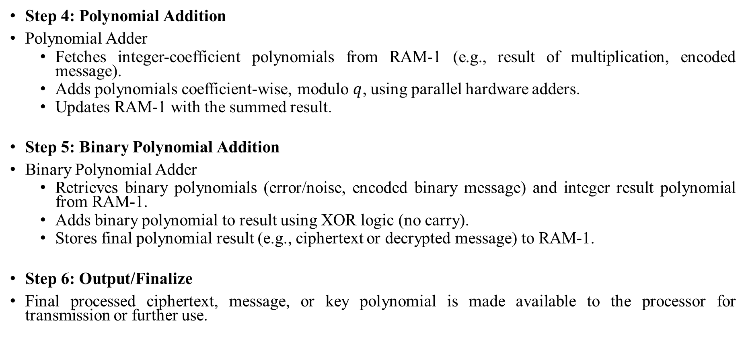
DESIGN AND IMPLEMENTATION
Step 4: Polynomial Addition
Polynomial Adder
  Fetches integer-coefficient polynomials from RAM-1 (e.g., result of multiplication, encoded message).
  Adds polynomials coefficient-wise, modulo $q$, using parallel hardware adders.
  Updates RAM-1 with the summed result.
Step 5: Binary Polynomial Addition
Binary Polynomial Adder
  Retrieves binary polynomials (error/noise, encoded binary message) and integer result polynomial from RAM-1.
  Adds binary polynomial to result using XOR logic (no carry).
  Stores final polynomial result (e.g., ciphertext or decrypted message) to RAM-1.
Step 6: Output/Finalize
Final processed ciphertext, message, or key polynomial is made available to the processor for transmission or further use.

Slide 21
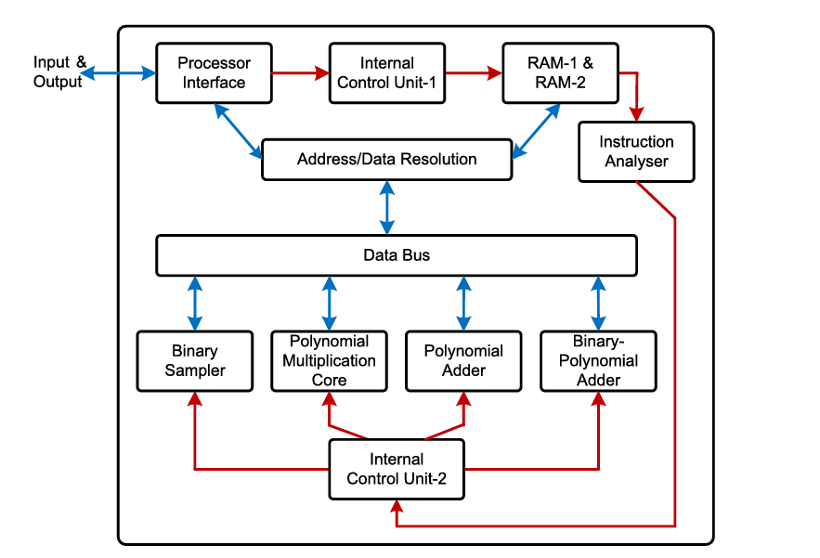
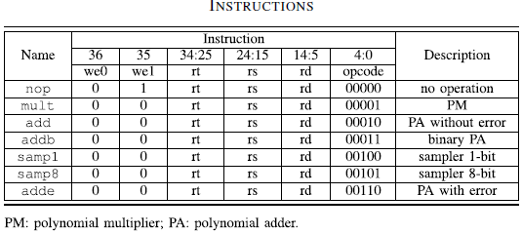
BLOCK DIAGRAM
DESIGN AND IMPLEMENTATION
Fig 1. Instruction-set accelerator architecture for RBLWE-ENC

Slide 22
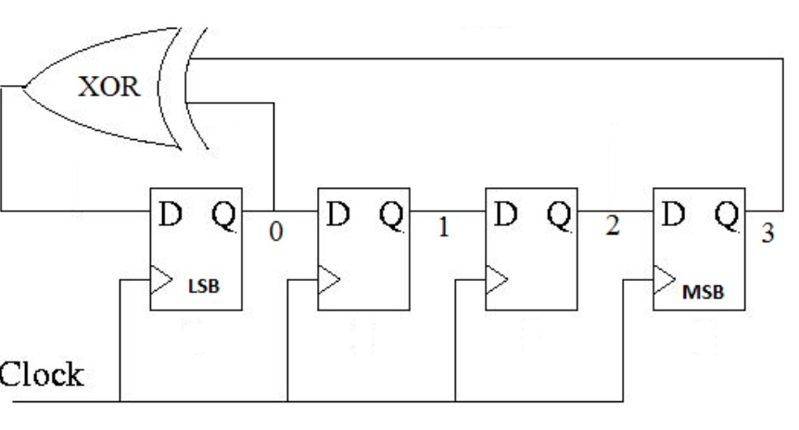
Conventional Binary Sampler Circuit
DESIGN AND IMPLEMENTATION

Slide 23
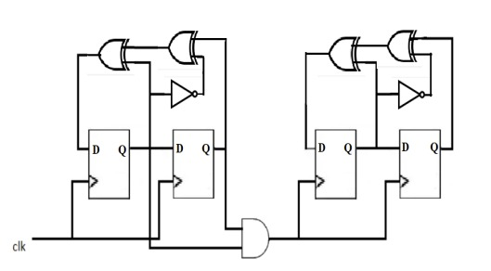
Enhanced LFSR-based Binary Sampler Circuit
DESIGN AND IMPLEMENTATION

Slide 24
Polynomial Adder Architecture
DESIGN AND IMPLEMENTATION

Slide 25
Binary Polynomial Adder Architecture
DESIGN AND IMPLEMENTATION

Slide 26
Polynomial Multiplier Core Architecture
DESIGN AND IMPLEMENTATION

Slide 27
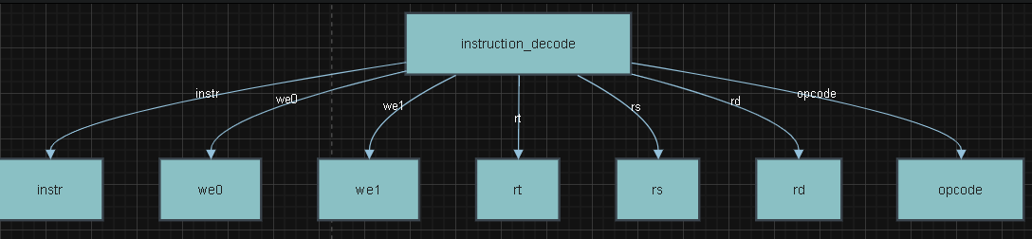
Control Finite State Machine and RAM Block
DESIGN AND IMPLEMENTATION
Control units manage data flow. Control unit directs the binary sampler, polynomial multiplier, polynomial adder, and binary polynomial adder.
RAM-1 stores/reads data from the input/output interface and the main arithmetic blocks. The word-size of RAM-1 is 32-bit, enhancing resource utilization.

Slide 28
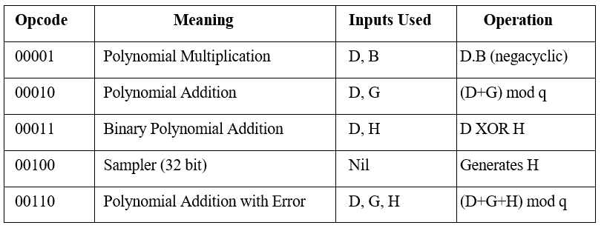
Final Top Module (Instruction Decoder)
DESIGN AND IMPLEMENTATION

Slide 29
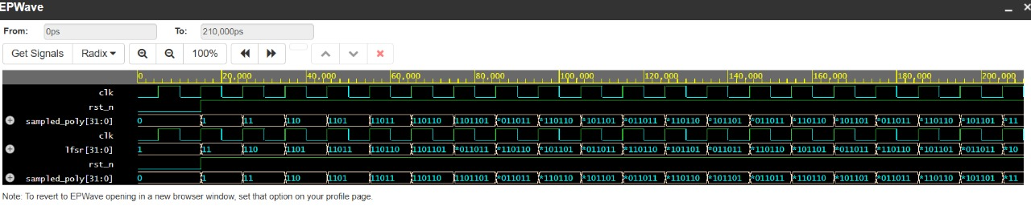
SIMULATION RESULTS
Conventional Binary Sampler Output Waveform
Binary sampler is a true random number generator (TRNG) producing 32-bit random binary values in one cycle.

Slide 30
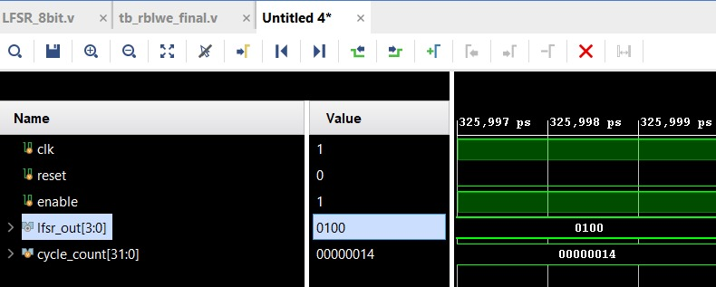
SIMULATION RESULTS
Enhanced LFSR-based Sampler Output Waveform

Slide 31
SIMULATION RESULTS(Contd.)
Polynomial Adder Output Waveform

Slide 32
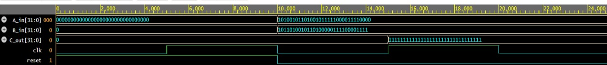
SIMULATION RESULTS(Contd.)
Binary Polynomial Adder Output Waveform

Slide 33
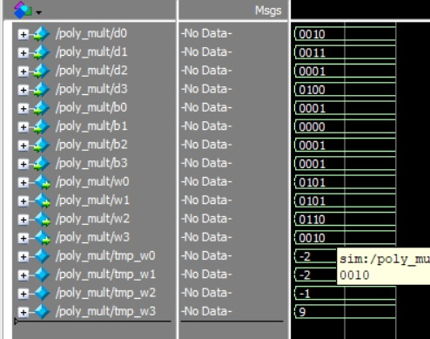
SIMULATION RESULTS(Contd.)
Polynomial Multiplier Output

Slide 34
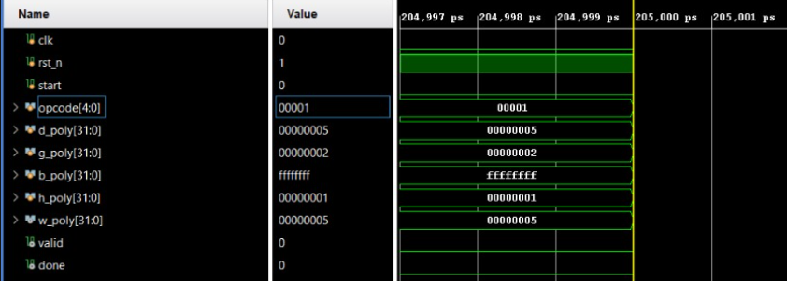
SIMULATION RESULTS(Contd.)
a)Instruction Decoder opcode 00001 (Polynomial Multiplication)

Slide 35
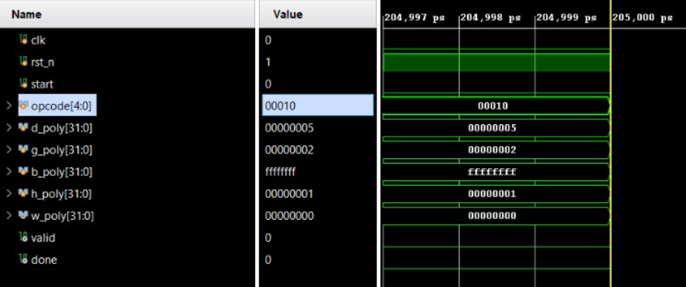
SIMULATION RESULTS(Contd.)
b)Opcode 00010 (Polynomial Addition without Error)

Slide 36
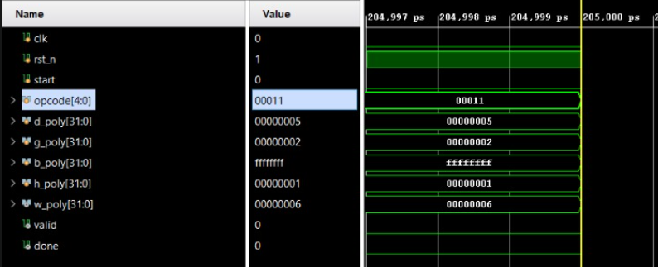
SIMULATION RESULTS(Contd.)
c)Opcode 00011 (Binary Polynomial Addition)

Slide 37

SIMULATION RESULTS(Contd.)
d)Opcode 00100 (Binary Sampler)

Slide 38
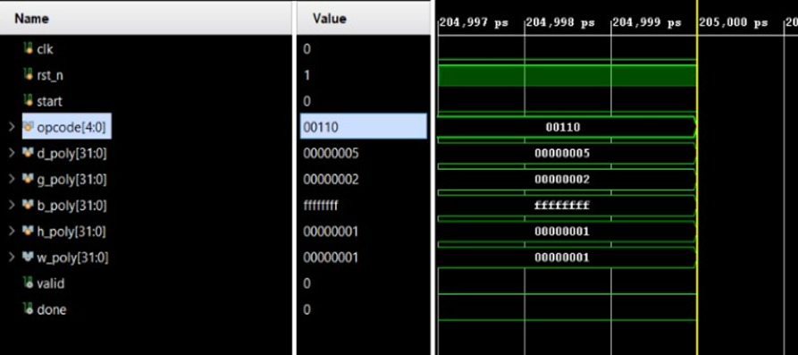
SIMULATION RESULTS(Contd.)
e)Opcode 00110 (Polynomial Addition with Error)

Slide 39
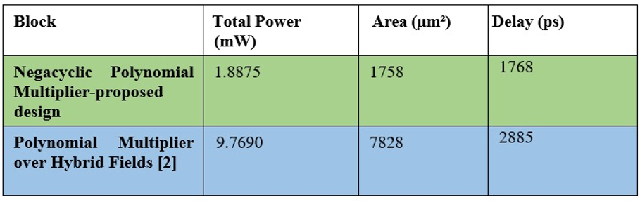
PARAMETER ANALYSIS RESULTS
Comparison Results
a)Negacyclic Polynomial Multiplier Vs Hybrid Field Multiplier(Paper 2)

Slide 40
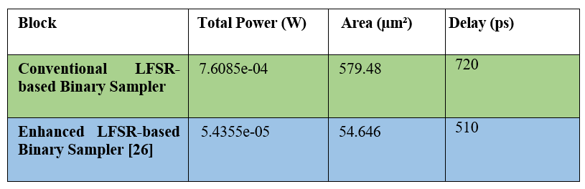
PARAMETER ANALYSIS RESULTS
Comparison Results
b) Conventional Sampler Vs Enhanced Sampler

Slide 41
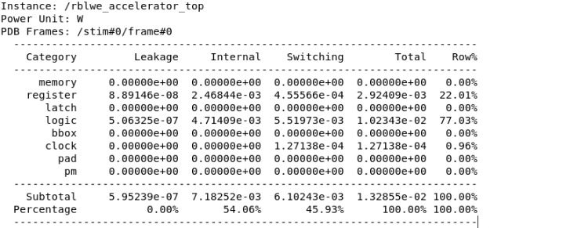
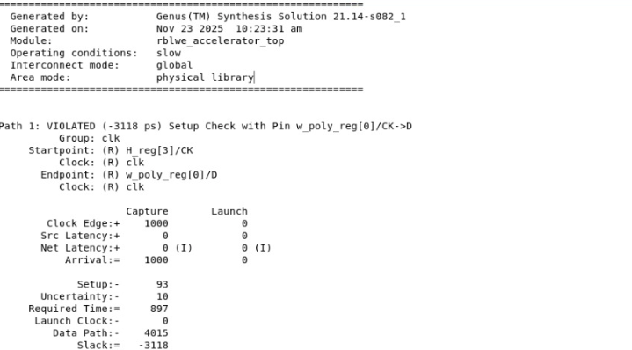

PARAMETER ANALYSIS RESULTS
Comparison Results
c)Area, Power and Timing Reports for complete Instruction set accelerator
Power
Timing
Area

Slide 42
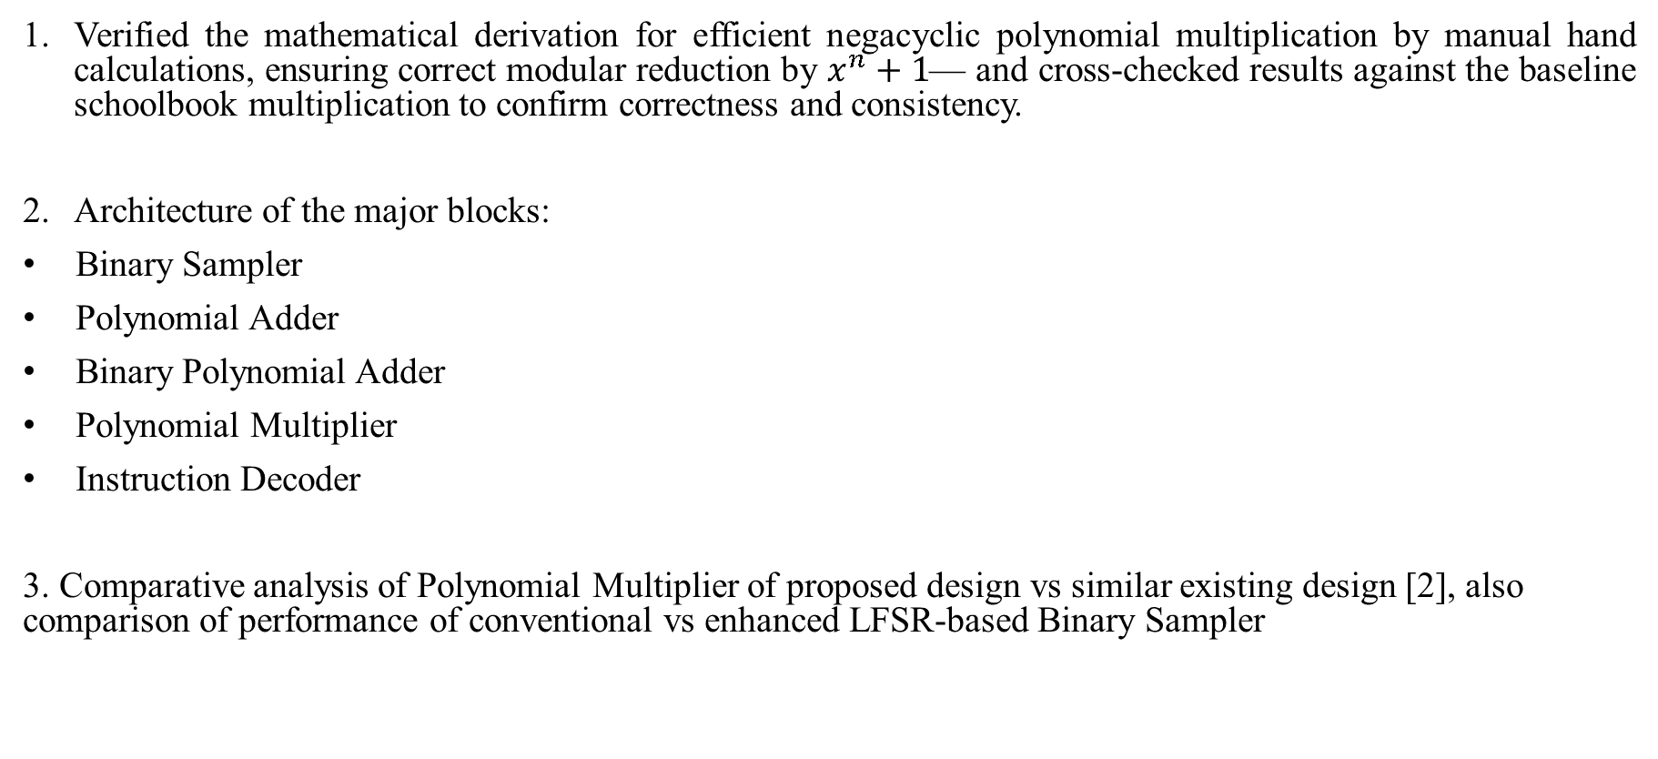
WORK DONE
Verified the mathematical derivation for efficient negacyclic polynomial multiplication by manual hand calculations, ensuring correct modular reduction by $x^{n}+1$— and cross-checked results against the baseline schoolbook multiplication to confirm correctness and consistency.
Architecture of the major blocks:
Binary Sampler
Polynomial Adder
Binary Polynomial Adder
Polynomial Multiplier
Instruction Decoder
3. Comparative analysis of Polynomial Multiplier of proposed design vs similar existing design [2], also comparison of performance of conventional vs enhanced LFSR-based Binary Sampler

Slide 43
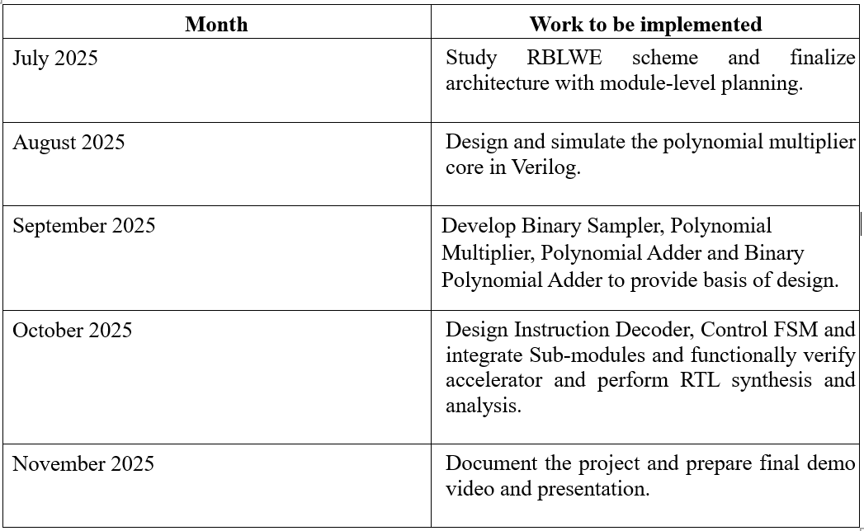
TIME PLAN
.

Slide 44
References:
[1] P. He, T. Bao and J. Xie, "High-Performance Instruction-Set Hardware Accelerator for Ring-Binary-LWE-Based Lightweight PQC," in IEEE Transactions on Very Large Scale Integration (VLSI) Systems, vol. 33, no. 5, pp. 1417-1421, May 2025, doi: 10.1109/TVLSI.2025.3538874.
[2] P. He, U. Guin, and J. Xie, “Novel low-complexity polynomial multiplication over hybrid fields for efficient implementation of binary ring-LWE post-quantum cryptography,” IEEE J. Emerg. Sel. Topics Circuits Syst., vol. 11, no. 2, pp. 383–394, Jun. 2021.
[3] Xie, Jiafeng, Pengzhou He, Xiaofang Wang, and Jose L. Imana. "Efficient Hardware Implementation of Finite Field Arithmetic AB+ C A B+ C for Binary Ring-LWE Based Post-Quantum Cryptography." IEEE Transactions on Emerging Topics in Computing 10, no. 2 (2021): 1222-1228.
[4] Lucas, Benjamin J., Ali Alwan, Marion Murzello, Yazheng Tu, Pengzhou He, Andrew J. Schwartz, David Guevara, Ujjwal Guin, Kyle Juretus, and Jiafeng Xie. "Lightweight hardware implementation of binary ring-LWE PQC accelerator." IEEE Computer Architecture Letters 21, no. 1 (2022): 17-20.
[5] J. Xie, K. Basu, K. Gaj, and U. Guin, “Special session: The recent advance in hardware implementation of post-quantum cryptography,” in Proc. IEEE 38th VLSI Test Symp. (VTS), Apr. 2020, pp. 1–10.
[6] A. Aysu, M. Orshansky, and M. Tiwari, “Binary ring-LWE hardware with power side-channel countermeasures,” in Proc. Design, Autom. Test Eur. Conf. Exhib. (DATE), Mar. 2018, pp. 1253– 1258.

Slide 45
References:
[7] K. Shahbazi and S.-B. Ko, “An optimized hardware implementation of modular multiplication of binary ring LWE,” IEEE Trans. Emerg. Topics Comput., vol. 11, no. 3, pp. 1–5, Jun. 2023.
[8] Ebrahimi, Shahriar, Siavash Bayat-Sarmadi, and Hatameh Mosanaei-Boorani. "Post-quantum cryptoprocessors optimized for edge and resource-constrained devices in IoT." IEEE Internet of Things Journal 6, no. 3 (2019): 5500-5507.
[9] Xie, Jiafeng, Pengzhou He, Xiaofang Wang, and Jose L. Imana. "Efficient Hardware Implementation of Finite Field Arithmetic AB+ C A B+ C for Binary Ring-LWE Based Post-Quantum Cryptography." IEEE Transactions on Emerging Topics in Computing 10, no. 2 (2021): 1222-1228.
[10] Bao, Tianyou, Pengzhou He, Shi Bai, and Jiafeng Xie. "TINA: TMVP-initiated novel accelerator for lightweight ring-LWE-based PQC." IEEE Transactions on Very Large Scale Integration (VLSI) Systems 32, no. 5 (2023): 870-882.
[11] S. R. P. V, S. Sanath Potnuru, T. S. Venkatesh and S. Agrawal, "Design and Implementation of Efficient Stochastic Number Generator," 2021 Fourth International Conference on Electrical, Computer and Communication Technologies (ICECCT), Erode, India, 2021, pp. 1-7, doi: 10.1109/ICECCT52121.2021.9616758. keywords: {Power demand;Computational modeling;Stochastic processes;Switches;Tools;Shift registers;Generators;Soft computing;stochastic number generator;non-linear feedback shift register;random number source;probability conversion circuit},

Slide 46


