Slide 1
Attention Is All You Need
Reading group review: Transformer architecture
Vaswani et al. | arXiv:1706.03762 | NeurIPS 2017
Main claim
The Transformer replaces recurrence with attention for sequence transduction.
Parallelizable architecture plus attention layers delivered strong MT results.
Review lens
Architecture
Attention formula
Discussion risk
SNUPI Reading Group | arXiv:1706.03762

Slide 2
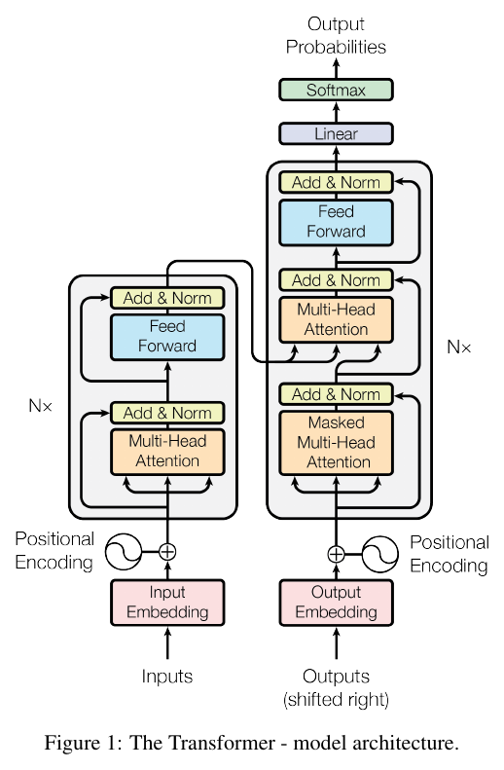
Transformer Architecture
FIGURE 1
Encoder stack
Self-attention + feed-forward layers
Residual path and normalization keep depth stable.
Decoder stack
Masked attention prevents future-token leakage.
Cross-attention reads encoder states.
Multi-head attention bridge
The same attention primitive connects representation, decoding, and alignment.
Turn 2 layout follows annotated screenshot
Source figure: Transformer architecture (Figure 1)
SNUPI Reading Group | arXiv:1706.03762

Slide 3
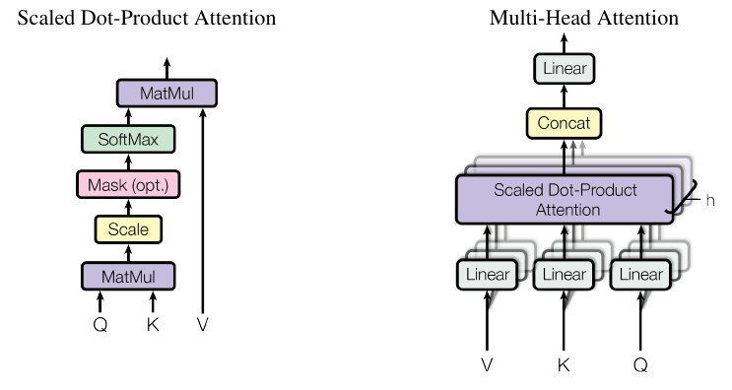

Scaled Dot-Product Attention
FORMULA + FIGURE 2
Scaled dot-product attention
Inputs are queries Q, keys K, and values V.
Scaling by sqrt(d_k) stabilizes the softmax.
Attention(Q, K, V) = softmax(QK^T / sqrt(d_k))V
Formula from paper PDF, Section 3.2.1
Why it matters: attention replaces recurrence for sequence transduction
SNUPI Reading Group | arXiv:1706.03762

Slide 4
Paper Verdict
DISCUSSION
Paper verdict
Strength: parallelizable sequence modeling
The paper made attention a practical replacement for recurrence.
It offered a cleaner path to scale training across positions.
Question: what breaks when context grows?
Quadratic attention cost becomes the pressure point.
Modern variants still negotiate this original design tradeoff.
For the reading group
Explain Figure 1 first.
Use the formula to connect the architecture to computation.
End with the scaling question.
Lab verdict: foundational, but evaluation now needs multimodal office tasks.
SNUPI Reading Group | arXiv:1706.03762

Slide 5
Lab Logistics
PROTECTED
Do not edit: Transformer seminar logistics invariant
Seminar metadata
Reading group: SNUPI Office Agents
Room: 302
Time box: 25 min review + 20 min discussion
Benchmark invariant
This slide is used to detect collateral damage.
Agent should preserve every text box on this slide.
Protected context slide | Do not edit

